Slide 1
Test Administrator (TA) Interface for Online Testing
Training Module
Notes:
Welcome to the Test Administrator Interface for Online Testing training module. It is designed to help you understand the Test Administrator (TA) Interface that you will use during online testing. The presentation is estimated to take about 30 minutes.

Slide 2
Objectives
After viewing this presentation, you should be able to:
Use the TA Interface to start and run a test session
View and edit student test settings and accessibility resources
Monitor the testing process
Pause and stop a test session
Transfer sessions between computers and mobile devices
Print test session information
Exit and log out of the TA Interface
Please note: The navigation instructions that follow are from the viewpoint of a Windows PC user with a two-button mouse. Your steps may vary depending upon the device and operating system you are using.
Notes:
After viewing this presentation, you should be able to:
Use the TA Interface to start and run a test session
View and edit student test settings and accessibility resources
Monitor the testing process
Pause and stop a test session
Transfer sessions between computers and mobile devices
Print test session information
Exit and log out of the TA Interface
Please note: The navigation instructions that follow are from the viewpoint of a Windows PC user with a two-button mouse. Your steps may vary depending upon the device and operating system you are using.

Slide 3
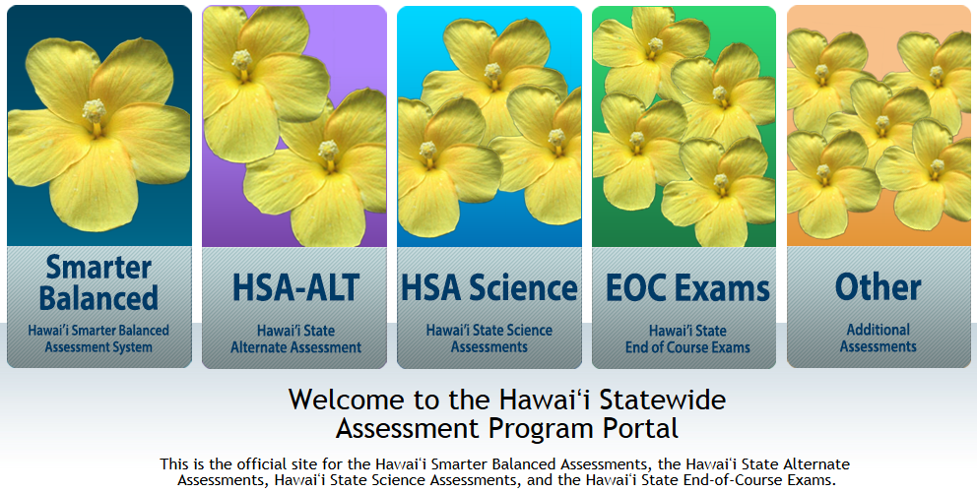
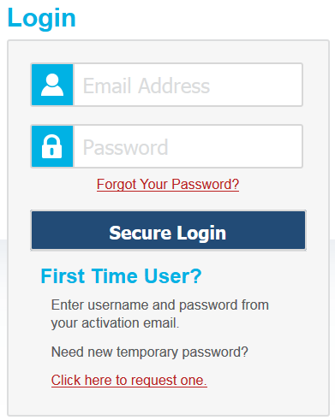
Accessing the TA Live Site
Notes:
To access the TA Live Site and the TA interface, go to alohahsap.org. Select one of the statewide assessments, then select the Test Coordinators/Administrators button.
When the new page opens, select the TA Live Site button which will take you to the log in for the TA Live Site. Enter your username and password. Select Secure Login.

Slide 4
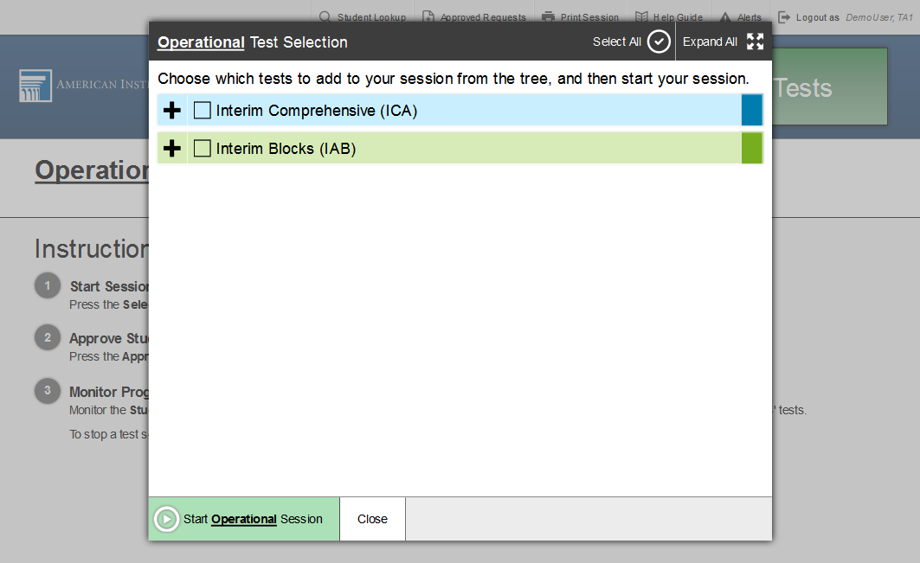
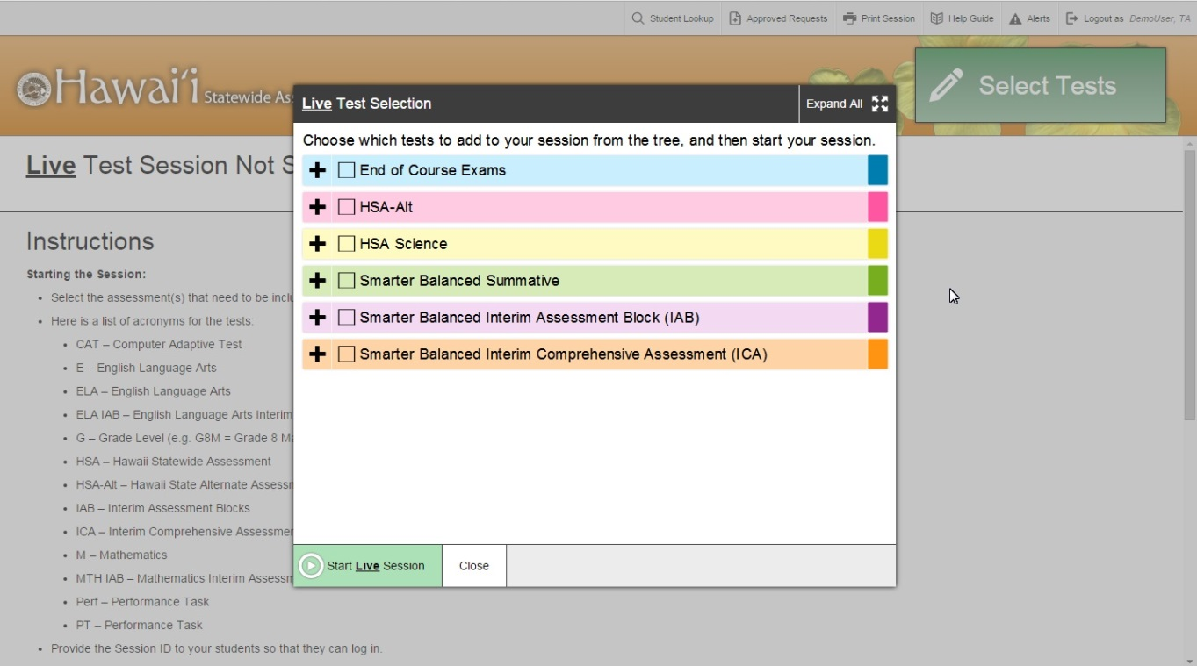
TA Interface: Overview
Notes:
Once you have logged in, you will see the TA Interface with the Test Selection window open by default. From the TA Interface, you can access the features you need to create and manage test sessions, look up students, and access help information. We will begin with an overview of the interface, followed by a more detailed review of each feature.

Slide 5
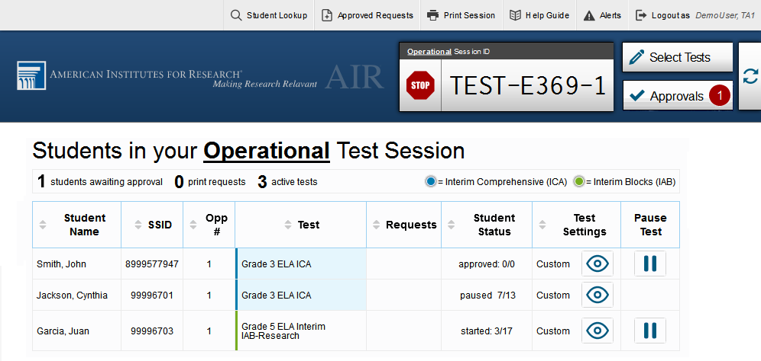
TA Interface: Overview (continued)
Notes:
When you first log in to the TA Interface, the Test Selection window appears automatically. This window closes when you start the session.
After you start a session, the session ID appears at the top of the TA Interface along with a [Stop] button. When students start signing in to the test session, an [Approvals] button also appears next to the session ID. Once you approve students for testing, the Test Session table appears in the center of the TA Interface, displaying students’ testing progress.
Additional features are available in the banner at the top of the screen.

Slide 6
TA Interface: Banner
Notes:
In the banner, you will see a set of buttons and your username.
You can click the [Student Lookup] button to search for student login information.
Click the [Approved Requests] button to view a list of print requests you approved during the test session.
Click the [Print Session] button to print a screenshot of the TA Interface.
Click the [Alerts] button to view messages sent by the state department of education.
Click the [Help Guide] button to access additional information about the TA Interface.
Click [Log Out] button when you want to exit the TA Interface.
More detailed information about these features is provided later on in this presentation.

Slide 7
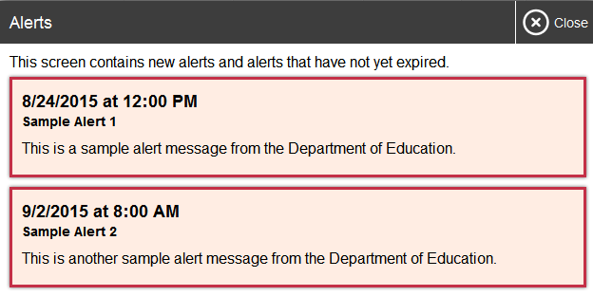
TA Interface: Viewing Alerts
7
Notes:
The Hawai’i Department of Education can send statewide alerts that appear as pop-up messages on the TA Interface. To view a record of active alert messages, click the [Alerts] button in the banner.

Slide 8
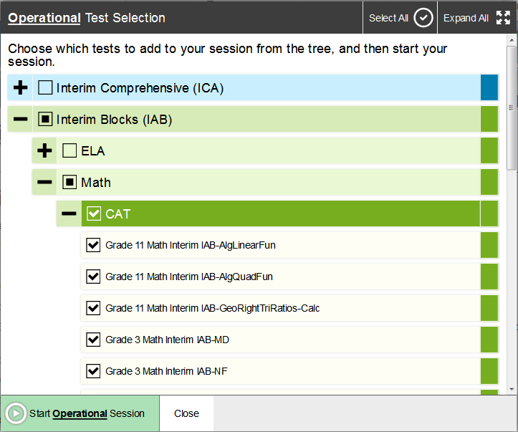
Create a Test Session
Notes:
The first step in administering a test is to create a test session. This should be done less than 30 minutes prior to starting the test in order to prevent the system from timing out. The list of students in the session will generate automatically when the students log in to the session.
You create test sessions in the Test Selection window that appears when you log in. The Test Selection window color-codes the available tests and organizes them into categories. You can click the Plus Sign button next to a category name to view the tests in that category. To create a testing session, click the test(s) you wish to administer or click the checkbox for a category to include all tests in that category. You may select all available tests listed, for all grade levels and all content areas. Be assured that students will only have access to the tests you selected for them.
Once you select your tests, the [Start Session] button in the lower-left corner of the window activates. Click the [Start Session] button. Please note, the exact name of this button may vary by state and session type (practice or operational). The system will automatically generate a session ID. This ID must be provided to students in order for them to log in. You may write it on the board or provide it to students using a printed card or similar method. If you do provide students with the information on paper, be sure to collect and destroy it when the session is complete.
You should also note the session ID for your own records. In the event that you are involuntarily logged out of the session due to an inactivity timeout or other event, entering the session ID will allow you to resume the session. If you do not have this information when you try to resume, you will be unable to do so.

Slide 9
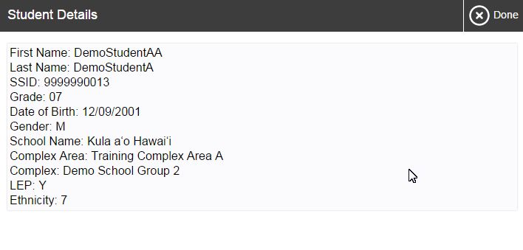
Student Lookup
Notes:
If a student is having trouble logging in, use the Student Lookup feature to verify that the student’s login credentials are correct. You can use either the [Quick Search] or [Advanced Search] option to view the information entered in TIDE for the student. With [Quick Search], you simply enter the student’s SSID and click the [Submit SSID] button. [Advanced Search] allows you to narrow your search using several filters, including Complex Area/School, Grade, and First and Last Name.
When using either [Quick Search] or [Advanced Search], if the search results matches, the information will appear in the bottom of the window. If there is no match, you will see an error message. If you see the student you are looking for, click the [Eye] button next to the student’s name. A new window displaying the student’s information will display. Note that the information displayed may vary slightly from what is shown here.

Slide 10
Approving Student Entry
Notes:
Once you start the test session and students log in, you must approve their test settings before they can access their tests. It is very important that you pay close attention to the test name prior to approving to be sure that students selected the appropriate test. You can do this by clicking the [Approvals] button. A list of students will display, organized by test name. You should review the list to make sure that all students chose the correct content area and test. You should also ensure that all of the settings that each student should have are correct. This is done using the [Eye] button in the See Details column. We will talk more about that in a few moments.
If no changes are needed, select [Approve All Students] to admit all students to the session. If a student selected an incorrect test, you must deny that student entry to the test session by clicking the [X] button in the Action column.

Slide 11
Denying Student Entry
Deny entry to a test session in these circumstances:
The student is not supposed to enter this session.
The student’s demographic information is incorrect.
The student’s required accommodations are incorrect.
Notes:
Although you can approve all students at the same time, students must be individually denied entry into the test session.
You should deny students entry into the session in these circumstances:
• The student is not supposed to enter this session.
• The student’s demographic information is incorrect.
• The student’s required accommodations are incorrect.
Denying the student entry into the test session will not prevent other approved students from beginning their tests.
If the student’s test settings are incorrect, the settings must be updated in TIDE or the TA Interface before the student takes the test. Contact your Test Coordinator to have the settings updated. This will prevent resetting the test for the student later.
Note that no settings can be changed while the student is actively testing. Once a student begins testing, the language option cannot be changed without resetting the test opportunity. Updates to background color or font size will take effect only after the student logs out and resumes testing.

Slide 12
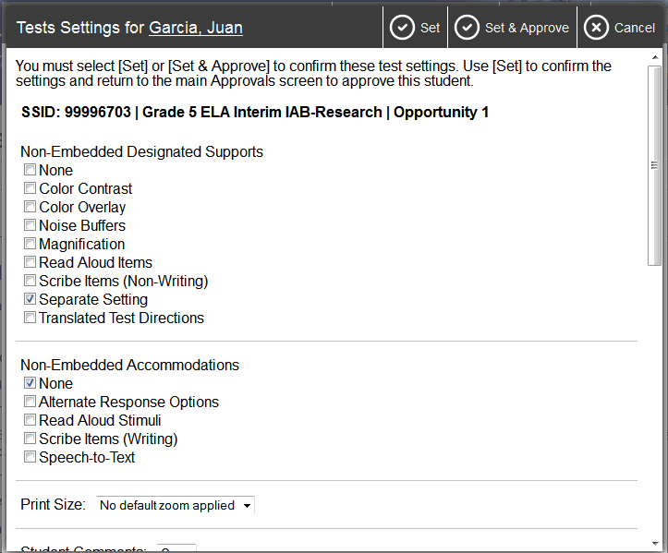
Editing Student Details: See/Edit Details
Notes:
If you need to change test settings for a student, click the [Eye] button in the See Details column. The Test Settings screen will appear, with the student’s information at the top. You will be able to view but not change any read-only settings in this window. These test settings must be set up by an authorized user in TIDE prior to testing. See the TIDE User Guide for more information.
You will be able to view and change any editable settings in this window. After making your selection, click the [Set] button to change the setting without approving the student. To both change settings and approve the student for testing, click the [Set & Approve] button. Note that the Test Settings screen may not appear exactly as it does in the screenshot shown, depending on your user role and permissions.

Slide 13
Editing Student Details: Turn Settings On and Off
Notes:
Some of the universal tools available by default may not be appropriate for some students. If you need to turn a universal tool off or on for a student, you must do so before testing begins. Use the selectors in the Test Settings screen to enable or disable the appropriate settings.
Some settings are managed using the TA Interface while other accessibility resources must be set up in TIDE prior to testing. For more information, consult the Usability, Accessibility and Accommodations Guidelines, available on the alohahsap.org website. As noted previously, the Test Settings screen may not appear exactly as shown here, depending upon your user role and permissions.

Slide 14
Monitoring Student Status
Notes:
Once students log in and are approved for testing, you can monitor their status from this screen. A table shows each student’s name, SSID, Opportunity Number, Test Name, Requests, Student Status, Test Settings, and a Pause Test option.
The Requests column displays a notification when students request a printout. We will discuss this in more detail shortly.
The Test Settings column will display either Standard or Custom. This column displays Custom when a student’s test settings are different from the default settings for that test. Click the [Eye] button to view a student’s test settings.
The Student Status column indicates the student’s progress through the items in the test. It shows the total number of items completed thus far and the total number of items in the test.

Slide 15
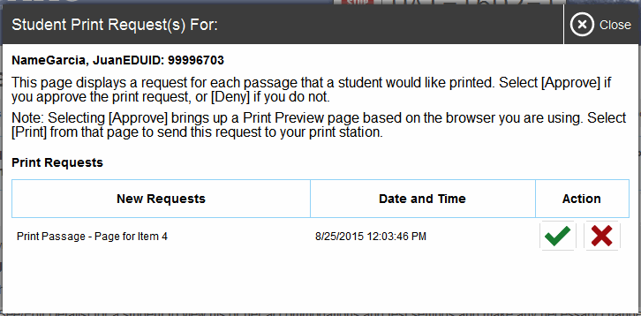
Print on Demand
Notes:
The Print on Demand feature is available only for students who require it. Please contact your Test Coordinator if your student needs this accommodation so that they may submit a request form to the Assessment Section. It is a testing impropriety to apply this restricted resource for a student who does not have an IEP or 504 plan documenting his or her need for the accommodation.
Students with this accommodation can request printouts of stimuli and/or items, depending on their settings.
• When a student sends a print request, the [Printer] button will appear in the Requests column of the monitoring screen. Click the button to view the request.
• If you click the [Check] button to approve the print request, a cover sheet containing the student’s name and SSID will display in a new browser window. No test content will ever display on your screen.
• Click [Print] in the new window to complete the print request. The printer dialog box will display. Adjust the print settings as needed.
• Click [Approve] to send the request to the printer.
• If you click the [X] button to deny the print request, nothing will be printed.
Before approving the student’s print request, ensure that it will be sent to a printer that is monitored by staff who have been trained in test security. All printed test items, stimuli, and reading passages must be securely stored and destroyed immediately following a testing session.

Slide 16
TA Interface: Approved Requests
Notes:
The [Approved Requests] button allows you to view a list of every print request you approved during the current session. If you wish to print this list for your own records, click [Print] at the top of the Approved Requests window.

Slide 17
Printing Test Session Information
Notes:
If you wish to print a snapshot of the TA Interface in its current view, click the [Print Session] button. This can be useful for tracking which students did not complete their tests and may need to be scheduled for another session. It may be necessary to set the page layout to landscape or adjust the margins in the Print Preview screen in order for the list to fit on the page. Remember that any printouts containing personally identifiable student information must be securely stored and should be destroyed after use.

Slide 18
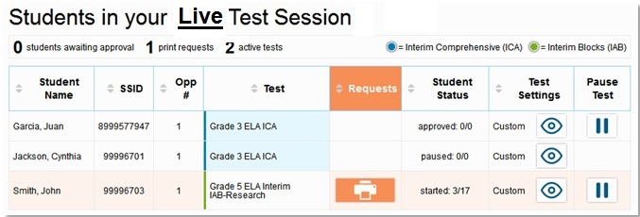
Pausing and Stopping Sessions
Notes:
You have two options within the TA Interface to pause or stop testing once it has begun. You can pause an individual student’s test, or stop the entire session. To pause an individual student’s test, click the [Pause] button on the monitoring screen for that student. When prompted, click [OK] to confirm that you want to pause the test. This option would be appropriate if a student becomes ill, for example. In the event of an emergency that requires all students to stop testing, you can pause all students’ tests by stopping the session.
If you stop the session, all in-progress tests will be paused. If a session stops, it cannot be resumed. You will have to create a new session and give the new session ID to students so that they can resume testing. To stop the entire test session for all students:
• Click the [Stop] button in the upper right corner of the screen. An “Important!” box will appear requesting verification to end the session and log students out.
• Click [OK] to continue.
If you forget to log out before leaving the testing area, the session will close automatically after 30 minutes of inactivity in both the TA and Student computers. You would then need to create a new session and provide the new session ID to students in order to resume testing.

Slide 19
Transferring Sessions
Notes:
In the event that you have problems with your computer or web browser or need to change computers during an active test session, you can transfer the session from one computer, mobile device, or browser to another without stopping the session or interrupting in-progress tests. To transfer a test session to a new device or browser:
• Do not log out of the session you are currently in or stop the test session. If you do, you will end the test session and pause all students’ tests.
• Log in to the TA Interface on the new machine or in the new browser. A session ID prompt will appear.
• Enter the active session ID into the text box and click [Enter]. When the session ID is validated, you will be able to continue your test administration activities.
The test session on the previous computer or browser will close automatically. This will not stop the session or pause student tests.

Slide 20
Logging Out of the TA Interface
Notes:
To log out of the TA Interface, click the [Log Out] button in the top right corner of the screen. It is preferable for you to log out only after stopping your active test session, as logging out will cause all in-progress tests to be paused. A confirmation message will appear, asking you to confirm that you want to exit the site and pause all students’ in-progress tests. This scenario also occurs when you navigate to another site from the TA Interface. However, regardless of when or how you log out or navigate away from the TA Interface, student data will NOT be lost. If you need to access another application, we encourage you to open it in a separate browser window.
Click [Yes] to proceed. When all students have completed testing, refer to the Test Administration Manual for instructions on destroying any printed testing materials and reporting testing improprieties or irregularities.

Slide 21
Troubleshooting
Description | What to Do
What should I do if a session ends? | Log in and start a new session. Provide the students with a new session ID.
What should I do if a student gets logged out of a test while a session is still active? | If a student’s test session is interrupted, the student should log back in and rejoin the session.
What should I do if forbidden applications are running? | The secure browser will not allow the student to begin testing if forbidden applications are running. You will see messages advising you which applications must be closed before testing can begin.
What should I do if a student’s test freezes? | Force quit the secure browser and log back in. For instructions, refer to the Test Administration Manual.
Notes:
This table presents some of the common issues that you or your students may encounter during a test session. Please take a moment to review this information. For more detailed information and additional technical tips, please refer to the Test Administration Manual and the Technical Specifications Manual for Online Testing.

Slide 22
Thank You!
Further Information
Visit
alohahsap.org
smarterbalanced.org
Call, fax, or email the American Institutes for Research HSAP Help Desk
Hours: 7:30 am to 4:00 p.m. HST, Monday-Friday (except holidays)
Phone: 1-866-648-3712
Fax: 1-877-231-7813
Email: HSAPHelpDesk@air.org
Notes:
Thank you for taking the time to view this training module. If you have general questions or need further information, you may visit the alohahsap.org website, the Smarter Balanced website, or consult the HSAP Help Desk for assistance.

