Slide 1
Online reporting system (ors)
Training module
2019-2020
“Cambium Assessment, Inc.” is a registered trademark. All other brand, product, or company names are trademarks or registered trademarks of their respective owners.
Notes:
Welcome to the online training module for the Online Reporting System, also known as ORS. This training module is designed to help you navigate ORS and understand its features. The Online Reporting System User Guide located on the AlohaHSAP portal contains additional information about ORS features that are specific to Hawaii.
Please note that your state’s ORS may be different from the images shown in this presentation.

Slide 2
Objectives
After viewing this presentation, you should understand how to:
Navigate the ORS system
View score reports
Generate and export summary statistics and student results
Search for specific students
Create, view, and edit student rosters
Notes:
After viewing this presentation, you should understand how to:
Navigate the system
View score reports
Generate and export summary statistics and student results
Search for specific students
Create, view, and edit student rosters

Slide 3
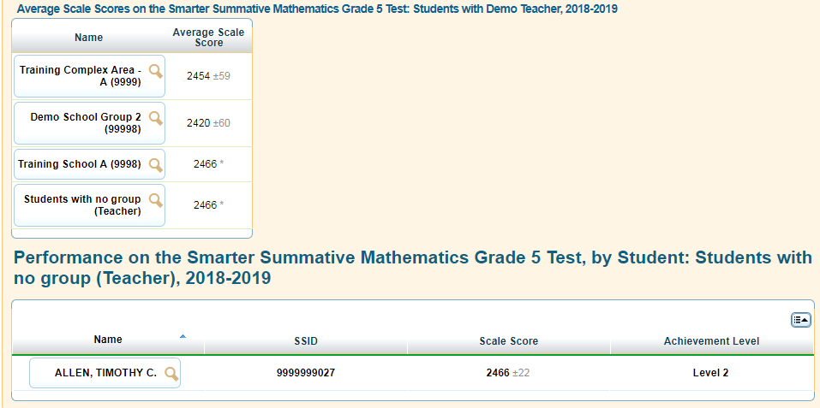
Purpose of the ORS
Provide timely, relevant reports and guide educators to make valid, actionable interpretations of the data
  Interactive data
  Near real-time reporting (upon completion of scoring the handscored responses)
Provide access to data
  Downloadable data files for complexes, schools, and teachers
  Results for multiple assessments in one system
Notes:
The ORS is designed to provide you with assessment data and tools you need to understand the performance of your students. Data presented in the system is interactive, allowing you to apply filters and break down results to better understand student performance. Because ORS can aggregate results in real time, the system is able to rapidly provide current and reliable reporting information.
Student data can be securely viewed and downloaded for complex areas, complexes, schools, and teachers. However, note that students must be registered in the Test Information Distribution Engine, or TIDE, in order to be included in the ORS. For more information about adding students into TIDE, consult the TIDE User Guide.

Slide 4
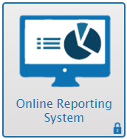
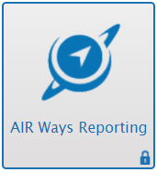
Key Differences between ORS and Centralized Reporting
ORS
Centralized Reporting
PLEASE NOTE:
Beginning this year, SY 2019-2020, Smarter Balanced and NGSS Interim Assessment results will no longer be reported in the Online Reporting System (ORS). Results for all Interim Assessments administered in school year 2019-2020 are available in the Centralized Reporting System. Results for all Interim Assessments from prior years remain available in ORS. Information about Interim Assessment Reports in ORS are included in this module for use when accessing these archived results.
Centralized Reporting
High-level reports for Summative Assessments
Export score data for multiple grades in one spreadsheet
May be used to access score reports for any assessment
Ability to view and print Individual Student Reports
Used to gauge performance on Interim Assessments
View actual items and responses
May be used as a source of guidance for tailored classroom instruction based on students’ individual performance
Notes:
There are some key differences between the ORS and the Centralized Reporting system.
ORS may be used to access score reports for any assessment. ORS is used for high-level student, roster, school, complex, and complex area score reporting. Users may export student score data for all tested grades contained in one spreadsheet. Individual Student Reports for all end-of-year tests may be viewed or printed from ORS.
The Centralized Reporting System produces detailed, item-level reports for the Smarter Balanced and NGSS Interim Assessments, allowing users to view individual items and students’ actual responses. It is specifically for gauging student performance on the Interim Assessment Blocks (IABs), Interim Comprehensive Assessments (ICAs), and NGSS Interim Assessments. Item-level data from Centralized Reporting may be used as a valuable tool and source of guidance to tailor classroom instruction based on students’ individual performance on IABs and ICAs.
**Note: Information about the Interim Assessment Reports in ORS are included in this training module only for use when accessing archived test results. Results for all Smarter Balanced and NGSS Interim Assessment administered in school year 2019-2020 will be reported in the Centralized Reporting system.

Slide 5
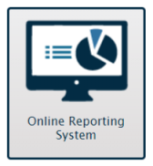
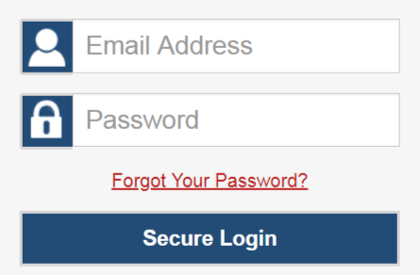
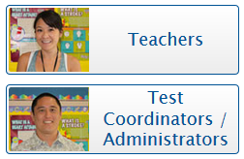
Logging In
Logging In
Notes:
After activating your account in TIDE, you will have access to the various systems located on Hawaii’s portal.
To access ORS, go to www.alohahsap.org and select the appropriate role icon. Next, click on the Online Reporting System icon. Once you are on the login page, enter your username and password, and click Secure Login.

Slide 6
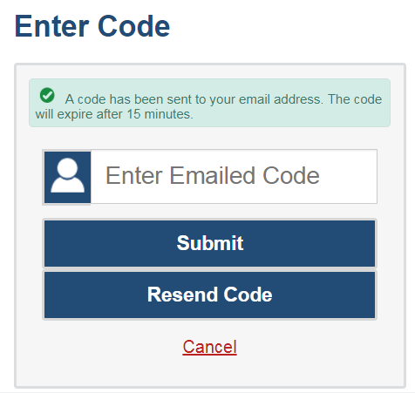
How to Log in to ORS
How to Log In to ORS
The system has an authentication process that will be triggered when you log in from a different device or browser, or clear your cache.
If you see this screen, an email will have been sent automatically to your email address.
Enter the code and click Submit.
If you need the code resent, click Resend Code.
Notes:
To improve security, an authentication process has been added. This will be triggered if you log in on a new device or browser or clear the cache on a previously used browser. You will see an Enter Code page. If this page appears, an authentication code will have been sent automatically to your email address. You will be required to enter the code on this page within 15 minutes of receiving the email. If you do not receive a code or do not enter the code within the 15-minute time limit, select Resend Code. Click Submit after entering the authentication code to enter the system.

Slide 7
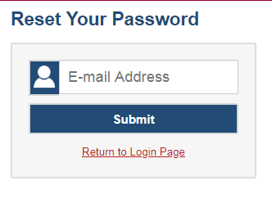
Resetting Your Password
Resetting Your Password
Notes:
You will need to reset your password in the following situations:
You forget your password.
Your activation link expired.
Your account is locked if you exceed the account login attempt limit.
It is a new school year.
To reset your password, click the Forgot Your Password Link. You will be taken to the Reset Your Password page. Enter and confirm a new password and click Submit.

Slide 8
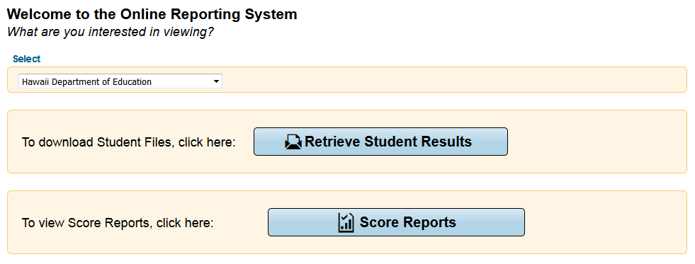
ORS Interface: Welcome Page
CAUTION: Any student information downloaded is confidential and must be kept in a secure location or shredded after use.
Notes:
The Welcome page appears when you first log in to the ORS and asks you to select the type of report you want to view. Note that you can navigate to a different report at any time while in the ORS.
Retrieve Student Results allows you to download student data for a complex, school, teacher, or roster. The data includes students’ personal information and their performance on the selected test and administration.
Score Reports provides test score data. You can compare score data between individual students and the school, complex, or overall state average scores. Information on strengths and weaknesses in a specified field is also available by claim.

Slide 9
ORS Interface: Global Tools
Notes:
The ORS banner that is displayed near the top of each page consists of tabs or “Global Tools” for accessing the different reports and performing different tasks.
The Score Reports tab takes you to the Home Page Dashboard that provides overall score data for your complex, school, or students.
The Reports & Files tab provides access to test summary statistics and the Retrieve Student Results page, where you can download large files of student results.
Inbox takes you to a pop-up window that lists the student data files you have requested.
Search Students lets you search for student information by using the student’s name or SSID number.
Upload Rosters allows PR and TC to create multiple rosters at once by uploading a spreadsheet.
Add Roster allows you to create custom rosters of your students for data analysis.
View/Edit Rosters allows you to view existing rosters and add or remove students from them as desired.
The Help button is where users may find useful information and step-by-step instructions for performing tasks in ORS.
Print provides options to print the data displayed on the page.
The Export button exports the data displayed on the page as an Excel file.
Definitions provides definitions for terms specific to the report you are viewing. This tool appears only on some pages.

Slide 10
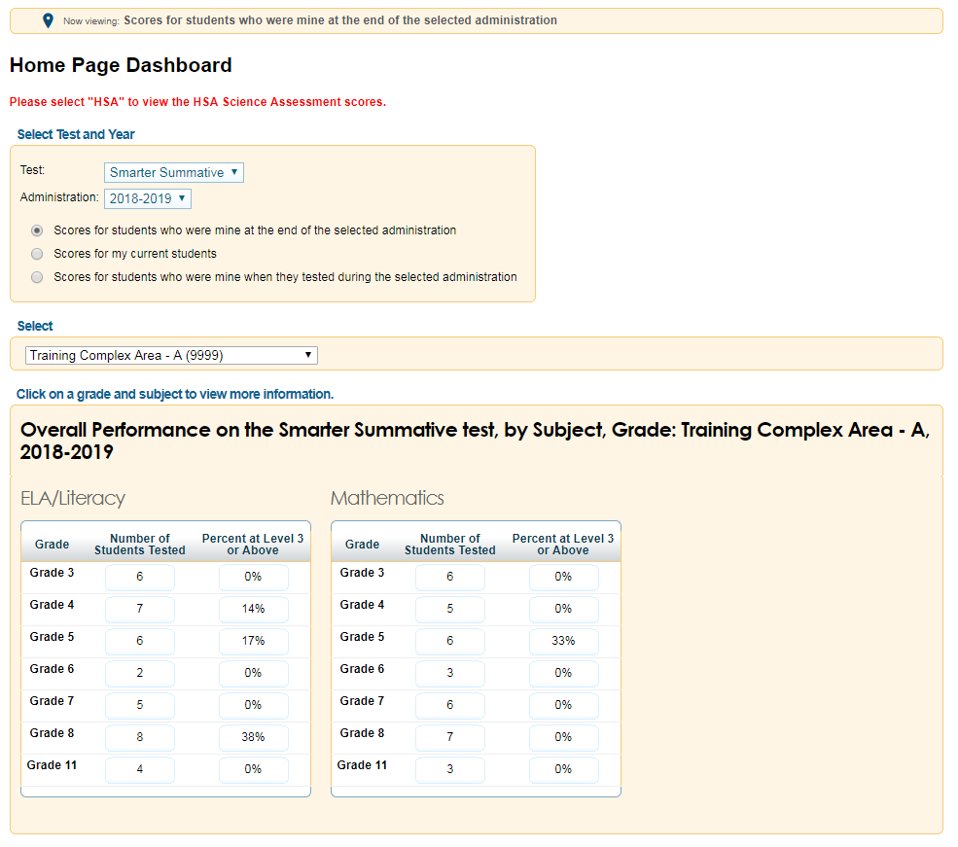
Home Page Dashboard
Notes:
When you click Score Reports on the Welcome page or from the banner, the Home Page Dashboard appears.
This page provides data about your students, including the number of students tested and the percentage proficient for the selected test and administration. Complex personnel see complex summaries; school personnel see school summaries; and teachers see summaries of their individual students.

Slide 11
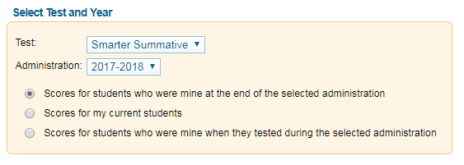
Home Page Dashboard: Select Test Administration
You can select the test and administration for which you want to view score data.
Notes:
From the Home Page Dashboard, you can select the test and administration for which you want to view score data. You can also specify the students whose data you wish to view using the available radio buttons.
This feature is particularly helpful for school personnel who want to see how students currently assigned to the user’s class roster performed in previous grades, even if students were enrolled in different schools during those previous administrations.
If you currently have a student who did not test in the selected test and administration, no data will be displayed for that student. An example may be students who moved to your school from out of state.

Slide 12
Home Page Dashboard: Defining the Student Population
Scores for students who were mine at the end of the selected administration | Scores for my current students | Scores for students who were mine when they tested during the selected administration
Allows you to see score data for those students who tested in the selected test and administration and remained associated with your roster, school, or complex through the end of the administration. | Allows you to view score data for students assigned to your current rosters, even if they were previously enrolled in a different school or complex. | Allows you to see score data for those students who were associated with your roster, school, or complex when they were tested in the selected test and administration.
Notes:
Scores for students who were mine at the end of the selected administration allows you to see score data for those students who tested in the selected test and administration and were associated with your roster, school, or complex at the end of the selected test and administration.
Scores for my current students allows you to view score data for students assigned to your current rosters, even if they were previously enrolled in a different school or complex. This view enables you to see your current students’ previous strengths and weaknesses before they begin testing this year.
Scores for students who were mine when they tested during the selected administration allows you to see score data for those students who were associated with your roster, school, or complex when they were tested in the selected test and administration.
On the next few slides, we will illustrate an example of how to use the three radio buttons.

Slide 13

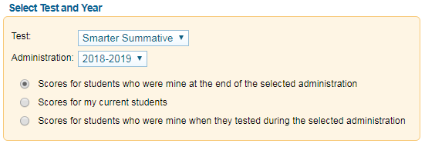


Home Page Dashboard: Defining the Student Population
A
B
Notes:
Imagine that two of your students, Student A and Student B, took a summative 2019-2020 test.

Slide 14


Home Page Dashboard: Defining the Student Population
C
A
B
Notes:
Immediately after testing, Student B moved to a different complex.
Then, after the summative 2019-2020 administration ended, a new student, named Student C, joined your class after taking the test in a different school.

Slide 15
Home Page Dashboard: Defining the Student Population
A
C
B
Notes:
Selecting the first radio button will show scores for students who were yours at the end of the selected administration. This option will include Student A. Student B will be excluded, because the student left the complex before the end of the administration. Student C will also be excluded, because the student was in a different school at the end of the administration and did not become your student until later.

Slide 16
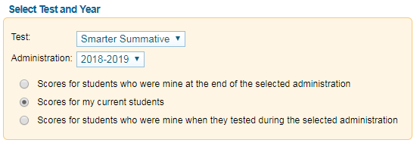
Home Page Dashboard: Defining the Student Population
C
A
B
Notes:
Selecting the second radio button will show scores for your current students. This option will also exclude Student B, who is no longer your student, but it will include Student C, who recently became your student.

Slide 17
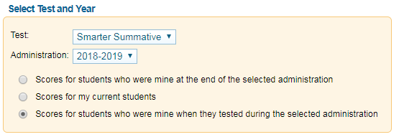
Home Page Dashboard: Defining the Student Population
A
B
C
Notes:
Selecting the third radio button will show scores for students who were yours when they took the test. This option includes Students A and B, who were yours when they tested, and excludes Student C, who tested at another school.

Slide 18
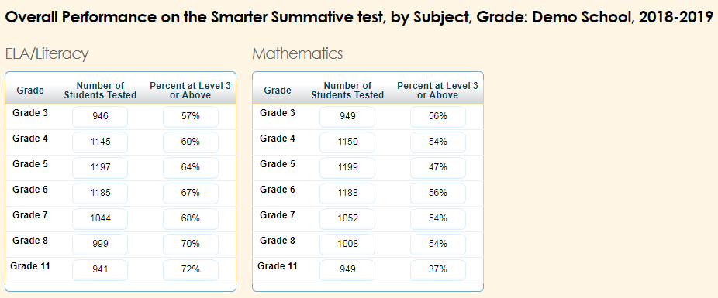
Home Page Dashboard: Report Tables
Notes:
After defining which students you wish to view, look toward the tables near the bottom of the Home Page Dashboard. These tables display aggregate data for each subject.
Grade displays the grade to which the score data belongs.
Number of Students Tested displays the number of students to date who have completed and submitted their tests for scoring.
Percent at Level 3 or Above displays the percentage of students to date who have scored proficiently on each test.
To access score reports for a particular subject and grade-based test, click a cell for the selected grade and subject. You will see only the tests administered by the selected complex or school. When you click a cell, a Subject Detail Report will load for the corresponding grade and subject.

Slide 19
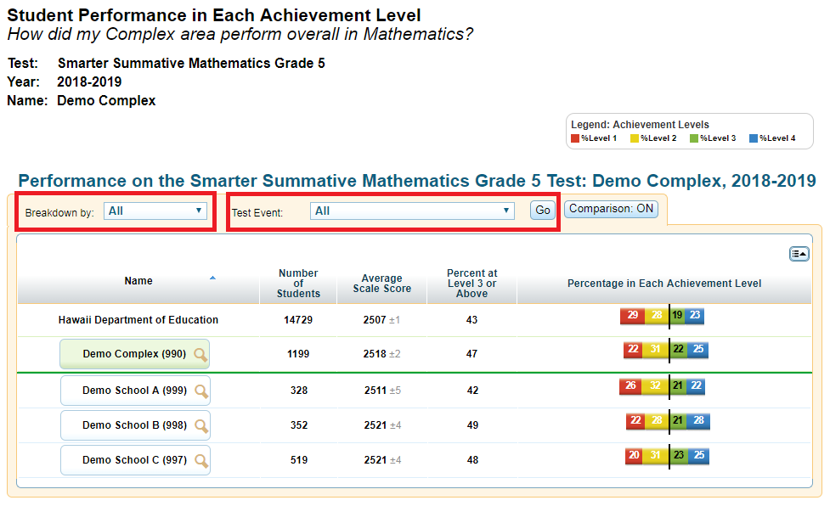
Subject Detail Report
Notes:
This example shows the information a complex user will see on the Subject Detail Report. It shows the list of schools in the complex and their aggregate score data.
You can sort the data, show or hide columns, disaggregate data by subgroups and/or test events, and show or hide comparison data.
To disaggregate the score data by a specific demographic subgroup category, from the Breakdown By drop-down list, select a group and click Go. The report will expand to display the data for each subgroup. For example, you can select Gender to see score data for All students, Female students, and Male students. Please note that the Go button does not appear for the Breakdown By drop-down list if there is not a Test Event drop-down list.
To disaggregate the score data by a specific test event, from the Test Event drop-down list, select an accommodation and click Go. The report will expand to display the data for each subgroup. If students are able to have different accommodations for different parts of the same test, these students can either be included in a separate category called “Multiple” or counted under both accommodation values.

Slide 20
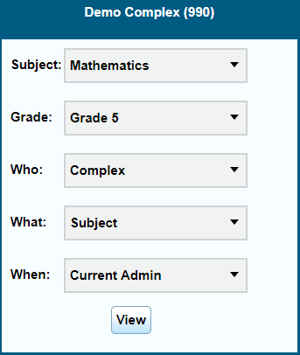
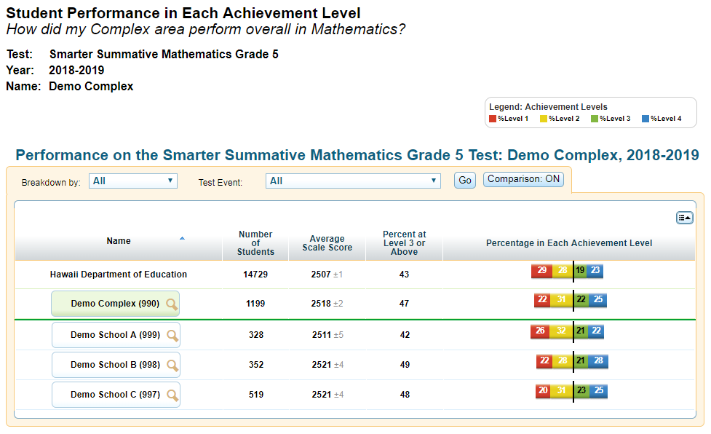
Subject Detail Report
Notes:
To view more information about a student, roster, teacher, school, or complex, click the magnifying glass icon that appears next to its name. An exploration menu will appear with the name of the entity you clicked in the title. The exploration menu is the preferred method for moving between reports and deciding which type of data you would like to view.

Slide 21
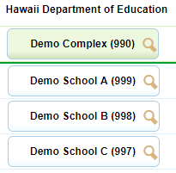
Score Report Navigation: General Approach
SUBJECT
GRADE
Notes:
The exploration menu’s first two drop-down lists display the subject and grade of the report you are viewing. You can use these menus to switch to a different subject within the same assessment or to a different grade without returning to the Home Page Dashboard.

Slide 22
Score Report Navigation: General Approach
WHO
WHAT
WHEN
Notes:
The other three drop-down lists determine the type of report that will load when you click the View button.
To help you quickly locate the score data you need, these three drop-down lists allow you to ask three different questions: Who, What, and When. Your answers to these questions will direct ORS to provide data from that perspective.

Slide 23
Score Report Navigation: General Approach
Roster
Teacher
School
Complex
Complex Area
Student
Who
Subject
Claims
Targets
What
When
Current Administration
Trend
Notes:
This slide displays some typical examples of the selections you can make in the Who, What, and When drop-down lists. Note that the selections you see will depend on your user role, the report you are viewing, and which entity’s magnifying glass you clicked. When you see “N/A” or no options in a drop-down list, that means you cannot navigate any further in that drop-down list.
The Who drop-down list determines who will be listed in the report, including all students associated with the complex, school, teacher, or roster that you clicked.
The What drop-down list lets you explore the data by claims and targets within the selected subject or content area. This drop-down list includes options to view performance data by subject, claims, and targets. You may see different options in this drop-down list, depending on your state’s ORS and the test you have selected.
The When drop-down list allows you to explore score data across multiple administrations of the same test for the same group of students. It allows you to see the data either as a snapshot of performance in the current testing window, or as a historical trend. Generally, this option is only available in states that have score data from multiple test administrations available in ORS.
For more information on using the exploration menu to navigate between score reports, consult your Online Reporting System User Guide.

Slide 24
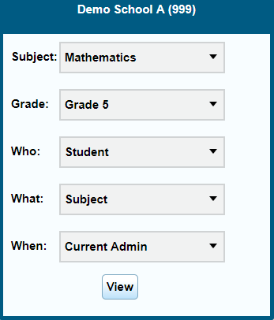
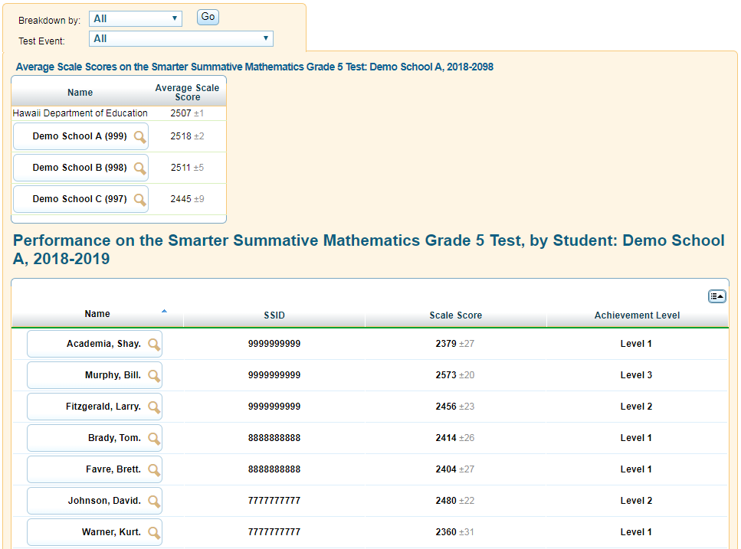
Student Listing Report
Notes:
Using the exploration menu, you can view reports at different levels—complexes, schools, teachers, rosters, and students. This is a sample student listing report showing student performance at each achievement level. You can access the student listing report by clicking the magnifying glass next to a school, teacher, or roster, and then selecting Student in the exploration menu’s “Who” drop-down list.

Slide 25
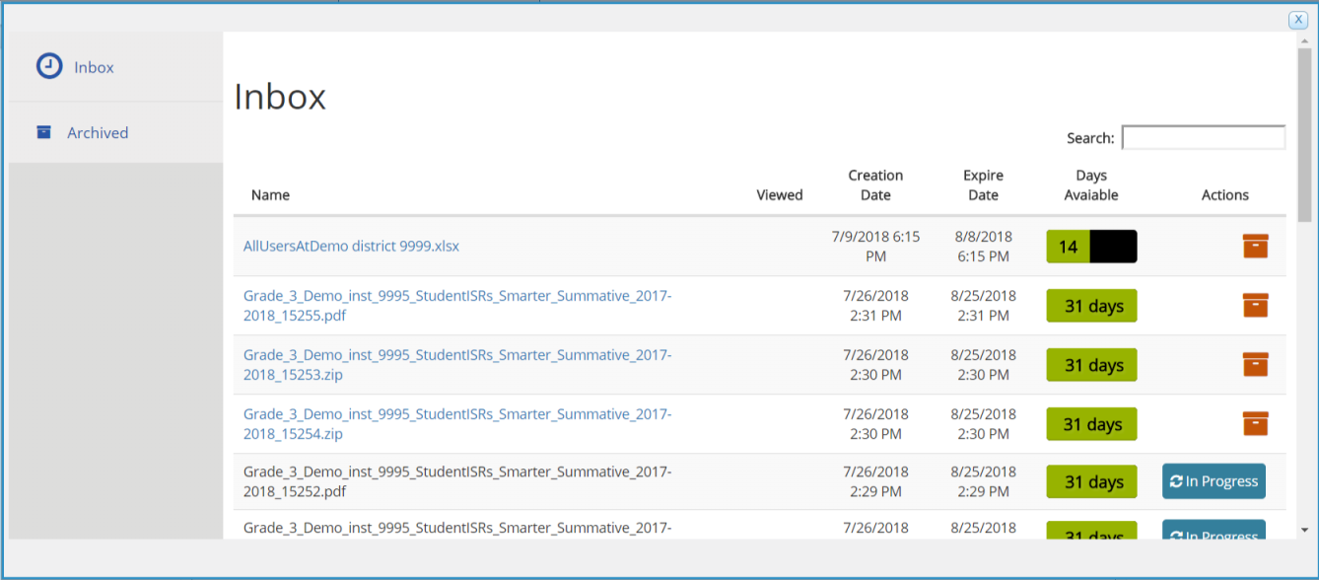
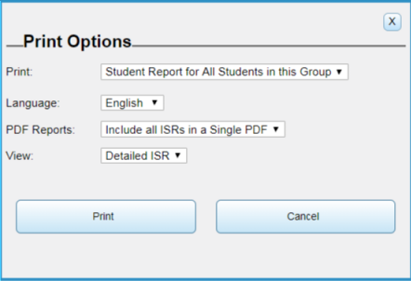
Student Listing Report: Printing
Single PDF
Batch ZIP PDF file
Notes:
On most pages in the ORS, using the Print tool simply prints the currently displayed information. However, printing from the student listing report works a bit differently.
When using the Print tool on the student listing report, a print pop-up window will appear, giving you the option to print just the currently displayed page, or to print a separate Individual Student Report (or ISR) for each student in the list. You can also select the language in which you want the report to appear. You can choose to include all of the ISRs in a single PDF, or you can download each ISR in a separate PDF, with the batch of PDFs contained in a ZIP file.
If detailed ISRs are available for the assessment you are viewing, you can choose whether to print simple or detailed ISRs. Simple ISRs include less information but are specifically designed to fit on a single sheet of paper.
When the PDF file or ZIP file is ready, you can download it by clicking Inbox in the ORS banner.

Slide 26
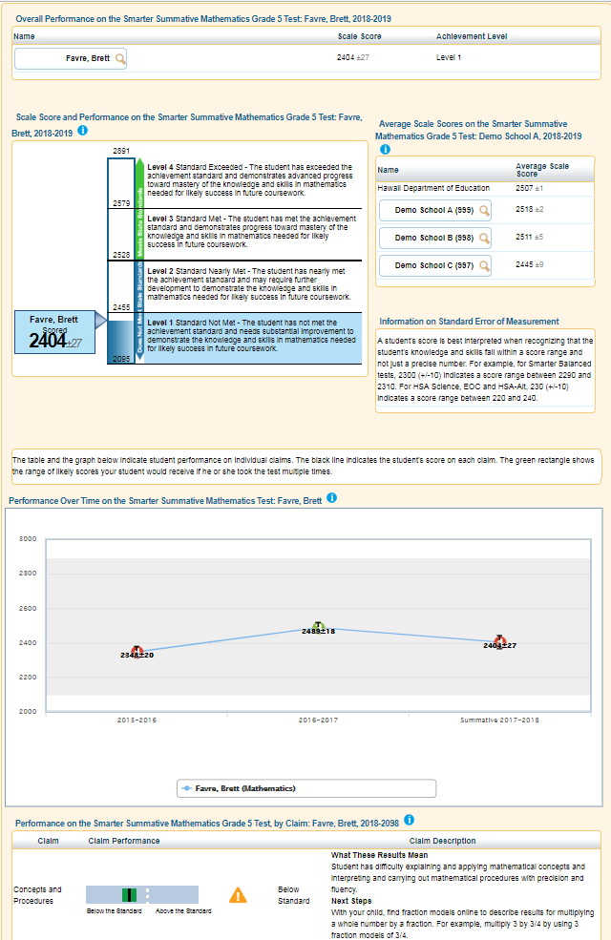
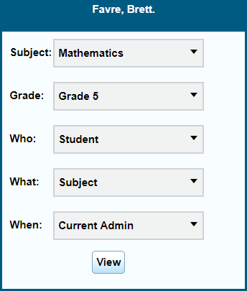
Individual Student Report
Notes:
An Individual Student Report presents a graphic representation of proficiency, along with a parent-friendly description of what the different proficiency levels mean. It includes more detailed diagnostic information and comparison scores for the class, teacher, school, complex area, and state. It also includes student performance on each claim along with a description of each claim. The report may additionally include a trend graph that visually depicts student performance over time.
You can access a student’s ISR by clicking the magnifying glass next to any student’s name and selecting Student in the exploration menu’s “Who” drop-down list.
If a student has taken multiple opportunities of the test, all of the test opportunities will be listed on the report, and you can toggle between the opportunities by clicking the opportunity number.

Slide 27
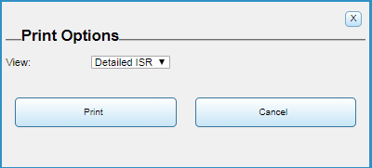

Individual Student Report: Printing
Notes:
Using the Print tool, you can generate a PDF report of the student’s score report. You can choose to print the current opportunity, the opportunity where the student scored the highest, or all the opportunities taken by the student.
You may also choose to print a detailed ISR or a simple ISR.

Slide 28
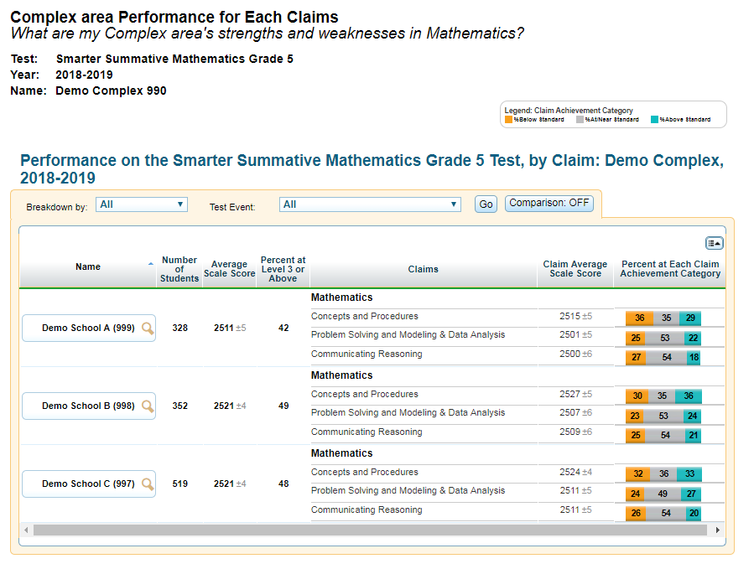
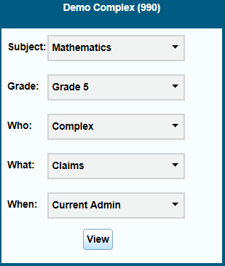
Claim Detail Report
Notes:
You can view more content detail for a group of students by clicking the magnifying glass next to a school, teacher, or roster, and then selecting Claim or Reporting Category in the exploration menu’s “What” drop-down list. This is a sample complex Claim Detail Report, which includes a scale score for each claim in the selected subject.

Slide 29
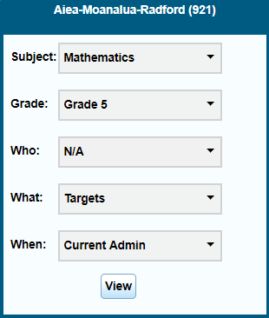
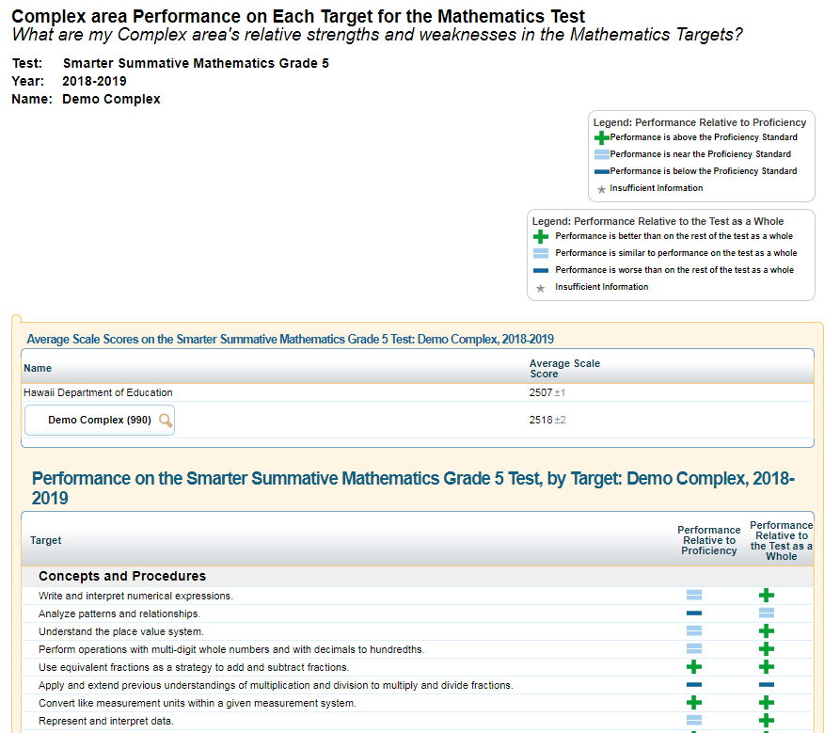
Target Detail Report
Notes:
For assessments that have targets or content standards, you can view even more specific content detail by selecting Targets, Benchmarks, or Content Standards in the exploration menu’s “What” drop-down list. This is a sample complex Target Detail Report, which shows how a group of students performed on each target compared to the test as a whole and compared to the proficiency standard.

Slide 30
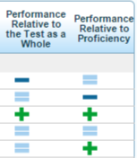
Target Legend: Performance Relative to Proficiency
Notes:
This table explains the meaning of each icon in the column named Performance Relative to Proficiency.
Performance is above the Proficiency Standard means the target performance is above the proficiency standard. The group of students performed above the proficiency standard on this target.
Performance is near the Proficiency Standard means the target performance is near the proficiency standard. The group of students performed near the proficiency standard on this target.
Performance is below the Proficiency Standard means the target performance is below the proficiency standard. The group of students performed below the proficiency standard on this target.
Insufficient Information means not enough information is available to determine whether the performance on this target is above, near, or below the proficiency standard.

Slide 31
Target Legend: Performance Relative to Overall Test Performance
Notes:
This table explains the meaning of each icon in the column named Performance Relative to Overall Test Performance.
Performance is better than on the rest of the test means this target is a relative strength. The group of students performed better on items from this target than they did on the rest of the test as a whole.
Performance is similar to performance on the test as a whole means this target is neither a relative strength nor a relative weakness. The group of students performed about as well on items from this target as they did on the rest of the test as a whole.
Performance is worse than on the rest of the test means this target is a relative weakness. The group of students did not perform as well on items from this target as they did on the rest of the test as a whole.
Insufficient Information means not enough information is available to determine whether this target is a relative strength or weakness. This could be due to too few items or too few students available to create a report.

Slide 32
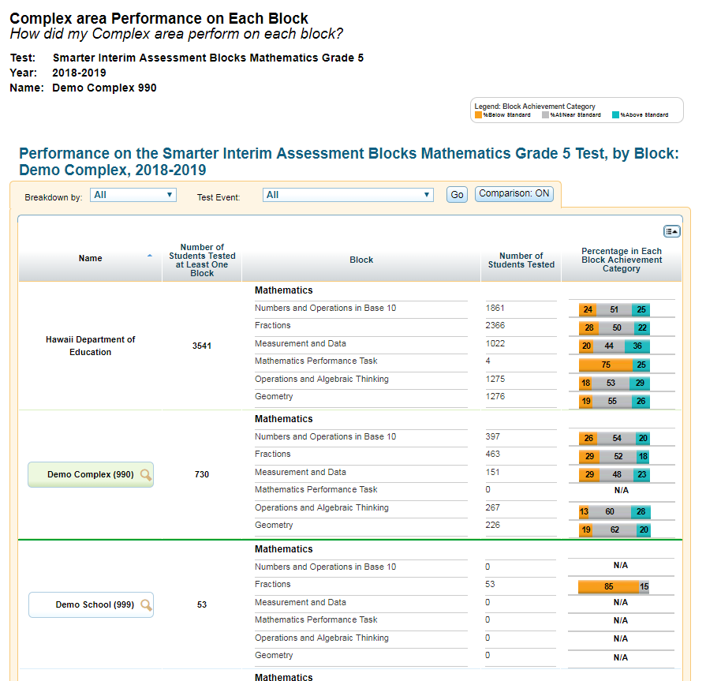
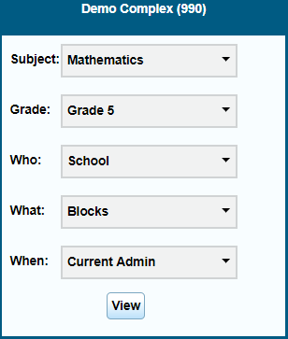
Reporting by Block: Interim Assessment Blocks (IAB)*
*Reminder: Results for all Interim Assessments from prior years remain available in ORS but Interim Assessment results from school year 2019-2020 are now reported in Centralized Reporting. Information about Interim Assessment Reports in ORS are included in this module for use when accessing these archived results.
Notes:
When viewing reports for Interim Assessment Blocks, you may view how the state, complex, school, teacher, and rosters performed on each of the blocks by selecting Blocks in the exploration menu’s “What” drop-down list. This report shows the number of students tested by block and the percentage in each block performance level.
Reminder: Results for all Interim Assessments from prior years remain available in ORS but Interim Assessment results from school year 2019-2020 are now reported in Centralized Reporting. Information about Interim Assessment Reports in ORS are included in this module for use when accessing these archived results.

Slide 33
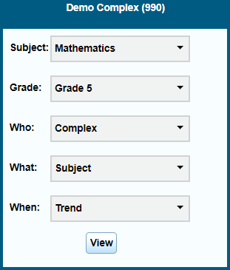
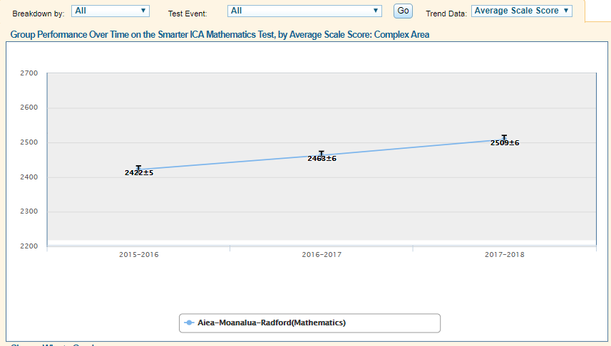
Trend Reports
Notes:
You can explore student performance over time by clicking the magnifying glass next to a school, teacher, roster, or student; and then selecting Trend in the exploration menu’s “When” drop-down list. This is a sample complex trend report. In addition to displaying the average scale score and achievement level, you can now choose to view the percentage of students proficient in a roster, school, or complex by selecting Percent Proficient in the Trend Data drop-down list and then clicking Go.
You can use the “Who,” “What,” and “When” drop-down lists together to show different kinds of data in a graph across time. The trend report is set to plot summative and interim administrations on the graph by default. However, you may choose to plot only the currently selected test by choosing Selected Test from the Display drop-down list, and then clicking Go.

Slide 34
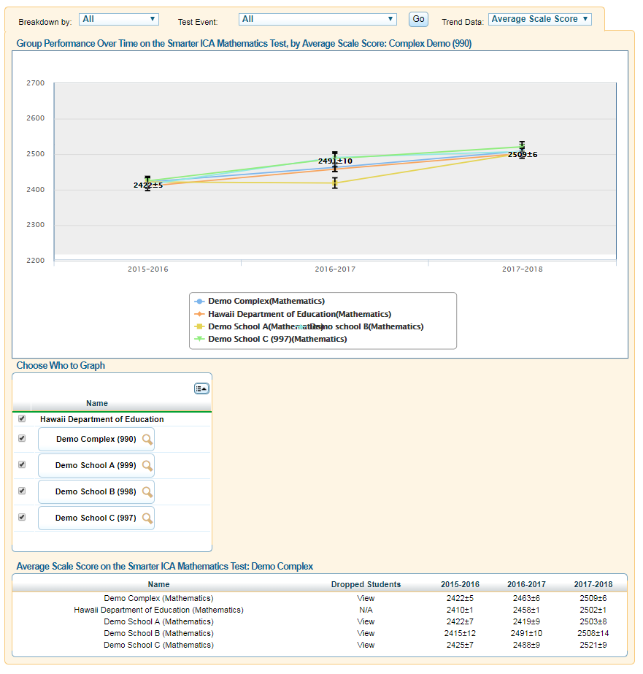
Trend Report Features
Choose Who to Graph
View Data by
Demographic Subgroup
Choose What to Graph
Hide Trend Lines
Notes:
Trend reports are interactive. You can choose the tests, entities, and categories that should be plotted on the graph.
You may select up to five entities to compare at one time by checking the required boxes from the Choose Who to Graph section. A color-coded trend line for each selected entity will appear on the graph.
You may also choose to plot data points for a subgroup, such as ethnicity, by using the Breakdown By drop-down list near the top of the report.
You may select the overall test subject data (which is selected by default) or individual reporting categories to plot from the What to Graph section.
Finally, you may temporarily hide a trend line to better view data. Click the trends you want to hide from the trend reports legend box below the graph. The trend you have selected will become grayed out and the line will disappear from the graph. To display the trend line again, click the trend name again.

Slide 35
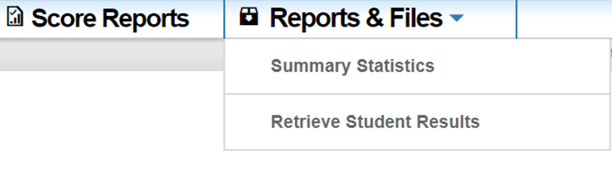
Reports & Files
Notes:
The Reports & Files drop-down menu provides access to additional reports through the Summary Statistics and Retrieve Student Results pages.
We will discuss how these pages function in more detail on the following slides.

Slide 36
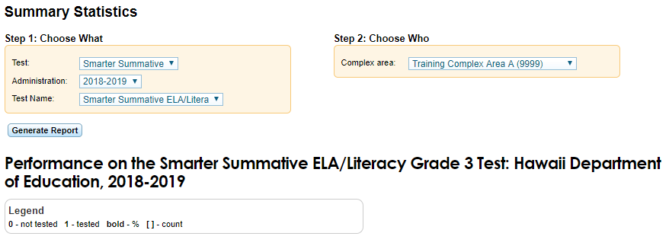
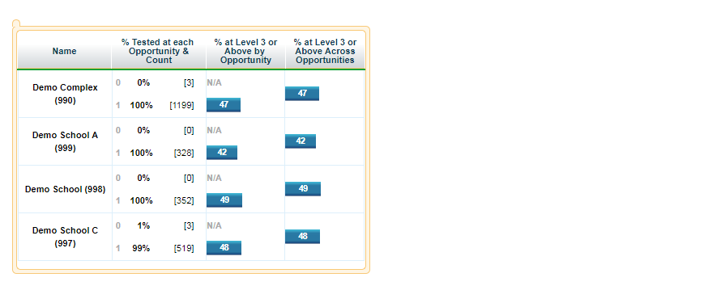
Test Management Center: Summary Statistics
Notes:
The Summary Statistics section displays statistics for students who have tested for a selected test by administration year and test name.
To generate a summary statistics report, click the Reports & Files drop-down list and select Summary Statistics. Select the test, administration, and test name for your report. Finally, click Generate Report to view the report on your screen.
The report will show the number of students at each opportunity, as shown in this sample report. For example, students at “Opportunity 0” have not taken the test, students at “Opportunity 1” have taken the test once, and so on.

Slide 37
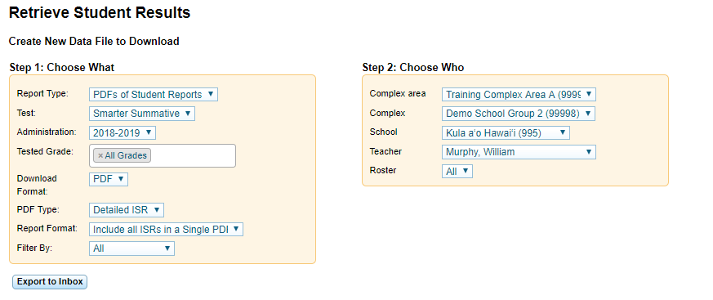
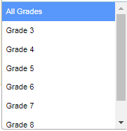
Test Management Center: Retrieve Student Results
Notes:
From the Retrieve Student Results section, you can download a ZIP file containing individual PDFs of each Individual Student Report for all the students associated with the selected school. The ZIP file will include a CSV manifest that lists all the PDFs included in the ZIP file.
You can also download student data files for a selected testing window by complex, school, teacher, or roster. The data file contains students’ personal information, including enrolled school and grade level, and the selected test scores and claim scale scores, if applicable. You can download the data file in Excel or CSV format.
To generate a report, click the Reports & Files drop-down list and select Retrieve Student Results. Next, select a report from the Report Type drop-down list. You may download either Student Data or PDFs of Student Reports. Finally, select the parameters for your file from the available drop-down lists and click Export to Inbox. You will receive an email once the file is ready. When your file is ready, click Inbox in the banner to access your file. Click on the file to download to your computer. Your file will continue to be available for 30 days in ORS.

Slide 38
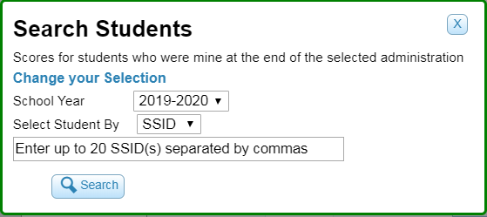
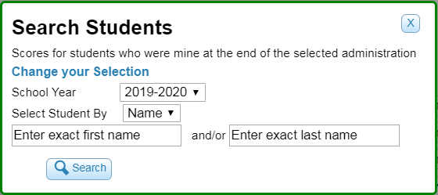
Search Students
Notes:
You can search for a student’s score reports by student ID or by name. This is especially useful if you need to find a student’s score reports, but do not know the student’s grade or school.
To search for multiple students at once, you can enter multiple SSID numbers separated by commas in the search field.

Slide 39
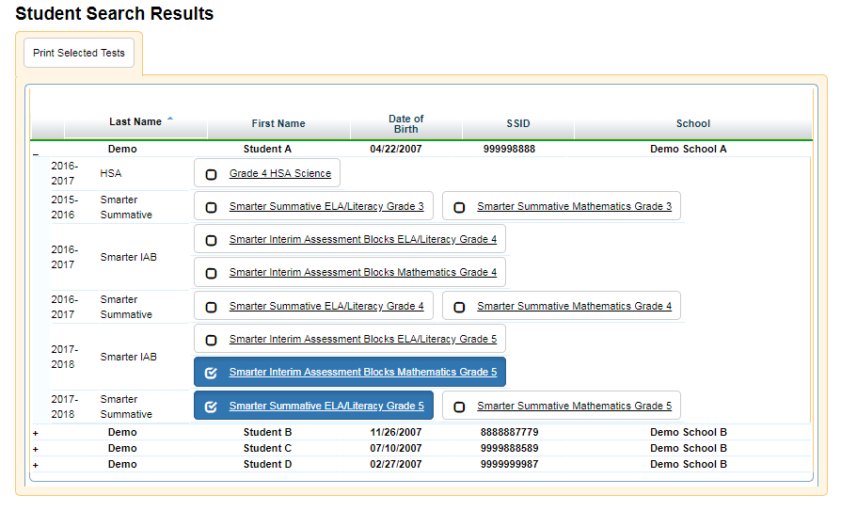
Search Students
Notes:
The Student Search Results page will show a list of students who match your search criteria.
To view all tests taken by a student, click the plus sign.
To view a student’s score report for a particular test, click the test name.
To select a test for printing, mark the checkbox next to the test name.

Slide 40
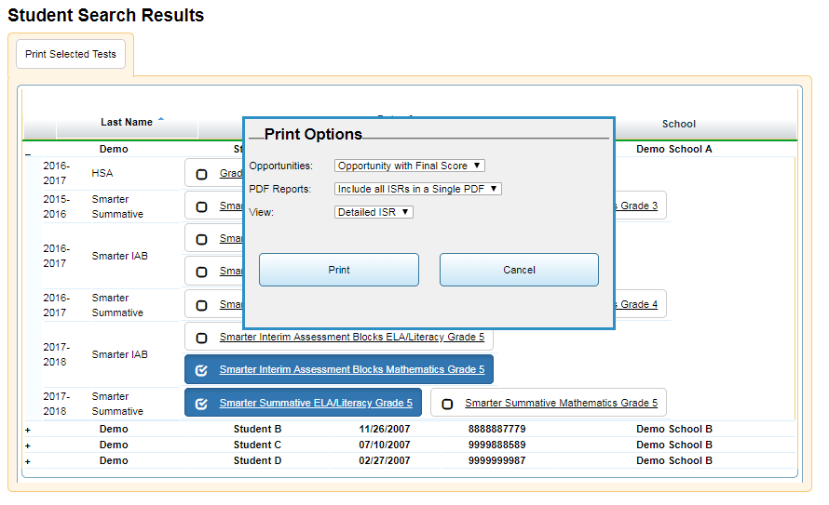
Search Students
Notes:
From the Student Search Results page, you can also print Individual Student Reports (ISRs).
After you select the test or tests you want to print, as shown on the previous slide, click the Print Selected Tests box. A Print Options pop-up window will appear. Select the desired options and click Print. A PDF file will be downloaded to the Inbox.

Slide 41
View/Edit Rosters
Notes:
On the next few slides, we will discuss adding, viewing, and editing rosters.
A roster is a collection of students sharing a similar characteristic who are assigned to a specific teacher. Rosters typically represent classrooms but can also be used to group students with special needs or students participating in particular activities or programs. You can view how a roster of students performed on a test by selecting Roster in the “Who” drop-down list in the Score Reports exploration menu.
Based on your user role, you may be able to create and edit rosters, which can be done in TIDE and in ORS. For some users, rosters may need to be created in TIDE before data can be viewed in ORS.
To view or edit a roster of students, click the View/Edit Rosters tool in the banner.

Slide 42
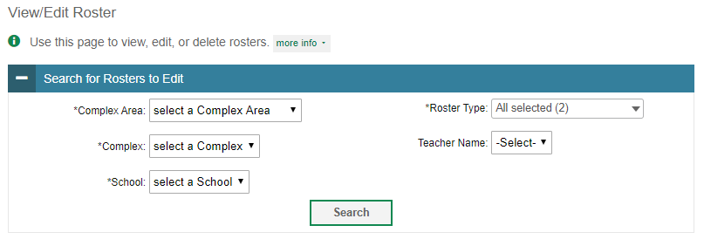
View/Edit Rosters
Notes:
When you click View/Edit Rosters, the View/Edit Rosters pop-up window will appear. In this example, the complex and school criteria are required. Your particular version of ORS may have other fields by which you can retrieve rosters. Click Search to display a list of rosters matching your criteria.

Slide 43
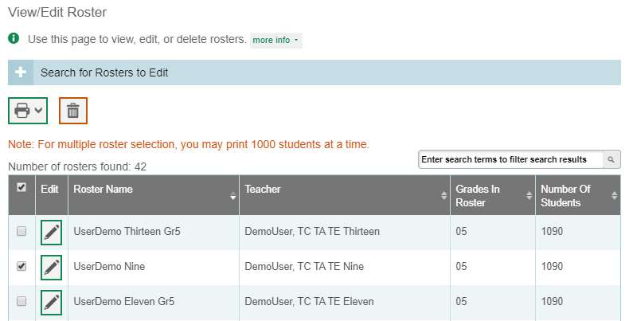
View/Edit Rosters
Notes:
Once the list of rosters has loaded, you may print or delete rosters by selecting them and clicking the Print or Delete buttons above the search results.
Click the pencil icon next to a roster to view or edit its details.

Slide 44
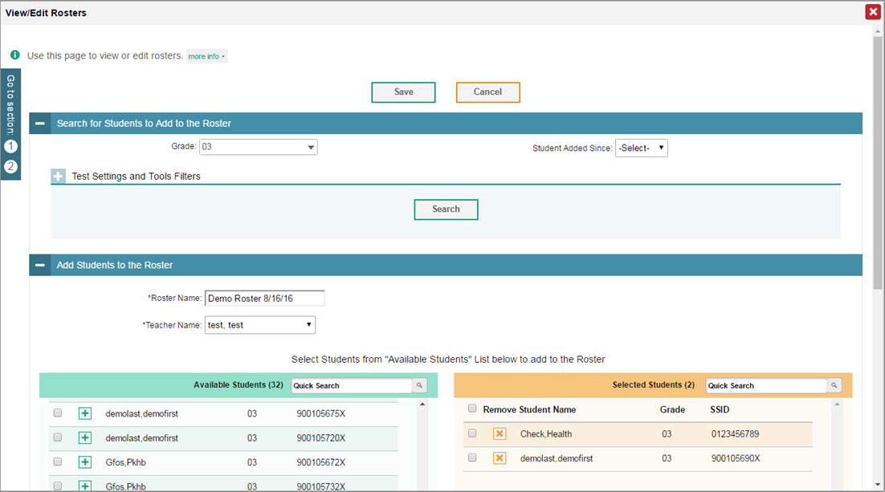
View/Edit Rosters
Notes:
When you click the pencil icon next to a roster, a new pop-up window will appear, allowing you to edit that roster’s name, teacher name, and students in the roster.
A list of students will appear in the Add Students to the Roster section near the bottom of the pop-up window. Students in the left column are available to be added to the roster, and students in the right column are currently in the roster.
To add students to the roster, select the necessary search criteria in the section titled, Search for Students to Add to the Roster. Click Search to display a list of students matching your criteria in the Available Students column.

Slide 45
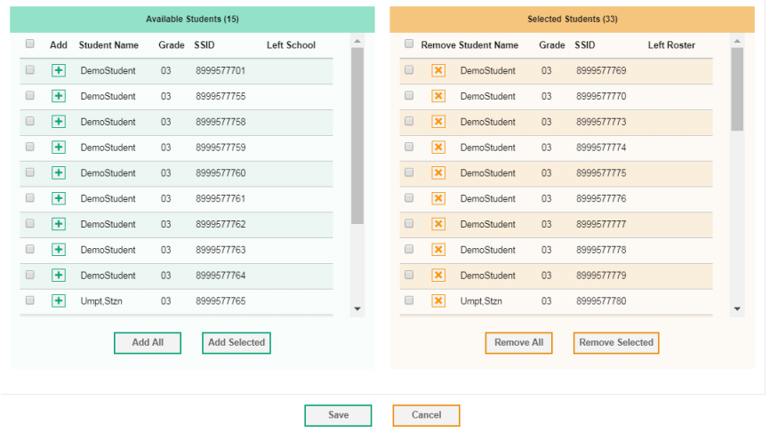
View/Edit Rosters
Notes:
To add a single student to the roster, click the green plus sign next to a student name in the left column. You can add multiple students to the roster by marking checkboxes next to the students you want to add, and then clicking Add Selected. Add all available students to the roster by clicking Add All.
To remove a single student from the roster, click the orange X next to a student name in the right column. You can remove multiple students from the roster by marking checkboxes next to the students you want to remove, and then clicking Remove Selected. Remove all students from the roster by clicking Remove All.
When you have finished editing your roster, click Save. You will return to the list of roster search results where you may view or edit additional rosters.

Slide 46
Add Roster
Notes:
You may wish to create a new roster in order to see how a particular group of students performed. School-level users can create a roster of all students in a specific grade who have tested. You can create a custom list of students receiving special instructions, or who belong to an extracurricular program, to track their performance as a group.
Click the Add Roster tool to create a new student roster.

Slide 47
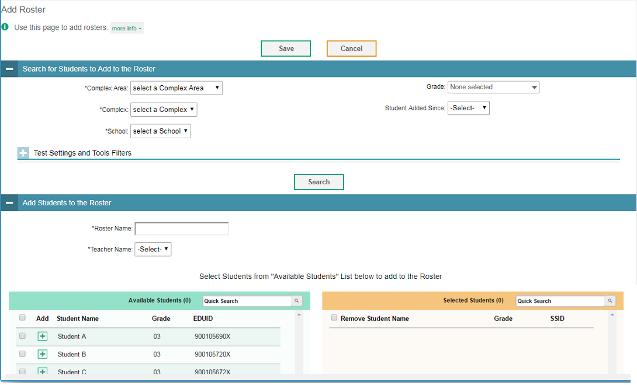
Add Roster
Notes:
When you click Add Roster, the Add Roster pop-up window will appear. To add a new roster, select the complex and school to which the roster belongs. Enter a roster name and select the name of the teacher who should be associated with the roster.
In Test Settings and Tools Filters, you may optionally refine the list of available students by selecting additional criteria from the drop-down lists and checkboxes. Then click Search. Students matching your search criteria will appear in the Available Students column near the bottom of the window.

Slide 48

Add Rosters
Notes:
To add a single student to the roster, click the green plus sign next to a student name in the left column. You can add multiple students to the roster by marking checkboxes next to the students you want to add, and then clicking Add Selected. Add all available students to the roster by clicking Add All.
To remove a single student from the roster, click the orange X next to a student in the right column. You can remove multiple students from the roster by marking checkboxes next to the students you want to remove, and then clicking Remove Selected. Remove all students from the roster by clicking Remove All.
When you are finished adding students to the roster, click Save to create the new roster.

Slide 49

Upload Rosters
Notes:
A second way to add new rosters is to use the Upload Rosters tool to compose an upload file in Excel or CSV format and then upload that file.
This method is easiest if you need to create many rosters and you don’t want to add them one at a time.
When you click the Upload Rosters button, the Upload Rosters pop-up window will appear. The easiest way to compose an upload file is to download an available template by clicking Download Templates. Open the template, enter information for the rosters you wish to add using Excel or another program, and save the file in Excel or CSV format. Detailed instructions for composing an upload file can be found in the ORS User Guide.
Return to the Upload Roster window in ORS, click Browse, and select the file you just saved.
Click Next to upload the file. A file preview page will appear, allowing you to verify that you uploaded the correct file. If the preview is correct, click Next to continue.

Slide 50

Upload Rosters
Notes:
The system will validate the file and display any errors or warnings according to the legend on the page. Click the orange error icons and blue warning icons in the validation results to view the reason a field is invalid. If a record contains an error, that record will not be included in the upload. If a record contains a warning, that record will be uploaded, but the field with the warning will be invalid.
To complete the upload, click Continue with Upload.
To upload a different file, click Upload Revised File.
To cancel the upload, click Cancel.
If your file contains a large number of records, the system will process it offline and send you a confirmation email when it is complete. Do not press Cancel while the file is being validated, as some records may have already started processing.
To view a PDF file listing the validation results for the uploaded file, click Download Validation Report in the upper-right corner.
When the upload is complete, a confirmation page will appear with a message that summarizes how many records were committed and how many were excluded.

Slide 51
Things to Remember
ORS helps educators answer questions regarding the assessment data in order to improve teaching and learning.
The magnifying glass icon displays the exploration menu, which is used to explore the different dimensions and levels of score data.
All reports can be printed and exported.
The Help button is available on every page of ORS.
You can use ORS to generate Individual Student Reports to share with parents.
Results for all Interim Assessments from prior years (before SY 2019-2020) remain available in ORS. Interim Assessment results for SY 2019-2020 are now reported in Centralized Reporting.
Notes:
Here are a few things to remember:
The Online Reporting System helps educators answer questions regarding the assessment data in order to improve teaching and learning.
The magnifying glass icon displays the exploration menu, which is used to explore the different dimensions and levels of score data.
All reports can be printed and exported.
The Help button is available on every page of ORS.
You can use ORS to generate Individual Student Reports to share with parents.
Results for all Interim Assessments from prior years (before SY 2019-2020) remain available in ORS. Interim Assessment results for SY 2019-2020 are now reported in Centralized Reporting.

Slide 52
Contact Your Help Desk
You can contact the HSAP Help Desk for assistance with any technical issues you encounter.
When contacting the HSAP Help Desk, please be ready to provide:
Any error messages that are appearing (including codes)
Your operating system and browser information
Your network configuration information
Your contact information for follow-up by phone or email
Any other relevant information, such as test names or content areas, student IDs, session IDs, and search criteria
For test administration or policy issues, please contact your complex test coordinator.
Notes:
You can find the ORS User Guide and other helpful resources on your state assessment portal. However, if you still require assistance with troubleshooting a technical issue, you may also contact the HSAP Help Desk. When contacting the HSAP Help Desk, please be ready to provide the following information:
Any error messages that are appearing (including codes)
Your operating system and browser information
Your network configuration information
Your contact information for follow-up by phone or email
Any other relevant information, such as test names or content areas, student IDs, session IDs, and search criteria
For questions about test administration or policy issues, please contact your complex test coordinator.

Slide 53
Thank You!
Further Information
Visit
  alohahsap.org
  https://smarterbalanced.alohahsap.org/
Call, fax, or email the HSAP Help Desk
  Hours: 7:30 am to 4:00 p.m. HST, Monday-Friday (except holidays)
  Phone: 1-866-648-3712
  Fax: 1-877-231-7813
  Email: HSAPHelpDesk@cambiumassessment.com
Notes:
Thank you for taking the time to view this training module. For detailed information, consult your Online Reporting System User Guide located at https://alohahsap.org/ or contact the HSAP help desk.

