Slide 1
The Centralized Reporting System for Interim Assessments
Training Module
Copyright © 2020 Cambium Assessment, Inc. All rights reserved.
Notes:
Welcome to the training module on the enhanced features of the Centralized Reporting System.
This training module is based on the Centralized Reporting System User Guide for Interim Assessments, 2019-2020, which is available on the Aloha HSAP online portal.

Slide 2
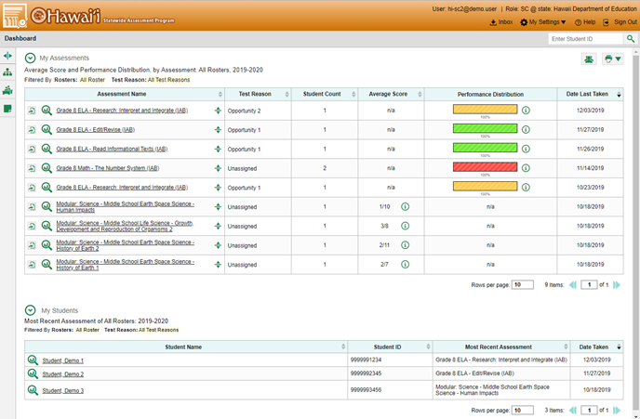
Purpose of the Centralized Reporting System
More user-friendly
Accurate
Scalable—designed to handle lots of data and more features over time
Accessible on different devices and by different user types
Notes:
The Centralized Reporting System is designed with a user interface that is more user-friendly, accurate, scalable, accessible, and easily digestible. With the intent to provide the clearest picture with the fewest number of clicks, the system displays state-, complex area-, complex-, school-, teacher-, class-, and student-level data in tabular and graphical format. It is designed to handle lots of data for a variety of tests, and it will be continuously updated with more features over time. The system is accessible on different devices and by different users at the teacher, school, complex area, complex, and state user level. Users can sort and filter the data in various ways and can create custom groups to generate timely reports for intervention groups or incoming classes.
The dashboard is the homepage for all users. The teacher dashboard is displayed here.

Slide 3
Objectives in Order of Presentation
After viewing this presentation, you will understand how to
Navigate Centralized Reporting for Interim Tests
See your results, sort them for analysis, expand them to view standard targets and measures, and quickly compare results at the state, complex area, complex, and school level.
Access the longitudinal reports to show performance trends over time, for associated tests.
Use the Student Portfolio Report.
Set Up Reports That Make Sense for Your Specific Needs
Set preferences and filters.
Use demographic sub-groups.
Work with Interim Tests—Their Items, Rubrics, and Scoring Essentials
Generate Individual Student Reports (ISRs) and Student Data Files
Print and Export Any Data You Can View in Reports
Notes:
This training focuses on five main objectives: navigating the test results pages to display data with just a few clicks; using the settings and filters to customize your reports and eliminate irrelevant data; working specifically with interim tests and their items; generating ISRs and student data files; and printing and exporting your reports.

Slide 4
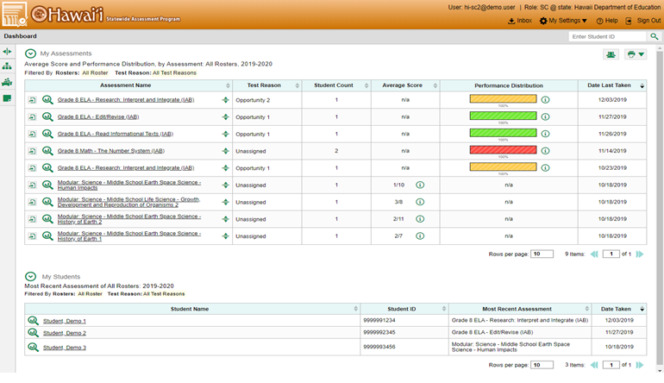
Teacher Dashboard Layout
Notes:
The Centralized Reporting System features two dashboard lay-outs for different users. The teacher dashboard displays two stacked tables, one for all assessments on top, and beneath it, a table of all the teacher’s students.
Sorting, setting preferences, filtering, and breaking down demographic groups are important functions for all users so that test data applies specifically to their needs. It only takes a few clicks to create a highly customized report, no matter the test type or the level of the user.

Slide 5
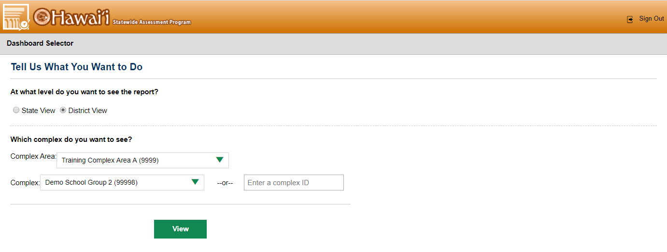
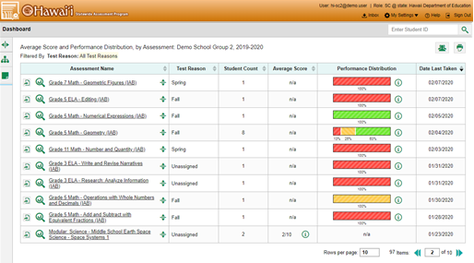
State or Complex Level Dashboard Layout
Notes:
As a state, complex area, or complex level user, you will first reach a Dashboard Selector screen upon logging in which gives you the prompt “Tell Us What You Want to Do.” From this screen, you can choose “State View” or “District View.” If you choose “District View,” you will be prompted to choose the complex area and complex you would like to view. Alternately, you can enter a complex ID instead of the complex name. Click “View” to proceed to the dashboard (shown on the right).
School personnel and complex users will see one table of all assessments.

Slide 6
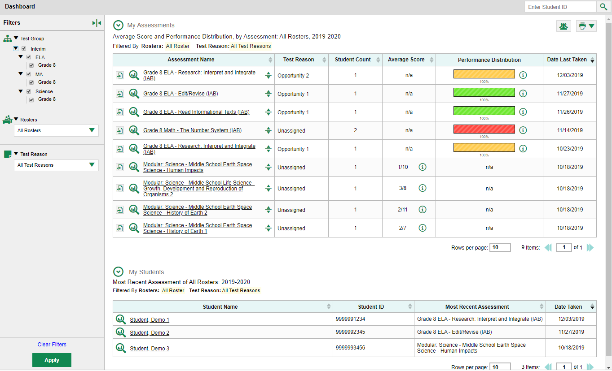
Dashboard Features: Table Headings
Title
Notes:
Users can see overall test results directly from the dashboard page. Each table is headed by a detailed title, listing the report type, the school year and any filters chosen by the user. Tests associated with the user will be listed under Assessment Name. Test Reason typically includes categories associated with the opportunity number for an interim test. Student Count is the number of students who took each test. Sorting arrows are located to the right of most column headings, allowing the user quick organization of the test results.

Slide 7
Dashboard Features: Table Headings (Continued)
Notes:
The next two columns, Average Score and Performance Distribution, reflect two scoring methods used by the various tests. The Average Score column lists a scale score for ICAs and a raw score for Science Interim assessments. IABs will not list a score in the Average Score column; this will instead say “n/a.” The Performance Distribution column shows the student’s level of achievement based on mastery of the academic standards assessed by the test. For an explanation of the scores and distribution levels, click the information button in the table (outlined with red boxes above). A quick sort of the Average Score column will place the tests with the highest scores at the top of the table, or those with the lowest scores at the top. Test administration dates are reported in the last column as Date Last Taken.

Slide 8
Dashboard Features: Table Headings (Continued)
Notes:
This is a teacher dashboard and features a second table labeled My Students. This table contains a list of the teacher’s students by Student Name, their Student ID numbers, the Most Recent Assessment taken, and the Date Taken.
This slide also shows the Filters panel, to the left of the tables. It is expanded to show the options available to the user. Filter options will be discussed later in the presentation.

Slide 9
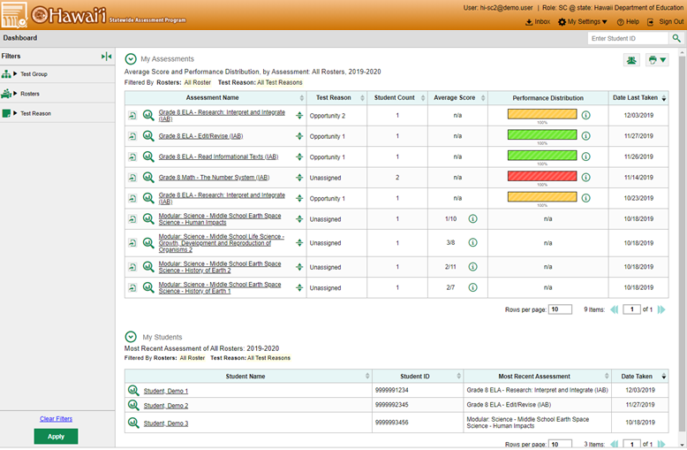
Dashboard Features: Buttons, Arrows, and Filters
Student Results Generator
Notes:
Test results and other data lie just under the surface of the dashboard page. Buttons, arrows, test names, and student names are all “clickable.” This slide shows the numerous clickable objects on the dashboard homepage. If a user hovers over a button, a label appears indicating the name of the button. These buttons include, but are not limited to the Inbox, My Settings, the Help feature, the Student Search box, the Student Results Generator, the Print button, and the Filters panel (by Test Group, Rosters, and Test Reason). These filters and how to apply them will be discussed later in the presentation.

Slide 10
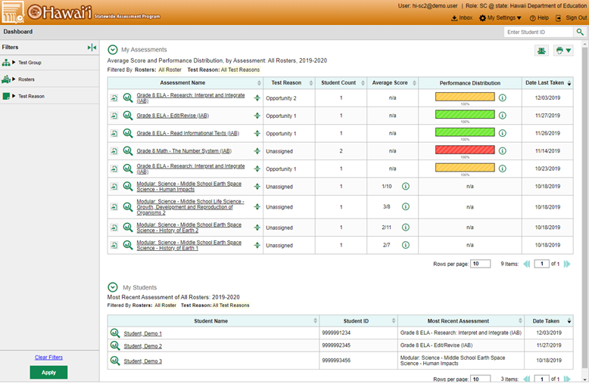
Dashboard Features (Continued)
1
3
2
Notes:
(1) In the My Assessments table, included with the name of an assessment are the Export button, the magnifying glass button, and a set of up/down arrows that expand to show state-, complex area-, complex-, and school-level results. This aggregate comparison view is shown on the next slide. Click on the assessment name to display the Performance on Test page.
(2) For teachers: In the My Students table, teachers can click on a Student Name OR the magnifying glass next to the name to navigate to the Student Portfolio results page.
(3) Both tables can be set to size preferences. Change the number of rows per page, as desired. Use the forward and back arrows to move to different pages of the table.

Slide 11
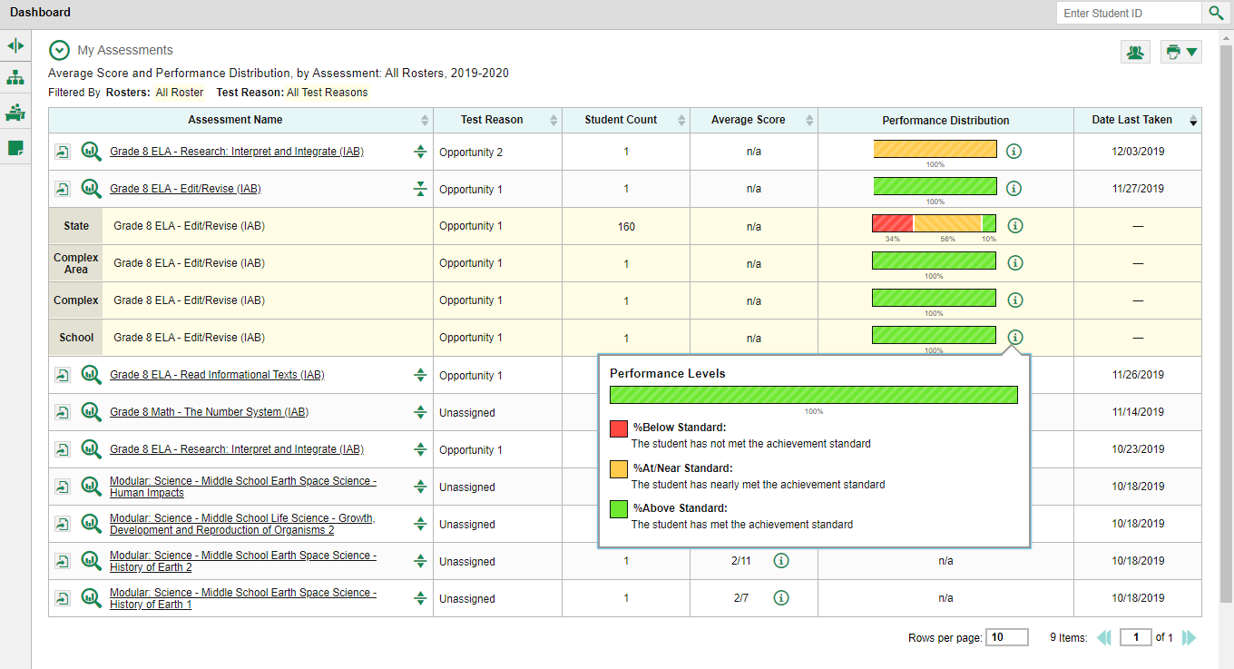
Compare Your Results to State, Complex, or School Level
Notes:
Typically, one of the first things a user is looking for is a comparison of their results to school-, complex area-, complex-, and state-level results. Click the up/down arrows to the right of the Assessment Name to view these comparisons. (You can also click on the assessment name and the comparison rows will show on the test results page.)
This slide shows the results for a Grade 8 ELA- Edit/Revise IAB. The Performance Distribution indicates that at the state level, 34% of students were Below Standard, 56% were At/Near Standard, and 10% were Above Standard. Comparatively, this school’s students scored Above Standard, which is higher than the state’s performance. The Performance Levels legend displays when the information button is clicked. Additionally, an Average Score will appear if more than one student in the class has completed that Interim Assessment.

Slide 12
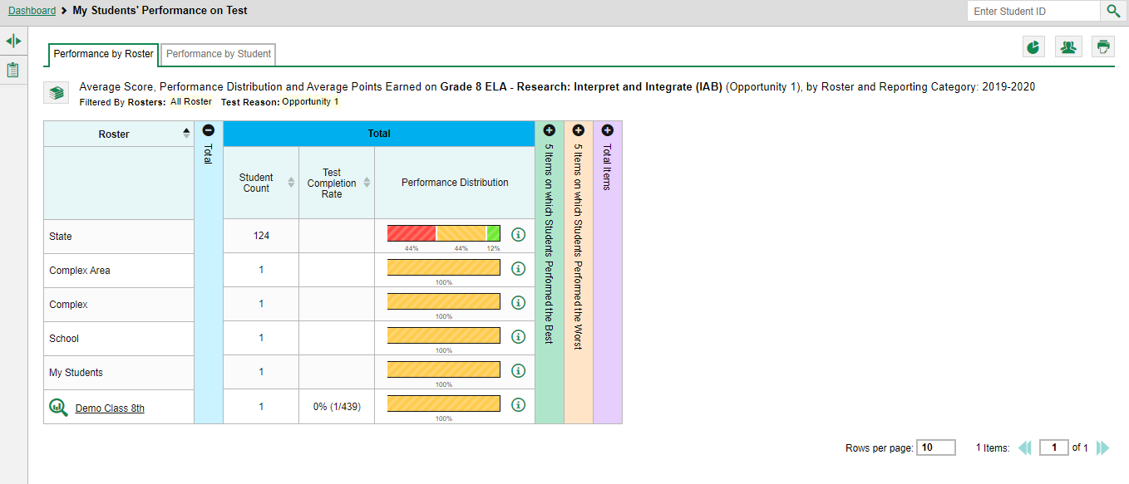
Navigate the Test Results Page
Notes:
Clicking an assessment name (or on the magnifying glass) will bring up test results pages. The page navigation trail is shown in a gray bar at the very top of every test results page. It reads Dashboard > My Students’ Performance on Test. This is a teacher’s report. School users will see the words “School Performance on Test.”

Slide 13
Navigate the Test Results Page
Sorting Arrows
Notes:
There are two tabs below the trail: the Performance by Roster and Performance by Student tabs. Users can toggle between the two depending on the data they wish to see. The Performance by Roster tab is open on this image, showing the Grade 8 ELA – Research: Interpret and Integrate (IAB) test results by roster. Sorting can be done in ascending or descending order by using the sort arrows under the Total heading.

Slide 14
Navigate the Test Results Page
3
1
3
Notes:
Other areas of interest on the page are as follows:
(1) The state, complex area, complex, school, and teacher’s results also display on the test results page for quick comparison to the roster results.
(2) Expanding the + arrows in the column headings shows the 5 items on which students performed best/worst and the test results in the topic areas of the test if it is an ICA (see the next slide). If you click on the informational button, a Performance Levels legend displays, showing the performance level measurements.
(3) Click on the name of the Roster or the magnifying glass to see a list of student results. Sorting will be available from the student test results page.

Slide 15
Navigate the Test Results Page: ICA Reports
Notes:
When viewing an ICA Report, expanding the + arrows in the column headings shows test results in the topic areas of the test. There are various columns that appear depending on the type of test administered. This Grade 4 Math CAT (ICA) assessed in three topic categories: Communicating Reasoning, Concepts and Procedures, and Problem Solving and Modeling & Data Analysis. If you click on the informational button, a Performance Levels legend displays, showing the performance level measurements.
This is a state level user’s report. A teacher’s report will include an option to see individual student scores.

Slide 16
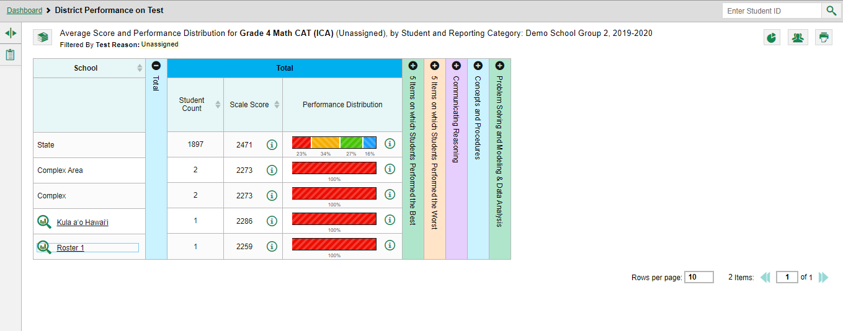
Performance Data
Notes:
Depending on the test, a report may display different kinds of performance data. Score data can be reported as scale scores or raw scores. Raw scores may be in the form of percentages or fractions. Performance level data, displayed as Performance Distribution provides qualitative measurements of students’ proficiency in relation to a single standard or a set of standards.
Some reports feature a Percent Proficient column (not shown here) that represents the total percentage of students who achieved proficiency in the test. It typically includes those who fell into the top one or two performance levels.
The display here is generated by a state-level user, viewing the results of a school on the Grade 4 Math CAT ICA.

Slide 17
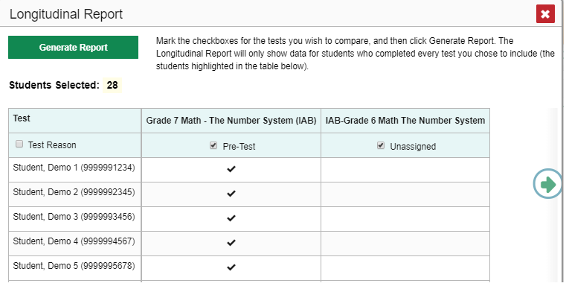
Longitudinal Reports
Context Menu
Report Options Page
(multiple students)
Notes:
The Longitudinal Report allows users to view students’ performance over the school year, across multiple test opportunities of a single assessment, or across multiple related assessments to see if performance has improved or declined. The appearance of the tables and graphs in a longitudinal report are based on whether the test data is for an individual student or a group of students who all took the same test or tests. Reports can span multiple school years, not just the latest school year.
Navigate to a page of test results. Click the context menu icon in the upper-left corner and highlight the longitudinal reports clock-face icon. Some users will see the clock-face icon directly on the test results page. If the report is for multiple students, the report options pop-up box appears. This window is explained on the next slide.

Slide 18
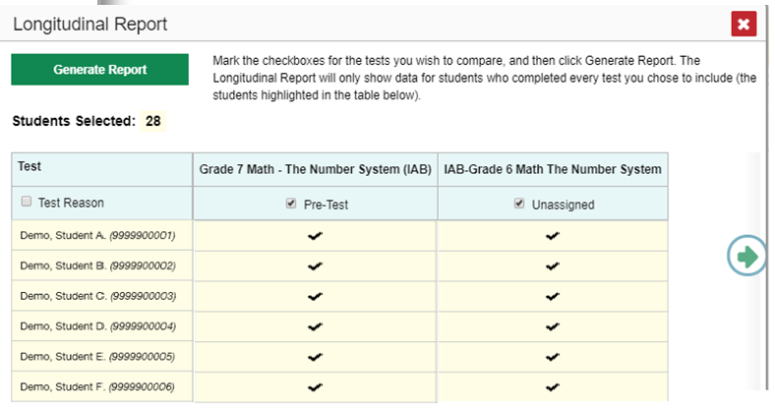
Longitudinal Report for Multiple Students
6
Notes:
If the desired test report is for multiple students and if the user is a teacher, the report options page for the Longitudinal Report will appear after clicking the watch face icon. This page lists columns for each related test completed by students in the report. The columns display checkmarks to indicate which students completed each test. If students completed the same tests with separate test reasons (categories of tests), a column appears for each test reason. Mark the checkbox for each test and test reason to include. Note that only tests taken by all the students will be included in the report. Click Generate Report to view the Longitudinal Report.

Slide 19
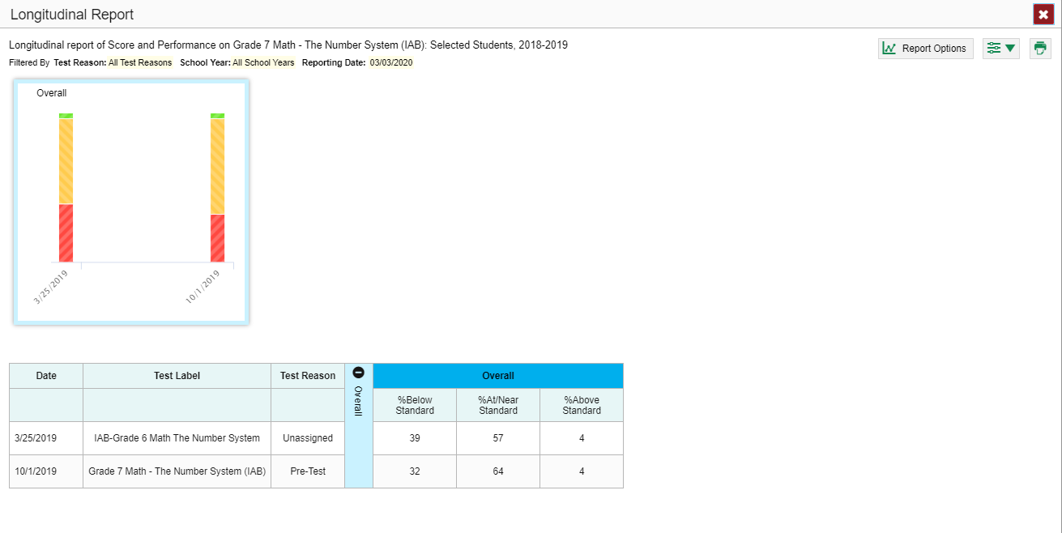
Longitudinal Report for Multiple Students (cont.)
Performance-Level Data
Notes:
To view students’ Overall Performance data on the assessments over time, look at the first graph in the upper-left corner of the report. This graph shows the scores or performance levels of the student or the students each time they took the test. Performance data can be shown as either a line graph or a performance distribution bar. To switch between score data and performance level data, toggle the button at the top of the graph. Note that some tests provide only one type of data.
Information on student scores and performance can also be found in the table at the bottom of the report.
For some tests, data is provided in different topic areas over time. When the tests include multiple reporting categories, additional graphs will appear. The report includes a graph and a table section for each reporting category on the tests. This allows users to see at a glance how students are improving or declining in each area.
Note: Once a report is generated, teachers can modify their selections by clicking Report Options in the upper-right corner. The filters button works as it does for an individual student’s longitudinal report. The print button allows the user to print a screen copy of the report, to save it to a PDF with multiple lay-out options, or to save the report as a CSV file.

Slide 20
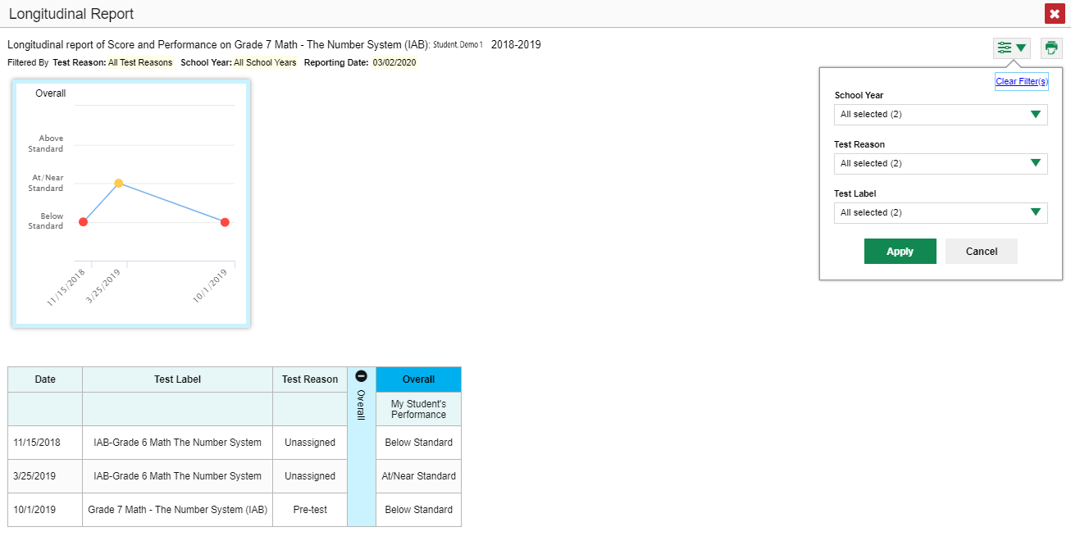
Longitudinal Report for an Individual Student
Notes:
The line graph above shows results from the Math Number System IAB the student took in both grades 6 and 7. Line graphs include overall results and graphs for each of the reporting categories used in the test in the case of an ICA. Hover the mouse over the points to get more information. Every graph is accompanied by a table at the bottom of the report.

Slide 21
Longitudinal Report for an Individual Student (Continued)
Filters Menu
Notes:
To show some test opportunities and not others in the report, open the filters menu at the upper-right corner and select the options preferred from the drop-down lists. Users may want to filter by a particular School Year or years. Note that years are not calendar years. For example, “2018” refers to the 2018–2019 school year.
Users may wish to filter by a Test Reason (a category of test), which means excluding all other test reasons from the data. For example, users may want to narrow the report down to show only tests taken in the spring.
Finally, users may find that certain tests are less relevant than others. Use the Test Label menu to deselect the names of the tests not needed on the report. Once choices have been selected, click Apply.

Slide 22
To Review: Types of Longitudinal Reports Available
Reporting Periods Available
Results from current and previous school years (This is the default report; filter to reduce results)
Results from the current school year
Individual Reports
Multiple instances of the same test (interims and benchmarks)
Related tests (typically related by standard and determined by school/complex administration)
Group Reports
Students who completed the same test, multiple times (interims, and benchmarks)
Students who completed related tests
Notes:
Longitudinal reports vary widely depending on the types of tests administered, how they are related and the user’s role. They are easy to access from the clock-face button or the context menu which displays for the assessments that will produce a trend report.

Slide 23
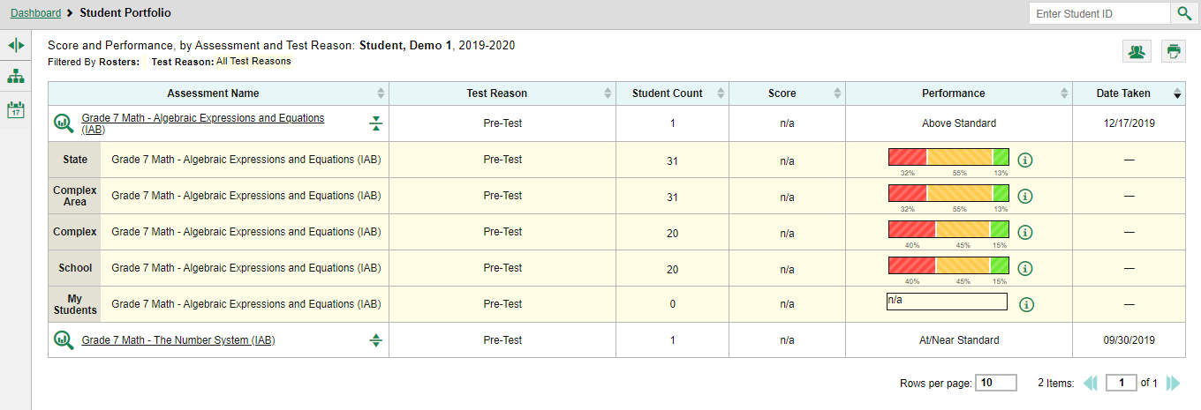
Ways to Use the Student Portfolio Report
View test results from current and previous school years using the school year filter
Compare a student’s results with state-, complex area-, complex-, school-, and teacher-level data
Sort results to see the most recent test scores
Generate and print an ISR or a Student Data File
Access specific test data and individual student item responses directly from the report
4
1
3
2
5
Notes:
For the times when a user needs to focus on an individual student and his or her test performance, the Centralized Reporting System features the Student Portfolio Report. The report is designed so that users can quickly:
View test results from current and previous school years using the school year filter
Compare a student’s results with state-, complex area-, complex-, school-, and teacher-level data
Sort results to see the most recent test scores
Generate and print an ISR or a Student Data File
Access specific test data and individual student item responses directly from the report
Teachers have a “fast pass” to the Student Portfolio Report. From their dashboard they can click on the magnifying glass or the student name in the “My Student’s table and the student portfolio report will immediately display.
Other users access the report from any page of test results by copying a student identification number into the student search box, located in the gray navigation trail at the top of the page, and clicking the search button.

Slide 24
Student Portfolio—Analysis By Sorting/Comparing
1
2
3
Notes:
All the assessments taken by the student in the current school year are listed in the Assessments Table.
Assessments can be sorted by the following using the sorting arrows:
Score
Date Taken
Sorting gives the user a rough idea of how the student is performing over time.
(3) When the expansion arrow is clicked, comparison rows of State, Complex Area, Complex, School, and My Students results are shown.

Slide 25
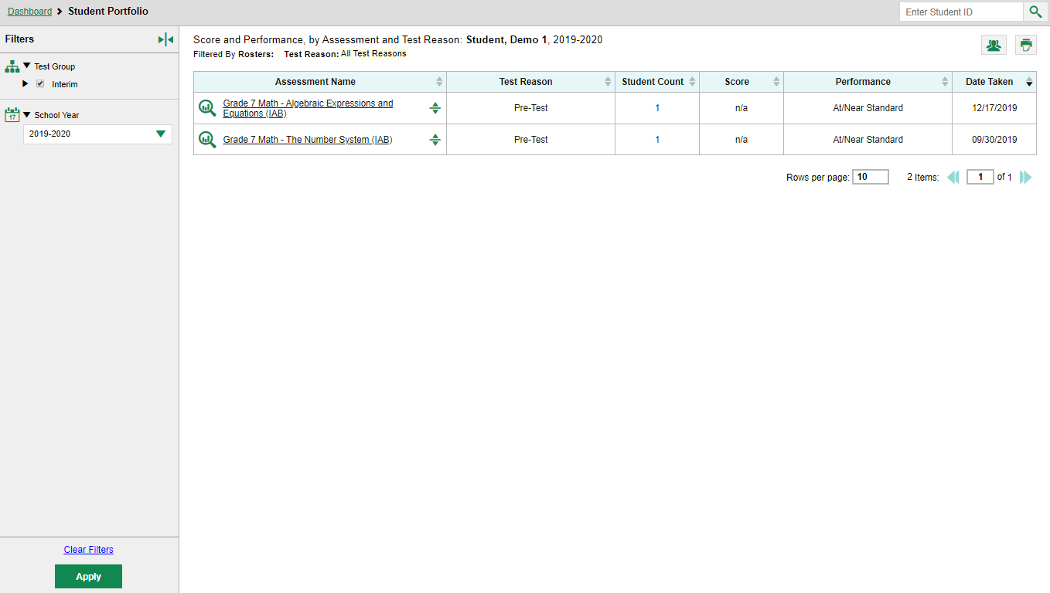
Filter Assessments by School Year
Notes:
To view a student’s test performance from previous school years, click the School Year option from the expanded Filters menu. Select desired years, and click Apply.
The assessments from the selected school years are now displayed in the table. Sorting may be done by Test Reason, Score, and Date Taken. State-, complex area-, complex-, school-, and teacher-level results may be expanded beneath the name of the assessment.
To clear filters, click Clear Filters and then Apply.

Slide 26
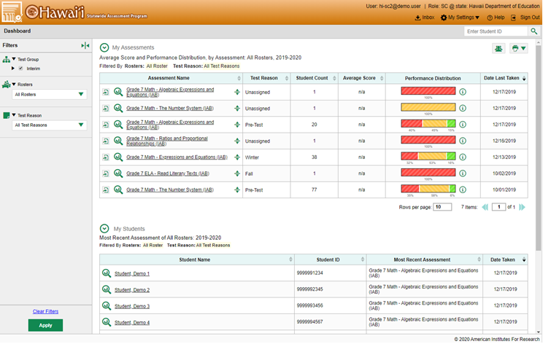
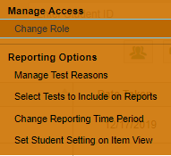
My Settings—Teacher Options
Notes:
To drill down to the most relevant results and eliminate unnecessary details, teachers and other users should take the time to set their preferences by using the options in the My Settings drop-down menu. The options in this list will vary, depending on user role and state.
Teachers will typically utilize these three main settings: Manage Test Reasons, Select Tests to Include on Reports, and Change Reporting Time Period.
The Manage Test Reasons option is used to organize interim assignments into categories, making data analysis more digestible.
The Select Tests to Include on Reports allows teachers to downsize the amount of data shown in their tables. Once a teacher has selected certain tests to display these choices are reflected when a school, complex, or state user elects to mirror the teacher’s choices in their data displays. This feature allows all users to bypass test data that does not suit their specific needs.
The Change Reporting Time Period allows a user to see results from a previous school year. These three options are explained in the following slides.
The Set Student Settings on Item View option, when toggled on, will allow teachers to see test items exactly the way the student saw them on the test, with the specific setting options in place. Settings such as large font, font color, and language choice can be seen by the teacher. This setting applies only to interim tests that include item-level data.
Each of these three main settings is explained in detail in the slides that follow.
Teachers also have options related to their class rosters. They can Add, View/Edit and Upload rosters.

Slide 27
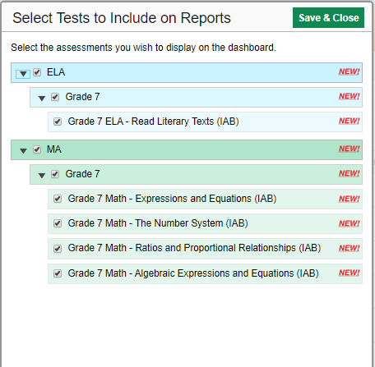
Options From My Settings—Select Tests to Include
Notes:
Under the Select Tests to Include on Reports option, teachers can use the expandable menus under each subject to choose the tests they want included in their reports. Once a teacher has selected certain tests to display these choices are reflected when a school, complex, or state user elects to “Use Teachers’ Test Selections” from their Settings drop-down menu. This feature allows all users to bypass test data that does not suit their specific needs. These three options are explained on the next slide.

Slide 28
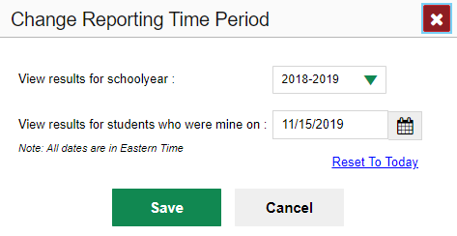
Options From My Settings—Change Reporting Time Period
Notes:
Users can select Change Reporting Time Period to view test results from a previous point in time. There are two time period settings: you can select a school year for which to view tests, and you can enter a date for which to view students. When a school year is selected, the reports show data for test opportunities completed in the selected school year. When a date is set for which to view students, the reports show data only for the students who were associated with the user as of the selected date. Students’ enrollment and demographic information is all given as of the selected date as well. Users can view students who have left rosters, the school, or the complex, or even the state.

Slide 29
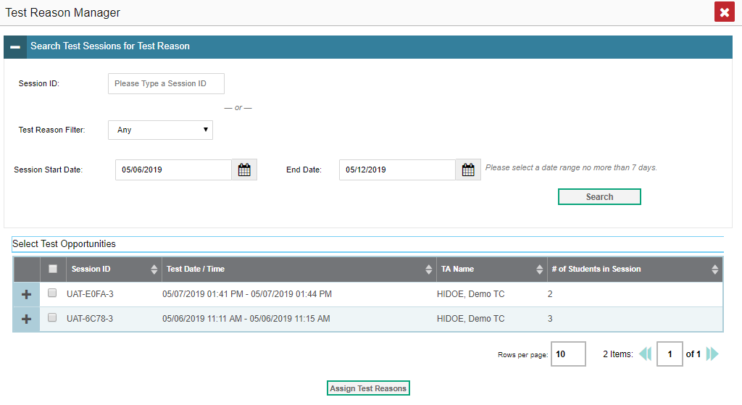
Options From My Settings—Test Reason Manager
Notes:
The Test Reason Manager is a tool used to organize interim tests into categories that will help users keep track of the various tests taken by their students. Reasons are set at the time of testing or after testing has been completed. When students take the same assessment multiple times, assigning different test reasons can help distinguish scores for more manageable analysis of results. Some administrators will create reasons to be used by all teachers and other users.

Slide 30
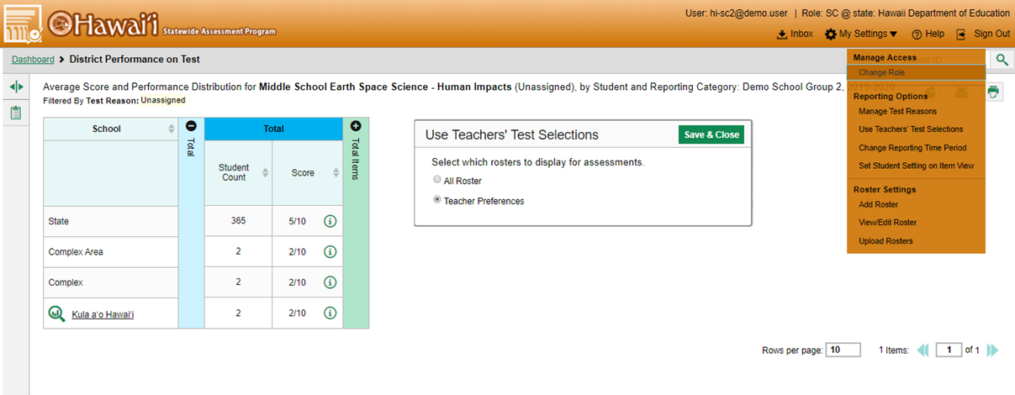
My Settings—School & Complex Options
Default Setting
Notes:
School and complex users can narrow down their data results by utilizing My Settings preferences, as well. Popular options include: Use Teachers’ Test Selections, Change Reporting Time Period, Add Roster, View/Edit Rosters, and Upload Rosters.
To limit the data to the results relevant to teachers and the specific tests they give, school and complex users set the Use Teachers’ Test Selections option accordingly.
The default setting for school and complex users under Select Roster Preferences is All Rosters. This option displays ALL rosters for ALL teachers and schools, depending on the user role. To select the Teacher Preferences setting, click Use Teachers’ Test Selections from the drop-down My Settings menu. Mark the Teacher Preferences button and click Save & Close.
If you select this option, results for any teachers who excluded a given assessment from their own reports will not appear in the school test results for that assessment. This option can be useful when you want to exclude tests for classes a teacher didn’t teach. With this option assigned, the school or complex user is seeing only the roster results for the tests chosen by the individual teachers according to what they have chosen to view in their reports.

Slide 31
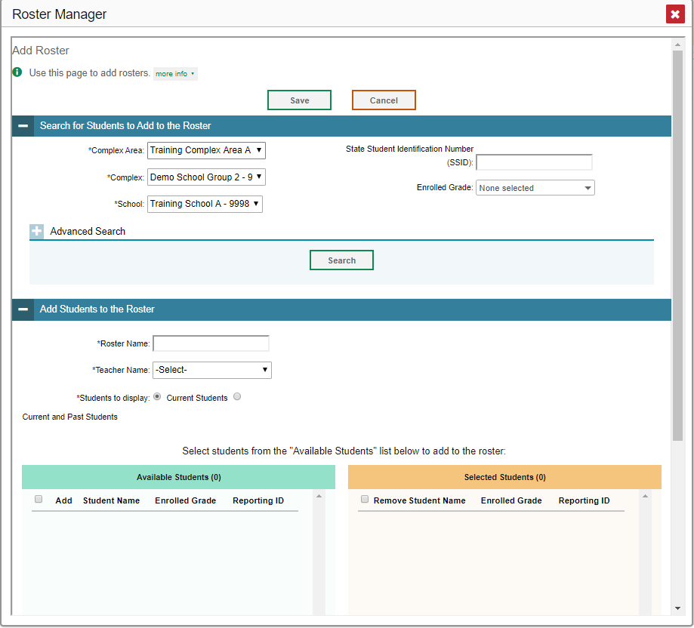
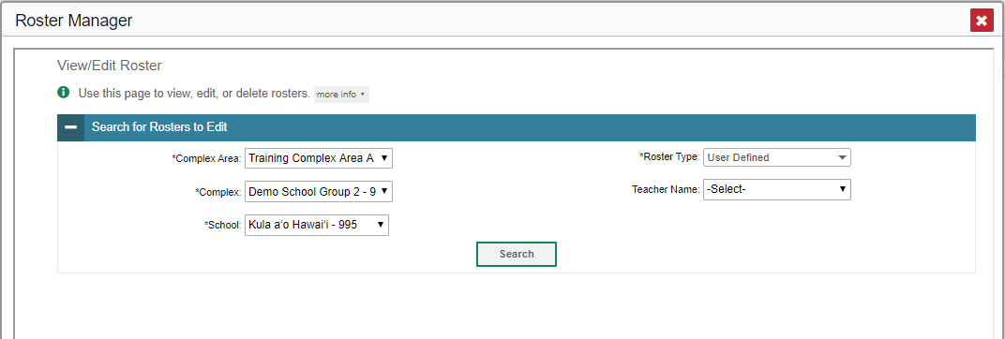
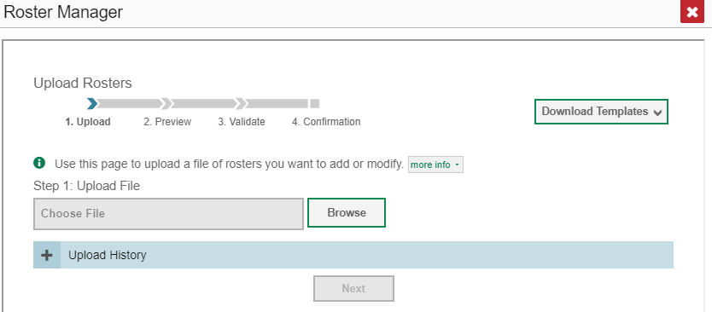
My Settings—Roster Management For All Users
Notes:
Users, depending on their role, can add, edit, export, and upload rosters using the Roster Manager pop-up windows. This mirrors the roster management functionality in TIDE. Complex test coordinators, school test coordinators, and teachers can build groups and assign students to them, allowing them to customize and update classroom rosters. Managing classes using these features is a great way to organize students, allow teachers to view their students’ performance, and generate information on incoming classes.
Refer to the Centralized Reporting System User Guide for specific instructions on using the Roster Manager windows.

Slide 32
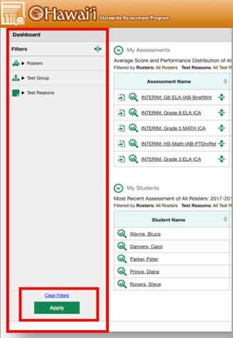
Filters Panel: Rosters, Test Group, Test Reasons
Graphic Object | Description
 | Use to focus on a particular class’s performance. By switching filters, a user can easily compare one class with another. Data for a single roster is easier to understand.
 | Use to filter out tests that you don’t want to see. For example, an ELA teacher might not want to see math scores. Set this group to exclude all math tests.
 | Test reasons are categories used to classify test opportunities for reporting purposes. They typically indicate the timeframe or season in which tests were taken. For example, a user may want to filter by fall and ELA, then filter by spring to see if students have improved. Not filtering brings up data for all different test reasons.
 | Use this filter to limit test results to one or several standards. This filter works on fixed-form tests with item-level data or adaptive tests for individual students.
 | Setting a reporting date allows the user to access data from previous school years. This is helpful when analyzing performance gains over time. Available for Longitudinal Reports or the Student Portfolio.
Notes:
A second feature helpful in drilling down to specific data is the Filters panel on the left margin of the dashboard and test results pages. Clicking on any of the graphic buttons in the panel will expand to show the selection options. The available buttons vary, depending on the User and the Test Performance page.
To expand the selections for each option, click the corresponding graphic button. Check the desired selections and click the Apply button. The table shows the filter buttons that appear on the various pages in Centralized Reporting.
This table provides a quick overview of each of the filter options. Some of these options are discussed throughout the presentation.

Slide 33
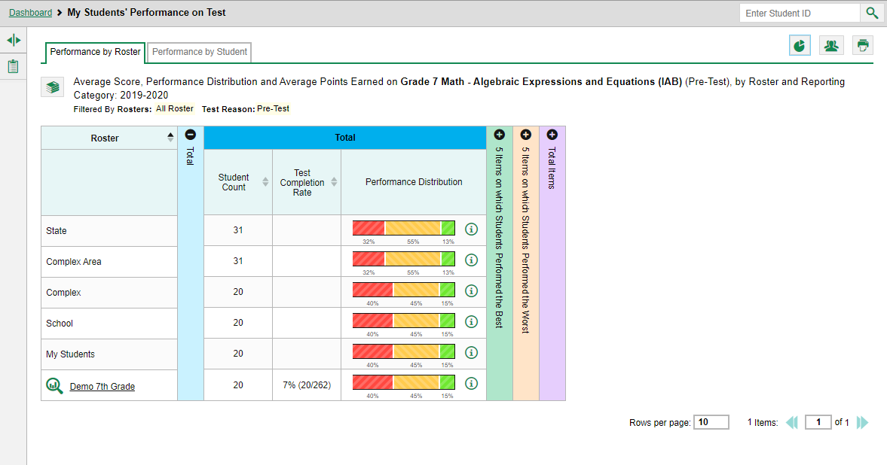
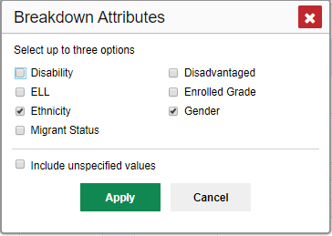
One More Setup Button: Demographic Sub-Groups
Breakdown Button
Notes:
There is one more setup tool that allows users to break down data by demographic sub-group. Use the breakdown button at the upper right corner to compare performance between different demographic sub-groups. This tool is helpful in identifying groups that need more instructional support.
From any test results page (for multiple students) click the breakdown button. The Breakdown Attributes window opens. Select up to three student demographic categories.
Unspecified Values (optional): Some students who completed tests do not have specific demographic information in the Test Information Distribution Engine (TIDE). These students are considered to have unspecified values. To include the test data for these students in your results, mark the checkbox “Include unspecified values” and click Apply.

Slide 34
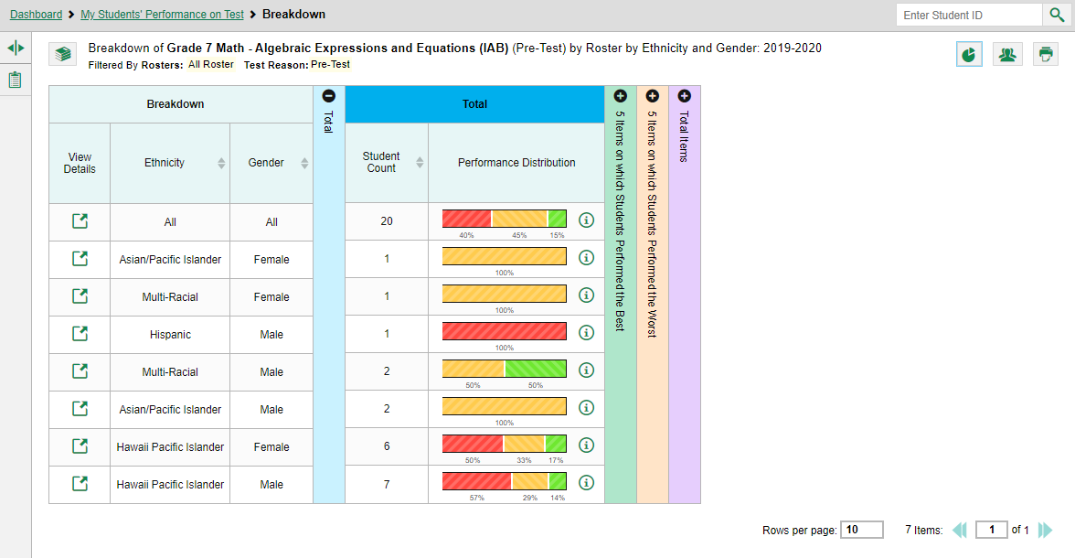
Breakdown of Demographic Sub-Groups
1
3
2
Notes:
Demographic columns (e.g., ethnicity, gender) appear on the test results page, one for each category chosen from the attributes menu.
(2) View Details buttons appear on the left of each column for each row of information.
(3) A row appears for each possible combination of demographic groups in the selected categories. If there are no students in a particular combination, no row appears for that combination.
Some sorting can be done with the category columns and the student count.

Slide 35
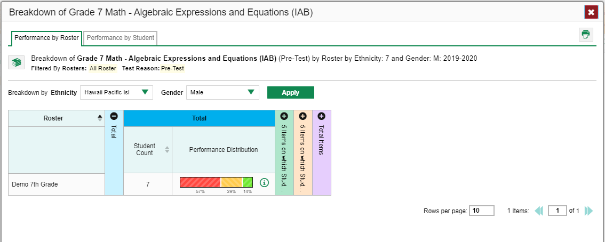
Breakdown of Demographic Sub-Groups (cont.)
View Details Button
Notes:
Test results for each demographic sub-group can be seen by clicking the View Details button to the left of each row that was shown on the previous slide. A window will open, displaying detailed results for that combination. This report table is now laid out the same way as the original report. At the top of the pop-up report table are filter menus for each demographic category chosen by the user. Combinations may be changed by using the filter arrows and clicking Apply. The new combination will be displayed.
Users can get an in-depth look at specific groups of students and their performance on specific tests.

Slide 36
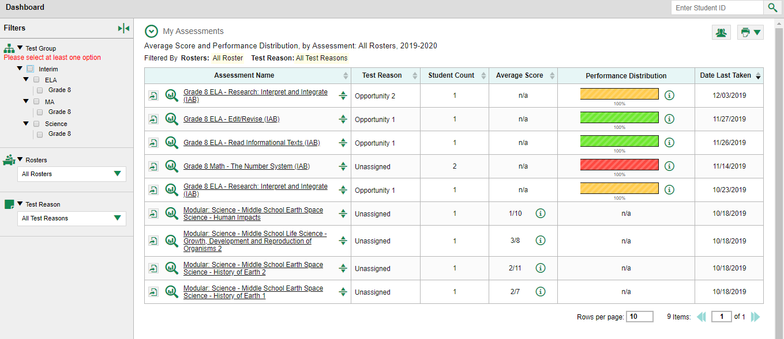
“Everything Interim”
Notes:
This portion of the training module is devoted to Interim Assessments and their unique reporting characteristics. The term “Interim” refers to any test that is not a summative, end-of-year, or end-of-course test. Interims may cover several academic standards or only one smaller content area or “benchmark.”
Depending on the type of tests administered by your state, interims may be fixed-form or computer adaptive in nature. A variety of interim assessments are displayed in the Assessments table on this slide. All the assessments in the table shown here are non-summative tests. You can also see the different types of tests reflected in the Test Group Filter menu to the left of the table.
Features and functions of Centralized Reporting vary depending on the type of non-summative test being administered.

Slide 37
Unique to Interims—Test Items and Their Uses
Notes:
The Centralized Reporting System allows the user to view the non-secure, non-public items on Interim assessments, along with student responses to those items. Viewing item-level information is what makes Centralized Reporting especially useful for classroom instruction. Teachers can see a student’s incorrect answer and then start a conversation with the student about where reasoning went off track.
This slide shows the My Student’s Performance on the Grade 8 ELA-Research: Interpret and Integrate (IAB). The teachers’ rosters are listed in the table. Sorting can be done by student count, test completion rate, or average scale score for quick analysis of the school’s test results.
The notable difference on a test results page for an Interim test is the table, which includes a collection of expandable columns related to the test items. Typically these columns appear as:
5 Items on which Students Performed the Best
5 Items on which Students Performed the Worst
A Total Items column

Slide 38
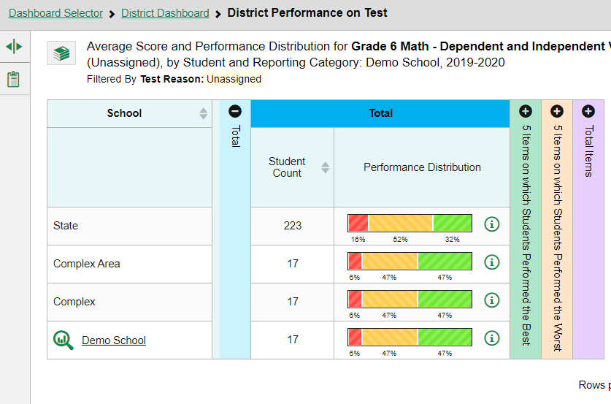
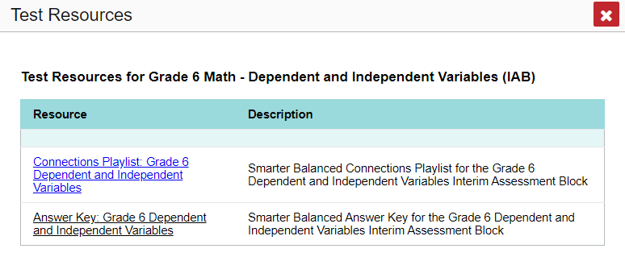
Test Resources: Connections Playlists and Answer Keys
Notes:
Clicking on the icon that looks like a stack of books will launch a list of Test Resources. These include the Smarter Balanced Connections Playlist for the Interim Assessment Blocks and a downloadable Answer Key for the Interim Assessment Block or Interim Comprehensive Assessment you are viewing. The Connections Playlist is intended to help educators advance student growth and provides “educator-recommended Digital Library resources that can supplement curriculum and other classroom activities” (Smarter Balanced, 2020).

Slide 39
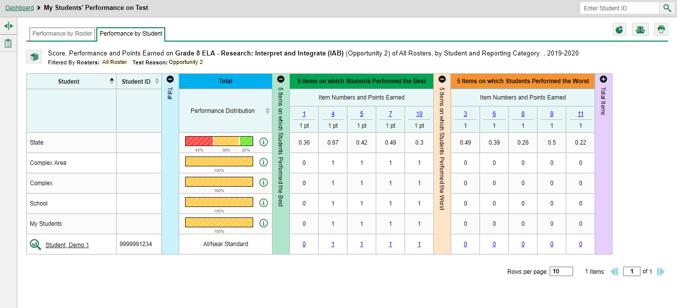
Analysis at First Glance—Interim Test Results Page
2
1
3
Notes:
Analysis is immediate after clicking any test in the assessments table. This example shows the results for a teacher who has chosen to view the Grade 8 ELA-Research: Interpret and Integrate (IAB) under the Performance by Student tab.
(1) The results of these students are shown in comparison with the State, Complex Area, Complex, School, and the teacher’s Students as a whole. Results are reported by Scale Score (not shown here) and by Performance Distribution.
In the expanded table headed, 5 Items on which Students Performed the Best, the item numbers are shown in blue and the maximum point value for that item is shown directly below. Here, users can see that the student on this roster performed best on items 1, 4, 5, 7, and 10.
(2) To see the item as it appeared on the test, click the blue numbered links under the heading: Item Numbers and Points Earned. To view an individual student’s response to that item, click the blue points earned value in the row to the right of the student’s name.
Click the + sign to open more categories of data.
(3) In order to view individual student data, click on the student’s name or the magnifying glass.

Slide 40
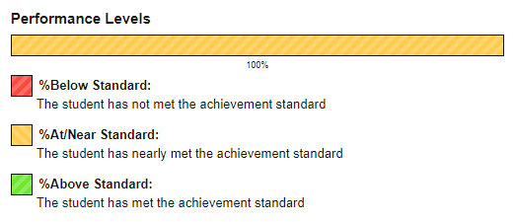
Student Performance—Single-Standard Assessment
Notes:
The test shown here, the Grade 8 ELA-Research: Interpret and Integrate Interim Assessment Block tests only one standard. The benchmark report table shows the Total performance levels, the five best items, and the five worst items. The teacher can get a good sense of where the students in the class excelled and where they need remediation.
Demo Student, the sample student, performed at or near the standard shown by Performance Levels legend for this test. The teacher can quickly see that this student needs help with items 3, 6, 8, 9, and 11. To view all his results, the teacher would click the plus button on the purple Total Items column.
Teachers need to thoroughly investigate their students’ incorrect answers, those with a zero in the student score link.

Slide 41
The Item View Window: Item Number Link
Item Number Link
Notes:
When the Item Number Link is clicked, the Item View Window appears as a pop-up box. The item is displayed exactly as it appeared on the test. Two tabs are at the top right corner of the window: Item & Score and Rubric & Resources.

Slide 42
The Item View Window: Student Score Link
Student Score Link
Notes:
When the Student Score Link is clicked, the item appears along with the student’s response. The window features a table at the top of the page that includes the Scoring Assertion and the Outcome for the test item. The Scoring Assertion states exactly what the student must do to earn the point value for the item. The Outcome box shows a checkmark for a correct answer, or an X for each incorrect answer. Some windows will display “Scoring Criteria” instead of “Scoring Assertion.”
Reviewing a student’s response in this window helps the teacher understand the reasoning behind the answer. It provides important clues into the struggles experienced by the student.

Slide 43
Student Score Link: Student Navigation Tool
Student Navigation Tool
Notes:
A quick way to find the other students who answered this item incorrectly is for the user to utilize the Student navigation tool at the top center of the page. Using the up/down arrows will display the results of other students who tested on that item. The teacher can identify those students who need remediation in that standard or utilize a reteaching strategy with that particular group.

Slide 44
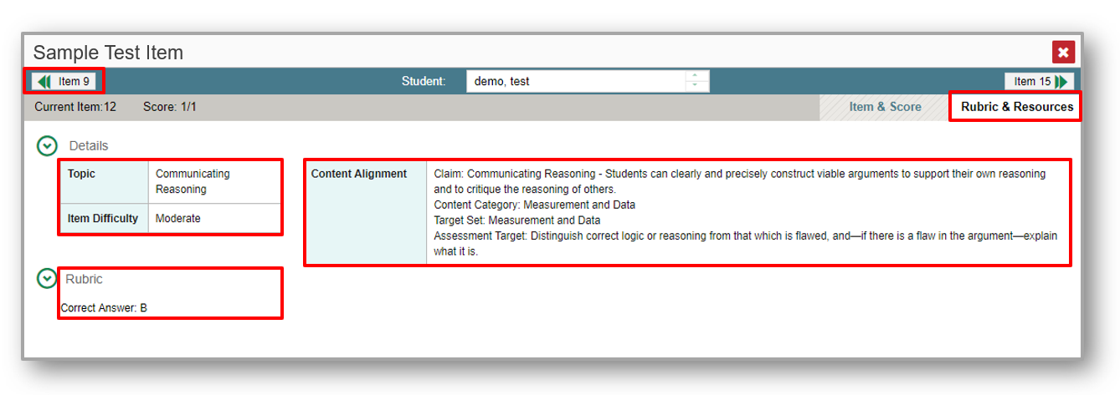
Rubric & Resources Tab
Notes:
The Rubric & Resources tab may include the following sections, which are expanded and collapsed with the circled arrows to the left. The sections included will vary, depending on the test item. In this sample rubric the Topic covered is Communicating Reasoning, and Item 12 is Moderate on the Item Difficulty scale.
The Content Alignment section describes, in detail, the academic or learning standard to which the item is aligned. The teacher needs to pay close attention to the students who are struggling with these standards.

Slide 45
Frequency Distribution of Student Responses
Notes:
The Frequency Distribution of Student Responses section of the Rubric & Resources page is especially helpful to users because it shows, at a quick glance, the number of a teacher’s (or a school’s) students on a roster and how many of them earned each number of points for the test item. In this example, one student earned the point for the item and two of the students did not.
Previous and Next arrows are positioned at the top right and left margins for ease of moving between item windows.

Slide 46
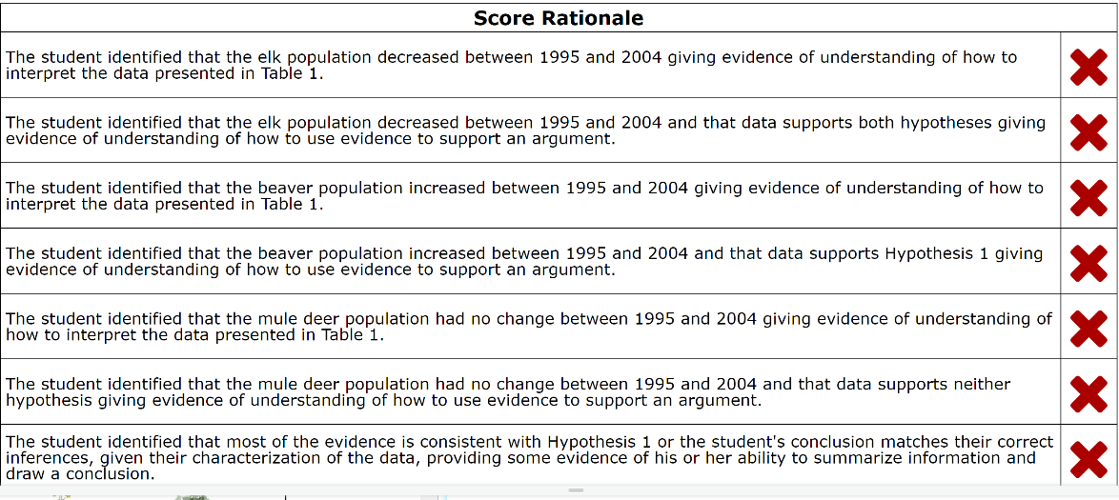
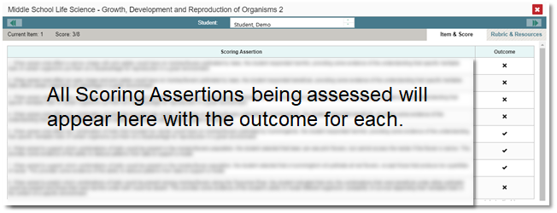
Multiple Scoring Assertions
Notes:
Some test items have Multiple Scoring Assertions. Typically these items feature a reading passage, along with graph images like a map, table, or illustration. Several test items are then associated with this prompt. Students are instructed to use what they have learned from the stimuli to perform the associated sub-item tasks.
This slide shows the Scoring Assertions window from question 1 on Growth, Development, and Reproduction of Organisms 2, a science interim test. It features a reading passage, a graphic, and eight sub-items. Each sub-item is worth 1 point. The sub-items are listed as 1-1, 1-2, 1-3, and so on. The information pop-up displays the scoring assertions associated with each of the sub-items. The Item & Score page shows all eight scoring assertions listed in that section of the page. It shows that this student answered 3 of the 8 sub-items correctly, #5-7.
In the top right, a table lists examples of scoring assertions from a training test for NGSS Science.

Slide 47
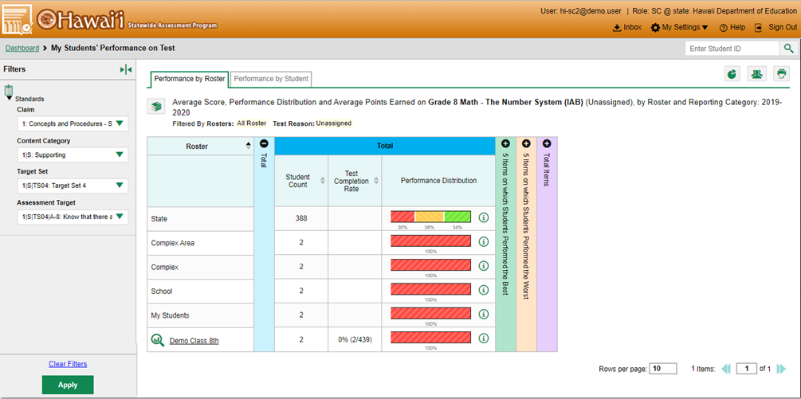
Filtering Results by Standards (a.k.a. Targets)
Notes:
Users will want to see how students performed on a particular claim, content category, target set, or assessment target. Certain reports can be filtered by the standard to which items are aligned. Utilizing this report is handy because it shows students’ performance in just ONE area of skill. If users do not filter by standard, reports show results for all standards, by default.
This slide shows a teacher and a list of the teacher’s classes.
Use the expansion arrows to open the Filters panel on the left margin and the standards button to open the Standards. The standards aligned to the Grade 8 Math-The Number System (IAB) assessment will drop down. Check the desired Claim, Content Category, Target Set, and Assessment Target and click Apply.
The affected report updates to show only data for those standards and/or the standard categories. These filter choices will become part of the assessment title at the top of every results table.

Slide 48
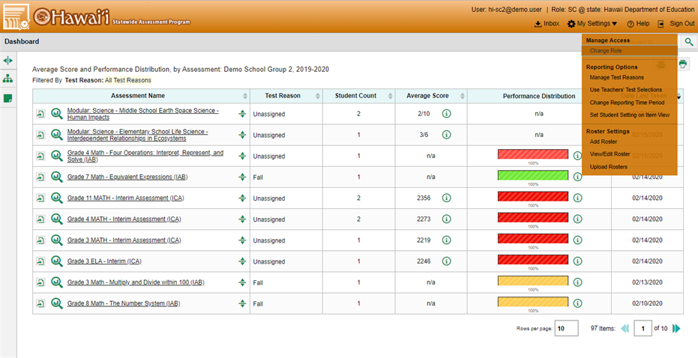
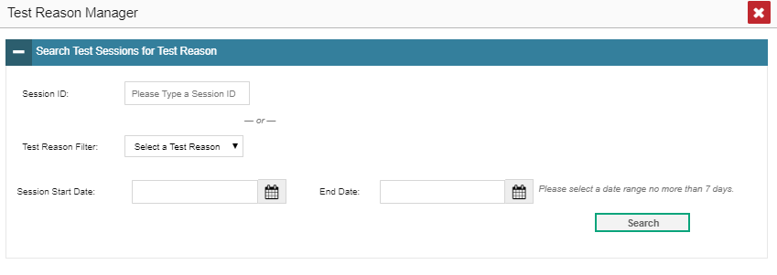
Assign Test Reasons
1
2
3
Notes:
There are two ways of setting up an Interim test report. One way is by filtering standards, which we just explained. The second way is to assign test reasons to interim test opportunities. Interim tests are often administered multiple times, and if assigned a test reason or a timeframe in which the test was taken, the data is easier to organize. Test reasons should ideally be assigned at the time of testing; however, users can utilize the Test Reason Manager to assign a different test reason.
From the My Settings drop-down list in the banner, select Manage Test Reasons.
The Test Reason Manager window opens. To search for test opportunities to categorize, do either of the following:
In the Session ID field, enter the session ID in which the opportunities were completed in the test delivery system (TDS).
Or, Select a Test Reason associated with the opportunities you want to edit. Then, select a range of dates during which the test session was administered. The range cannot exceed seven days.
(3) Then, click Search.

Slide 49
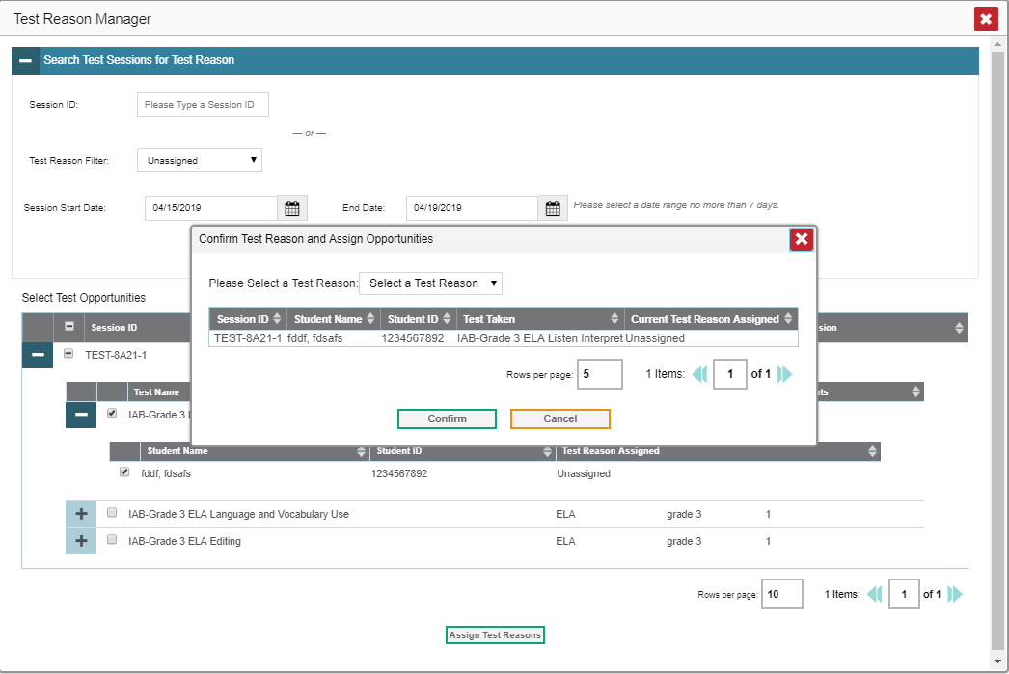
Assign Test Reasons (cont.)
5
1
6
3
2
4
Notes:
A list of retrieved test sessions appears in the section, Select Test Opportunities.
Click the + button(s) to expand the list of tests in each session and the list of students who took each test opens.
(3) Mark the checkboxes for each session, test, or opportunity that requires a test reason
(4) Click Assign Test Reasons.
(5) In the confirmation window, select a new test reason assign to the selected opportunities.
(6) Click Confirm
Assigning or re-assigning test reasons will make the Filter By Test Reason option much more useful.

Slide 50
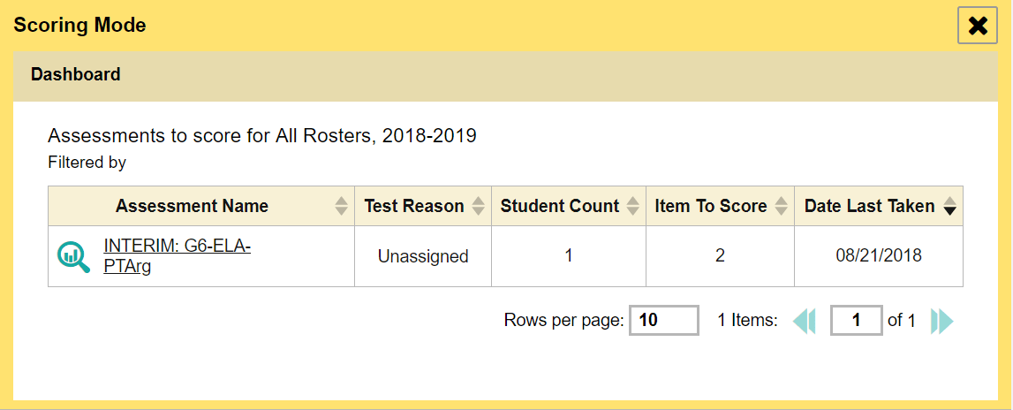
Enter Scores for Unscored Items
1
2
3
Notes:
The Centralized Reporting system allows users (with appropriate permission) to handscore unscored test items. It also allows modification of some automated scores suggested by the machine scoring system. If a test contains unscored items, its performance data is excluded from your Dashboard and Assessment Reports until you or another user with scoring permissions enters scores for all the unscored items in at least one opportunity of that test.
When you have tests awaiting item scoring, a Tests to Score notification appears in the banner. To enter scores for unscored items, click the Tests to Score notification.
The Scoring Mode window will open after clicking the Tests to Score notification and displays a list of tests with unscored items.
Click the magnifying glass icon next to the name of the test you wish to score.

Slide 51
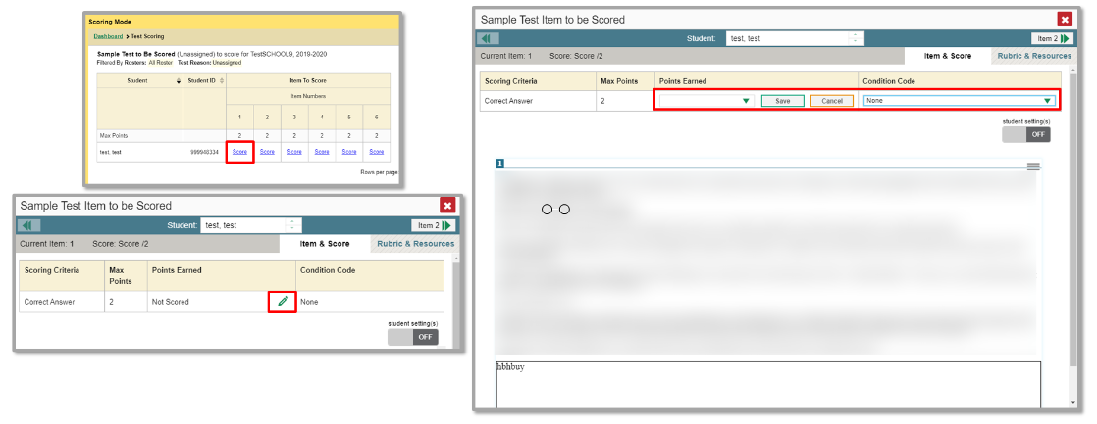
Enter Scores for Unscored Items (cont.)
1
3
2
Notes:
(1) The Scoring Mode window now displays a list of students and items awaiting scoring for the selected test. To enter scores for an item, click the score link for the item in the student’s row.
(2) The Item View window will open. You can review the item rubric and available resources on the Rubric & Resources tab, if necessary. On the Item & Score tab, review the student’s entered response for scoring. Click the pencil icon to display the points earned options and condition codes.
(3) To enter a score for the response, select or type a numerical score in the Points Earned drop-down menu and click Save.
If you need to assign a condition code to the response, select the appropriate option from the Condition Code drop-down list. Condition codes include instances such as blank or insufficient answer, off-topic or off-purpose answers, and the use of non-scorable language.
You can continue scoring unscored items in the Item Preview Window.
To view another unscored item for the same student, use the previous/next arrows on the left and right sides of the Item View banner.
To view the same unscored item for another student, use the up/down arrows in the Student field box in the center of the banner to switch between students.

Slide 52
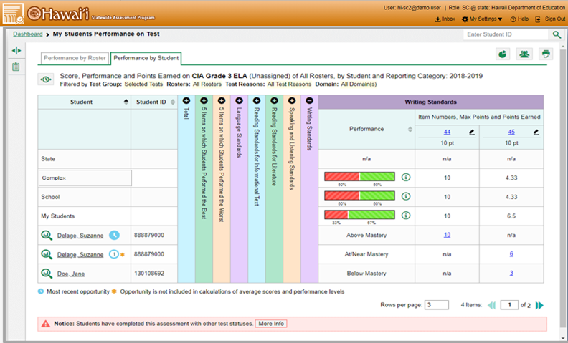
Modify a Score for an Item
Notes:
Users can modify scores for some items. Reports display a pencil icon in the column headers for each item with editable scores.
Click the item score link in the student’s row of the report. The Item View window opens.

Slide 53
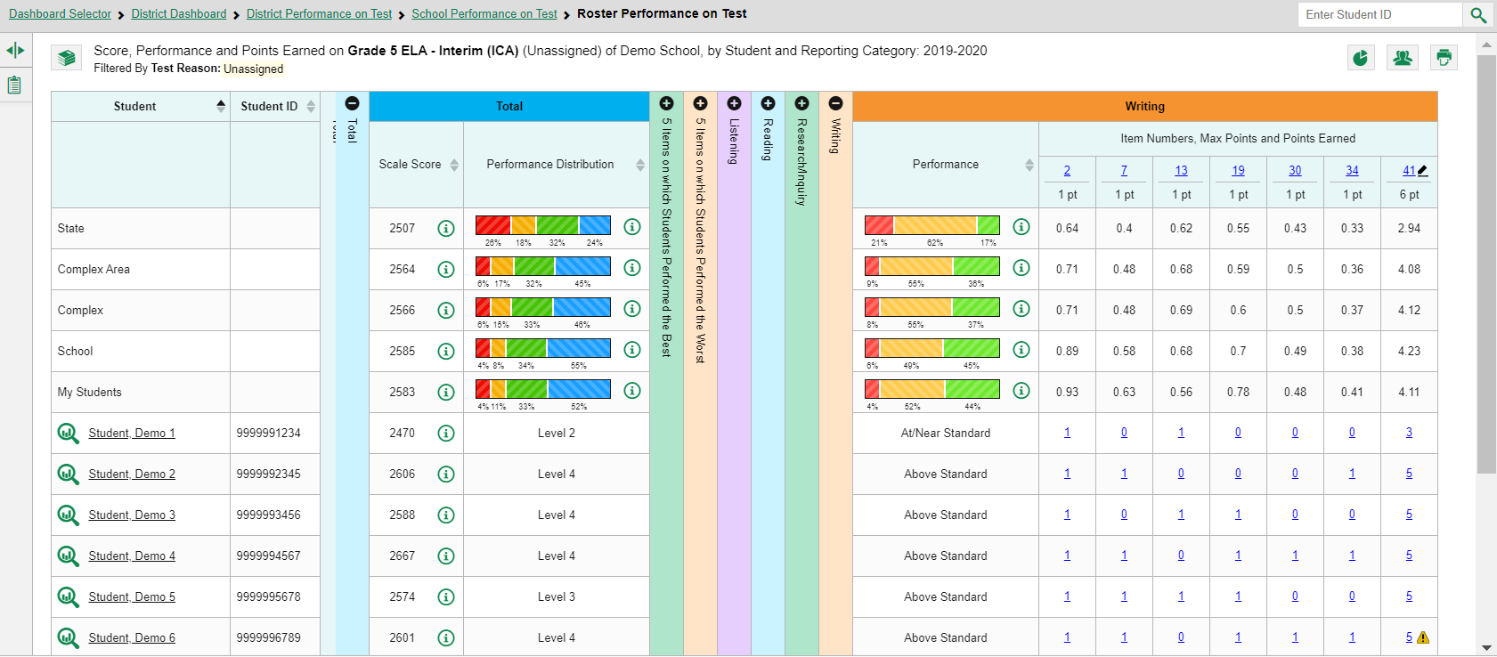
Low Confidence Scores
Notes:
If a machine-suggested score has a low confidence level, a yellow warning triangle appears next to the score number. It is highly recommended that teachers review low-confidence scores.

Slide 54
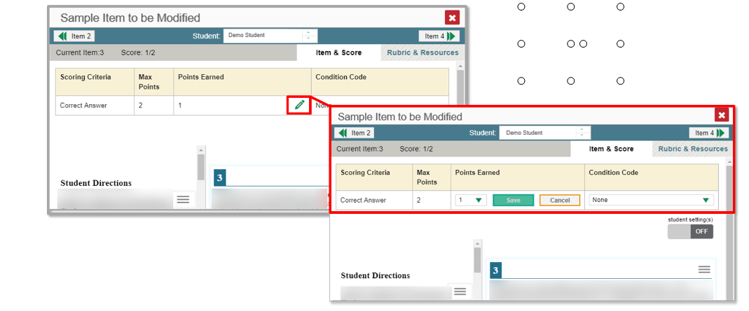
Modifying Scores (cont.)
Notes:
Click the pencil icon in the Scoring Criteria table.
To enter a score for the response, select a numerical score from the Points Earned drop-down list. If the item consists of multiple scoring criteria, select a numerical score from the score drop-down list for all scoring criteria. To save the score, click Save. When you close the item view window, any average scores or performance distributions on the assessment report update automatically.
Users can choose to assign a Condition Code in lieu of selecting the number of points earned.

Slide 55
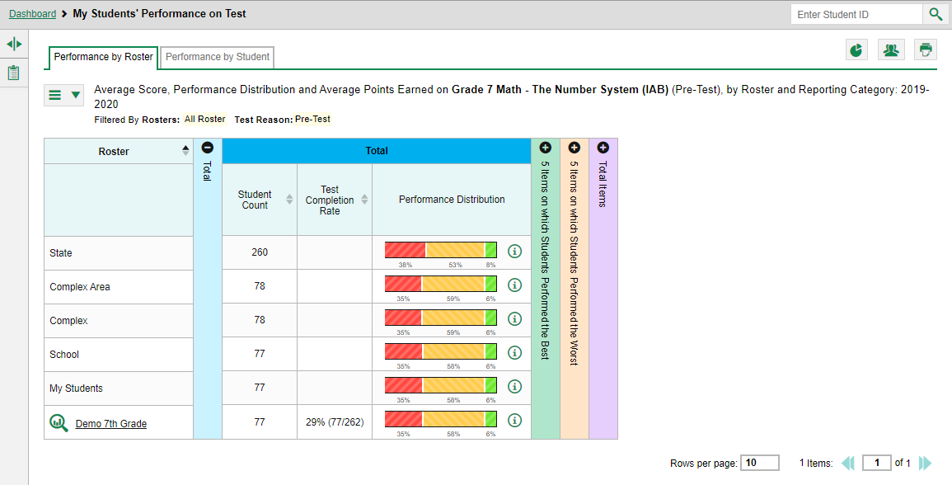
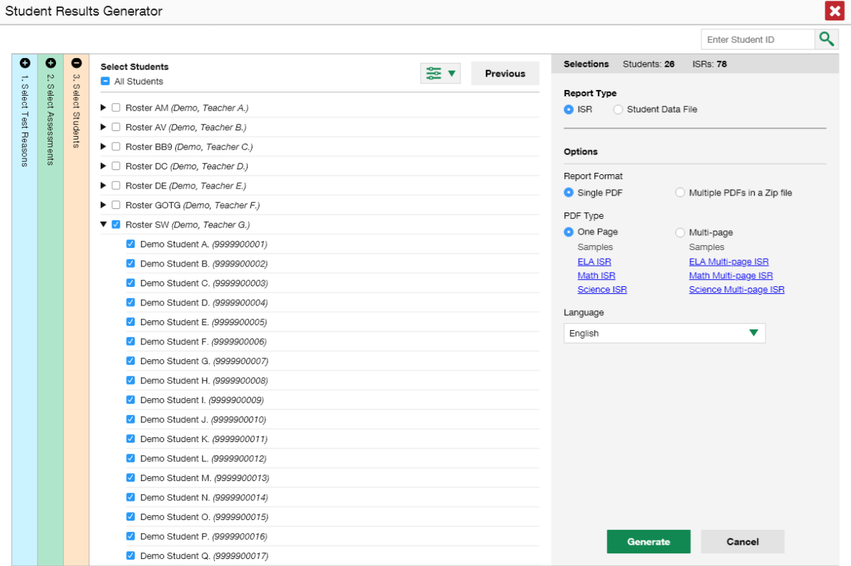
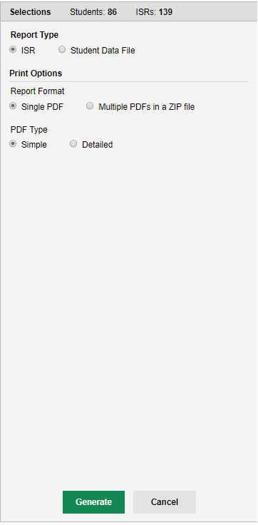
Generate and Print Individual and Batch Student Reports
1
3
2
4
5
6
Notes:
An Individual Student Report (ISR) shows a student’s overall performance on a test plus a breakdown of performance by topic. A user can select any combination of test reasons, assessments, and students in order to generate and export multiple ISRs at once.
The ISR Generator can be used to print large numbers of ISRs to be shared with students and their parents. It can be accessed from any page of test results.
The steps to generate an ISR are listed here:
(1) Navigate to the dashboard, the Student Portfolio page, or any set of test results.
(2) Click the Student Results Generator button in the upper-right corner of the page. The Student Results Generator window opens. The image on the right shows the Student Results Generator pop-up window from a School Performance on a Test page, listing several demo rosters, with student lists as a drop-down option.
(3) Click the Report Type, ISR.
(4) Starting at the left margin, click the section bars to expand the colored sections. Within each section, you must make certain selections: Select Test Reasons, Select Assessments, and Select Students. The image shows the Select Students tab expanded. A list of teacher rosters has been selected by a school administrator. Complex users will see a list of schools instead of classes.
(5) Choose the Report Format and the PDF type.
(6) Click the Generate button, and the new ISR(s) will be stored in the Inbox, available for downloading and printing.
Sample ISRs are shown on the next three slides.

Slide 56
Sample ISR—IAB—Math
Item Number
Difficulty Level
Points Earned Out of Maximum
Notes:
Shown here is an ISR for an interim assessment block, or IAB, in Math. Because it is an interim test, the items used in the assessment factor significantly in the score report.
The item numbers are listed below each topic heading in the far left column of test results. The middle column lists the difficulty of each item as Easy, Moderate, or Difficult. The far right column lists the number of points earned out of the maximum possible points for each item.

Slide 57
Sample ISR—Science Interim with Scoring Assertions
All scoring assertions that were assessed are listed here along with the outcome of each.
Notes:
When an interim item features more than one scoring assertion the sub-item numbers will be listed as 1-1, 1-2, 1-3, etc. under the Item # column. The table shown here describes the scoring assertion associated with each item number and displays the outcome as a checkmark or an X. A checkmark indicates that the student fulfilled the expectation and an X indicates that they did not.

Slide 58
The Student Data File
Student Results Generator
Notes:
Teachers and other users can choose to generate and print the Student Data File. This file includes the SAME information that the ISR details, but the report format is either a Microsoft Excel workbook file, a CSV file, or a text file. Printing reports in these formats will allow the user to use the features of Excel and word processing software to organize the data with a high degree of utility.
The setup instructions for a Student Data File are the same as for an ISR, except for the selections on the Report Type and Print Options panel on the right side of the Student Results Generator page.
This image shows the pop-up window that displays from a School Performance on Test results page. Rosters are identified by teacher name and the students display below, when each roster is dropped down.

Slide 59
Print or Export Data You Can View
Print Button
Export Button
Notes:
Users can print or export any data from Centralized Reporting. Use the print button (upper-right corner) to create a quick hard copy of any report or results displayed on the results page. The export button (to the left of each assessment on the dashboard) generates a detailed report of any specific test. Users may choose from a PDF file (a picture) or a CSV file (an Excel spreadsheet) and may choose to print test results with item performance or without it. The file will generate in the user’s Inbox and can be downloaded from there for up to 31 days.
Different options are available depending on the report being viewed.

Slide 60
Choices Available From the Print Button
Notes:
This slide shows the print choices for a teacher who is viewing My Students’ Performance on Test for the Grade 7 Math – Expressions and Equations (IAB). The table shows the one roster of students and their results. Zoom Levels (Normal, +1, +2, or +3) are only for previewing purposes. The teacher can choose to print the report with or without item scores and can choose a simple print or can save the report as a PDF or a CSV file. Clicking Confirm will bring up the printing page, or if PDF or CSV is chosen, the user’s Inbox will open.

Slide 61
Use the Inbox
3
1
6
5
4
2
7
8
9
Archive
Delete
Notes:
(1) The Inbox typically opens automatically after making report selections based on the choices available.
(2) Click on the name of the report to open it to a browser tab. Print as usual.
All ordered reports appear in a user’s Inbox.
(3) The Inbox button is found in the banner. The Inbox stores any PDF or CSV versions of reports, any file exports created in TIDE or the Online Reporting System (ORS), as well as secure files uploaded by administrative users. These files automatically expire after a designated period unless archived.
(4) The Archived button displays files that have been archived.
(5) To filter the files by keyword, enter a search term in the text box above the list of files. The table allows users to download, archive, and delete downloaded files. To download a file, click the file name in the Name column.
(6) To archive a file, click the file box icon in the Actions column. To delete a file, click the trashcan icon in the Actions column.
(7) The Days Available column displays how many days the report will be available for download before expiration.
(8) The System Labels and Custom Labels can be toggled on and off to Show or Hide these identifiers.
(9) The Show Tags button can be used to Save New Label or Apply Label.

Slide 62
Choices Available From the Export Button
Notes:
This slide shows the export choices for a teacher who has clicked the Export Assessment Data button for the Grade 7 Math IAB, The Number System from the teacher dashboard page. The user must choose a type of report with or without item performance, and a file type. Clicking the green button, Export Assessment Data, brings up a Confirmation Page that shows the name of the assessment, the type of report chosen, and the type of file chosen. Click Yes. The user’s Inbox will immediately open and display the report at the top of the inbox.

Slide 63
How Can I Get More Information?
You can contact the Aloha HSAP Help Desk for assistance with any technical issues you encounter.
When contacting the Help Desk, please be ready to provide:
Any error messages that are appearing (including codes)
Your operating system and browser information
Your network configuration information
Your contact information for follow-up by phone or email
Any other relevant information, such as test names or content areas, student IDs, session IDs, and search criteria
For test administration or policy issues, please contact your Complex Test Coordinator.
You can find more announcements on the Aloha HSAP portal.
Notes:
We hope this webinar has given you a solid, basic understanding of the enhanced features of the Centralized Reporting System. Watch for future announcements on www.alohahsap.org. A Centralized Reporting System User Guide will be posted there, along with a Quick Guide and an Information Brochure. You can also call or email the Help Desk with your questions.

Slide 64
Thank You!
Further Information: Centralized Reporting System User Guide, 2019-2020
Visit
alohahsap.org
https://smarterbalanced.alohahsap.org/
Call, fax, or email the HSAP Help Desk
Hours: 7:30 am to 4:00 p.m. HST, Monday-Friday (except holidays)
Phone: 1-866-648-3712
Fax: 1-877-231-7813
Email: HSAPHelpDesk@cambiumassessment.com
Notes:
Thank you for taking the time to attend this webinar. For detailed information, consult your Centralized Reporting System User Guide, 2019-2020, located at www.alohahsap.org, or contact the HSAP Help Desk.

