Slide 1
How to Print and Export Data You Can See in Your Reports
Centralized Reporting System Training Module Series #2
Copyright © 2020 Cambium Assessment, Inc. All rights reserved.
Notes:
Welcome to training module #2 in the Centralized Reporting System series: How to Print and Export Data You Can See in Your Reports. In this training module we show you how to print and export your reports directly from the dashboard and any page of test results.

Slide 2
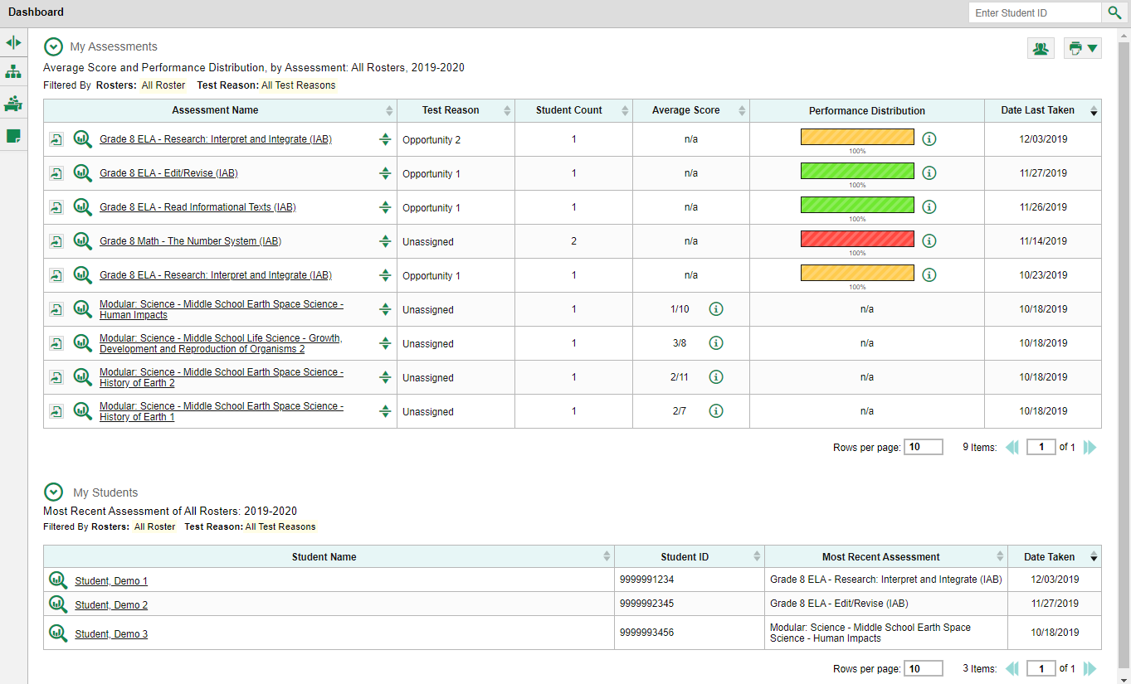
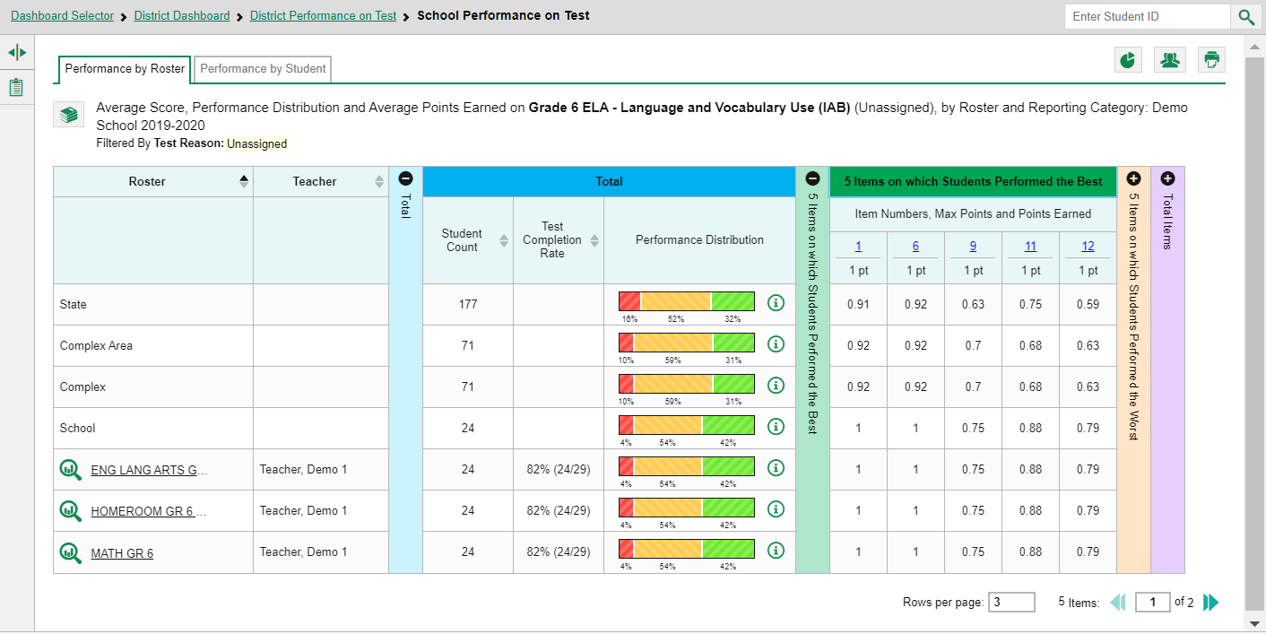
2
Print Button
Dashboard
Report Page
Export Button
1
2
Print Button
Notes:
Providing two buttons with similar options makes it convenient, no matter where you are in the Centralized Reporting System, to print or convert the report you need. The (1) Export button allows you to convert a test report into a PDF or CSV format and save it to your Inbox. The (2) Print button allows you to print a hard-copy of the dashboard tables and any report pages, AND it allows you to convert the report to PDF or CSV, just like you can with the Export button. The (1) Export button only appears on the dashboard, to the left of the name of the assessments in your dashboard table, as shown here. The (2) Print button appears on the dashboard and on all test report pages in Centralized Reporting. First, we show you how the Print features work, including the file conversion options under that button. Then we show you the pop-up windows that appear under the Export button.

Slide 3
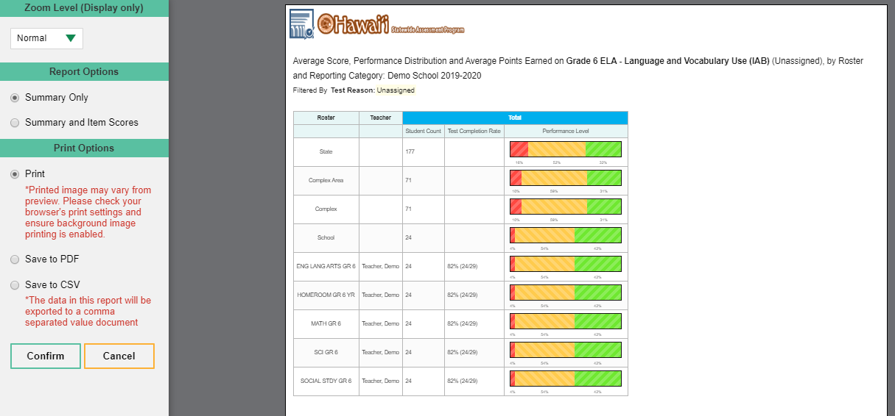
Print Button
1
Print Preview—Summary Only
Options Panel
3
2
4
5
7
6
Notes:
To print a page you are seeing on your screen, click the (1) Print button in the upper-right corner. A (2) print preview page opens, with an (3) options panel on the left. The options include (4) Zoom Level, (5) Report Options, and (6) Print Options. In the example here, you see a School Performance on Test report for the Grade 6 ELA – Language and Vocabulary IAB. There are five rosters on the report. The print preview page displays exactly what will print if you confirm the selections in the options panel. To zoom in on the print preview, use the (4) Zoom Level section in the option panel on the left. This setting affects the preview only, not the printed report. When the report includes data for individual assessment items like this one, the (5) Report Options section displays two selections, Summary Only and Summary and Item Scores. Select either Summary Only (shown here) or Summary and Item Scores (shown in the next slide). The Summary Only includes the data performance from the blue (7) Total column of the test report.

Slide 4
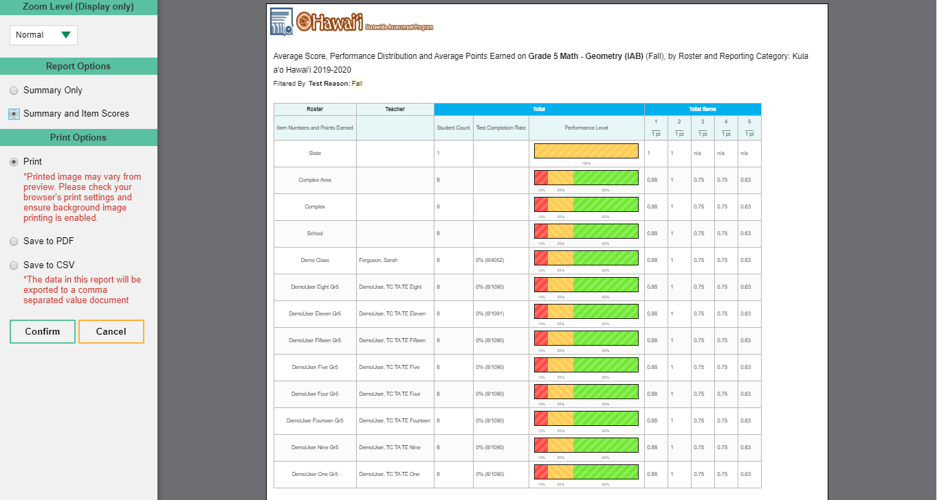
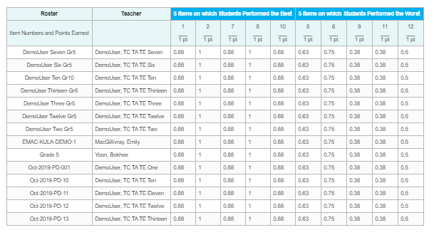
Print Button
1
Print Preview—Summary and Item Scores
3
4
2
Notes:
After clicking the (1) print button in the upper-right corner of the page, if you click on the (2) Summary and Item Scores option under Report Options, the report you see will include the (3) blue total column of the test report, as well as data for the (4) individual assessment items.

Slide 5
Print Preview—Complex Performance on Test Report—Summary and Item Scores
Click to confirm your selections
Notes:
You can choose from three report formats under the Print Options section: print, save to PDF, or save to comma-separated values (CSV). Choosing print will simply print the report. A PDF file is a picture of the report and is compatible with all platforms. The CSV file is a workbook application, like Excel, which allows you to sort and organize large amounts of data. Both the Save to PDF option and the Save to CSV option will result in a report being sent to your secure inbox, which is shown on the next slide. Make your selections and click Confirm. Your print preview window will display, and you will be able to make selections regarding layout (portrait or landscape) and which pages of the report you would like printed.

Slide 6
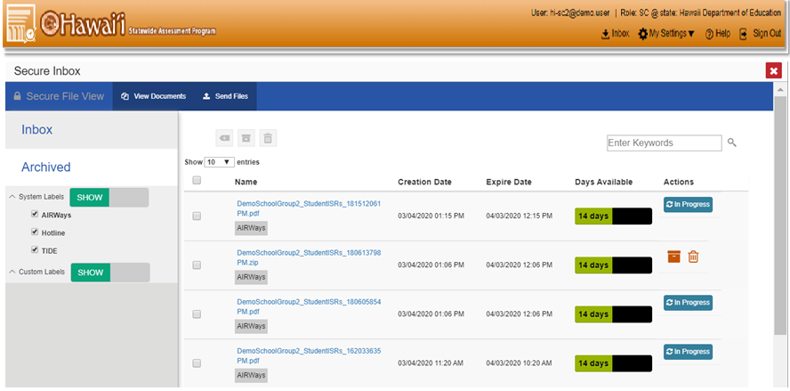
1
2
EXCEL
3
Notes:
If you saved the report as a PDF or CSV, the Inbox appears, displaying the generated report. Here is a sample of the Inbox, which stores your PDF and CSV files. These files automatically expire after a designated period. To access the (1) Inbox click the icon in the banner. Click the (2) name of the file to download it. For more information on the functions of the Inbox, refer to the appendix section of the Centralized Reporting System User Guide, posted on the Aloha HSAP Portal website. A sample (3) Excel file is shown on this slide. Now we show you how to convert your reports using the Export button.

Slide 7
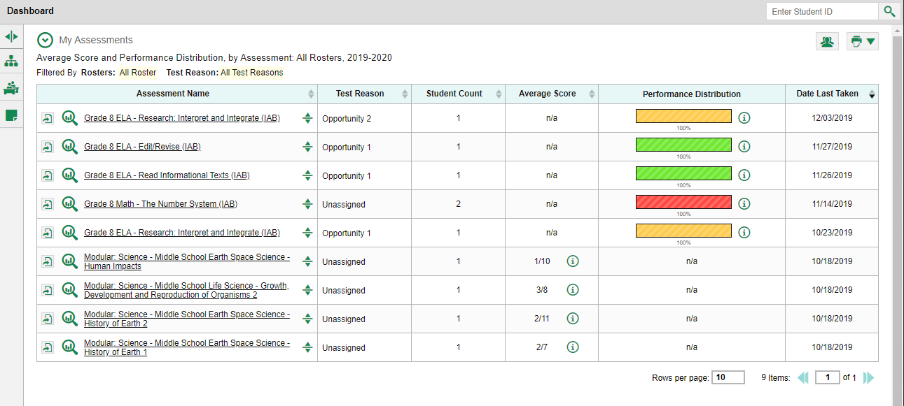
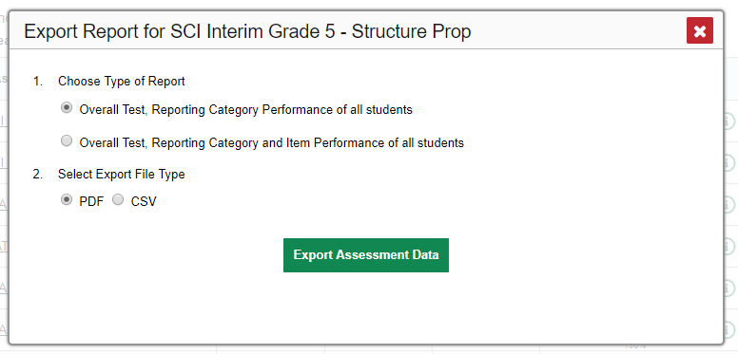
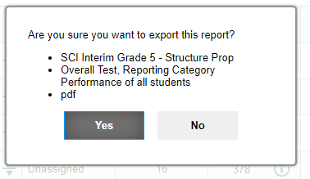
Export Options for Teachers and School Users
2
3
Export Button
4
1
5
Notes:
As mentioned previously, the export function is available on the dashboard. Reports for interim assessments include item-level data, so teachers and school-level users have a choice of short summary reports or reports including item performance data. This slide shows the pop-up windows that teachers and school users see. Click the (1) export button to the left of the magnifying glass, which will open up the (2) Export Report window. Make your selections regarding the type of report you would like to see and click the (3) Export Assessment Data button. A (4) confirmation window appears. Review your selections and click (5) Yes to send the report to your Inbox or No to return to the Export Report options window. Now we show you the pop-up windows for complex users.

Slide 8
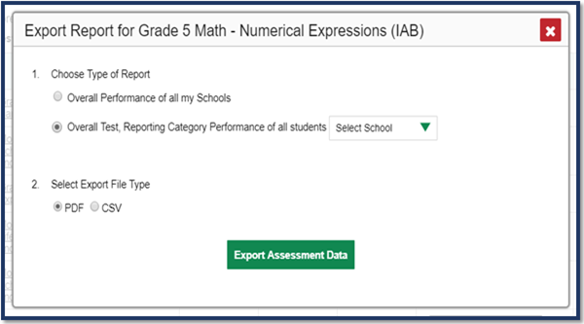
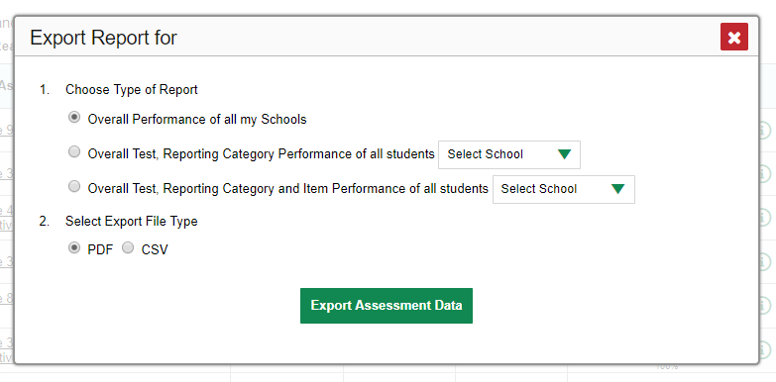
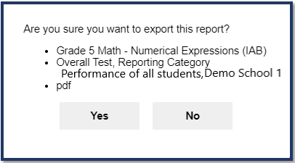
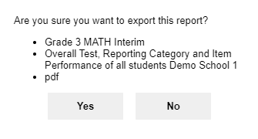
Export Options for Complex Users
Without Item-Level Data
With Item-Level Data
Grade 3 Math Interim
1
1
2
2
3
3
Notes:
Complex users see a (1) school drop-down menu on their Export Report windows, allowing them to select a single school in the complex. Export Report windows display as two different versions, one for reports without item-level data and one for reports with item-level data. Reports without item-level data (on left) display two choices under section #1: a report for all the schools in the complex or a report for a specific school in the complex. Reports with item performance data (on right) display three choices: the two just described and an additional option to generate a detailed school report including item-level results. Choose to export a (2) PDF or CSV file and click the (3) Export Assessment Data button. The process then proceeds as we explained it for teachers.

Slide 9
Centralized Reporting System Training Module Series
1. How to Print ISRs and Student Data Files
2. How to Print and Export Data You Can See in Your Reports
3. How to Use the Roster Manager to Add, Modify, and Upload Rosters
4. How to Analyze Item-Level Reports
5. How to Hand-Score Unscored Items and Modify Machine Scores
Notes:
Thank you for viewing this training module on printing and exporting reports in Centralized Reporting. More training modules are posted on the Aloha HSAP Portal website. You may also consult the Centralized Reporting System User Guide.

