Slide 1
Online Testing System Assessment Viewing Application (AVA)
Training Module
2020–2021
Copyright © 2020 Cambium Assessment, Inc. All rights reserved.
Notes:
Welcome to the Assessment Viewing Application (AVA) training module.
AVA is a component of the online testing system that allows authorized users to view interim assessments for administrative or instructional purposes.
This training module is designed to help you navigate AVA; however, you should consult the Assessment Viewing Application User Guide located on your state portal for features implemented by your state.

Slide 2
Objectives
After viewing this presentation, you should understand how to
Log in to AVA;
Access the assessments; and
Navigate through the test.
Notes:
After viewing this presentation, you should understand how to
log in to AVA;
access the assessments; and
navigate through the test.

Slide 3
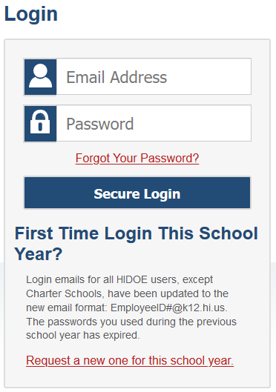
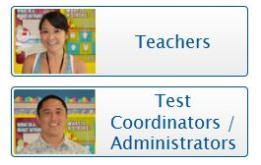
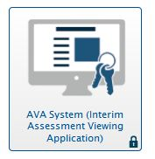
Logging in to AVA
Notes:
To log in to AVA, you must have an authorized email address and password, which are the same as the ones you use for the Test Information Distribution Engine (TIDE) and the Test Administrator (TA) Interface. Contact your School Test Coordinator if you do not have a TIDE account.
To log in to AVA, go to the AlohaHSAP.org portal. Click the appropriate assessment card, then the appropriate user role. On the next page, click the AVA System card. Enter your email address and password, and then click Secure Login.

Slide 4
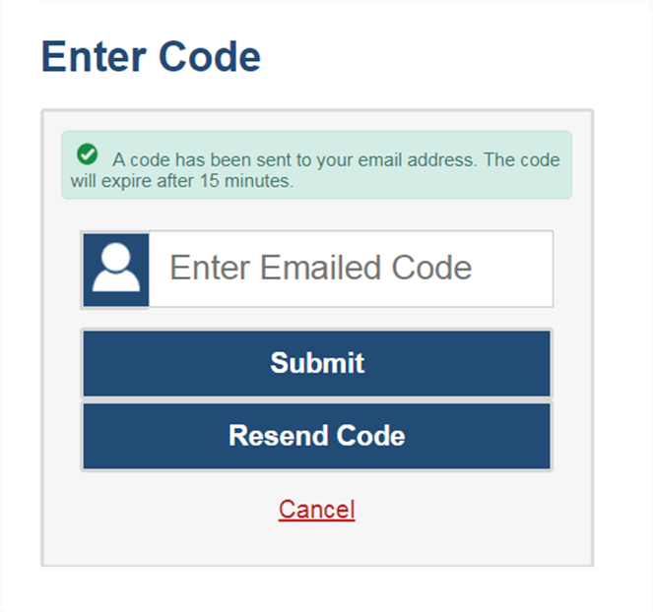
Logging in to AVA (continued)
The system has an authentication process that will be triggered when you log in from a different device or browser, or after clearing your browser’s cache.
If you see this screen, an email containing the code will have been sent automatically to your email address.
Enter the code and click Submit.
If you need the code resent, click Resend Code.
Notes:
When logging in to the system using a new device or browser, or after clearing the cache on a previously-used browser, you will see an Enter Code page.
If you see this screen, you will need to enter the code on this page within fifteen minutes of receiving the email. If you do not receive a code or do not enter the code within the fifteen-minute time limit, click Resend Code. Click Submit after entering the authentication code to access the system.

Slide 5
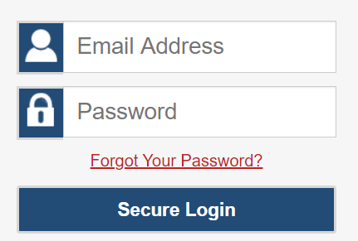
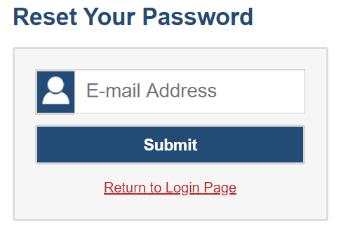
Resetting Your Password
Notes:
If you forget your password, you will need to reset it in order to access AVA.
You may need to reset your password in the following situations:
You forgot your password.
Your activation link expired.
Your account is locked because you exceeded the account login attempt limit.
It is a new school year.
To reset your password, click the Forgot Your Password? link. You will be taken to the Reset Your Password page. Enter your email address and click Submit.

Slide 6
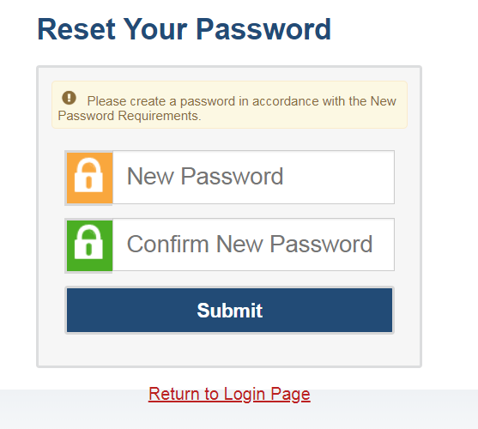
Resetting Your Password (continued)
Passwords must meet the following conditions:
Be at least eight characters long
Contain at least one lowercase alphabetic character
Contain at least one uppercase alphabetic character
Contain at least one number
Contain at least one special character
Notes:
Next, you will receive an email with an activation link. After you click the activation link, you will be taken to the Reset Your Password page.
In the New Password and Confirm New Password fields, enter a new password. The password must be at least eight characters long and must include at least one lowercase alphabetic character, one uppercase alphabetic character, one number, and one special character.

Slide 7
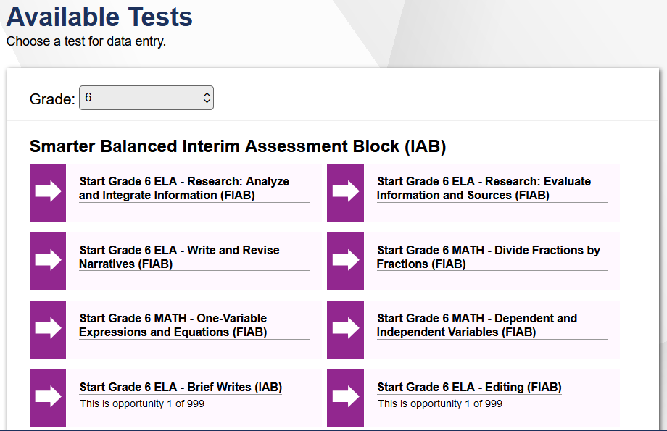
Choosing a Test and Grade
Notes:
After logging in, the Available Tests page will appear.
From the Grade drop-down list, select the desired grade level to view the available tests for the selected grade. Next, click the test name you want to view. The Choose a Test Form page will appear.

Slide 8
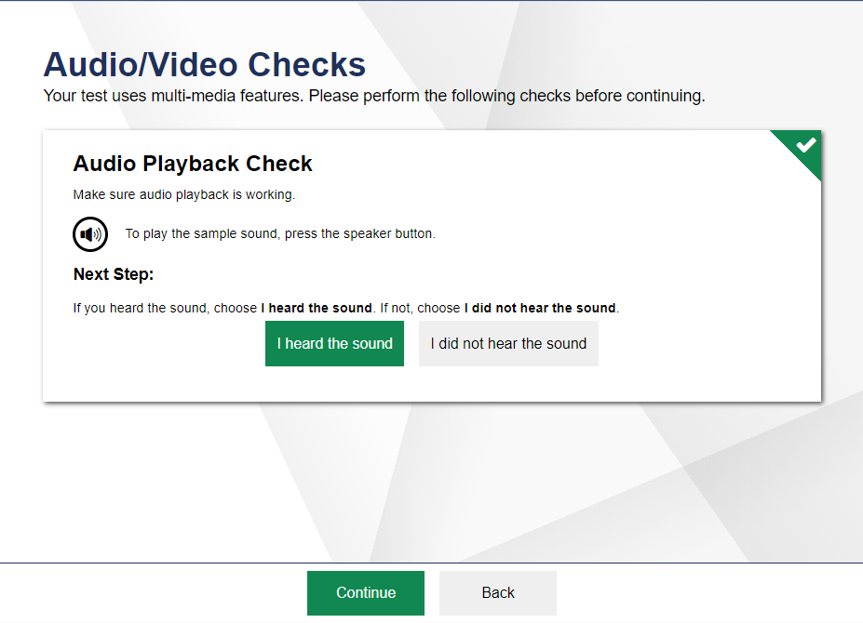
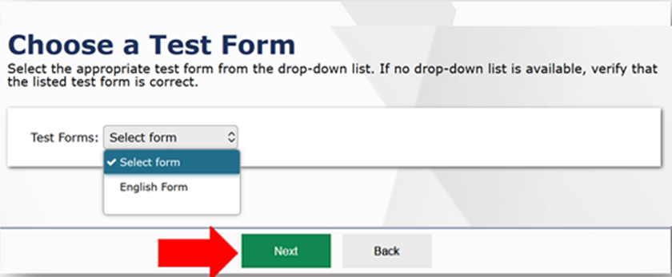
Confirming the Test
Notes:
The Choose a Test Form page will display one or more test forms. If the Test Forms drop-down list is available, select the appropriate form. If the drop-down list is not available, verify that the correct test is listed in the Test Forms field.
Click Next. If the test includes audio or video features, the Audio/Video Checks page will appear. If the test does not include audio or video features, the first page of the test will appear.

Slide 9
Audio Playback Check
Notes:
The Audio/Video Checks page allows you to verify the functionality of any audio and video features the test may include. Each functionality check will appear in a separate panel on the Audio/Video Checks page.
To perform the Audio Playback Check:
First, make sure that the speakers on your computer are not muted and your volume is set appropriately. Then, in the Audio Playback Check panel, click the speaker (or the ear) icon to hear a sample sound. If you hear a sound, click I heard the sound. Click Continue. The first page of the test will appear. If you do not hear a sound, click I did not hear the sound and consult your technology coordinator for assistance.

Slide 10
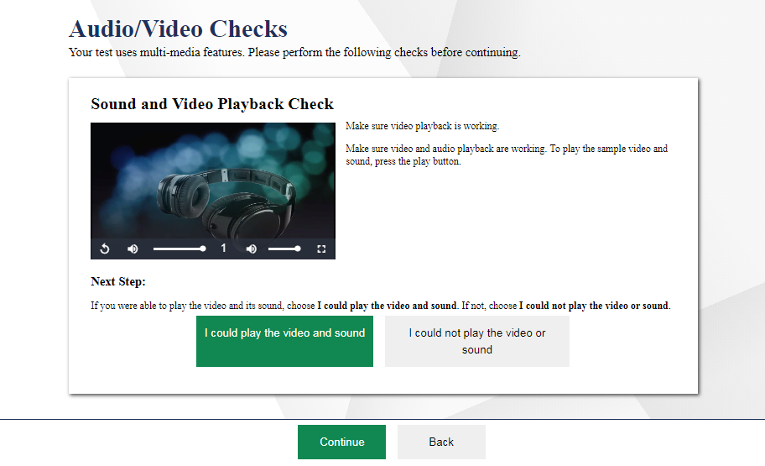
Sound and Video Playback Check
Notes:
On tests that contain video, you will see a Sound and Video Playback Check panel.
To perform the Sound and Video Playback Check:
Click the play button to play the video and audio.
If you can see the video and hear the audio, click the I could play the video and sound button to proceed.
If you cannot see the video and/or hear the audio, click the I could not play the video or sound button and consult your technology coordinator for assistance.

Slide 11
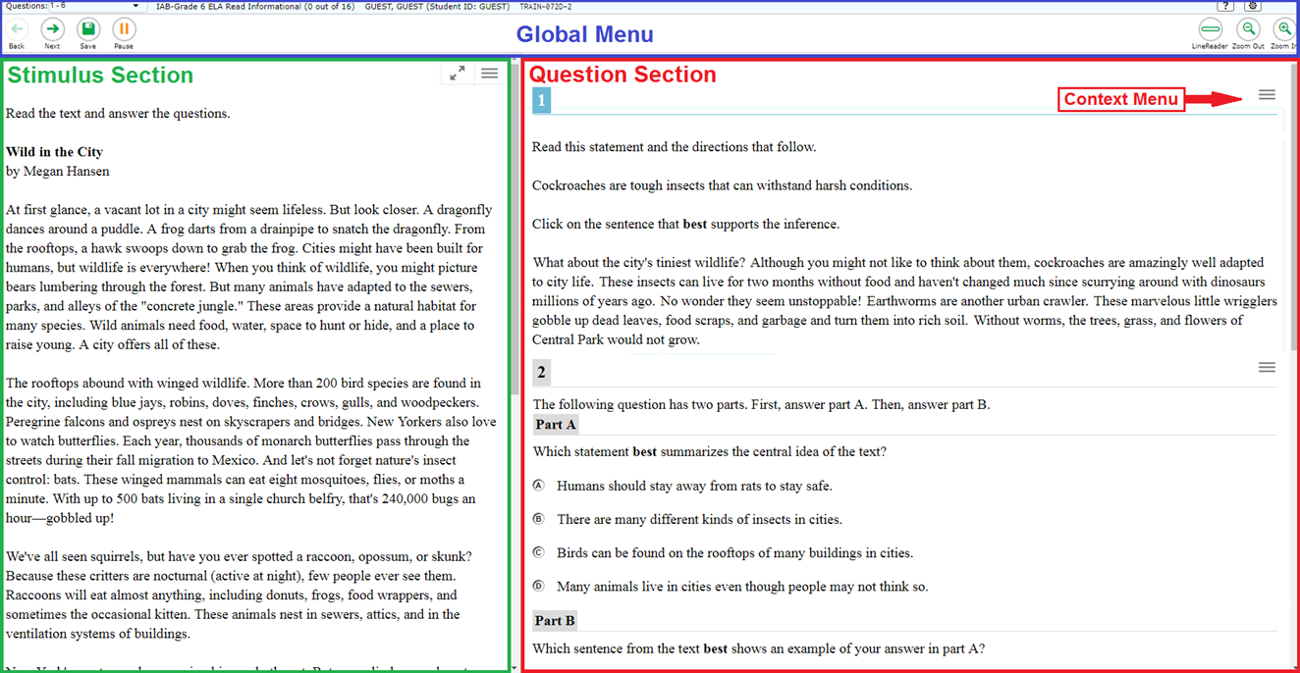
Understanding the Test Page
Notes:
This slide displays a sample test page.
AVA includes several on-screen tools, including global tools and context menu tools.
Global tools are available on every page in the banner. These include the Back, Next, Save, and Zoom buttons.
The context menu displays the tools available for that test item.
For a detailed list of tools, consult your Assessment Viewing Application User Guide.

Slide 12
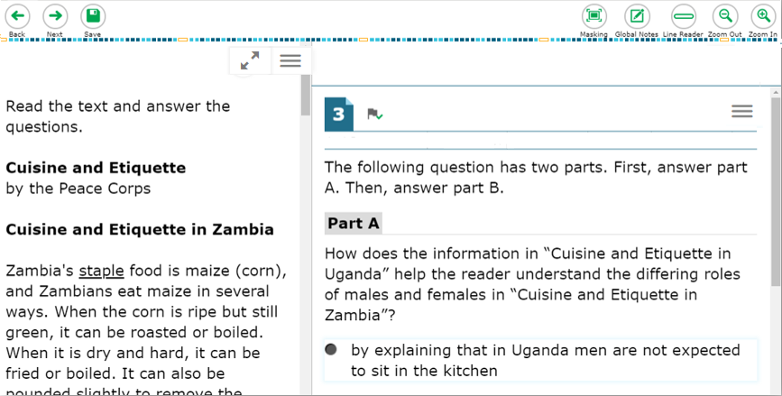
Responding to Items
Notes:
Next, we will discuss how to navigate a test, pause a test, and complete a test review.
When viewing a test, you can practice responding to each test item. You must respond to all items on a page before advancing to the next page. Pages may have only a single item, or they may contain multiple items. Responses you enter will not be scored when you complete the test review.

Slide 13
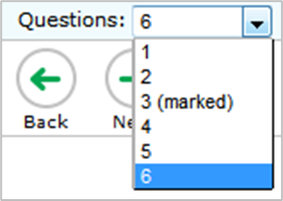
Navigating to Items
Notes:
You can navigate to items page-by-page or jump directly to an item’s page.
To navigate page-by-page, click the Back or Next buttons at the top of the screen.
To jump directly to an item page, select the appropriate item from the Items drop-down list. The Items drop-down list contains all items completed thus far and displays a blue flag for items that have been marked for review.

Slide 14
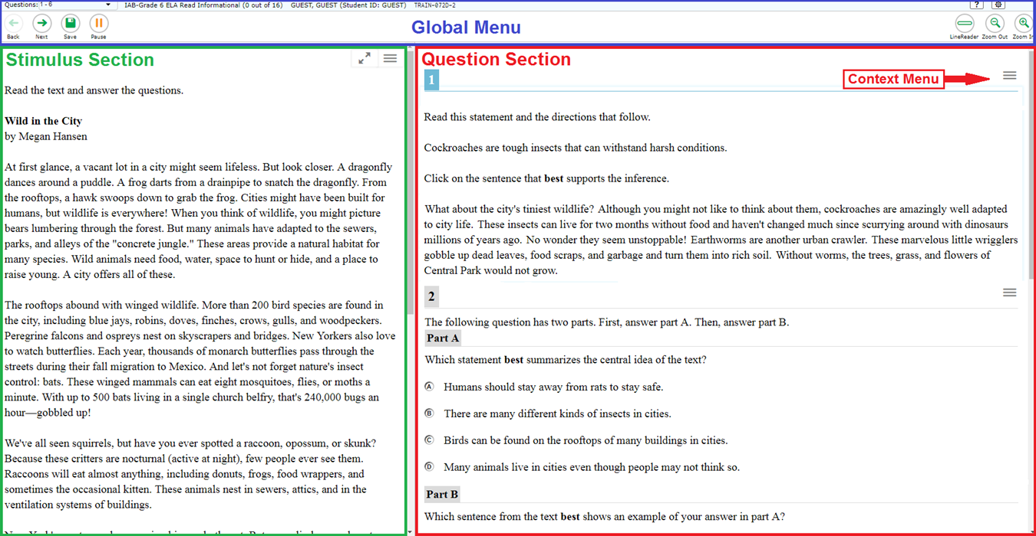
Pausing Tests
Notes:
You may pause the test at any time. Pausing the test automatically logs you out of AVA. To return to the test, you must log in and select the appropriate test again. Your progress will not be saved; when you return to the test you will be taken to question one.
To pause the test, click Pause in the Global Menu. A “log out” message will appear. Click Yes to confirm that you want to pause the test.
As a security measure, you are automatically logged out and your test is paused after 20 minutes of inactivity.

Slide 15
Finishing the Test Review
Notes:
After viewing all items in a test, the Finished button will appear at the top of the page. When you click Finished, a pop-up message will appear. Click Yes to complete the test review, or click No to continue reviewing the test.

Slide 16
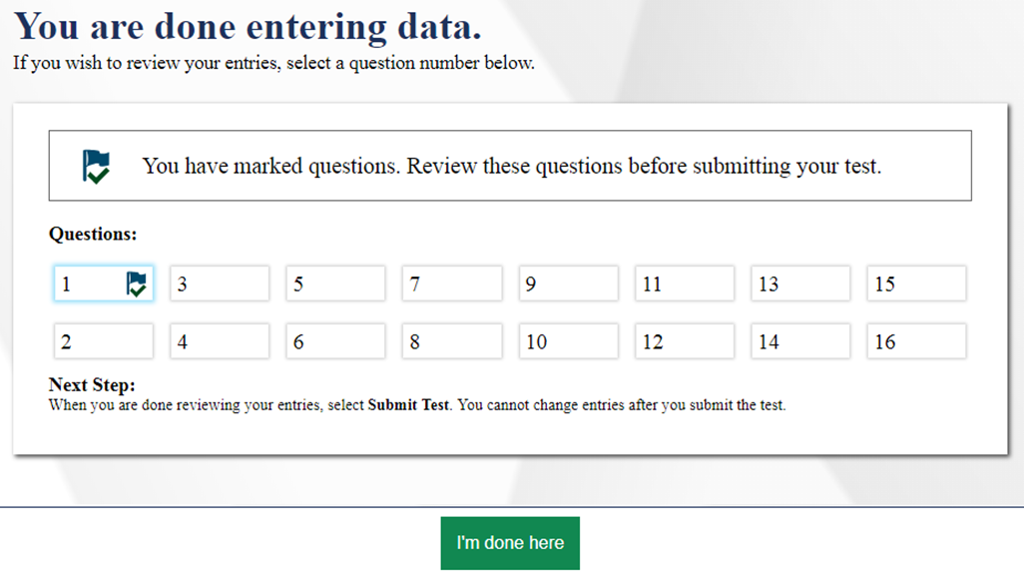
Reviewing Marked Items
Notes:
After finishing the test, you will have one more opportunity to review items. Click an item number to return to and review that item. You can navigate through the test as before. Click the Finish button to return to the review page at any time.
When you are finished reviewing, click I’m Done Here.

Slide 17
Completing the Review
Notes:
You will be asked one more time to confirm that you are done viewing the test. Click No to return to the review page, or click Yes to complete the test.

Slide 18
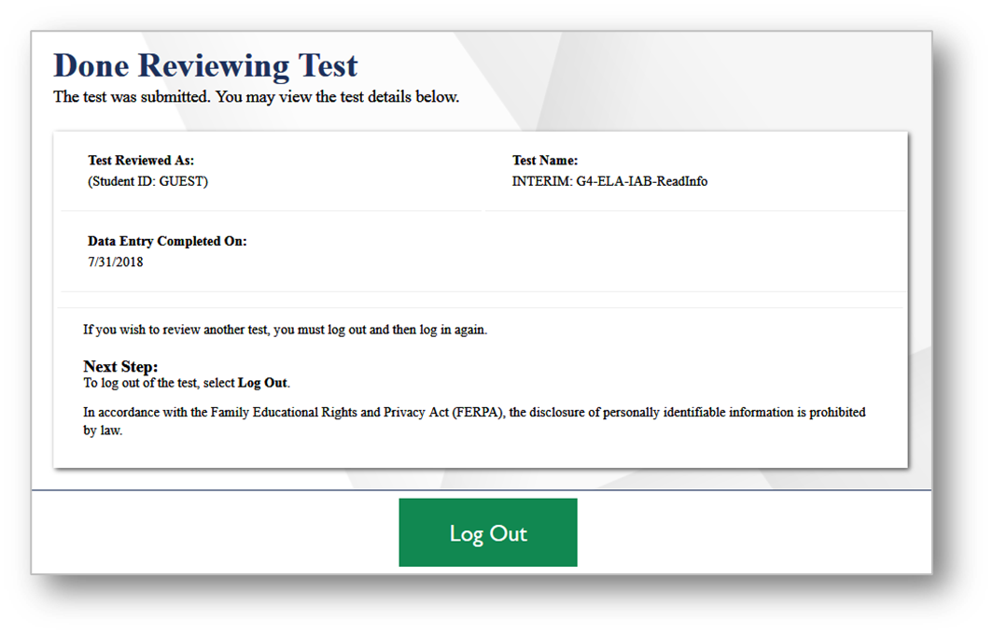
Logging Out
Notes:
The Done Reviewing Test page displays a confirmation that the test review is over. Click Log Out to return to the AVA Login page.

Slide 19
Thank You!
Further Information
Documents
The full Assessment Viewing Application User Guide can be found on the AlohaHSAP.org portal.
Further information regarding Interim Assessments and their use can be found in the Smarter Balanced and NGSS Interim Assessment Fact Sheets on the AlohaHSAP.org portal.
Interim Assessment Answer Keys can be found in TIDE under the “General Resources” link in the TIDE Navigation Bar.
Visit
alohahsap.org
smarterbalanced.org
Call, fax, or email the HSAP Help Desk
Hours: 7:30 am to 4:00 p.m. HST, Monday-Friday (except holidays)
Phone: 1-866-648-3712
Fax: 1-877-231-7813
Email: HSAPHelpDesk@cambiumassessment.com
Notes:
Thank you for taking the time to view this training module. The full Assessment Viewing Application User Guide can be found on the AlohaHSAP.org portal.
Further information regarding the Interim Assessments and their use can be found in the Smarter Balanced and NGSS Interim Assessment Fact Sheets, available on the AlohaHSAP.org portal.
The Interim Assessment Answer Keys can be in TIDE under the “General Resources” link in the TIDE navigation bar.

