Slide 1
Technology Requirements for Online Testing
Training Module
2020–2021
Copyright © 2020 Cambium Assessment, Inc. All rights reserved.
Notes:
Welcome to the Technology Requirements for Online Testing training module. This presentation is designed to help Technology Coordinators prepare for the administration of online tests.

Slide 2
Objectives
By the end of this presentation, you should be able to:
Prepare for online tests at your school by completing the four steps to set up technology for online testing
Install the Secure Browser
Troubleshoot technical problems during the tests
Notes:
By the end of this presentation, you should be able to:
Prepare for online tests at your school by completing the four steps to set up technology for online testing;
Install the Secure Browser; and
Troubleshoot technical problems during the tests.

Slide 3
Topics Covered in This Module
To set up online testing technology in your schools, complete these four steps:
Step 1: Set up Test Administrator (TA) workstations
Step 2: Set up student workstations
Step 3: Configure your network
Step 4: Configure assistive technologies
Notes:
In order to set up online testing technology in your schools, there are only four steps to complete:
Step 1: Set up Test Administrator (Examiner) workstations
Step 2: Set up student workstations
Step 3: Configure your network
Step 4: Configure assistive technologies

Slide 4
Setting Up the Test Administrator Workstation
Nearly any modern device, including mobile devices like tablets, with any modern browser can be used to access the TA site and administer a test session.
The TA Interface is a website. Any device you already use to check your email and access the Internet should be capable of administering tests.
TAs can print test session information or test items for students with the print-on-request accommodation. To be able to print, TA workstations must be connected to a printer.
If your school uses a firewall or other networking equipment that blocks access to public websites, you may need to add Cambium Assessment, Inc. (CAI) websites to the allowlist.
Notes:
The first step in setting up online testing technology is to set up your TA workstation. It is unlikely that any setup is required for your TA workstations. Nearly any modern device, including mobile devices like tablets, with any modern browser can be used to access the TA site and administer a test session. Because the TA Interface is a website, any device you already use to check your email and access the Internet should be capable of administering tests.
TAs can print test session information or test items for students with the print-on-request accommodation. To be able to print, TA workstations must be connected to a printer.
If your school uses a firewall or other networking equipment that blocks access to public websites, you may need to add Cambium Assessment, Inc. (CAI) websites to the allowlist. For a list of websites you should add to the allowlist, see the configuration guide for your operating system.
Next, we will discuss step two: setting up student workstations.

Slide 5
Setting Up Student Workstations
Each student workstation needs the CAI Secure Browser installed on it.
The Secure Browser is CAI’s customized web browser designed to keep tests secure by locking down the student desktop and preventing the students from accessing anything except their tests.
The Secure Browser displays the student application in full-screen mode with no user interface to the browser itself. It has no back button, next button, refresh button, or URL bar.
Notes:
In order for students to access online tests, each student workstation needs the CAI Secure Browser installed on it. The Secure Browser is CAI’s customized web browser designed to keep tests secure by locking down the student desktop and preventing the students from accessing anything except their tests.
Unlike conventional web browsers, the Secure Browser displays the student application in full-screen mode with no user interface to the browser itself. It has no back button, next button, refresh button, or URL bar. Students open the Secure Browser and are navigated automatically in the online testing system.

Slide 6
System Requirements
To get started setting up your student workstations, you should make sure your devices are supported.
Notes:
To get started setting up your student workstations, you should make sure your devices are supported. The following slides discuss system requirements for desktops, laptops, and mobile devices.

Slide 7
System Requirements: Desktops and Laptops
Supported Operating Systems | Minimum Requirements | Recommended Specifications
Windows 8, 8.1 (Professional & Enterprise) 10, 10 in S Mode (Educational, Professional, & Enterprise) (Versions 1909-2004a) Server 2012 R2, 2016 R2 (thin client) | 1 GHZ Processor 1 GB RAM (32-bit) 2 GB RAM (64-bit) 16 GB hard drive (32-bit) 20 GB hard drive (64-bit) | 1.4 GHZ Processor 2+ GB RAM 20+ GB hard drive space
macOS X 10.11 – 10.16ª | 1 GHZ Processor 1 GB RAM (32-bit) 2 GB RAM (64-bit) 16 GB hard drive (32-bit) 20 GB hard drive (64-bit) | 1.4 GHZ Processor 2+ GB RAM 20+ GB hard drive space
a Support for this version will begin upon the completion of testing following its release.
Notes:
Before you begin testing, you must ensure that your school’s computers meet the minimum hardware and software requirements in order for assessments to function effectively. Please note that online testing performance can be improved by using computers with faster processors and more disk space than what is minimally required. The table shown provides minimum and recommended specifications for Windows and macOS operating systems and related system requirements.

Slide 8
System Requirements: Linux
System Requirements: Desktops and Laptops
Supported Operating Systems | Minimum Requirements | Recommended Specifications
Linux (64-bit or 32-bit) Fedora 30 – 31a LTS (Gnome) Ubuntu 16.04 LTS (Gnome) | 1 GHZ Processor 1 GB RAM (32-bit) 2 GB RAM (64-bit) 16 GB hard drive (32-bit) 20 GB hard drive (64-bit) Required libraries/packages: GTK+ 2.18 or higher GLib 2.22 or higher Pango 1.14 or higher X.Org 1.0 or higher (1.7+ recommended) libstdc++ 4.3 or higher libreadline6:i386 (required for Ubuntu only) GNOME 2.16 or higher | 1.4 GHZ Processor 2+ GB RAM 20+ GB hard drive space Recommended libraries/‌packages: In addition to the required libraries listed under minimum requirements, the following should be installed: NetworkManager 0.7 or higher DBus 1.0 or higher HAL 0.5.8 or higher
Linux (64-bit only) Ubuntu 18.04 LTS (Gnome) Ubuntu 20.04 LTS (Gnome) | 1 GHZ Processor 2 GB RAM 20 GB hard drive Ubuntu 18.04 LTS (Gnome) also requires the following libraries: Sox Net-tools | 1.4 GHZ Processor 2+ GB RAM 20+ GB hard drive space
a Support for this version will begin upon the completion of testing following its release.
Notes:
This table provides minimum and recommended specifications for Linux operating systems and related system requirements. The most current system requirements can be found in your Quick Guide for Setting Up Your Online Testing Technology.

Slide 9
Supported Mobile Devices: iOS
Operating System | Supported Devices | Browsers | TA Site | Practice Test Site | TIDE, CRS
iOS (iPads) 12.4, 13.4, 14a | All iPads with a 9.7” display running a supported version of iOS/iPadOS | Safari 12 Safari 13 Safari 14a | ü | ü
Notes:
This table shows the iOS mobile devices that are supported for use in testing. All iPads with a 9.7-inch display running a supported version of iOS/iPadOS are acceptable. A minimum screen resolution of 1024 by 768 is required for all testing devices. An external keyboard is required.

Slide 10
Supported Mobile Devices: Windows and Chrome
Operating System | Supported Devices | Browsers | TA Site | Practice Test Site | TIDE, CRS
Windows 8 (Professional & Enterprise) 8.1 (Professional & Enterprise) 10 (Professional, Educational, & Enterprise) | CAI supports any tablet running these versions of Windows but has done extensive testing only on Surface Pro, Surface Pro 3, Asus Transformer, and Dell Venue. | Chrome 84+ Firefox 60+ Edge 17+ | ü | ü | ü
Chrome OS 84+ | See https://support.google.com/chrome/a/answer/6220366 for a full list of supported Chromebooks. | Chrome 84+ | ü | ü
Notes:
This table shows the Windows and Chrome OS mobile devices that are supported for use in testing. As new systems and browsers are released through the year, please see the Supported Browsers page on the portal for the latest information.
If you have devices used for testing that run Chrome OS, CAI strongly recommends turning off or delaying automatic updates of the Chrome operating system.
Please note that due to recent changes by Google, users with Chromebooks manufactured in 2017 or later who do not have an Enterprise or Education license will not be able to use those machines for assessments. Google no longer allows users without these licenses to set up kiosk mode, which is necessary to run the Secure Browser.
This change restricting kiosk mode does not affect the Chrome operating system. You can still user any version of Chrome OS on hardware manufactured in 2016 or earlier with or without Enterprise or Education licensing.

Slide 11
Appropriate Monitor Displays
Monitor settings may need to be adjusted if test items with shaded images are very light or cannot be seen
The larger the monitor, the more “real estate” students have
Minimum resolution for desktops, laptops, and tablets: 1024 x 768 or better
Notes:
As monitors vary widely, support for specific monitors cannot be provided. We cannot guarantee that the monitor’s default settings are optimal. Use the student practice tests to verify that test items with shaded images (e.g., pie charts) can be seen clearly. Monitor settings may need to be adjusted if a student says test items with shaded images are very light or cannot be seen.
In general, the larger the monitor, the more “real estate” students have. Some assessments may include pages that have multiple items and/or reading passages that require scrolling.
For the best experience, your device’s display scale should be set to 100% to keep the amount of usable screen real estate within the 1024 by 768 minimum resolution for TDS.
Individuals using small monitors or tablets may need to scroll vertically and/or horizontally in order to view all information on the screen. Students may also use the Zoom tool available in the tests to enlarge content on the screen.
A secure testing environment can only be guaranteed when using a single display. A multi-monitor configuration is not supported.
Next, to continue setting up student workstations, you must download and install the Secure Browser.

Slide 12
Where Can I Download the Secure Browser?
Download the Secure Browser from the portal: AlohaHSAP.org
Basic installation instructions for each Secure Browser can be found on the portal
System Requirements: Secure Browser
Computer/Device | Secure Browser Location
Windows, Mac, and Linux computers | https://alohahsap.org/secure-browsers.stml
iPad tablets | Apple App Store
Chromebooks | Chrome Web Store
Notes:
Once you have made sure your device is supported, you are ready to download and install the Secure Browser. You can download the Secure Browser from the AlohaHSAP.org portal.
For tablets and Chromebooks, the Secure Browser can be downloaded from the portal or corresponding app stores.
For iPads, the Secure Browser can be downloaded from the portal or from the Apple App Store.
For Chromebooks, the Secure Browser can be downloaded from the portal or from the Chrome Web Store.
Basic installation instructions for each Secure Browser can be found on the portal. Additional installation instructions, including instructions for installing the Secure Browser on multiple devices running Windows, macOS, or Chrome OS, see the document titled Configurations, Troubleshooting, and Advanced Secure Browser Installation for Windows, macOS, or Chrome OS.

Slide 13
Secure Browser Installation Methods
Download and install the Secure Browser from the portal.
Download and save the Secure Browser onto a media device (such as a flash drive), and copy and install the files on each computer.
Download and save the Secure Browser to a network folder, and copy and install the files on each computer.
Note: Running the Secure Browser application from a shared network location is strongly discouraged.
Notes:
You can install the Secure Browser on individual computers or devices using several methods:
Download and install the Secure Browser directly from your portal.
Download and save the Secure Browser onto a media device (such as a flash drive), and copy and install the files on each computer.
Download and save the Secure Browser to a network folder, and copy and install the files on each computer.
If you need to install the Secure Browser for Windows on a system for which you do not have administrative rights, see the instructions in the document titled Configurations, Troubleshooting, and Advanced Secure Browser Installation for Windows. You may push the Secure Browser out to all of the testing computers and devices on your network using the software tools you normally use to manage deployments.
CAI strongly discourages the use of network shared drive installation for the Secure Browser, as this setup can compromise the stability and performance of the browser, especially during peak testing times.

Slide 14
Installing the Secure Browser
If you manage a large number of machines across your school, complex, or complex area, you can likely use the same tools with which you are already familiar to push the Secure Browser out to all of your machines at scale.
For example, the Secure Browser ships as an MSI package, which enables use of MSIEXEC.
If you manage the technology at a small school, you can follow the basic installation instructions on the portal to install the Secure Browser.
The Secure Browser is installed the same way as most other software.
Notes:
If you are a Technology Coordinator and it is your responsibility to manage a large number of machines across your school, complex, or complex area, you can likely use the same tools with which you are already familiar to push the Secure Browser out to all of your machines at scale. For example, the Secure Browser ships as an MSI package, which enables use of MSIEXEC.
If you manage the technology at a small school, you can follow the basic installation instructions on your portal to install the Secure Browser. The Secure Browser is installed the same way as most other software. You will be asked to download a file, open that file, and follow prompts to install the Secure Browser. If you are familiar with installing software, install the Secure Browser the same way.

Slide 15
Secure Browser Installation: Windows
Windows
MSI file type enables deployment using a number of tools:
Active Directory Group Policy
Microsoft SMS
Microsoft SCCM
Microsoft WSUS
Windows NT Batch
Notes:
There are several methods to deploy the Secure Browser depending on your platform. For the Windows platform, we provide the Secure Browser in an MSI package file. This file type enables deployment using a number of tools including:
Active Directory Group Policy
Microsoft SMS
Microsoft SCCM
Microsoft WSUS
Windows NT Batch

Slide 16
Secure Browser Installation: macOS and Linux
macOS
DMG file type enables deployment using Apple Remote Desktop.
Munki
Filewave
Linux
TAR file type enables deployment using a number of tools including the following:
Shell Scripts
Puppet
Notes:
For macOS, we provide the Secure Browser as a DMG package file. This file type enables deployment using Apple Remote Desktop.
For Linux, we provide the Secure Browser in a generic TAR file. This file type enables deployment using a number of tools including shell scripts and puppet.
Next, we will discuss installing the mobile Secure Browser.

Slide 17
Installing the Mobile Secure Browser
For iPads and Chromebooks, the SecureTest (formerly AIRSecureTest) app is CAI’s mobile version of the Secure Browser.
SecureTest (formerly AIRSecureTest) is available in each app store to download and install.
The first time you open this app, it will ask you to choose your state and assessment program. Your choice will be saved, and the Mobile Secure Browser will perform like the desktop version, allowing you to access operational tests, practice tests, and the network diagnostic tool.
You can also use any mobile device management utility to install the Secure Browser on multiple managed devices and configure those devices.
Notes:
For iPads and Chromebooks, the SecureTest (formerly AIRSecureTest) app is CAI’s mobile version of the Secure Browser.
It is available in each app store to download and install.
The first time you open this app, it will ask you to choose your state and assessment program. Your choice will be saved, and the Mobile Secure Browser will perform like the desktop version, allowing you to access operational tests, practice tests, and the network diagnostic tool.
You can also use any mobile device management utility to install the Secure Browser on multiple managed devices and configure those devices.
Next, we will discuss Microsoft’s Take a Test app.

Slide 18
Microsoft’s Take a Test App
Windows 10 and Windows 10 in S Mode come with Microsoft’s Take a Test app, which enforces a locked-down, secure testing environment identical to the CAI Secure Browser.
Users of the Take a Test app do not need to install the Secure Browser on the testing machine.
Instructions for configuring the Take a Test app can be found on the portal.
Notes:
Microsoft’s Take a Test App is for Windows 10 users. Windows 10 and Windows 10 in S Mode come with Microsoft’s Take a Test app, which enforces a locked-down, secure testing environment identical to the CAI Secure Browser. Users of the Take a Test app do not need to install the Secure Browser on the testing machine. Instructions for configuring the Take a Test app can be found on your portal.
Next, we will discuss additional configurations.

Slide 19
Configuring Student Workstations
Operating System | Additional Configuration
Windows | Disable Fast User Switching (applies to users of our Secure Browser) Disable App Pre-Launching (applies to users of the Take a Test app)
macOS | Install Secure Profile (optional) and disable Third-Party App Updates, iTunes Updates, and Fast User Switching *If the optional Secure Profile is not installed, additional built-in features will need to be manually disabled. *NOTE: The Secure Profile is optional and once installed will affect all profiles on the device. CAI recommends that schools only install the Secure Profile on devices that are solely used for testing. Before you install the Secure Profile, you should back up your device profile’s preferences and settings. Once the device is no longer used for testing, the Secure Profile can be removed, and your original settings can be manually reapplied.
Linux | Disable On-Screen Keyboard Enable Verdana Font
Chrome OS | Manage Chrome OS Auto Updates
iOS | Assessment Mode (formerly Automatic Assessment Configuration) disables many features automatically and requires no further setup. Additional features can be disabled through Mobile Device Management. In addition to the features disabled by Assessment Mode, also disable Voice Control, VoiceOver, and the emoji keyboard. If these are not available to disable through MDM, please disable them manually.
Notes:
For devices running Windows, macOS, Linux, or Chrome OS, there are a few additional configurations before secure testing can begin. Some operating systems have features that can compromise a test’s integrity. Please complete the following additional configurations:
For Windows, disable Fast User Switching (applies to users of the Secure Browser) and disable App Pre-Launching (applies to users of the Take a Test app).
For macOS, install the Secure Profile (optional) and disable built-in features, Third-Party App Updates, iTunes Updates, and Fast User Switching. Please note that the Mac Secure Profile is optional and once installed will affect all profiles on the device. CAI recommends that schools only install the Mac Secure Profile on devices that are solely used for testing. Before you install the Secure Profile, you should back up your device profile’s preferences and settings. Once the device is no longer used for testing, the Secure Profile can be removed, and your original settings can be manually reapplied. If the optional Secure Profile is not installed, additional built-in features will need to be manually disabled. See the Configurations, Troubleshooting, and Advanced Secure Browser Installation for macOS.
For Linux, disable On-Screen Keyboard and enable Verdana Font.
New versions of Chrome OS are released regularly and tested by CAI to ensure that no new features pose a risk for online testing. However, bugs or unintentional features do sometimes occur in the latest release. Because of this, CAI recommends disabling limiting auto-updates to a version used successfully before summative testing begins to ensure that Chromebooks remain stable during the testing window.
Assessment Mode (formerly Automatic Assessment Configuration) disables many features automatically and requires no further setup. Additional features can be disabled through Mobile Device Management. In addition to the features disabled by Assessment Mode, also disable Voice Control, VoiceOver, and the emoji keyboard. If these are not available to disable through MDM, please disable them manually.
You can find instructions to disable these features in your Quick Guide for Setting Up Your Online Testing Technology.

Slide 20
Installing the Secure Profile for macOS
The optional Secure Profile helps to configure Mac workstations for online testing by automatically performing the following:
Disables hot keys for enabling Mission Control, Spaces, Screenshots, and Dictation
Disables trackpad gestures for accessing Lookup, App Exposé, Launchpad, and Show Desktop
Sets function keys to standard functions for all users of Mac to which it is deployed
Disables Voice Control
Disables the menu pop-up that appears when triple-tapping the power button on Touch Bar-enabled devices
Download the Secure Profile from your portal, install it, and restart your computer.
NOTE: The Secure Profile is optional and once installed will affect all profiles on the device. CAI recommends that schools only install the Mac Secure Profile on devices that are solely used for testing. Before you install the Secure Profile, you should back up your device profile’s preferences and settings. Once the device is no longer used for testing, the Secure Profile can be removed, and your original settings can be manually reapplied.
If the optional Secure Profile is not installed, additional built-in features will need to be manually disabled. See the Configurations, Troubleshooting, and Advanced Secure Browser Installation for macOS.
Notes:
Mac workstations require a two-step setup process. First, download the optional Secure Profile from the Secure Browser page on your portal, install it, and restart your computer. The optional Secure Profile can also be installed on multiple devices all at once using any commercially available mobile device management (MDM) application you already use to manage your devices.
The optional Secure Profile automates several of the previously manual steps that would need to happen to secure the device after installing the Secure Browser. The profile automatically performs the following:
Disables the hot keys for enabling Mission Control, Spaces, Screenshots, and Dictation,
Disables trackpad gestures for accessing Lookup, App Expose´, Launchpad, and Show Desktop,
Sets function keys to standard functions for all users of Mac to which it is deployed,
Disables Voice Control, and
Disables the menu pop-up that appears when triple-tapping the power button on Touch Bar-enabled devices.
If the optional Secure Profile is not installed, additional built-in features will need to be manually disabled. See the Configurations, Troubleshooting, and Advanced Secure Browser Installation for macOS.
After you have installed the Secure Profile, download the Secure Browser from the Secure Browser page on your portal and install it using the instructions on your portal or in the document titled Configurations, Troubleshooting, and Advanced Secure Browser Installation for macOS.

Slide 21
Configuring Student Workstations
Ensure that all scheduled tasks take place outside of testing hours:
Virus scans
Software updates
Operating system updates (such as Windows updates)
Notes:
For all machines to be used for testing, ensure that all scheduled tasks running in the background, such as virus scans or software updates, are scheduled to take place outside of test administration hours. For example, if your testing takes place between 8:00 a.m. and 3:00 p.m., schedule background jobs outside of these hours.
Next, we will discuss step three in setting up technology for online testing, configuring your network for online testing.

Slide 22
Configuring Your Network: Performance Factors
Performance Factors in Online Testing
The response time of systems used for online testing depends on a number of factors, including:
Network bandwidth
Number of students simultaneously testing
Wireless networking configuration
Secure Browser
Notes:
In general, the response time and performance of systems used for online testing depends on a number of factors, including bandwidth, the number of students simultaneously testing, the wireless networking configuration (if used), and the Secure Browser. We will go into further detail about these factors in the next few slides.

Slide 23
Configuring Your Network: Network Bandwidth
Ensure at least 20 Kbps bandwidth per student being tested.
Network bandwidth can be affected by both Local Area Network (LAN) traffic and Internet traffic from the router.
LAN should always be analyzed to determine potential traffic bottlenecks.
Notes:
To configure your network for online testing, we recommend having at least 20 kilobytes-per-second bandwidth per student being tested. This is in addition to any network demands by other users within the school. Bandwidth performance can be affected by both Local Area Network (LAN) traffic and Internet traffic from the router. Regardless of hardware or network topology, we recommend a performance analysis of both the LAN and the Internet infrastructure in order to identify any bottlenecks that may impact test performance.

Slide 24
Number of Students Simultaneously Testing
Network performance may slow when large numbers of students are testing at the same time.
Multiply the number of students being tested by 20 Kbps to get an estimate of bandwidth needed, and compare that estimate with the network speed test.
Perform network analyses at different times to ensure adequate capacity.
Notes:
A factor that may affect network performance is the number of students who are testing at the same time. Just as traffic speed decreases on a busy highway, network performance may slow when large numbers of students are testing simultaneously.
It is recommended that network performance analyses be performed at various times prior to testing to ensure adequate capacity. Multiply the number of students who will test simultaneously by 20 kilobytes-per-second to get an estimate of bandwidth needed.
Compare that estimate with the results of the network speed test, and ensure that there is a sufficient margin.
Next, we will discuss the network diagnostic tool available through the Secure Browser or the practice test site.

Slide 25
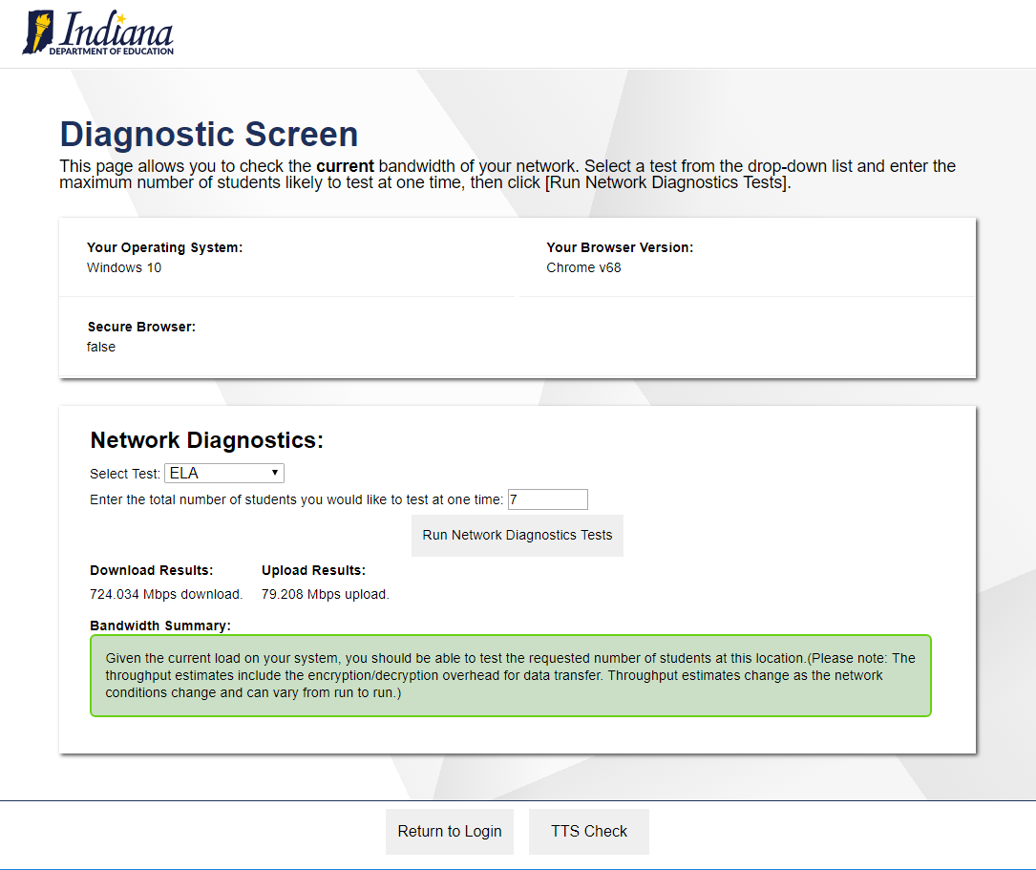
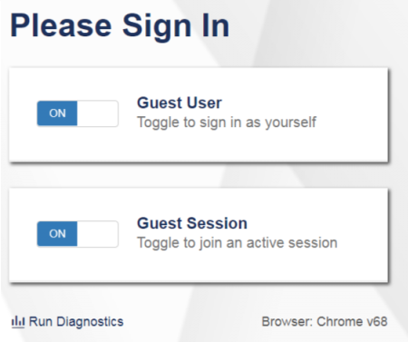
Diagnostic Tool
Notes:
CAI provides a network diagnostic tool available through the Secure Browser or the practice and training tests. The network diagnostic tool compares the number of students testing simultaneously (as entered in the box) to an estimate of that particular test’s required bandwidth. Then, it indicates if your network can adequately support testing for the designated number of students.
We recommend testing the system at various times during the school day to evaluate the available network capacity.
To run the network diagnostics tests, first navigate to your Secure Browser or to your practice test site through a conventional browser. From the Please Sign In screen, click Run Diagnostics. On the Diagnostic Screen, select a test from the Select Test drop-down menu and enter the total number of students you would like to test at one time. Click Run Network Diagnostics Tests.
When testing is complete, you will see your upload and download speed results along with a summary that indicates whether your network can adequately support testing for the designated number of students.
Next, we will discuss configuring proxy servers for online testing.

Slide 26
Configuring Your Network: Proxy Servers
Session time-outs on proxy servers and other devices should be set to values greater than the typically scheduled testing time. For example, if test sessions are scheduled for 60 minutes, consider session time-outs of 65–70 minutes.
Web proxy servers must be configured to NOT cache data received from servers.
For any device that performs traffic shaping, packet prioritization, or quality of service, the URLs to be used for testing should be given a high priority to ensure the best performance.
Notes:
A stable, high-speed, wired or wireless network and Internet connection are required for the test.
For online testing applications to work properly, it is important that your network settings are configured correctly. Session time-outs on proxy servers and other devices should be set to values greater than the typically scheduled testing time. For example, if test sessions are scheduled for 60 minutes, consider session time-outs of 65–70 minutes. This will help limit network interruptions during testing.
Web proxy servers must be configured to NOT cache data received from servers.
If your client network uses any device that performs traffic shaping, packet prioritization, or quality of service, the URLs to be used for testing should be given a high priority to ensure the best performance.
Next, we will discuss network requirements, wireless network configurations, and network performance.

Slide 27
Configuring Your Network: Network Requirements
System | URLs to Add to the Allowlist
Non-Testing Sites Portal and Secure Browser Installation Files Single Sign-On System Test Information Distribution Engine Reporting Systems | AlohaHSAP.org hi.sso.cambiumast.com hitide.org hsa.reports.cambiumast.com hi.crs.cambiumast.com
TA and Student Testing Sites Assessment Viewing Application (if applicable) | *.cambiumast.com *.tds.cambiumast.com *.cloud1.tds.cambiumast.com *.cloud2.tds.cambiumast.com | *.airast.org *.tds.airast.org *.cloud1.tds.airast.org *.cloud2.tds.airast.org
Online Dictionary and Thesaurus | Domain: media.merriam-webster.com www.dictionaryapi.com | IP Address: 64.124.231.250 64.124.231.250
Copyright © 2020 Cambium Assessment, Inc. All rights reserved.
Notes:
This table lists URLs for all CAI systems that need to be accessible for testing. CAI strongly encourages you to add to the allowlist at the root level using wildcards.
It is important that session time-outs on proxy servers and other devices are set appropriately, that web filters are not blocking test-related websites, and that test data are not being cached.

Slide 28
Wireless Network Configuration
Wireless traffic must use encryption.
Wi-Fi Protected Access II (WPA2)
Advanced Encryption Standard (AES)
Wireless access points have limits on total bandwidth and number of simultaneous devices in use.
To ensure sufficient capacity, all computers to be used for testing should be turned on and connected to the wireless access point simultaneously.
Notes:
In order to maintain the security of sensitive test‐related data, wireless traffic must use encryption. Wi-Fi Protected Access II (WPA2) with Advanced Encryption Standard (AES) is strongly recommended.
Wireless access points have limits on total bandwidth as well as on the number of simultaneous devices in use. A properly configured wireless network should provide adequate bandwidth and wireless access points for testing. To ensure sufficient capacity, all computers to be used for testing should be turned on and connected to the wireless access point simultaneously.
Next, we will discuss step four in setting up technology for online testing, configuring assistive technology.

Slide 29
Configuring Assistive Technologies
CAI’s test delivery system (TDS) is a website visible through a customized web browser.
Students who use assistive technologies with a standard web browser should be able to use those same technologies with the TDS.
The best way to test compatibility with assistive technologies is by taking a practice test with those technologies turned on.
Notes:
The final step to preparing your schools for online testing is configuring assistive technologies for students.
CAI’s test delivery system (TDS) is a website visible through a customized web browser. Students who use assistive technologies with a standard web browser should be able to use those same technologies with the TDS. The best way to test compatibility with assistive technologies is by taking a practice test with those technologies turned on.
We will now discuss the requirements for specific assistive technologies for use during online testing.

Slide 30
Text-to-Speech
Voice technology must be available and functioning for students who require this accommodation.
For students who need the use of text-to-speech (TTS), CAI recommends using a desktop, laptop, or tablet running Windows, OS X/macOS, or iOS/iPadOS.
For Windows and macOS, default voice packs are fully compatible with the Secure Browser.
Linux users will find a voice pack included with the Linux Secure Browser installation file.
Notes:
The Secure Browser includes an accessibility option that allows test material to be read to the student. This text-to-speech (TTS) feature is available only when using the Secure Browser. TTS works by tapping into the computer’s built-in speech engine to allow eligible students to listen to test content.
Voice packs that ship with the operating systems out of the box for Windows, Mac, and iOS/iPadOS is fully compatible with the Secure Browser. The Secure Browser works with voice packs that ship out of the box for Chrome OS devices, but the pause feature does not work properly on these devices. For students who need the use of TTS, CAI recommends using a desktop, laptop, or tablet running Windows, OS X/macOS, or iOS/iPadOS.
If a Chromebook is being used, there is a workaround that allows students to highlight a passage of text and have TTS read just that passage, eliminating the need for the pause feature.
Linux users will find a voice pack included with the Linux Secure Browser installation file.
Technology Coordinators are responsible for ensuring that this voice pack software is available and functioning. Detailed information about voice packs can be found in the document titled Assistive Technology Manual.

Slide 31
Text-to-Speech on Mobile Devices
iPad users have full TTS functionality with voice packs that ship out of the box.
The Secure Browser recognizes voice packs that ship out of the box for Chrome OS devices for playback and stop, but the pause feature does not work properly on these devices.
A workaround for Chrome OS is available. It allows students to highlight a passage of text and have TTS read just that passage, eliminating the need for the pause feature.
Notes:
iPad users have full TTS functionality with voice packs that ship out of the box.
The Secure Browser recognizes voice packs that ship out of the box for Chrome OS devices for playback and stop, but the pause feature does not work properly on these devices.
A workaround for Chrome OS is available. It allows students to highlight a passage of text and have TTS read just that passage, eliminating the need for the pause feature.

Slide 32
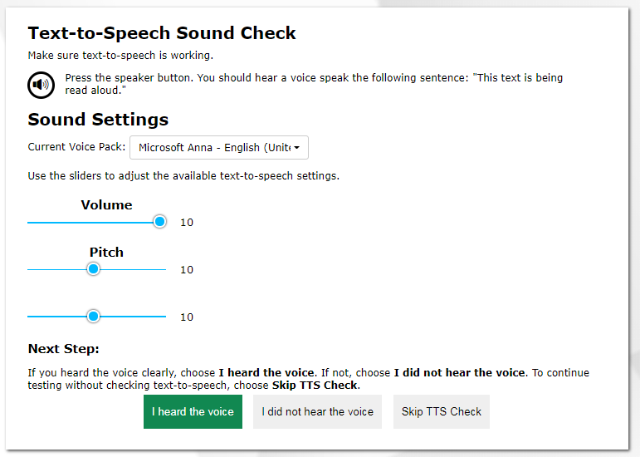
Text-to-Speech Check
Notes:
To check TTS settings, you must use the Secure Browser, Chrome, or Firefox. After clicking the Run Diagnostics link on the Practice Test Site, click the TTS Check button.
On the TTS check screen, do the following:
Click the speaker icon.
Verify whether you heard the recorded voice.
Then, if you do not hear the voice:
Check your machine’s audio controls.
Confirm that the headphones are plugged in and functioning properly with other applications.
Ensure that an appropriate voice pack is installed.
Adjust the available sound settings as necessary.
Next, we will discuss configurations for screen readers.

Slide 33
Screen Readers
Screen readers allow students to read text displayed on a screen with a speech synthesizer or braille display.
Required software for student workstation:
JAWS
Most refreshable braille displays
For screen reading on ELA tests, you must use the JAWS screen reader because it is the only screen reader that supports suppressing read-aloud on reading passages.
Required software for TA workstation:
Duxbury Braille Translation
TAs need this software to emboss braille test content. Other screen readers may also work and should be tested in a practice test.
To emboss tactile graphics, CAI supports ViewPlus embossers using the Tiger Software Suite (Tiger Designer and Tiger Viewer).
Notes:
Screen readers allow students to read text displayed on a screen with a speech synthesizer or braille display. The student’s workstation must have software installed to access screen readers during online testing.
CAI supports JAWS for student workstations. TA workstations must have Duxbury Braille Translation software installed. TAs need this software to emboss braille test content. Other screen readers may also work and should be tested in a practice test. For instructions on how to configure screen readers, see the document titled Assistive Technology Manual.
Next, we will discuss configurations for speech-to-text.

Slide 34
Speech-to-Text
Speech-to-text (STT) allows a student to speak into a headset and have their speech converted into text that becomes the response that is entered into the TDS.
Available for Windows and macOS through Dragon Naturally Speaking or other similar software.
Unavailable for Linux, iOS, or Chrome OS.
Notes:
Speech-to-text (STT) allows a student with this accommodation to speak into a headset and have their speech converted into text that becomes the response that is entered into the TDS.
STT for Windows and macOS is also available through Dragon Naturally Speaking or other similar software, but the embedded tool should be used whenever possible.
STT is not available for Linux, iOS, or Chrome OS.
Lastly, we will discuss configurations for word prediction.

Slide 35
Word Prediction
Word prediction software predicts words as a student types.
Available for Windows and macOS through the use of third-party apps like Read&Write and others.
For more information about supported third-party apps, see the document titled Assistive Technology Manual.
Unavailable for Linux, iOS or Chrome OS.
Notes:
Word prediction software predicts words as a student types. Configurations are available for Windows and macOS through the use of third-party apps like Read&Write and others. For more information about supported third-party apps, see the document titled Assistive Technology Manual.
Word prediction software is not available for Linux, iOS, or Chrome OS.

Slide 36
Thank You!
Further Information
Visit
alohahsap.org
smarterbalanced.org
Call, fax, or email the HSAP Help Desk
Hours: 7:30 am to 4:00 p.m. HST, Monday-Friday (except holidays)
Phone: 1-866-648-3712
Fax: 1-877-231-7813
Email: HSAPHelpDesk@cambiumassessment.com
Notes:
Thank you for taking the time to view this training module. For additional information, refer to your Quick Guide for Setting Up Online Testing Technology located on the AlohaHSAP.org portal or contact the help desk.

