Slide 1
Agenda: Day 2
Accessibility and Accommodations
Administering the Tests
Test Security
The Centralized Reporting System
Interim Assessment and Tool for Teachers (formerly the Digital Library) Updates
PowerPoint: https://bit.ly/3oZm4vt

Slide 2
Accessibility and Accommodations
Notes:
Smarter Balanced is built on a framework of accessibility for all students, including students with disabilities and English learners, in order to provide accurate measures of achievement and growth.

Slide 3
Accessibility and Accommodations
Test accommodations are any changes made to testing conditions that allow students with physical disabilities, learning disabilities, or limited English-language ability to demonstrate their knowledge and skills in a testing situation.
The general goal of providing accommodations is to create a level playing field for students whose disabilities or language abilities may adversely affect their ability to show on a test what they have learned.
Testing accommodations can be different from those used for instruction. For example, using a spell-checker might help a student with writing difficulties take notes during class but wouldn’t be appropriate during a spelling test.
https://smarterbalanced.alohahsap.org/resources/accessibility-and-accommodations/
Notes:
It’s the goal of the Smarter Balanced Assessment System to provide each student with a positive and productive assessment experience, generating results that are a fair and accurate estimate of each student’s achievement.

Slide 4
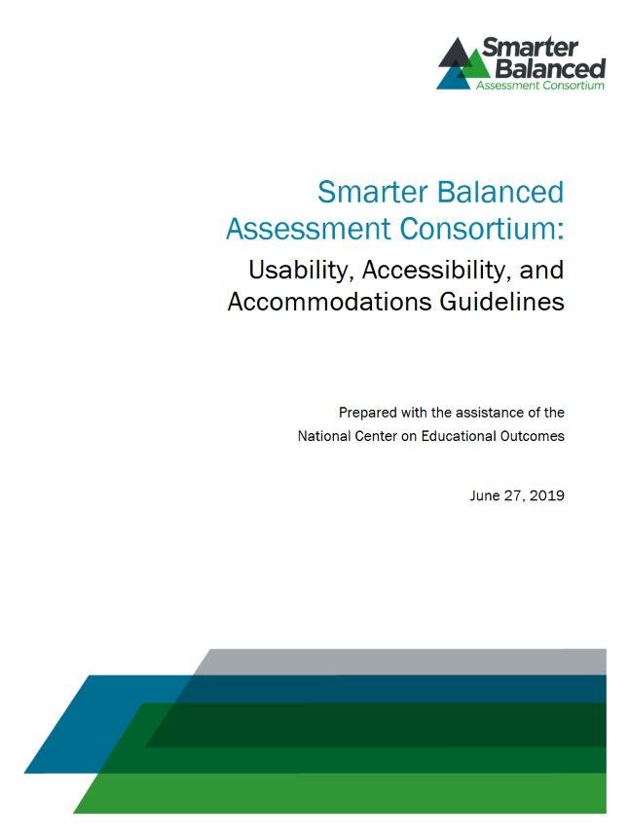
Usability, Accessibility, and Accommodations Guidelines
The Smarter Balanced Assessment Consortium’s Usability, Accessibility, and Accommodations Guidelines (UAAG) is intended for school-level personnel and decision-making teams, particularly Individualized Education Program (IEP) teams, as they prepare for and implement the Smarter Balanced assessment.
Validity depends on students having appropriate :
universal tools
designated supports
accommodations when needed
Something to keep in mind: If a tool/support/accommodation is not used regularly during instruction, this support is likely to be confusing and may impede the performance on assessments.
Notes:
UAAG Developed by SB in partnership with the U.S. Dept of Ed OSIP funded National Center on Educational Outcomes. Intended for school-level personnel and decision-making teams, particularly IEP teams as they implement the SB assessment system.
FAQs in Appendix C on page 26.

Slide 5
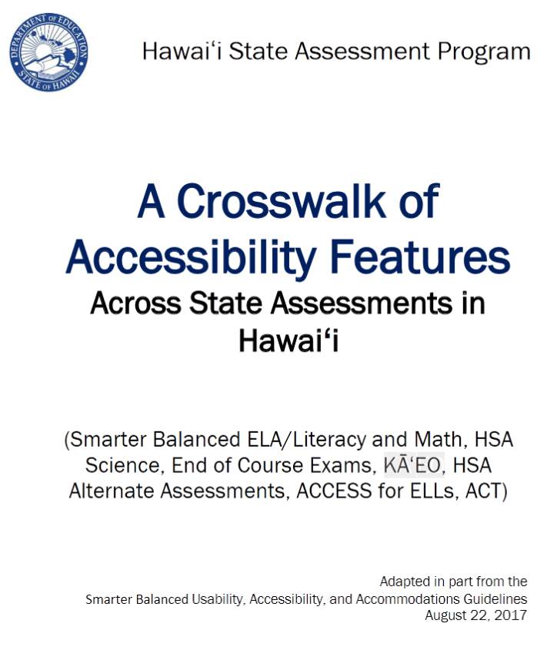
Crosswalk of Accessibility Features
This Hawai‘i specific document, referred to as the CAF, is intended to inform the selection and administration of universal tools, designated supports, and accommodations across statewide assessments.
This document is supported by the respective Test Administration Manuals for each of the assessments.
The CAF includes Smarter Balanced ELA/L and Math, HSA Science, EOCs, HSA-Alt, ACCESS 2.0, KĀʻEO and ACT .
Be sure to check the various test-specific manuals for updated information
Notes:
UAAG Developed by SB in partnership with the U.S. Dept of Ed OSIP funded National Center on Educational Outcomes. Intended for school-level personnel and decision-making teams, particularly IEP teams as they implement the SB assessment system.
FAQs in Appendix C on page 26.

Slide 6
Supports: 3 Types each with 2 Categories
The types are:
Universal tools are features that are provided to all students based on student preference and selection.
Designated supports are features that can be made available for use by any student for whom the need has been indicated by an educator or team of educators familiar with the student’s characteristics and needs.
Accommodations are changes in procedures or materials that increase equitable access and allow these students to show what they know and can do. They are for students for whom there is a documented need for the accommodations on an IEP or 504 plan and whose disability meets the recommended use guidelines in the UAAG.
The categories are:
Embedded tools, supports and accommodations are built into and delivered as part of the computer-based test delivery system.
Non-Embedded tools, supports and accommodations are provided to students “locally” outside of the computer test administration system at the time of testing
Notes:
There are 3 classifications of supports – universal tools, designated supports, and accommodations
They are divided into 2 categories – embedded (built into the test delivery system) and non-embedded (made available outside of the “system”)

Slide 7
Automatically available for all students
Can be made available to any student with a need who regularly uses it in the classroom
Limited to students with a documented need who regularly use it in the classroom
UAAG pg. 7
Notes:
The first resource category is universal tools (available for all students, including those receiving designated supports and/or accommodations). Universal tools are described in detail in the training module titled “Embedded Universal Tools and Online Features.”
The non-embedded universal tools may be provided to any/all students. Any student who needs a restroom break is allowed to pause his/her test and take a break. Only one student at a time should be allowed to take a restroom break. When the student returns from the break he/she will have access to previously answered questions as long as the break was not more than 30 minutes.
English Dictionaries and Thesauruses are allowed for the ELA PT full write only.
All students may use scratch paper to make notes. The scratch paper must be collected after the CAT portion of the assessment and securely destroyed. For the PT, scratch paper is collected at the end of the session and may be given back to a student who needs to complete the PT at a later time. Once the student completes the PT the scratch paper must be collected and securely destroyed.
The second Smarter Balanced assessment resource category is designated supports. Designated supports are available for students who have a need indicated by an educator (or team of educators with a parent/guardian or the student). The educator making the decision must be knowledgeable of the student's needs as well as the student's familiarity and success with resources available.
Assigning a designated support does not require documentation of need in an IEP or 504 plan. It is recommended that a consistent process be used to determine these supports for individual students.
The third resource category is accommodations. Accommodations are available when the need is documented in an Individualized Education Program (IEP) or 504 plan, or in unique circumstances where a student who may not typically require an accommodation may make use of one. For example, if a student who has not needed an accommodation in the past were to break his or her arm, then this student might use a scribe if appropriately documented.
Accommodations are changes in procedures or materials that increase equitable access during the Smarter Balanced assessments. Assessment accommodations generate valid assessment results for students who need them; they allow these students to show what they know and can do.

Slide 8
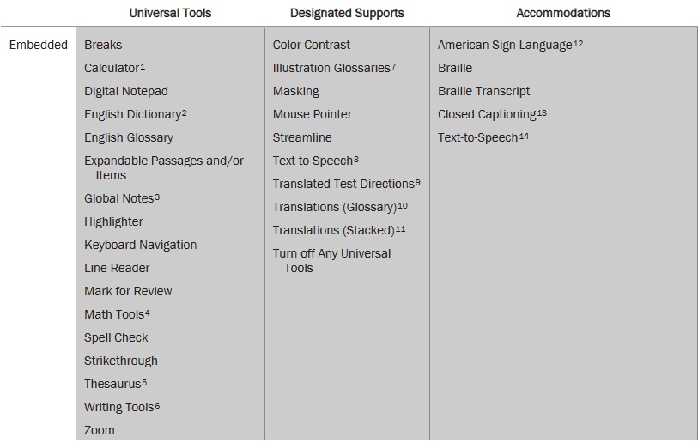
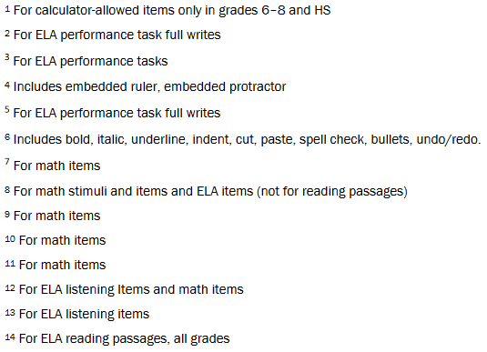
Smarter Balanced Universal Tools, Designated Supports, and Accommodations
UAAG pg. 30
Notes:
UAAG p. 29
There are 60 tools, supports and accommodations in the SB assessment system. It would be a highly unusual situation in which any particular student is assigned a large number of these designated supports or accommodations. Rather, these supports and accommodations are selected specifically according to the unique need of the student that has been indicated by an educator or a team of educators with a parent/guardian or the student. Another variable is the student’s familiarity with a tool and how effective the tool has been in the past for that student.
Remember that many of the tools lead to additional testing time and, in the case of non-embedded supports, “more complicated” test administration.

Slide 9
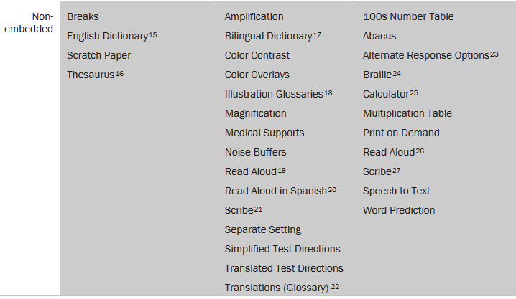
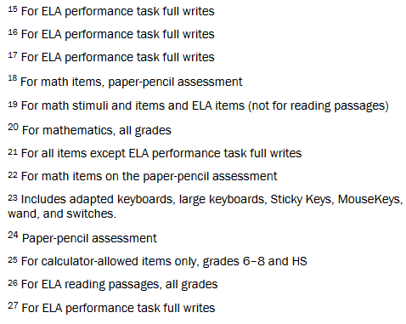
UAAG pg.31

Slide 10
Some Appear in Multiple Types or Categories
 | Universal Tools | Designated Supports | Accommodations
Embedded | Breaks Calculator Digital Notepad English Dictionary English Glossary Expandable Passages Global Notes Highlighter Keyboard Navigation Mark for Review Math Tools Spell Check Strikethrough Writing Tools Zoom | Color Contrast Masking Text-to-Speech Translated Test Directions Translations (Glossary) Translations (Stacked) Turn off Any Universal Tools | American Sign Language Braille Closed Captioning Streamline Text-to-Speech
Non-embedded | Breaks English Dictionary Scratch Paper Thesaurus | Bilingual Dictionary Color Contrast Color Overlay Magnification Read Aloud Noise Buffers Scribe Separate Setting Simplified Test Directions Translated Test Directions Translations (Glossary) | 100s Number Table Abacus Alternate Response Calculator Multiplication Table Print on Demand Read Aloud Scribe Speech-to-Text
Notes:
There are a number of tools that are available in different categories. These usually have different criteria for each instance.

Slide 11
Text-to-speech (for math stimuli items and ELA items, not for reading passages) | Text is read aloud to the student via embedded text-to-speech technology. | Students who are struggling readers may need assistance accessing the assessment by having all or portions of the assessment read aloud. This support also may be needed by students with reading-related disabilities, or by students who are blind and do not yet have adequate braille skills. This support will likely be confusing and may impede the performance of students who do not regularly have the support during instruction.
Some Appear in Multiple Types or Categories: Text-to-Speech
 | Universal Tools | Designated Supports | Accommodations
Embedded | Breaks Calculator Digital Notepad English Dictionary English Glossary Expandable Passages Global Notes Highlighter Keyboard Navigation Mark for Review Math Tools Spell Check Strikethrough Writing Tools Zoom | Color Contrast Masking Text-to-Speech Translated Test Directions Translations (Glossary) Translations (Stacked) Turn off Any Universal Tools | American Sign Language Braille Closed Captioning Streamline Text-to-Speech
Non-embedded | Breaks English Dictionary Scratch Paper | Bilingual Dictionary Color Contrast Color Overlay | 100s Number Table Abacus Alternate Response Options
Text-to-speech (available for ELA reading passages, all grades) UAAG p 18 | Text is read aloud to the student via embedded text-to-speech technology. | This accommodation is appropriate for a very small number of students. Text-to- speech is available as an accommodation for students whose need is documented, i.e. diagnosed dyslexia, in an IEP or 504 plan. (See Read Aloud)
Notes:
Stress the need for a documented need/diagnoses and likelihood of being a lifelong learner.
Emphasize the fact the designated support can be a big distraction !!

Slide 12
Some Appear in Multiple Types or Categories: Read Aloud
 | Universal Tools | Designated Supports | Accommodations
Embedded | Breaks Calculator Zoom | Color Contrast Turn off Any Universal Tools | American Sign Language Braille Text-to-Speech
Non-embedded | Breaks English Dictionary Scratch Paper Thesaurus | Bilingual Dictionary Color Contrast Color Overlay Magnification Read Aloud Noise Buffers Scribe Separate Setting Simplified Test Directions Translated Test Directions Translations (Glossary) | 100s Number Table Abacus Alternate Response Options Calculator Multiplication Table Print on Demand Read Aloud Scribe Speech-to-Text
Read aloud (for math and ELA items, not for reading passages) | Text is read aloud to the student by a trained and qualified human reader who follows the administration guidelines. All or portions of the content may be read aloud. | Students who are struggling readers may need assistance accessing the assessment by having all or portions of the assessment read aloud. This support also may be needed by students with reading-related disabilities, or by students who are blind and do not yet have adequate braille skills.
Read Aloud (for ELA reading passages) | Text is read aloud to the student via an external screen reader or by a trained and qualified human reader who follows the administration guidelines provided. | This accommodation is appropriate for a very small number of students. Read aloud is available as an accommodation for students whose have been diagnosed with a reading disability such as dyslexia and the need is documented in an IEP or 504 plan.
The Read Aloud Designated Support and/or Accommodation requires the reader to complete the Read Aloud Guidelines and the TC should keep the signed Read Aloud Protocol for HSAP Assessments Security/Confidentiality Agreement on file at the school.

Slide 13
Designated Supports
Designated supports for the Smarter Balanced assessments are those features that are available for use by any student for whom the need has been indicated by an educator (or team of educators with parent/guardian and student).
Informed adults make decisions about designated supports. Ideally, the decisions are made by all educators familiar with the student’s characteristics and needs, as well as those supports that the student has been using during instruction and for other assessments.
Designated supports must be set by the school in TIDE and,in addition for SPED students and ELs, they need to be indicated in eCSSS

Slide 14
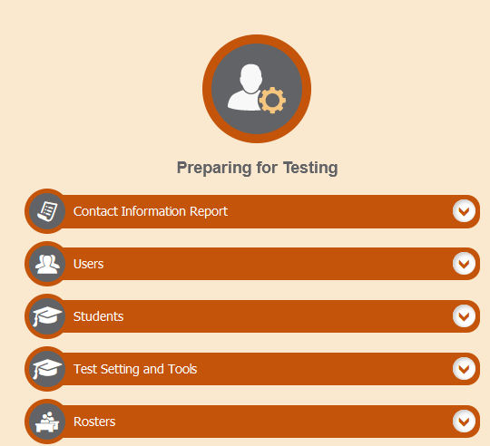
Inputting Designated Supports in TIDE
Embedded accessibility tools will only be available if “set” in TIDE.

Slide 15
Accommodations
Hawai’i has developed guidelines for the provision of appropriate accommodations on statewide assessments. These guidelines identify accommodations for each assessment that do not invalidate the score if used according to the recommendations for use described in this document and the Smarter Balanced UAAG. IEP Teams should select, for each assessment, only those accommodations for which a student meets the recommendations for use guidelines. (Authority: 20 U.S.C. 1412(a)(16)) [72 FR 17781, Apr. 9, 2007]
Accommodations must be set in TIDE by the Assessment Section. Schools begin the process by submitting an Accommodations Request Form to the Assessment Section.

Slide 16
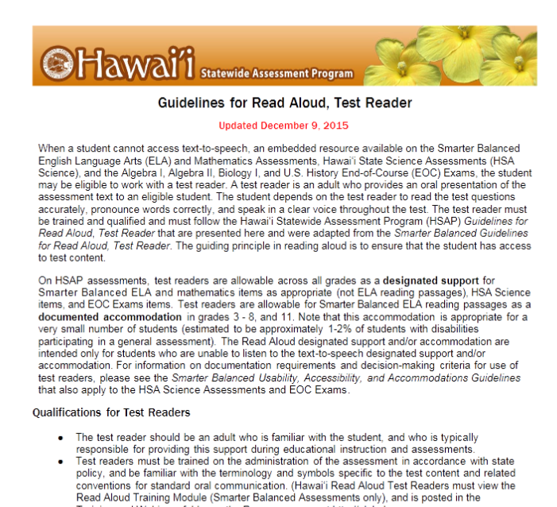
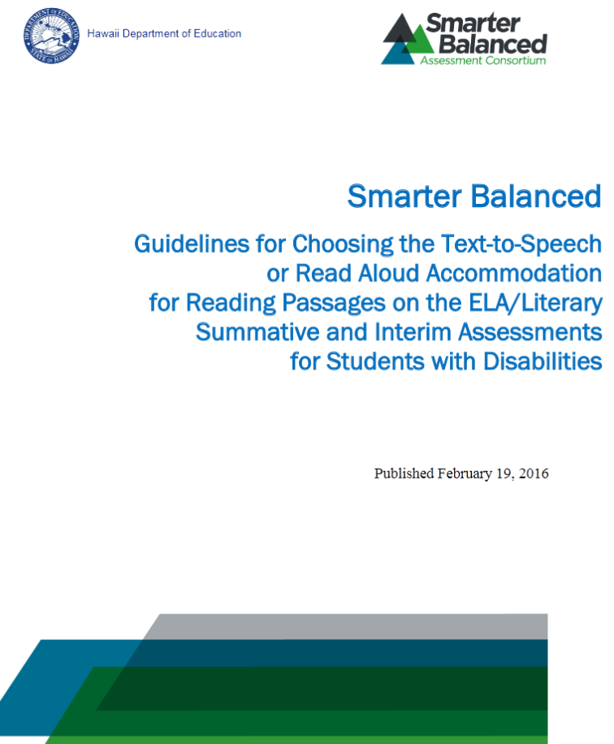
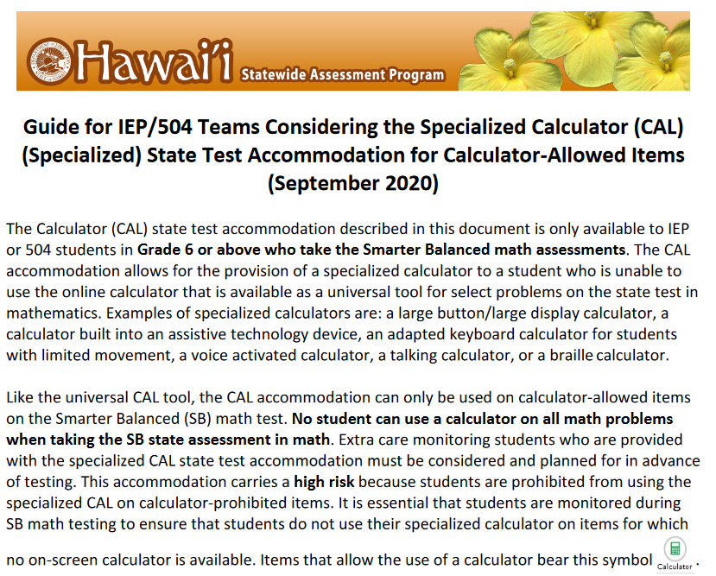
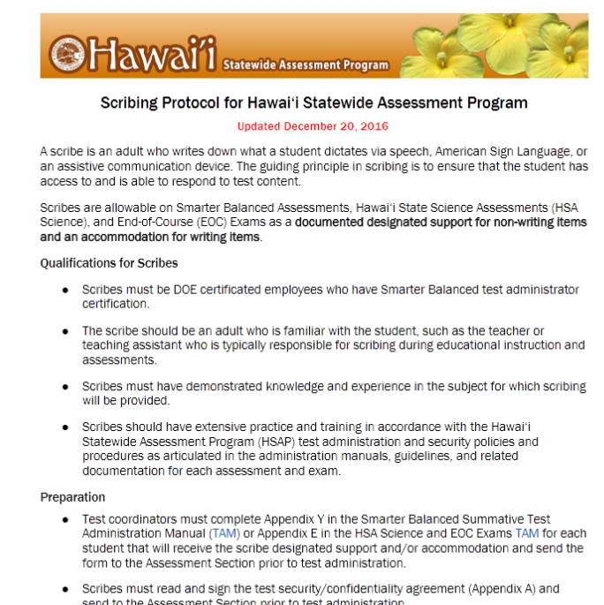
Check the Guidelines for the Various Accessibility Features

Slide 17
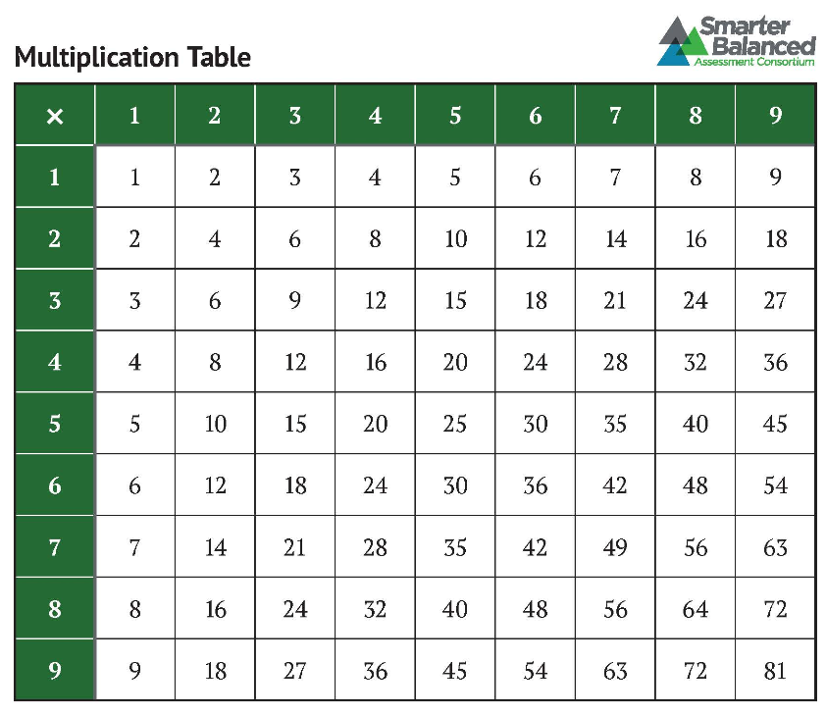
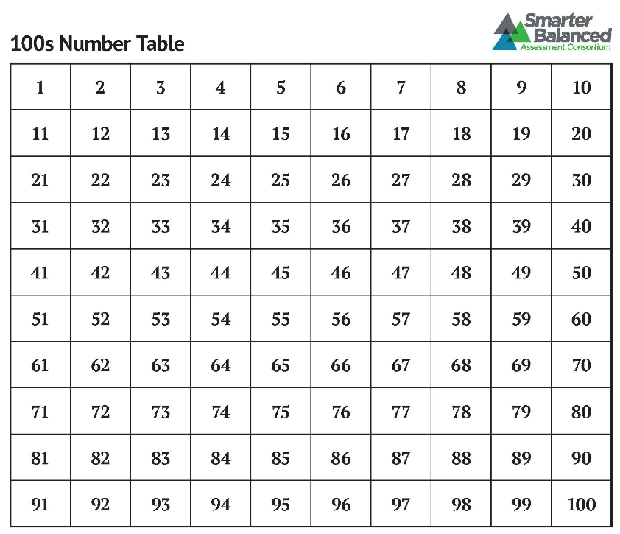
Multiplication and Hundreds Tables
Accommodation | Description |  |  | Recommendations for Use
Multiplication Table (grades 4–8 and 11 math items) |  | A paper-based single digit (1–9) multiplication table will be available from alohahsap.org for reference. | For students with a documented and persistent calculation disability (i.e., dyscalculia).
100s Number Table (grades 4-8 and 11 math) |  | A paper-based table listing numbers from 1 – 100 available on alohahsap.org for reference. | Students with visual processing or spatial perception needs may find this beneficial, as documented in their IEP or 504 plan.
These two accommodations are not allowed for students in grade 3
They both require documented and persistent disabilities.
The hundred table is primarily intended for students with visual or spatial needs

Slide 18
Accommodation Request Process
Students with IEPs and/or 504 plans, including English Learners (ELs) with IEPs, must be provided with appropriate supports on state tests in order for their results to be considered valid. The process for identifying those supports and communicating them to the Assessment Section has changed this year.
Verified state test accommodations from SY 2019-20 will be carried over for use in SY 2020-21.
Ideally, TCs should submit any new state test accommodation requests by Monday, November 2, 2020, for Fall 2020 testing and by Friday, January 15, 2021, for Spring 2021 testing. In all cases, at least 2 weeks before testing.
TC completes and submits the State Test Accommodation Request Form electronically.

Slide 19
Steps for Testing Coordinators (TCs) to Request State Test Accommodations
TCs and SSC/SPED Department Heads (DHs) meet to review the processes and procedures for identifying designated supports and accommodations for students with IEPs/504 Plans, including ELs with disabilities. Keep in mind that these accommodations are determined by the IEP teams.
SSCs/SPED DHs work with the Care Coordinators and IEP teams to ensure that the criteria, processes, and procedures for identifying accommodations on state tests, laid out in the Hawai'i State Test Accommodation Guides, are understood and followed.
IEP/504 Team meets to determine student need for state test accommodations. The Hawai'iState Test Accommodation Guides are tools used to make test accommodation decisions.
If the IEP/504 Team decides state test accommodations are needed for a student, the Team documents and records this decision in “Table (1 or 2): Questions to Guide IEP/504 Team Decision..”, updates the student's IEP/504 record, and then transmits a copy of the completed Table to the SSC/DH and the TC.
TC completes and submits the State Test Accommodation Request Form electronically.

Slide 20
Hawaii State Test Accommodation Guides
The Hawaii State Test Accommodation Guides provide information for School IEP and 504 Teams to determine student eligibility for the following assessment accommodations:
Calculator
Multiplication Table
Print on Demand
Scribe
Speech-to-Text
Text-to-Speech and Read Aloud
Word Prediction
Low-Risk Accommodations (100s Number Table, Abacus, Alternate Response Options, American Sign Language, various Braille forms, and Closed Captioning)

Slide 21
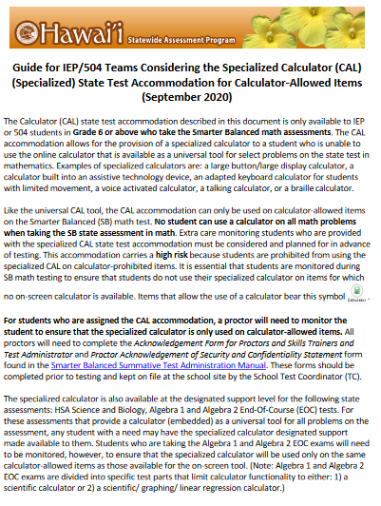
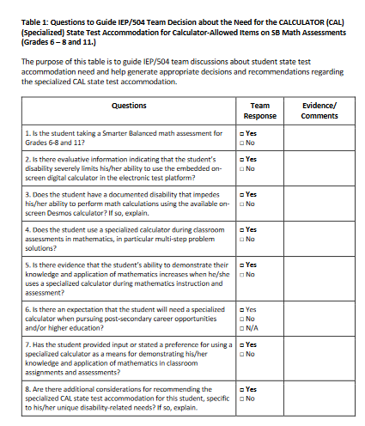
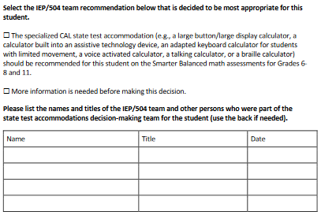

Slide 22
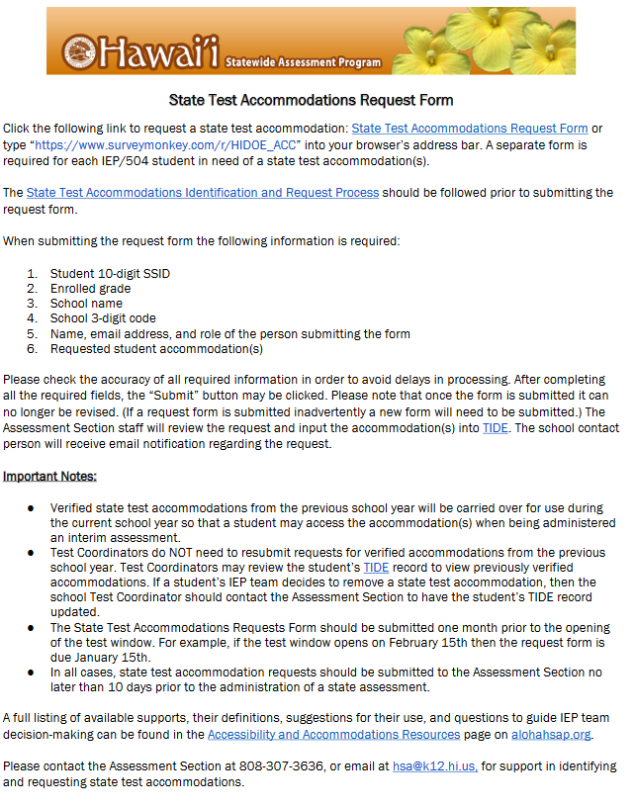

Slide 23
Documenting Supports for ELs and Students with Disabilities
To meet Federal requirements Designated Supports for ELs and Students with Disabilities need to be documented in both TIDE and eCSSS.
Keep in mind that eCSSS is the student’s permanent record. TIDE resets every year.

Slide 24
Day 2 Activity #1
Jamboard Breakout
What are/Who can have:
Accommodations?
Designated Supports?
Universal Tools?
What do you need to do and who you will need to talk to make these decisions?
What challenges do you anticipate?
How will you address the challenges?
https://bit.ly/3k7hZSp
Remember: to select a scribe to post your: Suggestions/Successful Strategies, Anticipated Challenges, and Questions to the Jamboard.

Slide 25
Administering the Tests
Training and Practice Tests
Test Environment
TAs and Test Administration
Test Security

Slide 26
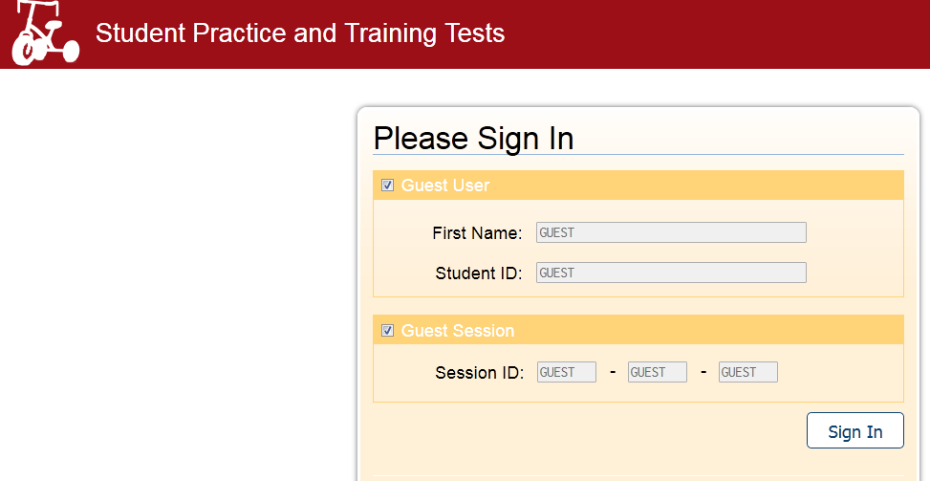
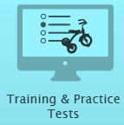
Training and Practice Tests
Remember the Training Test allows students to become familiar with the assessment software, tools, etc., while the Practice Test includes about 30 items at each grade level and provides access to the designated supports and accommodations if administered using the secure browser.
Both tests can be conducted in a testing session administered by a Test Administrator using the TA Practice Site and secure browser or in a “guest session” using any browser from any location.
Notes:
Remember the Training Test allows students to become familiar with the assessment software, tools, etc., while the Practice Test includes about 30 items at each grade level and provides access to the designated supports and accommodations if administered using the secure browser.
Both tests can be conducted in a testing session administered by a Test Administrator using the TA Practice Site and secure browser or in a “guest session” using any browser from any location.
alohahsap.org >>Smarter Balanced>> Students and Families>>Training and Practice Tests

Slide 27
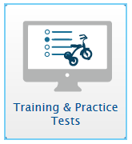
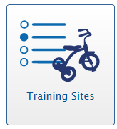
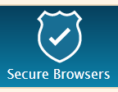
Training and Practice Tests
Remember the Training Test allows students to become familiar with the assessment software, tools, etc., while the Practice Test includes about 30 items at each grade level and provides access to the designated supports and accommodations if administered using the secure browser.
Both tests can be conducted in a testing session administered by a Test Administrator using the TA Practice Site and secure browser or in a “guest session” using any browser from any location.
If students complete a Training or Practice Test in a session set up be the teacher they will receive the supports set in TIDE.
GUEST
Session ID
First Name
SSID
Notes:
Remember the Training Test allows students to become familiar with the assessment software, tools, etc., while the Practice Test includes about 30 items at each grade level and provides access to the designated supports and accommodations if administered using the secure browser.
Both tests can be conducted in a testing session administered by a Test Administrator using the TA Practice Site and secure browser or in a “guest session” using any browser from any location.
alohahsap.org >>Smarter Balanced>> Students and Families>>Training and Practice Tests

Slide 28
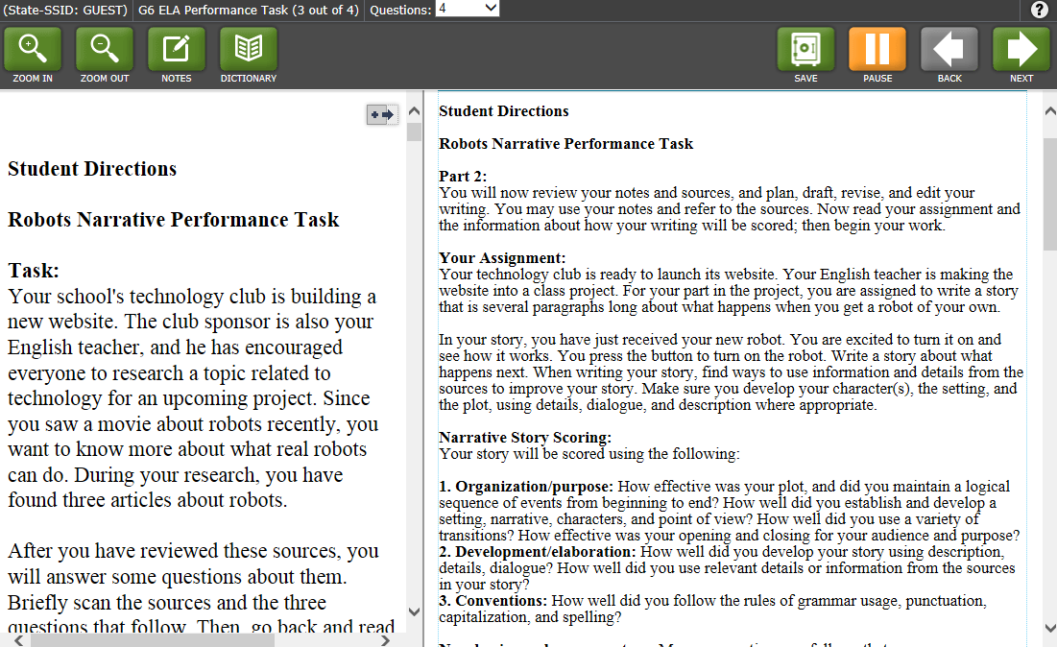
Accessing Tools Through the Tool Bar
Notes:
Dictionary/Thesaurus button The Dictionary and Thesaurus is an embedded universal tool that is available for the full-write portion (the 2nd part) of the ELA performance task. With this embedded universal tool, the student can access a Dictionary or Thesaurus to view more information about a word. To access this embedded universal tool simply click on the Dictionary button in the upper left-hand corner. A pop up will appear that gives access to both a dictionary and a thesaurus.
The student types the word he or she wants to use in the blank space and then clicks either “Dictionary” or “Thesaurus.” The definition for the word will appear if you selected “Dictionary” or the synonym will appear if you selected “Thesaurus.” You can switch between the “Dictionary” and “Thesaurus” for the same word by simply selecting the button that corresponds to each. To close the Dictionary/Thesaurus click the X in the upper-right-hand corner.

Slide 29
Testing Environment
Testing Room: Students can be tested in any room that provides a quiet environment where other students are not participating in learning activities including not doing homework or accessing the internet.
Instructional Materials: Instructional materials must be removed or covered. Materials include, but are not limited to, information that might assist students in answering questions that is displayed on bulletin boards, chalkboards or dry-erase boards, or on charts.
Student Seating: Students must be seated so there is enough space between them to minimize opportunities to look at each other’s work, or they should be provided with table-top partition.
Student Supervision: Students are actively supervised by a certified test administrator and are prohibited from access to unauthorized electronic devices that allow availability to outside information.

Slide 30
Testing Environment
Access to Testing Room: Unauthorized staff or other adults must not be in the room during testing. Students who are not participating in testing may not be in the room where a test is being administered.
Electronic Devices: Collect or ensure that all electronic devices are turned off and put away in backpacks and placed in a corner of the testing environment.
Test Directions Script: Remember that the script (TAM Appendix Z) must be followed exactly and used each time a test is administered except when students are designated for the Simplified Directions (alohahsap.org).
Test Related Materials: All test-related print materials, scratch paper, and documents with student information must be kept in a securely in a locked cabinet and shredded after testing.
Record Keeping: Remember to write the Test Session ID on a spread sheet daily in case you need to refer to it.

Slide 31
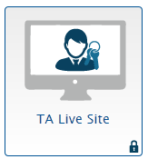
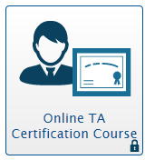
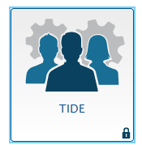
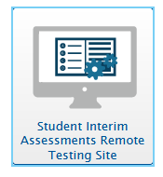
Administering Smarter Balanced Assessments
Summative and Interim Assessments (Smarter Balanced, HSA Science and EOCs) are usually administered in the same way. The tests are administered using the TA Live Site and students log in using the Secure Browser, so…..
Test Administrators need to complete the TA Certification Course and launch test sessions.
Student computers need to have the Secure Browser installed.
Students will need test tickets which can be printed in TIDE.
TAs must use caution when launching tests. Launch the test you intend!
Remember Dual Authentication: If TAs are using a “new computer” they will need access to their email while signing in.
This year Interim Assessments can be administered remotely. TAs use the TA Live Site. Students use the Remote Testing Site
Notes:
Interim Assessments are administered in the same way as the SB summative assessments.
Students will have access to the appropriate tools and supports if they have been “set” in TIDE

Slide 32
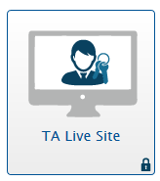
Summative Test Administration
Summative and Interim Assessments– can only be administered by a trained certified test administrator using the TA Live Site and with students using the HI Secure Browser.
There are no significant changes
to summative test administration for
SY 2020-2021.
Session ID
First Name
SSID
Notes:
Training and Practice Tests can be taken as a guest or in a testing session set up in the Training Site by any Teacher
“Actual Assessments” – HSA Science, End of Course Exams, Smarter Balanced Interim and Summative Assessments, and HSA-Alt Assessments can only be administered by a trained certified test administrator using the TA Live Site and with students using the HI Secure Browser.
For SY 2015-16…
The TA Live Site has a new look and feel.
For Smarter Balanced Summative Assessments, more than one Performance Task will appear for each grade level in both ELA and Math. All PTs that appear should be started. This is because, with the removal of classroom activities, students in the same grade/classroom will not all be asked to complete the same performance task.

Slide 33
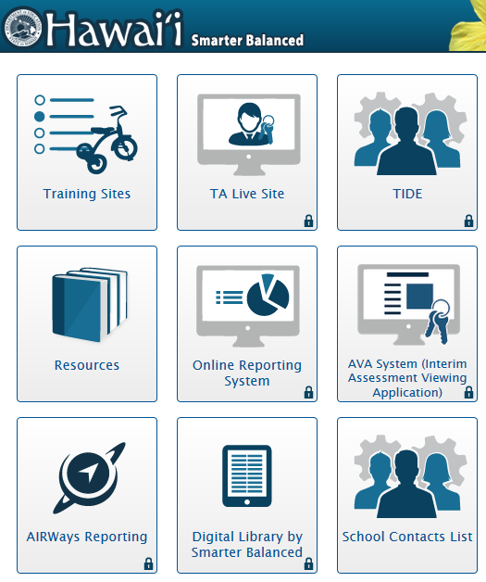
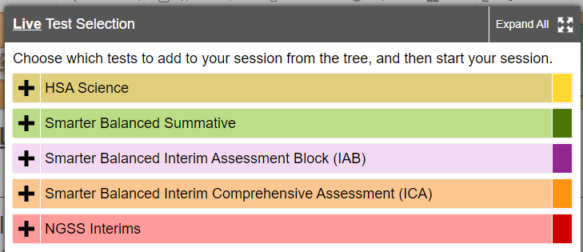
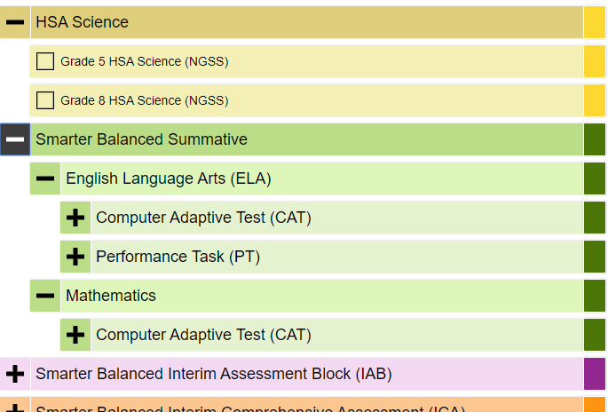
Do Not confuse Summative Tests with Interim Tests when Starting Live Sessions
Notes:
This slide has animations
The TA Live Site has a “tree structure” that allows the TA to open various branches until they reach the tests they will be administering then select and launch those tests.
Multiple tests can be launched in the same session but care must be taken to ensure that students select and are admitted to the correct test.
Once a TA selects tests and Starts a Live Session the session ID appears

Slide 34
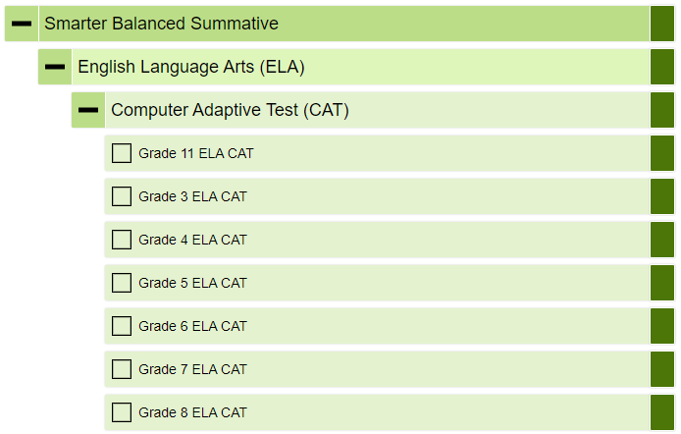
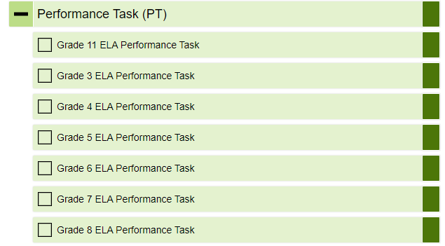
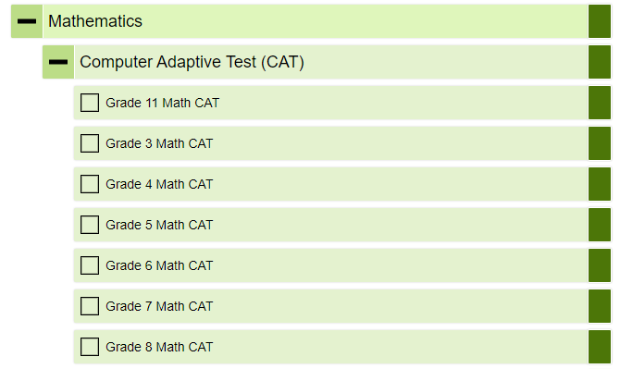

Slide 35
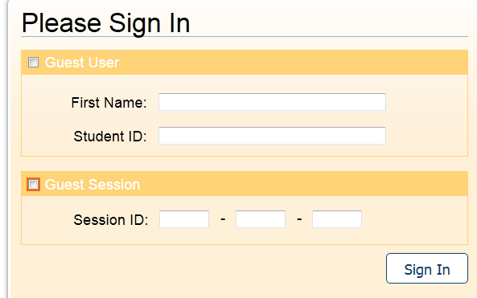
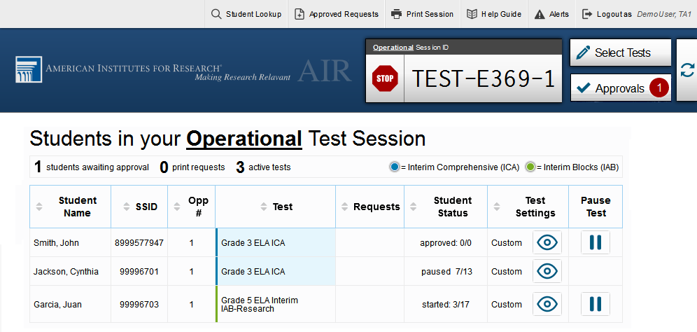
Accepting Students into the Session
Notes:
This Slide has animations.
Once you have set up a test session and have a Session ID, students can begin logging in
To begin testing, students launch the Secure Browser and login using their legal first name, SSID and the Session ID
When students start signing in to the test session, an [Approvals] button also appears next to the session ID. Once you approve students for testing, the Test Session table appears in the center of the TA Interface, displaying students’ testing progress.
Additional features are available in the banner at the top of the screen.
In the banner, you will see a set of buttons and your username.
You can click the [Student Lookup] button to search for student login information.
Click the [Approved Requests] button to view a list of requests you approved during the test session.
Click the [Print Session] button to print a screenshot of the TA Interface.
Click the [Alerts] button to view messages sent by the state department of education.
Click the [Help Guide] button to access additional information about the TA Interface.
Click [Log Out] button when you want to exit the TA Interface.

Slide 36
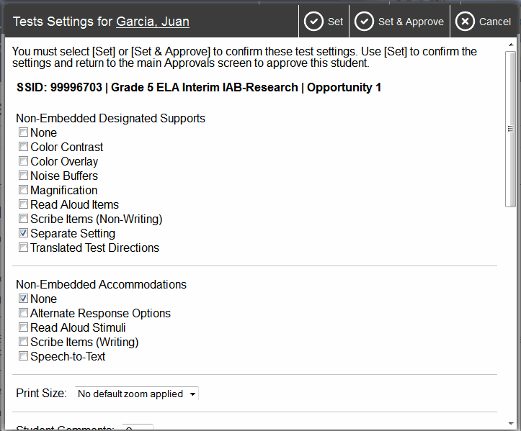
Editing Student Details: Turn Settings On and Off
TAs should view the Test Administrator (TA) Interface for Online Testing training PowerPoint available under Training in the Resources Section on alohahsap.org
Notes:
Ideally, student settings should be set in TIDE before students enter a testing session but it is possible for the TA to adjust many settings before accepting a student into a session. Some of the universal tools available by default may not be appropriate for some students. If you need to turn a universal tool off or on for a student, you must do so before testing begins. Use the selectors in the Test Settings screen to enable or disable the appropriate settings.
Some accessibility resources, particularly accommodations must be set up in TIDE prior to testing. For more information, consult the Usability, Accessibility and Accommodations Guidelines, available on the alohahsap.org website. As noted previously, the Test Settings screen may not appear exactly as shown here, depending upon your user role and permissions.
This is not a TA Training and all TAs should be familiar with the Test Administration Manual, view the Test Administrator (TA) Interface for Online Testing training PowerPoint, and must complete the Certification Course

Slide 37
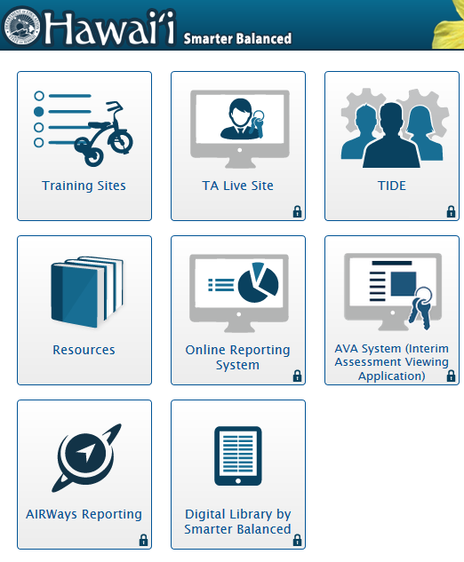
Test Administrators and Test Administration
Test Administration Resources
Guide to Navigating the Online HSAP Administration
Guidelines for Choosing TTS or Read Aloud Accommodations
Guidelines for Read Aloud, Test Reader
Guidelines for Simplified Test Directions
HSAP Systems User Roles and Access
HSAP TIDE User Guide HSAP TIDE Quick Guide
Interim Assessments Fact Sheet
Scribing Protocol
Smarter Balanced 100s Number Table
Smarter Balanced Interim Assessments Test Administration Guide
Smarter Balanced Multiplication Table
Smarter Balanced Summative Test Administration Manual
Usability, Accessibility, and Accommodations Guidelines
Science and EOC TAM as well as Various NGSS Resources hsa.alohahsap.org

Slide 38
Day 2 Activity #2: Breakout Discussion
Based on what you’ve just heard….
How will you be certain that all of the activities necessary to ensure students have appropriate supports and all students take the Training and Practice Tests?
What general questions do you still have?

Slide 39
TIME FOR A BREAK
10 Minutes

Slide 40
Test Security
The three guiding principles:
All students have an equitable opportunity to demonstrate what they know and are able to do.
Test policies and procedures are implemented with fidelity based on the guidelines in the TAM.
Secure summative assessment items are recognized as secure and steps are taken to ensure they remain secure.
These principles apply before, during, and after testing.
Notes:
The security of assessment instruments and the confidentiality of student information are vital to maintaining the validity, reliability, and fairness of the results.

Slide 41
An Equitable Opportunity
Establishing classroom-sized groups reduces test fear and anxiety for the students and facilitates monitoring and control for the TA.
Good lighting, ventilation, and freedom from noise and interruptions are important factors to be considered when selecting a site.
The “technology” is checked ahead of time to ensure there are no “avoidable” delays and/or interruptions to testing sessions.
Students’ designated supports and accommodation are set prior to testing.
Students are actively supervised by a certified test administrator
Students must only have access to and use of those allowable resources identified by the respective TAMs.
Students must be seated so there is enough space between them to minimize opportunities to look at each other’s work.

Slide 42
Policies and Procedures
Instructional materials must be removed or covered.
The TA should prepare a designated location in the classroom for students to place their backpacks and purses, along with cell phones and other electronic devices. This location should be inaccessible to students during testing.
Students are prohibited from access to unauthorized electronic devices that allow availability to outside information, communication with other individuals, or photographing or copying test content.
The test administration script is followed exactly.
Students who are not participating in testing may not be in the room where a test is being administered.
Students who have submitted their test must not use the computer for any reason and cannot work on homework or other “school work”.
Unauthorized staff or other adults must not be in the room during testing.

Slide 43
Policies and Procedures
Principals, Test Coordinators (TCs), Test Administrators (TAs), and other staff are not permitted to actively review any test items or student responses in the testing interface or students’ notes on scratch paper.
Descriptions of test items, stimuli, printed reading passages, or writing prompts must not be retained, discussed, or released to anyone.
All test materials must remain secure at all times. Printed materials from the print-on-demand accommodation, scratch paper, and documents with student information must be kept in a secure location and destroyed when testing is complete.
Students who require access to medical monitoring devices during testing should be tested in a separate setting.
If you have witnessed, been informed of or suspect a Test Security Incident, follow the steps outlined in section Responding to Testing Improprieties, Irregularities, and Breaches in the TAM.

Slide 44
Electronic Devices
The Test Administrator must direct each student who enters the testing room with a cell phone or any other electronic device (including smart watches) to turn it off, put it in a backpack or bag, and place the backpack or bag in a designated, secure area in the testing room that cannot be accessed during the test session. If a student does not have a backpack or bag, his/her cell phone must be placed in a designated area. Students’ cell phones or other electronic devices will be returned to them after all students have ended their test session.
This procedure is intended to prevent students from having their tests invalidated!
Any use of electronics devices may constitute a breach in test security, must be reported immediately to the Assessment Section, and will result in the invalidation of a student’s score for an assessment or exam.

Slide 45
When Things Go Wrong
Test security incidents are behaviors prohibited either because they give a student an unfair advantage or because they compromise the secure administration of the assessments.
Whether intentional or by accident, failure to comply with security rules, either by staff or students, constitutes a test security incident.
Test security incidents are classified as improprieties, irregularities, and breaches depending upon the type of incident and its severity.
All improprieties, irregularities, and breaches need to be reported to the Assessment Section in accordance with the instructions in this section for each severity level.
Improprieties and Irregularities should be reported to the Assessment Section by the end of the school day.
A breach requires that the incident is addressed at the school site, that it be reported to the appropriate school personnel right away, and that both the CAS and Assessment Section be contacted by telephone.

Slide 46
Improprieties
An unusual circumstance that has a low impact on the individual or group of students who are testing and has a low risk of potentially affecting student performance on the test, test security, or test validity.
An impropriety should be reported to the School Principal and Test Coordinator (TC) immediately, and forwarded to the Assessment Section within 24 hours and entered into TIDE should a testing incident request be required.
Improprieties are to be reported using the Testing Incident Report Form found in Appendix P. This form can also be downloaded from the Test Administration Forms page on alohahsap.org

Slide 47
Irregularities
An unusual circumstance that impacts an individual or group of students who are testing and may potentially affect student performance on the test, test security, or test validity.
An irregularity must be reported to the School Principal and TC immediately, and forwarded to the Assessment Section within 24 hours and entered into TIDE should a testing incident request be required.
Irregularities are to be reported using the Testing Incident Report Form found in Appendix P. This form can also be downloaded from the Test Administration Forms page on alohahsap.org

Slide 48
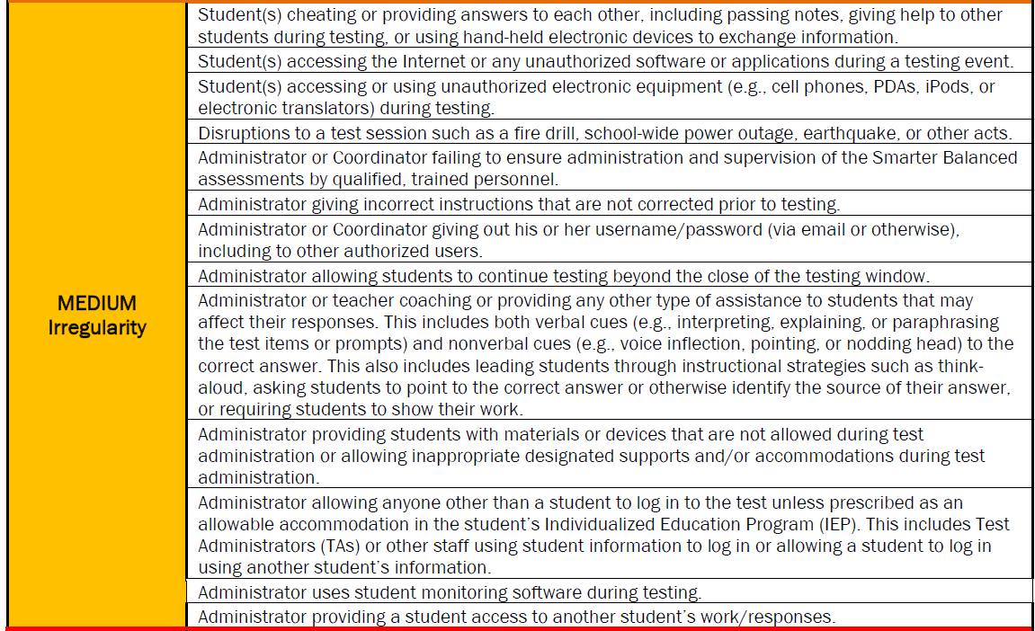

Slide 49
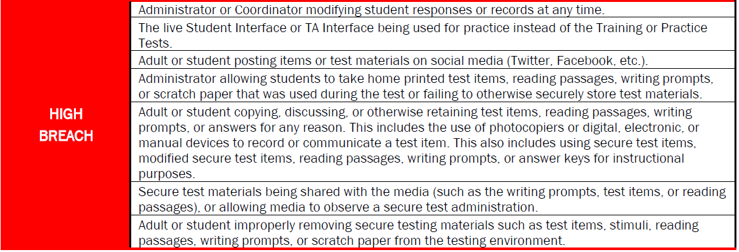
Breaches
An event that poses a threat to the validity of the test. Examples may include such situations as a release of secure materials or a security/system risk.
A breach incident must be reported to the School Principal and TC immediately and both the Complex Area Superintendent and Assessment Section (808-307-3636) should be immediately contacted by telephone. A more complete report of the incident should be submitted to the Assessment Section using the Testing Incident Report Form, found in Appendix P, by the end of the school day during which the incident occurs.

Slide 50
Possible Outcomes of Testing Incidents
Testing Incidents may result in one or more of the following actions:
Grace Period Extension
Invalidation
Re-Open a Test or Test Segment
Reset of a Test
More detailed information can be found on pages 23-25 of the TAM.
Any of these actions can be requested using the Test Incidents function in TIDE.
In addition, in cases where school staff is involved:
Staff may be required to be retrained or to retake the TA Certification Course.
There may be a requirement to have a second adult present in the testing room.
NB: Administering a test to a student with an IEP or 504 Plan without the verified accommodations can result in a students test being Reset.

Slide 51
Protocol for Incidents Involving Cell Phones and Electronic Devices
If a student is caught with cell phone or electronic device during a testing session, you need to report this and take immediate action:
Confiscate phone and take it to the Test Coordinator/Principal
Have principal go through the phone checking students
Instagram
Facebook
Text messages
Snapchat
Photo albums/phone/cloud storage
Contact every person in the students list per social media account if the photos or test related messages are found on the phone
Report to the Assessment Section Immediately

Slide 52
TIDE-Administering Tests Testing Incidents

Slide 53
Types of Requests Regarding Testing Incidents
Grace period extension: A Grace Period Extension (GPE) allows students whose tests have been paused for more than 20 minutes to review previously answered questions. (State may approve)
Reset: Resetting a student’s test removes that test from the system and enables the student to start a new test. (State may reset any test CAT or PT)
Invalidation: Invalidating a student’s test eliminates the test. The test will not be scored. (State may invalidate)

Slide 54
Reopen
Reopening a test allows a student to access a test that has already been submitted or has expired. If an expired test is reopened, the test will reopen at the location at which the student stopped the test.
The student will be able to review items within the current segment of the test but cannot return to previous segments. If a submitted test is reopened, the test will reopen at the last page of the test. The student can review items in the current segment but cannot return to previous segments. (State may reopen)
Reopen Test Segment Reopening a test segment allows a student to access a test segment that the student inadvertently leaves. (State may reopen test segment)
Restore Restoring a test returns a test from the Reset status to its prior status. This action can only be performed on tests that have been reset. (State may restore)

Slide 55
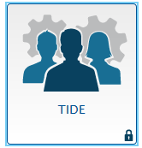
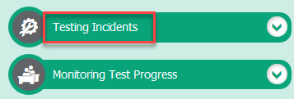
How to Enter a Testing Incident in TIDE
Click on the TIDE icon:
Once in TIDE, under Administering Tests click Testing Incident:
Then click on Create Test Incident:
Notes:
Once a Test Incident is identified, you will need to input it into TIDE.
This is how you enter a Test Security Incident in TIDE.
*Read steps to input Test Incident into TIDE.

Slide 56
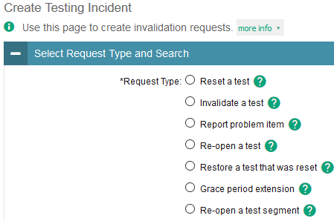
How to Enter a Testing Incident in TIDE
Step 1: Select a category
Step 2: Select a Search
Step 3: Enter Student SSID
Task or Site |  | PR* | TC*
Creating Test Incidents |  |  | ✔
Retrieving Testing Incidents | ▪ | ✔ | ✔
Creating Testing Incidents through File Uploads |  |  | ✔

Slide 57
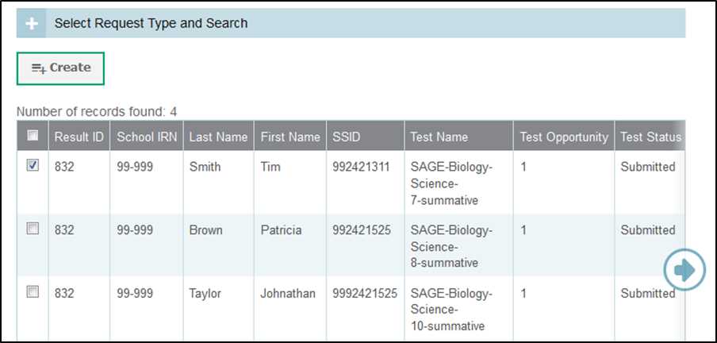
How to Enter a Testing Incident in TIDE (cont.)
Then click Search Student Results
Next click Create and then, enter a reason for the request in the window that pops up, then click Submit

Slide 58
Day 2 Activity #3 Breakout: Addressing Test Security at Your School
Based on what you’ve just heard….
How are you addressing test security at your school?
Effective policies and procedures
Ongoing challenges
Suggestions for others

Slide 59
BREAKTIME

Slide 60
After Testing
Central Reporting System
Documenting Non-Participation

Slide 61
Reporting: School and Student Results
The Online Reporting System is being retired
The Centralized Reporting System (CRS) (aka AirWays Reporting) is taking its place

Slide 62
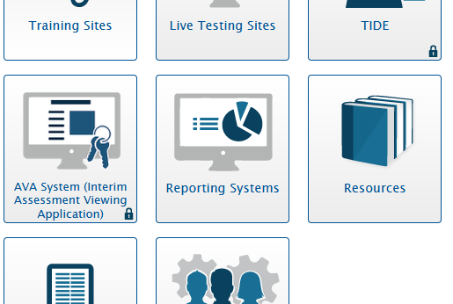
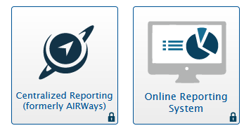
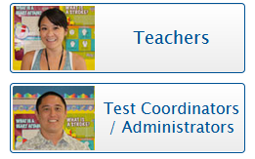
The Centralized Reporting System
See the Centralized Reporting User Guides for more detailed information
Centralized Reporting for Interim Assessments User Guide 2020-2021
Centralized Reporting for Summative Assessments User Guide 2020-2021
Access to the CRS reports and features depends on your user role.

Slide 63
CRS Training Resources
CRS Training Videos CRS Tutorial: How to Navigate the Dashboard and Access Your Summative Results CRS Tutorial: How to Understand Measures for Standards, Depth of Knowledge (DOK) Levels, and Writing Dimensions CRS Tutorial: How to Understand a Demographic Breakdown Report and a Student Portfolio Report CRS Tutorial: How to Drill Down into Your Results by Selecting Specific Tests and Classes CRS Tutorial: How to Drill Down into Your Results by Selecting Previous School Years and Previous Students CRS Tutorial: How to Track Student Performance Over Time Using the Longitudinal Report CRS Tutorial: How to Print Individual Student Reports (ISR) and Student Data Files CRS Tutorial: How to Print and Export Data You Can See in Your Reports CRS Tutorial: How to Use the Roster Manager to Add, Modify, and Upload Rosters CRS Tutorial: How to Analyze Basic Interim Assessment Reports CRS Tutorial: How to Use the Advanced Features of the Reporting System to View Your Interim Assessment Data CRS Tutorial: How to Hand-Score Unscored Items and Modify Machine Scores
CRS Training PowerPoints
Centralized Reporting Training Module (Non-Narrated) 2019-2020
Centralized Reporting Mini-Module: How to Print Individual Student Reports (ISRs) and Student Data Files
Centralized Reporting Mini-Module: How to Print and Export Data You Can See in Your Reports
Centralized Reporting Mini-Module: How to Use the Roster Manager to Add, Modify, and Upload Rosters
Centralized Reporting Mini-Module: How to Analyze Item-Level Reports
Centralized Reporting Mini-Module: How to Hand Score Unscored Items and Modify Machine Scores
Centralized Reporting Training Module 2020-2021 (Coming Soon)

Slide 64
Let’s watch !!!
CRS Tutorial: How to Navigate the Dashboard
and Access Your Summative Results
https://files.portal.cambiumast.com/Media/RS+1+Final/RS+1+Final.html
We will go into more of the CRS in our training for all TCs after Winter Break

Slide 65
Exploring CRS
Let’s take a few minutes for you to explore CRS!
Log in to your school using your TIDE Username and Password
Check out Score Reports and Retrieve Student Results

Slide 66
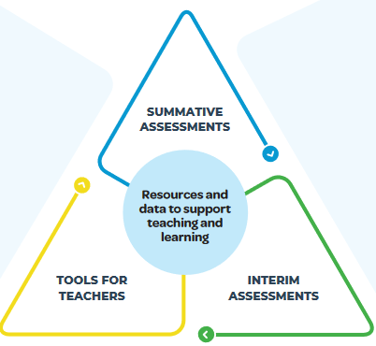
Interim Assessments and Tools for Teachers

Slide 67
INTERIM ASSESSMENTS
Tools for Teachers
•Flexible tests administered throughout the year to help teachers monitor student progress
•Provides educators with data to help them target instruction to meet students’ individual learning needs
•Full-length assessments and shorter assessment “blocks,” designed for grades 3-8 and high school, enable educators to choose the right assessment tool at the right time.
•Classroom resources you can use today
• Lessons and activities created by educators to enhance instruction and save time
•Embedded formative assessment strategies and connections to interim assessment items
•Links to additional resources for educators to facilitate seamless access to relevant content.
Tools for Teachers has replaced the Digital Library

Slide 68
Non-Secure but Non-Public
The interim assessments are considered non-secure and non-public.
Because the interims are non-secure, they are not intended to be used for accountability purposes.
Non-secure means teachers and students can have access to the items, answers, and student responses.
Non-public means they are not to be posted publicly (such as on a school website).
Schools and departments should be “on the same page” regarding Interim Assessments. School leaders may want to establish a timeframe and policies related to the use of the Interim Assessments.

Slide 69
Types of Interim Assessments at a Glance

Slide 70
Interim Assessments: ICAs
The Interim Assessments are intended to gauge student progress.
The Interim Comprehensive Assessment (ICA) is a complete assessment based on the Summative Assessment blueprint.
ICAs have been updated to reflect changes to the Summative blueprint.
ELA/L will include both CAT and shortened PT. Math will include CAT only
Both ELA/L and Math ICA are completely machine scored and results will be available “immediately”.
In ELA/L, Both the CAT and PT must be completed for a student to get results for the ICA.
Although students have five opportunities, all of these tests are fixed form – there is only one version of each.
Notes:
The Interim Assessments are intended to support teaching and learning by gauging student progress towards attaining the knowledge and skills called for in the Common Core State Standards as they are measured by the Smarter Balanced Summative Assessment.
The Interim Comprehensive Assessment (ICA) is a complete assessment based on the Summative Assessment blueprint including Computer Adaptive Test , Performance Tasks. The classroom Activities will be discussed more a little later.
The Interim Assessment Blocks (IABs) are shorter, focused assessments that provide more detailed information for instructional purposes.
Grades 3-8 and high school are supported. At the high school level, the assessments are consistent with the grade 11 summative design and may be administered in grades 9, 10, 11, and/or 12.
Both the ICA and IABs can only be administered in a proctored test session set up by a certified Test Administrator using the TA Live Site and accessed by students using the HISecure Browser.
Constructed response items within the CAT portion of the ICA and the ICA Performance Tasks require hand scoring at the school level. This scoring must be completed for students results to become available.
Both the CAT and PT and all hand scoring must be completed for a student to get results.

Slide 71
Interim Assessments: IABs
The Interim Assessment Blocks (IABs) are shorter, focused assessments that provide more detailed information for instructional purposes. They assess 3 to 8 targets.
Mathematics PT Interim Assessment Blocks will remain available to teachers who wish to use them.
Although students have five opportunities, all of these tests are fixed form – there is only one version of each.
The Focused Interim Assessment Blocks (FIABs) are even more focused, assessing 1 to 3 targets.
Interim test blueprints can be found at alohahsap.org
See: SB Interim Assessment Fact Sheet, SB Interim Test Administration Guide, NGSS Interim Assessment Fact Sheet, NGSS Interim Test Administration Guide
Notes:
The Interim Assessments are intended to support teaching and learning by gauging student progress towards attaining the knowledge and skills called for in the Common Core State Standards as they are measured by the Smarter Balanced Summative Assessment.
The Interim Comprehensive Assessment (ICA) is a complete assessment based on the Summative Assessment blueprint including Computer Adaptive Test , Performance Tasks. The classroom Activities will be discussed more a little later.
The Interim Assessment Blocks (IABs) are shorter, focused assessments that provide more detailed information for instructional purposes.
Grades 3-8 and high school are supported. At the high school level, the assessments are consistent with the grade 11 summative design and may be administered in grades 9, 10, 11, and/or 12.
Both the ICA and IABs can only be administered in a proctored test session set up by a certified Test Administrator using the TA Live Site and accessed by students using the HISecure Browser.
Constructed response items within the CAT portion of the ICA and the ICA Performance Tasks require hand scoring at the school level. This scoring must be completed for students results to become available.
Both the CAT and PT and all hand scoring must be completed for a student to get results.

Slide 72
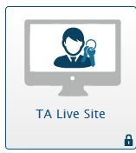
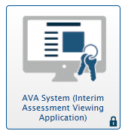
Interim Assessments AVA, Centralized Reporting, Tools for Teachers
Administered using the TA Live Site and Secure Browser
Assessment Viewing Application (AVA) is a component of the Online Testing System that allows users to view the Smarter Balanced Interim Assessment items.
Centralized Reporting provides student performance reports for the Interim Assessments including rescore option.
Tools for Teachers is an online collection of high-quality instructional and professional learning resources many of which are connected to the Interim Assessment Blocks.
Notes:
The Interim Assessments and the information gained from them as well as the resources available to support teachers to “act on the results” continue to grow every year.
There are now…AVA…etc.
Do remember the Interims are administered in the same way as the summative assessments…TA Live and Secure Browser !!!

Slide 73
Interim Assessment Resources
Assessment Viewing Application User Guide 2020-2021
ELA Focused Interim Assessment Blocks Blueprint
Focused Interim Assessment Blocks and Interim Assessment Blocks Differentiated in the TA Live Site
Focused Interim Assessment Blocks and Interim Assessment Blocks Differentiated in the Interim Assessment Viewing Application (AVA)
Guide to Remotely Administering Interim Assessments 2020-2021
Mathematics Focused Interim Assessment Blocks Blueprint
Smarter Balanced Assessment Playbook
Smarter Balanced Interim Assessments Fact Sheet 2020-2021
Smarter Balanced Interim Assessments Overview 2020-2021
Smarter Balanced Interim Assessments Test Administration Guide 2020-2021
Smarter Balanced Interim Assessments: A Beginner's Guide
Taking Tests from Home: A Quick Guide for Families
How to Check your Internet Speed
How to Take a Practice Test
Tools for Teachers Remote Teaching and Learning Website

Slide 74
Tools for Teachers Let’s watch !!!
What is Tool for Teachers
Tools for Teachers (2 Minute Introduction)
Tools for Teachers (20 Minutes)
There is a short introduction (2 min.) and a longer (20 min.) demonstration

Slide 75
Day 2 Activity #4: Breakout - Interims and Tools for Teachers
How are you using Interim Assessments and Tools for Teachers in your school?
Do you have any thoughts about using them better?

Slide 76
Questions
Feel free to unmute yourself or type your question in the chat box.

Slide 77
Who can assist if I have questions in the future?
Review the resources and documentation available on the portal at: http://alohahsap.org
Contact the HSAP Help Desk:
Hours: 7:30 am to 4:00 p.m. HST,
Monday-Friday (except holidays)
Phone: 1-866-648-3712 (toll free)
Email: HSAPHelpDesk@air.org
Contact the Assessment Section (808) 307-3636

Slide 78
We Are In This Together
1.Be mentally prepared
I am prepared for the worst, but hope for the best.
2.Take stock of all you’ve been through already
The hardships and misfortunes you’ve been through can give you confidence that you’re capable of handling whatever comes your way. Your past experiences can help you find your inner strength and resilience.
3. Make peace with the situation
Make peace with what happened. Accept the situation for what it is, and then move forward.
4. Embrace adversity as a chance for opportunity
It’s through difficult times like these that we learn the most important lessons in life and build resilience. The true secret to success is the ability to embrace adversity as a chance to change ourselves and our situation.

