Slide 1
Hawaii Statewide Assessment Program
Test Security Office Hour
To mute/unmute:
On your computer, click the microphone button in the Participants list
On phone - *6 to mute/unmute
(To call in dial 1-844-621-3956 access code 120 746 8646#)
February 18, 2021
Notes:
(In chat type: Good afternoon everyone!! We will be monitoring the Chat so please type in any questions you may have during the presentation using the chat box. We have staff who will keep track of them and be sure they get addressed as we go through the webinar. Thanks.; To join the conference call, dial 1-877-668-4493 and enter access code 120 746 8646#.)
This webinar is being recorded and will be posted to alohahsap.org after the rendering of the video has been completed.

Slide 2
Test Security
WHY DOES IT MATTER?
Consider what you are protecting:
Validity, fairness and reliability of assessments
Accountability determinations
Educational resource decisions
Professional standards
Federal and State funding
Public trust and confidence
Notes:
Secure test administration protects the integrity, validity, and confidentiality of assessment items, prompts, and student information. By assuring proper test administration you are protecting more than just fairness, validity and reliability of the results…you are maintaining trust and confidence that the results are accurate and can be used for high stakes purposes such as school and state accountbiltiy.

Slide 3
Test Security Goals
Test Security = Test Integrity
Test Integrity = Validity
A Test Security Incident can threaten the integrity of the assessment and undermine the VALIDITY of the assessment and all decisions based upon the results of the assessment.
Rigorous test security compliance protects validity and integrity.
Notes:
The goals of test security are to ensure test integrity which in turn protects test validity. Any deviation in test administration must be reported as a test security incident to ensure the validity of the assessment results.

Slide 4
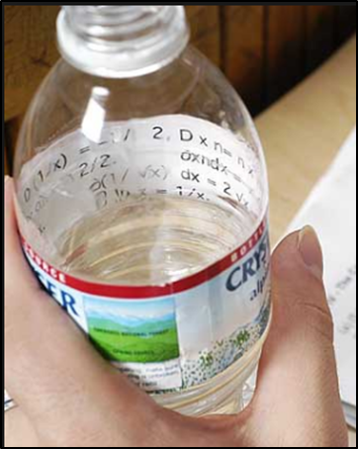
Why Is Training on Test Security Important?
Situations that can jeopardize the confidentiality of a state assessment or the validity of a student's test can occur:
anywhere
in a very short amount of time
Notes:
Test security breaches on statewide assessments can happen anywhere and at any time. Proper awareness of test security and what a test security breach is, as well as proper planning for unexpected events or circumstances, can help to prevent test security issues from occurring. This awareness and planning happen through training.

Slide 5
Test Security Policies and Procedures
The Importance of Following Policies and Procedures
The purpose of uniform policies and procedures is to ensure fairness of testing and validity of test results across the entire population of examinees.
Strictly adhering to established test policies and procedures ensures fairness and validity.
Deviations from policies and procedures can provide unfair advantages to some examinees and undermine validity.
LEARN AND REFER TO THE POLICIES AND PROCEDURES.
Notes:
Uniform policies and procedures are in place to ensure fairness of testing and the validity of test results for the entire population of those tested. Deviations from those policies and procedures can provide an unfair advantage to some students and undermine the validity of the results. It is important that test coordinators and test administrators learn the policies and procedures and refer to them whenever a question comes up with regard to proper test adminstraton.

Slide 6
Test Security Policies and Procedures
HSAP Policies and Procedures
Applicable Policies and Procedures for Statewide Assessments
Test Administration Manual (TAM)
Smarter Balanced TAM pages 16 - 25
Sec. 3: Ensuring Test Security
Sec. 4: Responding to Testing Improprieties, Irregularities, and Breaches
Appendices
P: Test Incident Reporting Form
V: Test Security and Administrative Procedures Acknowledgement Form for Proctors
AA: Test Administration and Proctor Acknowledgement of Security and Confidentiality Statement
Notes:
The Hawaii Statewide Assessment Program includes the Smarter Balanced, HSA Science, KAEO, HSA-Alternate and End-Of-Course Exams. The applicable policies and procedures for each assessment are found in the respective Test Administration Manuals (TAM). The Smarter Balanced TAM will be used in the presentation as an overview of the general policies and procedures for the Hawaii Statewide Assessment Program. Pages 16-25 of the TAM includes sections on Ensuring Test Security and Responding to Testing Improprieties, Irregularities, and Breaches. The Appendices include a number of test security forms including the Test Incident Reporting Form, Test Security and Administrative Procedures Acknowledgement Form for Proctors, and the Test Administration and Proctor Acknowledgement of Security and Confidentiality Statement

Slide 7
Test Security Policies and Procedures
Test Administration Manual Appendices:
F: Test Security Chart
J: School Principal Checklist
K: School Test Coordinator Checklist
L: School Test Administrator Checklist
M: School Technology Coordinator Checklist
N: School Student Services Coordinator Checklist
O: School Curriculum Coordinator Checklist
P: Test Incident Reporting Form
V: Test Security and Administrative Procedures Acknowledgement Form for Proctors
AA: Test Administration and Proctor Acknowledgement of Security and Confidentiality Statement

Slide 8
Test Security Roles and Responsibilities
The Role of the Test Coordinator (TC)
Attend training on policies and procedures.
Ensure TA’s properly trained and certified in test policies and procedures.
Monitor testing progress.
Address testing problems.
Review, investigate and report on all potential Test Security Incidents reported by TA.
Mitigate, document, and report all Test Security Incidents to Principal.
(See Smarter Balanced TAM Sec. 7; Appendix K.)

Slide 9
Test Security Roles and Responsibilities
The Role of the Test Administrator (TA)
Complete training and certification in test administration policies and procedures.
Administer tests.
Address testing problems.
Report all Test Security Incidents to TC and Principal.
(See Smarter Balanced TAM Sec. 7; Appendix L)

Slide 10
Test Security Roles and Responsibilities
The Role of the Teacher (TE)
Review all test administration and security policies and procedures.
Monitor testing progress.
Report all potential Test Security Incidents to TC consistent with state policies.
(See Smarter Balanced TAM 7; Appendix L)

Slide 11
Test Security Basics
Ensuring Test Security
All summative test items and test materials are secure and must be appropriately handled.
Security of the Test Environment
Security requirements for the test environment before, during, and after testing includes all aspects of the testing situation while students are testing.
If you have witnessed, been informed of or suspect a Test Security Incident, follow the steps outlined in section Responding to Testing Improprieties, Irregularities, and Breaches in the Smarter Balanced TAM on pages 20-22.
Notes:
Security requirements for the test environment before, during, and after testing includes all aspects of the testing situation while students are testing. and includes what a student can see, hear, or access (including access via technology).
TAs and TCs or other individuals who have witnessed, been informed of, or suspect the possibility of a test security incident that could potentially affect the integrity of the assessments or the data should follow the steps outlined in Section 4: Responding to Testing Improprieties, Irregularities, and Breaches in the TAM on pages 20-22.

Slide 12
Reporting Test Security Incidents
When it comes to Test Security Incidents:
ALL staff members at a school are required to report testing incidents.
Testing incidents that do not involve the Test Coordinator should also be reported immediately to the Test Coordinator.
Principals who have witnessed, been informed of, or suspect the possibility of a testing incident that could potentially impact the integrity of the assessments or tests and test results should immediately contact the Assessment Section.
(Smarter Balanced TAM p.22)

Slide 13
Test Security Incidents
Examples of Test Security Incidents
Answer coaching or prompting (e.g., “check your work” or “good job” or “keep trying” or nonverbal cues)
Viewing assessment content or student responses
Possession or use of electronic devices
Accessing prohibited material
Allowing untrained persons to participate in testing
Student answer copying or sharing
Recording or “harvesting” assessment content
Academic content visible on walls of testing room

Slide 14
Test Security Incidents
When a Test Security Incident is detected, you must first determine the severity of the incident.
Does the incident threaten the VALIDITY of the assessment?
What is the scope of the validity threat?
Categorize the incident
Impropriety
Irregularity
Breach
(See Smarter Balanced TAM p. 21; Appendix F)

Slide 15
Definitions of Test Security Impropriety
Impropriety (Low Severity)
Has a low impact on the individual or group of students who are testing and has a low risk of potentially affecting student performance.
Examples
Student(s) making distracting gestures/sounds or talking during the test session that creates a disruption in the test session for other students.
Student(s) leave the test room without authorization.
Administrator or Coordinator leaving related instructional materials on the walls in the testing room.
Notes:
There are 3 types of Test Security Incidents: Improprieties, Irregularities, and Breaches. These are behaviors prohibited either because they give a student an unfair advantage or because they compromise the secure administration of the assessments. Whether intentional or by accident, failure to comply with security rules, either by staff or students, constitutes a test security incident. Improprieties, Irregularities, and Breaches need to be reported in accordance with the instructions in this section for each severity level.
The 1st Incident level is an Impropriety.
An Impropriety is an unusual circumstance that has a low impact on the individual or group of students who are testing and has a low risk of potentially affecting student performance on the test, test security, or test validity.
[Read examples of Impropriety.]
[To report a Test Impropriety: read yellow boxes]

Slide 16
Definitions of Test Security Irregularity
Irregularity (Medium Severity)
Impacts an individual or group of students who are testing and may potentially affect student performance.
Examples
Student(s) cheating or providing answers to each other, including passing notes, giving help to other students during testing, or using hand-held electronic devices to exchange information.
Student(s) accessing the Internet or any unauthorized software or applications during a testing event.
Student(s) accessing or using unauthorized electronic equipment (e.g., cell phones, calculator, smart watch or electronic translators) during testing.
Notes:
The 2nd Incident level is an Irregularity.
An Irregularity is an unusual circumstance that impacts an individual or group of students who are testing and may potentially affect student performance on the test, test security, or test validity.
[Read examples of Irregularity]
[To report Test Irregularities read orange boxes]

Slide 17
Definition of Test Security Breach
Breach (High Severity)
Poses a threat to the validity of the test. Examples may include such situations as a release of secure materials or a security/system risk.
Notes:
The 3rd Incident level is a Breach.
A Breach is the highest security incident level.
A Breach is an event that poses a threat to the validity of the test. Examples may include such situations as a release of secure materials or a security/system risk. These circumstances have external implications for the Consortium and may result in a Consortium decision to remove the test item(s) from the available secure bank.
Some examples of a breach include:
A Test Administrator or Coordinator modifying student responses or records at any time.
An adult or student posting items or test materials on social media (Twitter, Facebook, etc.).
An adult or student copying, discussing, or otherwise retaining test items, reading passages, writing prompts, or answers for any reason. This includes the use of photocopiers or digital, electronic, or manual devices to record or communicate a test item.
[To report a Breach read white and red boxes.]

Slide 18
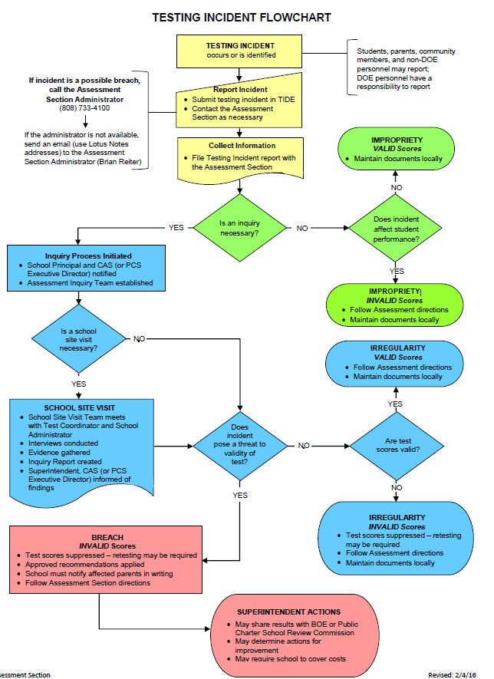
Testing Incident Flowchart

Slide 19
Test Security Incident Response Essentials
Whenever an Incident occurs, get the facts straight.
Record date, time and location (school and room identifier) of incident.
Identify grade level and specific test component(s) at issue (i.e., Grade 4, ELA Section 1).
Identify the Test Administrator (and Proctor) assigned to the testing room.
Determine key facts/allegations as quickly as possible.
List all persons with knowledge of incident (i.e., school staff and students).
Briefly summarize knowledge of each participant and witness.
Identify and preserve relevant evidence (may include seating charts, social media posts, text messages, photographs).
Include all facts in reports to District and State.
Notes:
Although it is very important to follow all of the protocols for reporting incidents, it is critical to gather as much information as is available as close in time as possible to any security incident. The timely and thorough gathering of facts around incidents ensures that the District and the State have sufficient information to assess the scope of potential risk to the assessment program and to make reliable decisions after the fact related to score validity, and the need for possible additional consequences.

Slide 20
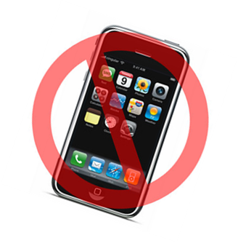
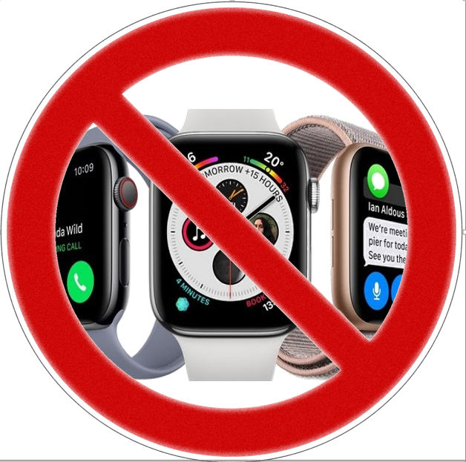
Protocol for Incidents Involving Cell Phones and Electronic Devices
If a student is caught with cell phone or electronic device during a testing session, you need to report this and take immediate action:
Confiscate phone and take it to the Test Coordinator/Principal
Have principal go through the phone checking students
Instagram
Facebook
Text messages
Snapchat
Photo albums/phone/cloud storage
Contact every person in the students list per social media account if the photos or test related messages are found on the phone
Report to the Assessment Section immediately !!

Slide 21
Consequences of a Test Security Breach
Due to the importance of test security for all of the statewide assessments, any school that has a student or staff member whose actions result in a breach of a test item will be subject to the following actions/consequences:
Involved student’s incomplete test or complete test that has been scored will be invalidated.
Retrain the staff.
Retake the Test Administrator Certification Course.
Required to have a second adult present in the testing room.
The school will be required to pay for the cost of each test item that was posted on a social networking site.
Must submit its detailed testing schedule that includes the date, time, and student seating chart for each test session for all statewide assessments administered.
Unannounced site monitoring.
Notes:
Due to the importance of test security for all of the statewide assessments, any school that has a student or staff member who which results in a breach of a test item will be subject to the following actions/consequences:
1. The involved student’s incomplete test or complete test that has been scored will be invalidated by the Department of Education’s Student Assessment Section.
2. The school administration and test coordinator must retrain the staff regarding the test security requirements for all statewide assessments during a face-to-face meeting.
3. The test administrator who was conducting the test session when the breach occurred will be required to retake the Test Administrator Certification Course.
4. The school will be required to have a second adult present in the testing room with the test administrator who was conducting the test session when the breach the security occurred for the remainder of the current school year.
5. The school will be required to pay for the cost of each test item that was posted on a social networking site which required its removal from the current online, adaptive item bank.
6. The school must submit its detailed testing schedule that includes the date, time, and student seating chart for each test session for all statewide assessments administered during the remainder of the current school year and the next school year.
Unannounced site monitoring by the Complex Area Superintendent’s identified staff and the Systems Accountability Office’s staff, may extend beyond one school year.
Are there any questions regarding test security?

Slide 22
TIDE > Administrating Tests Testing Incidents

Slide 23
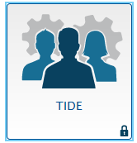
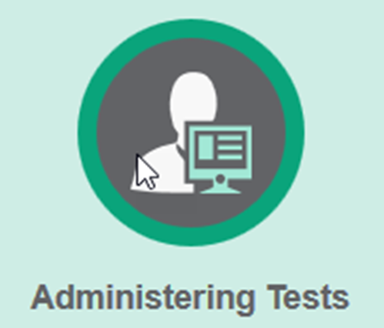
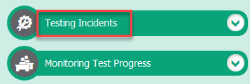
How to Enter a Testing Incident in TIDE
Click on the TIDE icon:
Once in TIDE, under Administering Tests click Testing Incidents:
Then click on
Create Testing Incident:
Notes:
Once a Test Incident is identified, you will need to input it into TIDE.
This is how you enter a Test Security Incident in TIDE.
*Read steps to input Test Incident into TIDE.

Slide 24
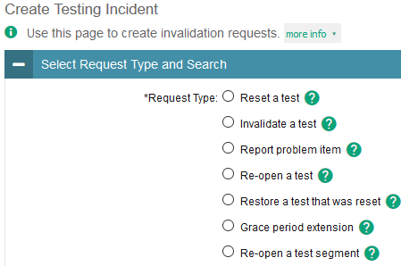
How to Enter a Testing Incident in TIDE (cont.)
Step 1: Select a category
Step 2: Select a Search
Step 3: Enter Student SSID

Slide 25
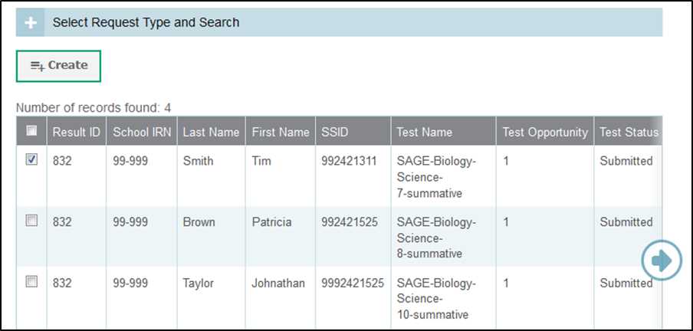
How to Enter a Testing Incident in TIDE (cont.)
Then click Search Student Results
Next click Create and then, enter a reason for the request in the window that pops up, then click Submit

Slide 26
Test Administration Site Monitoring
Testing Best Practices and Federal Guidelines both call for Site Monitoring to ensure the fidelity of test administration and monitor test security to prevent irregularities and ensure the integrity of test results.
Also, per DOE Memo “Assessment Monitoring Site Visits”, the Assessment Section is called upon to regularly conduct school visits during statewide assessment windows to observe test administration and to gather information from school test coordinators about state assessment administration training, management and practices.
HIDOE is called upon to monitor test administration in its schools to ensure that appropriate assessments are selected for all students with disabilities and ELs so that they are appropriately included in assessments and receive the accommodations and supports.

Slide 27
Test Administration Site Monitoring SY 2020-2021
Due to the pandemic, site visits may be conducted virtually via Webex to maintain the safety and security of all students and staff. Should a site visit be conducted in-person, all Department and school safety protocols and procedures will be followed.
Please note that any school may be selected for site visits so all public and public charter schools should anticipate the presence of an assessment monitor during the administration of any statewide summative assessment during their respective testing windows.
See the Quality Assurance and Assessment Monitoring
Site Visits DOE memo (01/12/2021)

Slide 28
Questions?
To unmute:
Click on Participants list then click on the microphone next to your name
If you are calling in, Press *6 to unmute your phone
Type in questions in Chat (address to “Everyone”)

Slide 29
SY 2020-21 Assessment Section Office Hour Webinar
NEXT:
HSAP Office Hour Webinar
March 18, 2021, 2:30 PM

