Slide 1
How to use the roster manager to add, modify, and upload rosters
The Centralized Reporting system series #9
Copyright © 2020 Cambium Assessment, Inc. All rights reserved.
Notes:
Welcome to training module #9 in the Centralized Reporting System series: How to Use the Roster Manager to Add, Modify, and Upload Rosters. Class rosters are a great way to organize students, allow teachers to view their students’ performance, and allow all users to compare the performance of different classes or groups.

Slide 2
Objectives
Understand how rosters can be useful
Access the Roster Manager
Add a new roster
View or modify an existing roster
Upload multiple new rosters or edits to existing rosters using a template
2
Notes:
In this training module we briefly explain how rosters can be useful; then we show you how to add a roster, how to view or modify an existing roster, and how to upload multiple new rosters or edits to existing rosters using a template.
To start out, we explain how rosters are useful.

Slide 3
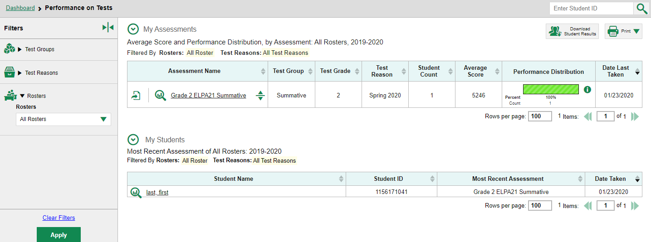
Understand How Rosters Can Be Useful
3
Notes:
There are advantages to creating and modifying rosters for students you have identified as sharing certain characteristics or belonging to a specific group. For example, any roster you create will appear in the Performance by Roster tab of reports and also in the Roster Performance on Test reports.
If you are a school user or teacher, you can filter for a particular roster using the Rosters filter on the left side of the Performance on Tests page.
Next, we show you how to access the Roster Manager that allows you to create and modify rosters.

Slide 4
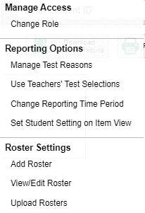
Access the Roster Manager with My Settings
4
Notes:
In Centralized Reporting, the Roster Manager tool can be accessed using the My Settings drop-down menu from the banner. The Roster Settings you see listed in your menu vary by state, district, and user role. Here you see the options Add Roster, View or Edit Roster, and Upload Rosters.

Slide 5
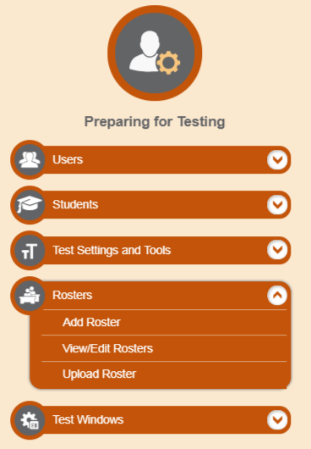
Access the Roster Manager in TIDE
Notes:
You may be familiar with the Roster Manager tool from using it in the Test Information Distribution Engine, or TIDE. It works the same way in both systems.
On the next slides, we show you how to add a roster.

Slide 6
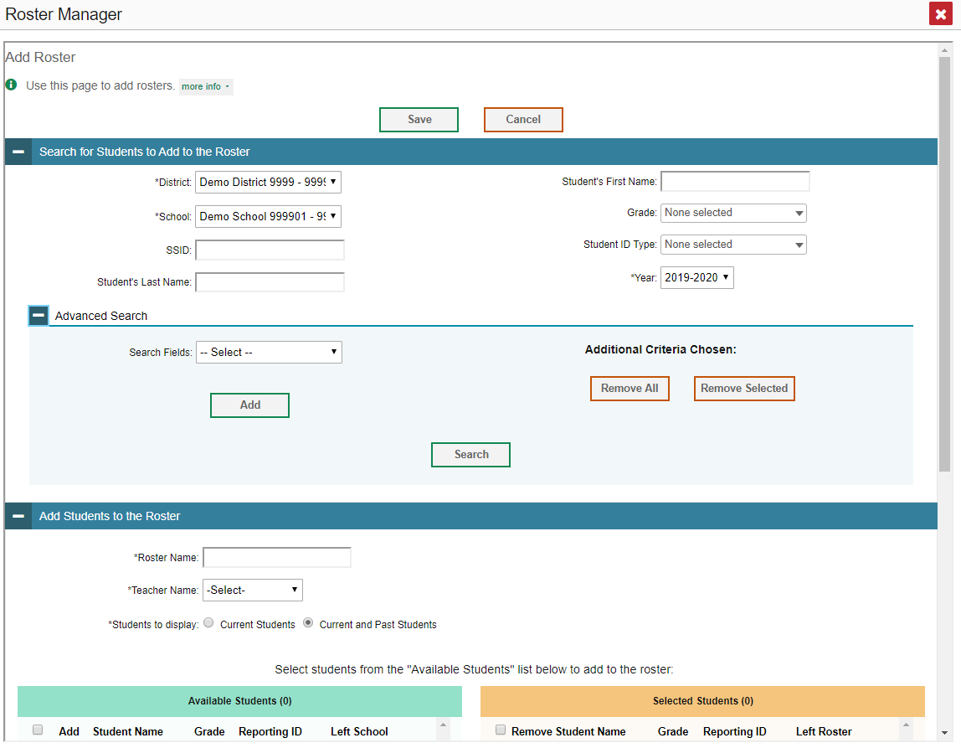
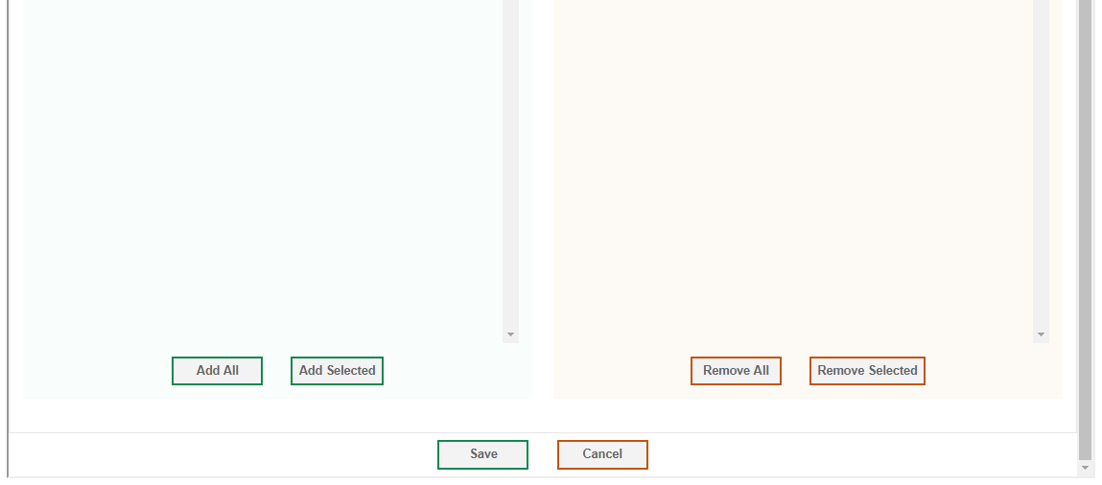
Add Roster
1. Search for Students to Add to the Roster:
Complete mandatory selections (*)
Search categories: SSID, Last Name, First Name, Grade, etc.
Advanced Search
Various demographic options are available
To modify criteria: Remove All and Remove Selected buttons
CLICK SEARCH
2. Add Students to the Roster
Name the roster; select a teacher name
Choose current students or current and past students
6
Notes:
To add a new roster, open the My Settings menu in the Reporting banner and select Add Roster. The Roster Manager window displays. This window contains more info buttons, which when clicked display instructions for completing the fields specific to each page. You can click on them at any step in the process.
The Add Roster page is organized into two panels, each headed by a blue bar. The top panel is Search for Students to Add to the Roster and the bottom panel is Add Students to the Roster.
To search for students that you want to add to your roster, complete the fields under the Search for Students to Add to the Roster panel. The fields marked with an asterisk are mandatory. Search categories are determined by your state and may vary from the sample shown here. Use the options under Advanced Search to further refine your search. Then click Search at the bottom of the panel.
Next, in the Add Students to the Roster panel, name the new roster, associate it with a teacher, and choose whether to display only current students or current and past students. Past students include those who have left the selected school.

Slide 7
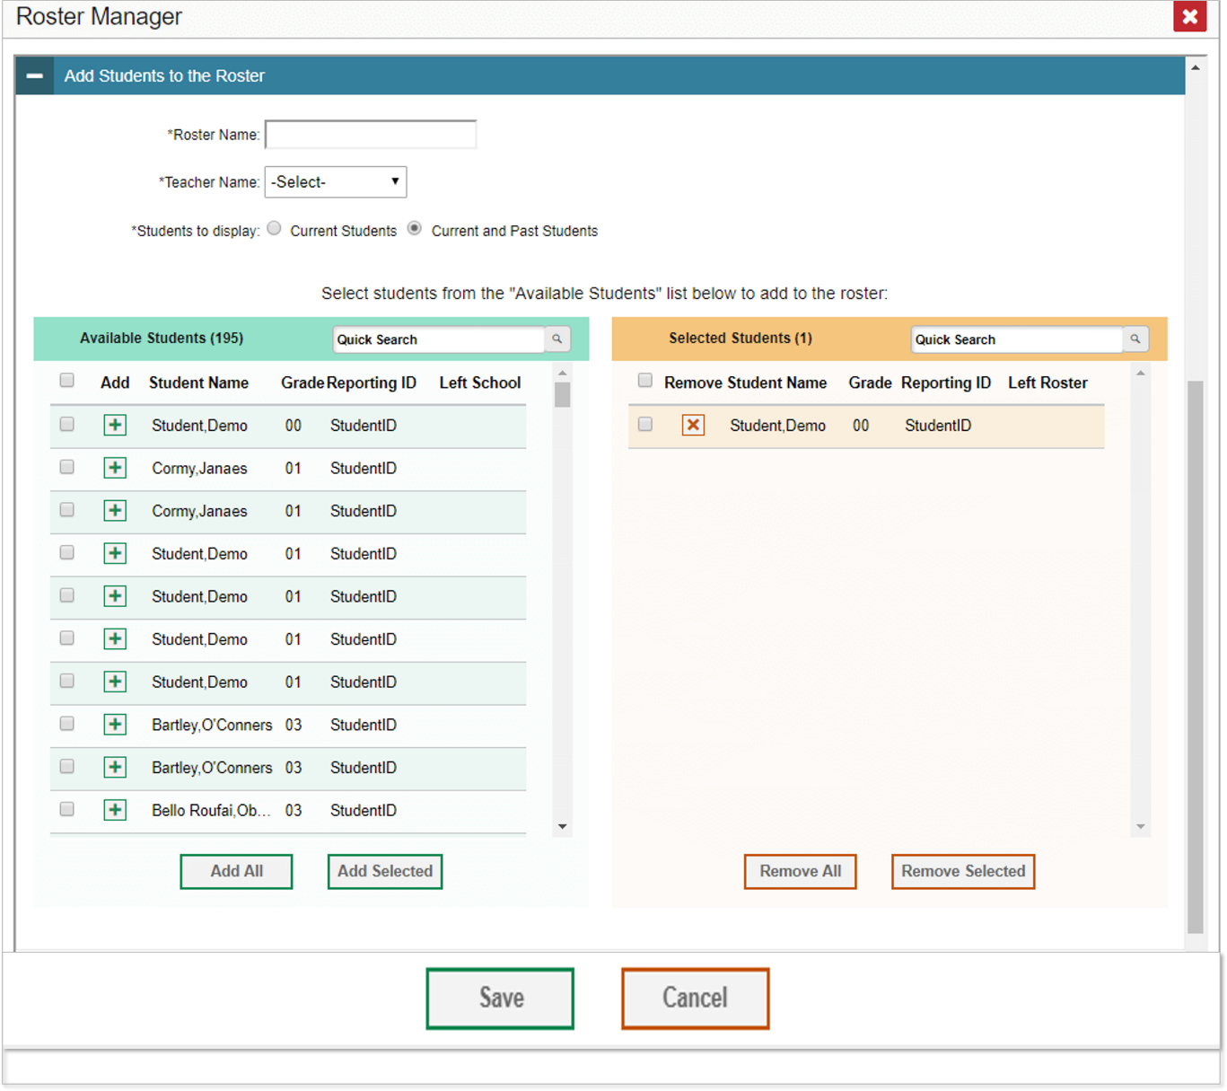
Add Roster (continued)
Add Students to the Roster:
Move students from the green Available Students list to the orange Selected Students list
Click Save
7
Notes:
The Roster Manager window updates to list available students under the green header on the left. Click the plus sign button beside a student’s name to move that student from the green Available Students list to the orange Selected Students list. To add multiple students at once, select them using the checkboxes and click Add Selected, or simply click Add All.
You can remove individual students from the roster by clicking the orange X button next to the student name. To remove multiple students, use the Remove All or the Remove Selected buttons. When you’re finished constructing your roster, click Save. The new roster will appear in any future roster search as a user-defined roster.
Next, we show you how to view or modify a roster.

Slide 8
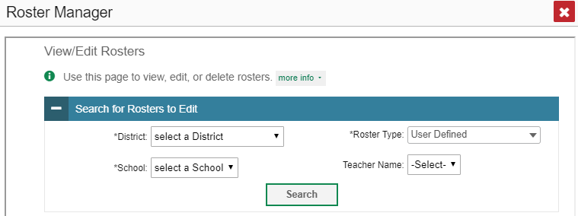
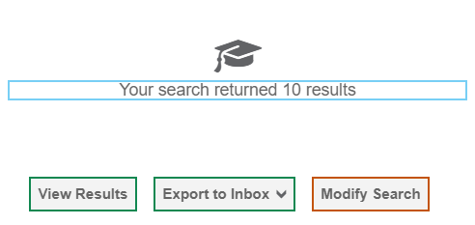
View/Edit Roster
8
Notes:
You can modify a class roster by changing its name, changing its associated teacher, adding students, or removing students. To view or edit an existing roster, choose the View/Edit Roster option from the My Settings menu.
The View/Edit/Export page displays a Search for Rosters to Edit panel. The mandatory search boxes, marked with an asterisk, must be completed. The Roster Type box allows you to limit the search to User Defined rosters, System Defined rosters, or both. You can focus the search results by entering a teacher name as well. Make your choices and click Search. A search results notification window appears, as shown at the bottom right of this slide.
Click View Results to continue. Note that you may also see the option Export to Inbox.

Slide 9
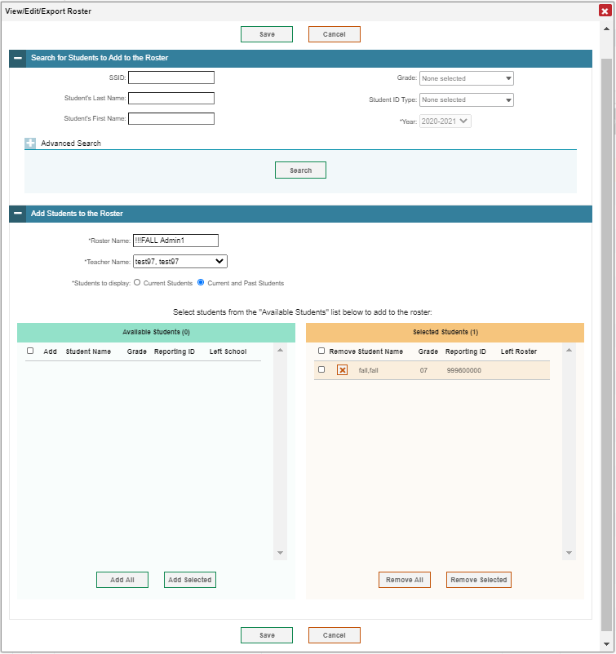
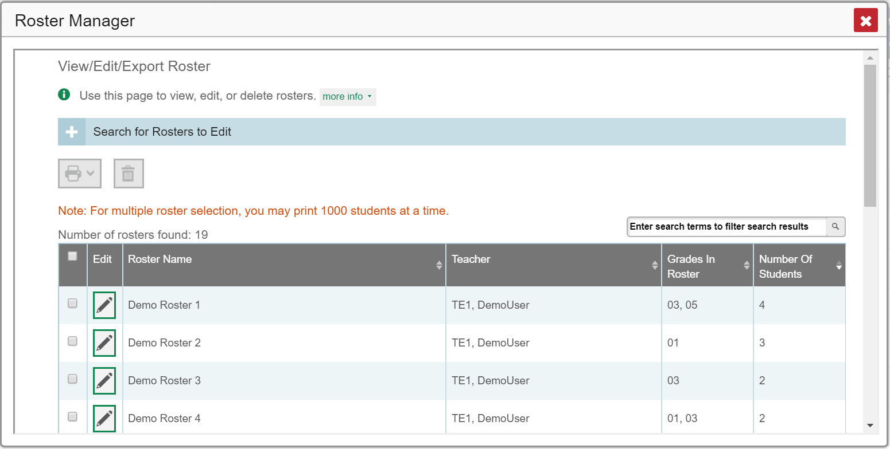
View/Edit Roster (continued)
Notes:
A list of retrieved rosters appears, as shown on the left side of this slide. Click the pencil edit button for the roster you want to view or edit. A new window opens, as shown on the right.
Like the Add Roster page, this window contains two Search and Add panels: Search for Students to Add to the Roster and Add Students to the Roster. You can search for students to add to the roster by completing the search fields, or you can remove students.
You can also choose whether to display only current students or current and past students. If you include past students, the Available Students list will include students who have left the selected school, while the Selected Students list will include students who have left the roster.
In addition to adding or removing students, you can change the roster name, or you can assign the roster to a different teacher. Click the Save button after making your changes.
Next, we show you how to upload new rosters and edits to existing rosters.

Slide 10
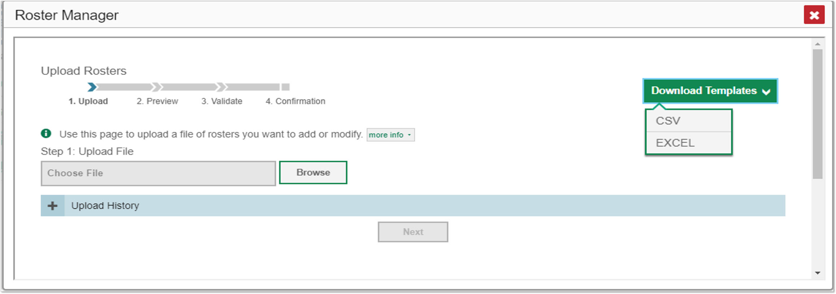
Upload Rosters Using a Template
10
Notes:
If you have multiple rosters to create or modify, it may be easier to use file uploads. This task requires familiarity with composing comma-separated values (CSV) files or working with Microsoft Excel.
Choose the Upload Roster option from the My Settings menu. The Roster Manager window displays, showing the Upload Rosters page. The Roster Manager window for the Upload Roster function requires four steps: Upload, Preview, Validate, and Confirmation. To begin, click the Download Templates button at the upper right and select the file type you prefer. A template downloads. Open the template, enter the required information, and save it to your computer.
A sample Excel worksheet showing a filled-out template is shown at the bottom of this slide. The next slide presents guidelines for filling out the template.

Slide 11
Upload Rosters—Template Guidelines
Column Name | Description | Valid Values
Complex Area ID* | Complex Area associated with the roster. | Complex Area ID that exists in TIDE. Up to 20 characters.
Complex ID* | Complex associated with the roster. | Complex ID that exists in TIDE. Up to 20 characters. Must be associated with the Complex Area ID. Can be blank when adding complex area-level rosters.
User Email ID* | Email address of the teacher associated with the roster. | Email address of a teacher existing in TIDE.
Roster Name* | Name of the roster. | Up to 20 characters.
SSID* | Student’s unique identifier within the district. | Up to 30 alphanumeric characters.
Action | Action to be taken on the student, either adding them to or deleting them from the roster. If blank, the student will be added. | Add or Delete.
*Required field.
11
Notes:
This table shows you how to fill out the roster template.

Slide 12
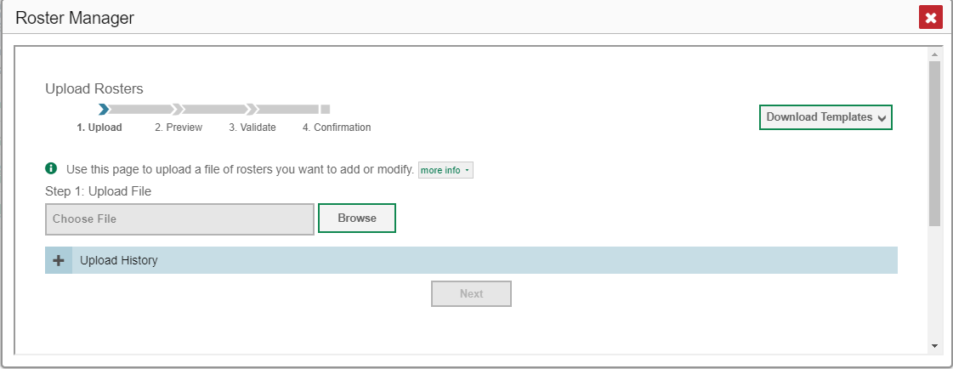
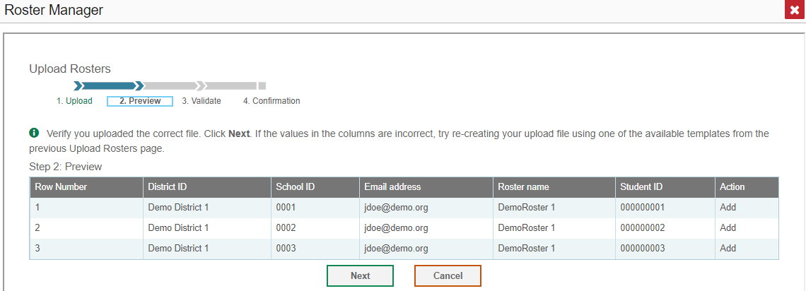
Upload Rosters (continued)
12
Notes:
On the same Upload Rosters page, click the Browse button and select the file you created. Click Next. The Preview Page appears. Review the data in the table and verify that you uploaded the correct file. Click Next to validate the file.

Slide 13
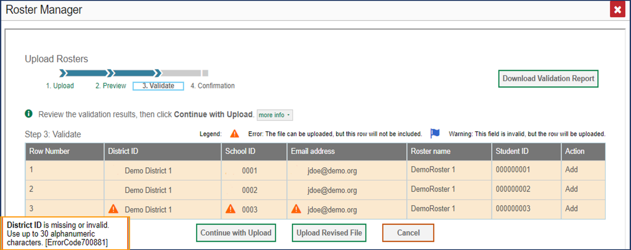
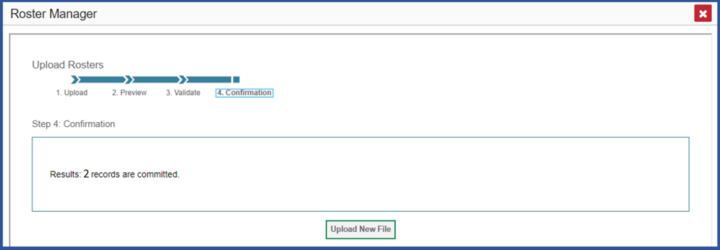
Upload Rosters (continued)
13
Notes:
In the Validate step of uploading, you can view any errors or warnings generated by your upload. If a row contains an error, signified by an orange triangle icon, that row will not be included in the upload. If a row contains a warning, signified by a blue flag icon, that row will be uploaded, but the field with the warning will be invalid. Click the icons to view the reasons for the errors and warnings. Your choices at this step are to Continue with Upload, Upload a Revised File, Cancel, or Download a Validation Report.
If you continue with the upload, the Confirmation Page appears, as shown at the bottom of this slide. It displays a message saying how many records were committed. Close the window or, to upload a new file, click the Upload New File button.

Slide 14
The Centralized Reporting System Series
1. How to Navigate the Dashboard and Access Your Summative Results
2. How to Understand Measures for Standards, Depth of Knowledge (DoK) Levels, and Writing Dimensions
3. How to Understand a Demographic Breakdown Report and a Student Portfolio Report
4. How to Drill Down into Your Results by Selecting Specific Tests & Classes
5. How to Drill Down into Your Results by Selecting Previous School Years & Previous Students
6. How to Track Student Performance Over Time Using the Longitudinal Report
7. How to Print Individual Student Reports (ISR) and Student Data Files
8. How to Print and Export Data You Can See in Your Reports
9. How to Use the Roster Manager to Add, Modify, and Upload Rosters
10. How to Analyze a Basic Interim Test Report
11. How to Use the Advanced Features of Reporting to View Interim Data
12. How to Hand-Score Unscored Items and Modify Machine Scores
Interim and Benchmark Assessments Only
Notes:
Thank you for viewing this training module on how to use the Roster Manager to add, modify, and upload rosters to the Centralized Reporting System. The full series is posted on the HSAP portal.

Slide 15
More Help
Further Information: Centralized Reporting Guide 2020–2021
HSAP Portal Website: https://alohahsap.org/
HSAP Help Desk Email: hsaphelpdesk@cambiumassessment.com
Help Desk Phone Number: 1-866-648-3712
Notes:
For detailed information on this system, consult your Centralized Reporting Guide 2020–2021, located on your HSAP portal, or contact your Help Desk.

