Slide 1
How to drill down into your results by selecting previous school years and previous students
Centralized reporting system series #5
Copyright © 2021 Cambium Assessment, Inc. All rights reserved.
Notes:
Welcome to the fifth module in the Centralized Reporting System training series: How to Drill Down into Your Results by Selecting Previous School Years and Previous Students. These settings are used to go back in time to compare current data with previous years’ data.

Slide 2
Objectives
Use your My Settings option to:
Understand how to see your current students’ test results from previous years
Understand how to see your former students and their results
Notes:
By default, your reports in Centralized Reporting display test opportunities only for the current school year, with current student data. The two exceptions to this are the Longitudinal Report and the Student Portfolio Report. There are times when it is helpful to compare your current students’ test scores to data from previous years and to results from your former students. This video is designed to teach you to use your settings to see your current students’ test results from previous years AND to see the results of your former students.

Slide 3
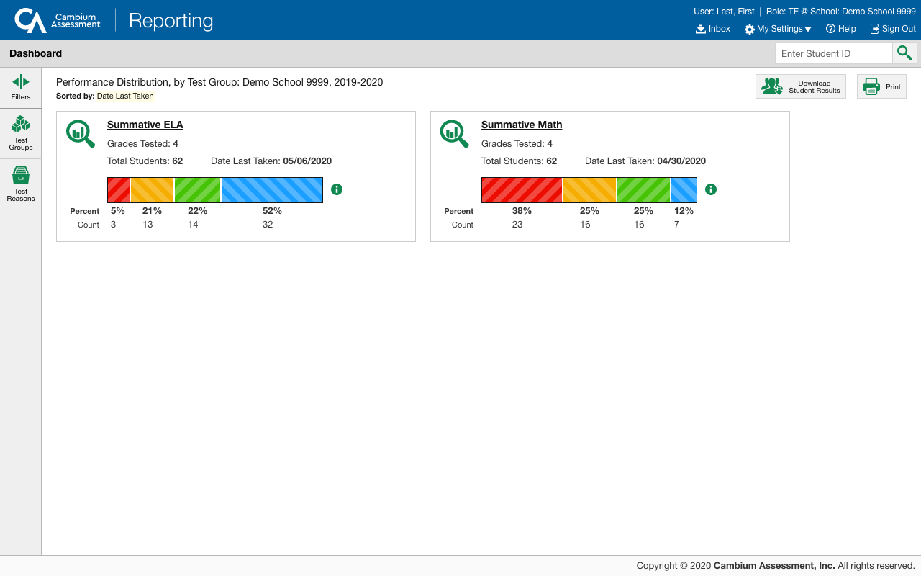
My Settings Button
1
Manage Access
Change Role
Reporting Options
Manage Test Reasons
Select Tests to Include on Reports
Change Reporting Time Period
Set Student Settings on Item View
Roster Settings
Add Roster
View/Edit Roster
Upload Rosters
2
Notes:
The My Settings button is located in the Reporting banner and includes several options. You can access the button from any page in the reporting system.
Click the expansion arrow on the right side of the button and select the setting Change Reporting Time Period.
A pop-up window with the same name appears.

Slide 4
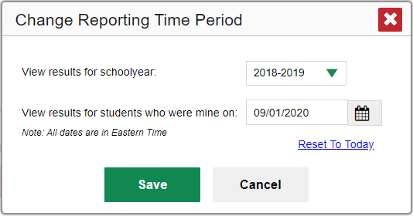
Current Students: Previous Year’s Results
Current Students: Previous Year’s Results
To view your current students' past performance, select the previous school year and leave the calendar date set to today.
4
Notes:
The Change Reporting Time Period pop-up window displays with two search fields: one for returning to a previous school year and one to use for returning to students who were assigned to you, as of a specific date, usually a time from a previous school year. You use one of the fields or both of them, depending on the data you want to return to. To see your current students’ previous results select a previous school year from the drop-down list. Leave the calendar date set to today or reset it, if necessary. This image displays those settings. Click Save. Your reports now show your current students’ test results from the year you selected.

Slide 5
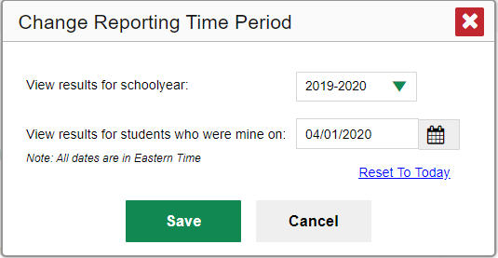
Former Students: Results from the Year You Taught Them
Former Students and Their Results: for comparison to current students
To view the performance of classes you taught in previous years, choose the previous school year and set the calendar date to a day within that year when the students had started testing.
Notes:
Sometimes you may want to contrast the results of your current classes with classes you had in the past. To do this, set the school year option to the desired year and then enter a calendar date within that particular year when you know the students had started testing. This will take you “back in time” to see the results of your former classes. The pop-up window displays these settings. Set like this, a teacher will see his or her students from last year and their results from that year.
You can start the drilling down process with this step when you know that you want results other than your current schoolyear results for your current students.
To return to the default settings click the Reset to Today link.

Slide 6
The Centralized Reporting System Series
1. How to Navigate the Dashboard and Read a Basic Summative Test Report
2. How to Understand Measures for Standards, Depth of Knowledge (DoK) Levels, and Writing Dimensions
3. How to Understand a Demographic Breakdown Report and a Student Portfolio Report
4. How to Drill Down into Your Results by Selecting Specific Tests & Classes
5. How to Drill Down into Your Results by Selecting Previous School Years & Previous Students
6. How to Track Student Performance Over Time Using the Longitudinal Report
7. How to Print Individual Student Reports (ISR) and Student Data Files
8. How to Print and Export Data You Can See in Your Reports
9. How to Use the Roster Manager to Add, Modify, and Upload Rosters
10. How to Analyze a Basic Interim Test Report
11. How to Use the Advanced Features of Reporting to View Interim Data
12. How to Hand-Score Unscored Items and Modify Machine Scores
Interim and Benchmark Assessments Only
6
Notes:
Over time you will learn the many configurations possible with the Change Reporting Time Period setting and you’ll be an expert at returning to exactly the results you want to see.
Thank you for viewing this video on selecting previous year’s data. More training modules are posted on the HSAP portal.

Slide 7
More Help
Further Information: Centralized Reporting System User Guide for Summative and Interim Assessments, 2021-2022
HSAP Portal Website: https://alohahsap.org/
HSAP Help Desk Email: hsaphelpdesk@cambiumassessment.com
Help Desk Phone Number: 1-866-648-3712
Notes:
For detailed information, consult your Centralized Reporting System User Guide for Summative and Interim Assessments, 2021-2022, located on the HSAP portal, or contact the Help Desk.

