Slide 1
How to Print Individual Student Reports (ISR) and Student Data Files
Centralized Reporting system series #7
Copyright © 2021 Cambium Assessment, Inc. All rights reserved.
Notes:
Welcome to the seventh training module in the Centralized Reporting System series: How to Print Individual Student Reports (ISR) and Student Data Files.

Slide 2
Objectives
Understand sample ISRs
Generate an Individual Student Report
From Dashboard or Performance on Tests report
From a test report, using pre-selected and/or pre-populated data
Print options
Generate a student data file
Sample Inbox
Notes:
In this training module we show you some sample ISRs and then how to generate the Individual Student Report, which is designed to be shared with parents and students. The student data file, generated in the same way, is designed to help you analyze large amounts of data in a spreadsheet application. We end the training by showing you the Inbox, from which you can download your files.

Slide 3
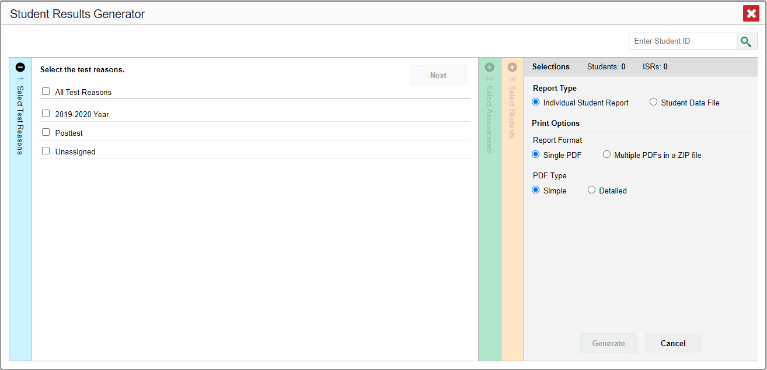
Student Results Generator
1
2
Notes:
The Student Results Generator button is the “head and shoulders” icon located in the top-right corner of the dashboard and report pages, outfitted with the label “Download Student Results.”
When you click on it, the Student Results Generator pop-up window displays. Both reports, the ISR and the student data file, are built by completing three numbered and colored sections, #1 Select Test Reasons, #2 Select Assessments, and #3 Select Students.
In this training module we show you several sample ISRs and then take you through the steps of generating an ISR. You construct the student data file in the same way, but your report will be in the form of a spreadsheet—either Excel, comma-separated values, or text. What you see in your Student Results Generator pop-up window may vary slightly from these images depending on the types of assessments administered in your state or district.

Slide 4
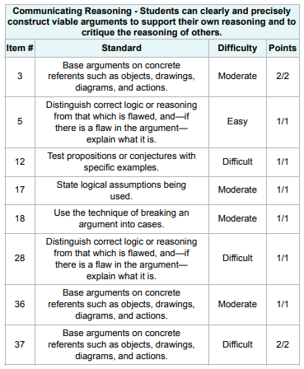
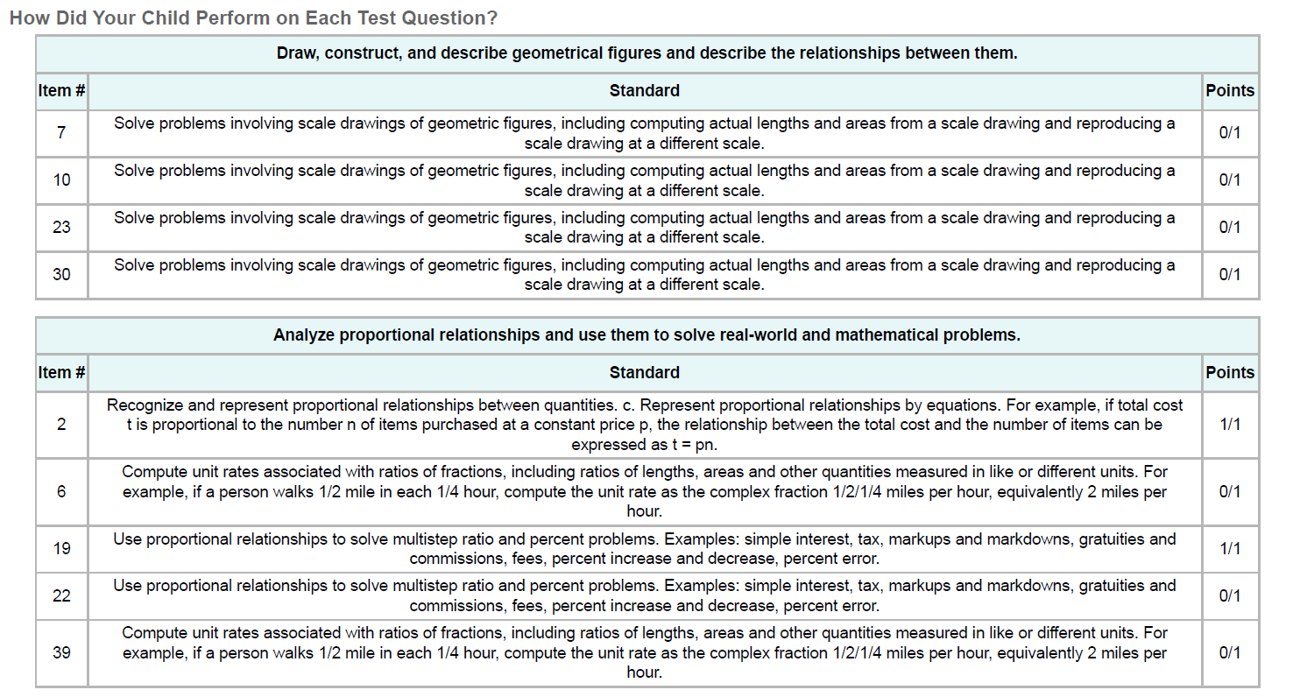
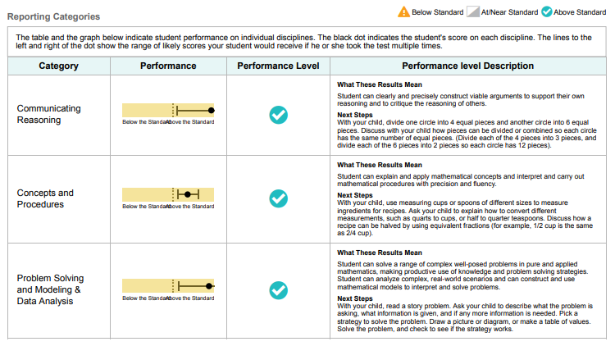
Sample ISRs
Simple ISR with Reporting Categories
Detail from Two Detailed ISRs with Item-Level Data
Note: The item-level data is only available for Smarter Balanced Interim Assessments and Checkpoint Assessments.
Notes:
An ISR is a PDF that displays the performance results of one test taken by one student. It may consist of either a one-page document called a “simple report” or a longer document called a “detailed report.” Simple reports show the most pivotal information about the test the student took for easy viewing, while detailed reports will show more in-depth results the student achieved on different aspects of the test. On the left is a simple ISR, showing the results for a grade 5 mathematics interim assessment. Student, test, school, and complex information is located at the top, followed by a summary of performance. A vertical scale of cut scores and performance levels features prominently. State, complex, and school average scores may be included, if available. If the test is structured with reporting categories, levels and descriptors for those are reported, as well. Other data are displayed depending on the test. If the report is for an interim or benchmark test with non-secure items, item-specific data are included in the detailed, multiple-page report. Shown here are two excerpts from two different detailed mathematics ISRs, which group the test items into reporting categories. Each item has its target descriptor along with the points the student scored on that item out of the points possible. Some tests also have item difficulty levels, such as easy, moderate, and difficult.

Slide 5
Sample Trend Report from an ISR
Notes:
Here we have another page in the detailed report, showing a trend report. A trend report is similar to the Longitudinal Report accessed in the Reporting System. Here we see that the student’s scores and performance levels on two instances of this interim mathematics test have risen over time. Your ISRs’ layout may vary from the samples used in this module, depending on your configurations. However, the content will still be similar. Now we show you how to build the ISRs you need.

Slide 6
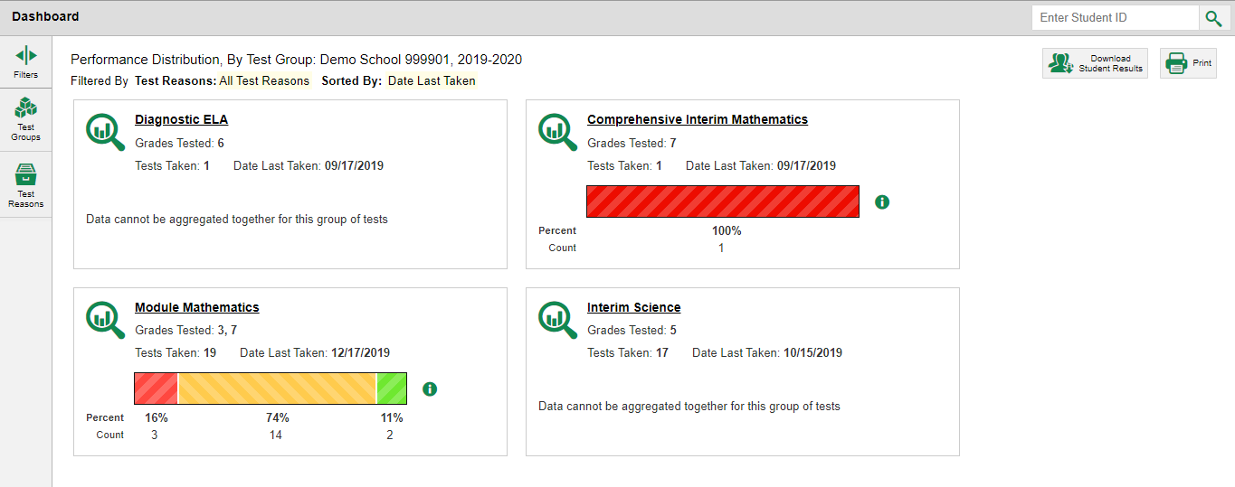
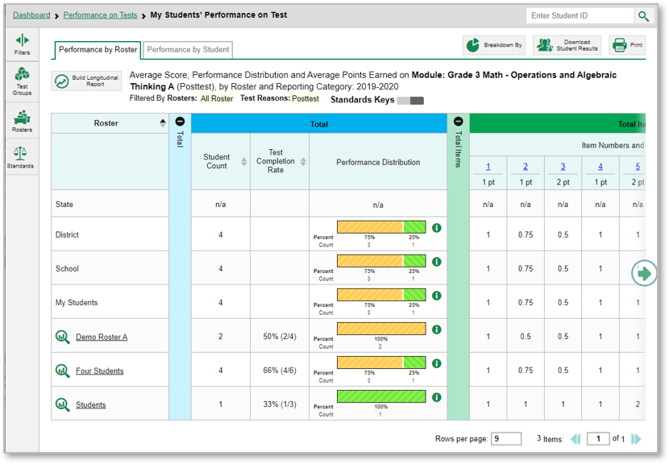
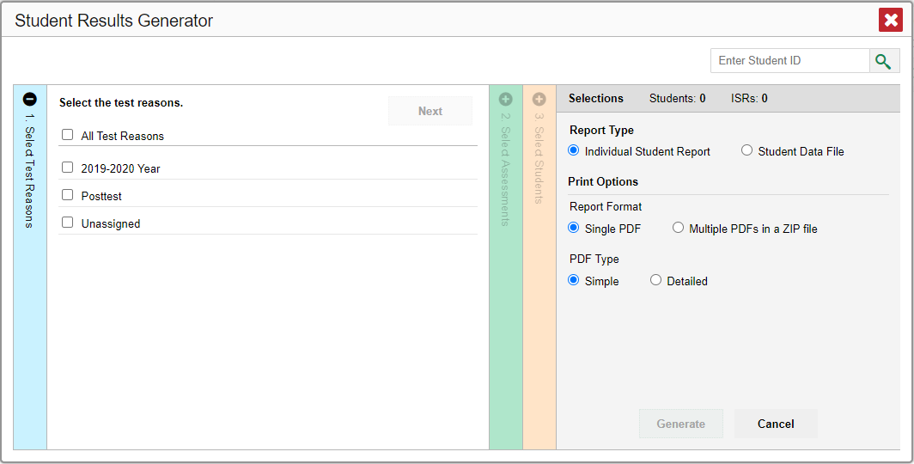
Two Ways to Build an ISR
1. From Dashboard or Performance on Tests Report—Generate ISRs from Scratch
2. From Test Report—Generate ISRs Using Pre-Populated Data
1
2
Notes:
You can build your ISRs from scratch or you can build them using pre-selected and pre-populated data.
If you click the Download Student Results button from the dashboard, as shown here in the images on the left, the Student Results Generator window opens with all the choices unselected.
The same is true if you start from the Performance on Tests report.
You generate the ISR or ISRs by selecting the test reasons, assessments, and students that match your ISR needs. You can choose any combination of test reasons, assessments, and students. The pop-up window displays with section #1, Test Reasons, open. If you open the generator from a report page, as shown in the image on the right, the Student Results Generator has pre-selected and/or pre-populated data associated with the specific test report. The selections are made for you and you only need to confirm them or change them to generate the ISR or ISRs you need. On the next slide we demonstrate the process using a pop-up window with pre-selected data.

Slide 7
Student Results Generator, Pre-Selected from Report Page
Notes:
Here is the Student Results Generator window showing pre-populated and pre-selected students. Typically, when the generator button is clicked on from a test report page, the Select Students section, #3, displays in the open position. This slide shows the window as it appears to a teacher who was viewing the Roster Performance on Test report for Demo Roster A. The Select Students section is pre-populated with that roster alone, which is also pre-selected. The roster has been expanded to show the students in it by clicking the arrow next to the roster name. You can populate this section with more rosters and students by selecting Click to Load More….
Depending on the ISRs you need to generate, confirm that the pre-selections are those that you want or mark the checkboxes for the rosters and/or students you need. Now go to the other two sections and confirm or change the selections. You open and close each section by clicking the vertical section bar with the plus or minus symbol at the top. Or you can click the Previous and Next buttons at the top of each open section. We explain the sections on the next slide.

Slide 8
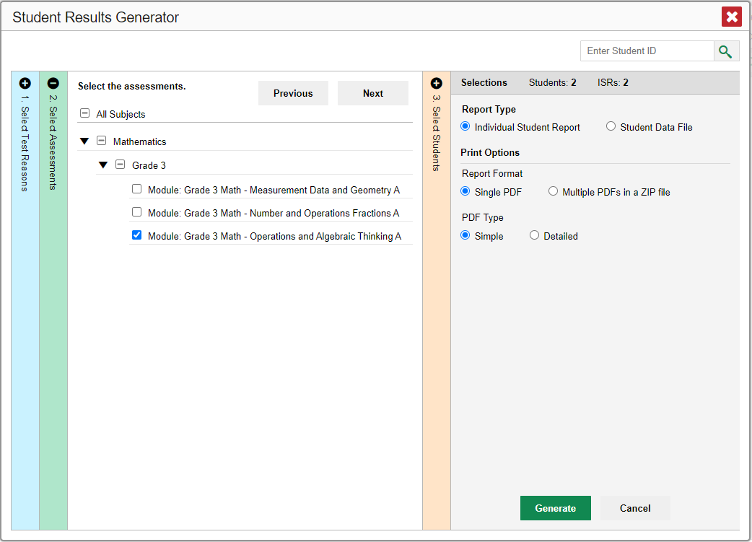
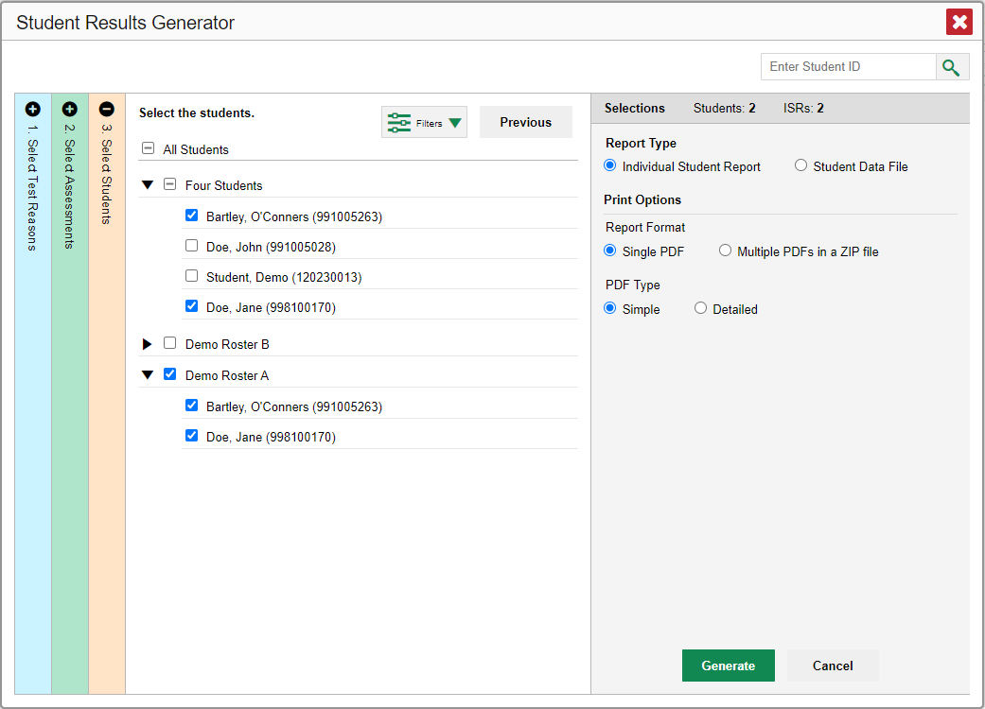
Sections #1, #2, and #3
1. Select Test Reasons
2. Select Assessments
3. Select Students
Notes:
Section #1 is labeled Select Test Reasons. Test reasons for summative tests represent the test administration windows. Test reasons for interim, benchmark, and modular tests can be categories, like Pre-test or Post-test, or numbered opportunities. Mark the boxes for the test reasons that apply to the ISRs you need to generate. Section #2 lists assessments by type of test, subject, and grade. Select the assessments you want or mark All Subjects. The Select Students Section, #3, will load results depending on the user’s role. Teachers and school-level users will see a list of rosters with student names below. Complex users will see a list of schools. The Selections panel on the right displays a count indicating the total number of students selected and the number of ISRs you have ordered.

Slide 9
Fourth Customizing Option
4. Set Date Range
1
3
2
Notes:
A fourth customizing option is accessed via the Filters button, which is located in the Select Students section to the left of the Previous button.
You can select a range of dates to be included in the ISR by using the calendar to enter a start date and an end date. Click Apply.
After making your customizations, click the Individual Student Report radio button under Report Type in the Selections panel. We now explain the print options available.

Slide 10
Print Options and Inbox Button
Banner
Notes:
After selecting your customization options for the ISRs, you choose how to print the reports. Options for printing ISRs are listed under the Print Options heading in the Selections panel to the right. You can print simple, one-page ISRs or detailed, multiple-page ones. In some cases you can select a radio button to include supplemental materials and use a drop-down list to choose a language (not shown). The options in this panel vary according to your configurations. After you have made your selections, click the green Generate button. The ISR file, or multiple PDFs in a zip file, will be sent to your Inbox, which can be accessed via the banner on all pages in the Reporting System. We will explain how to download from the Inbox after we explain the student data file.

Slide 11
Generate a Student Data File
Student Data File—Excel Worksheet
Notes:
A student data file is a user report on performance data in Excel, comma-separated values, or text format. Files of this nature allow the user to employ the workbook features of a spreadsheet application to organize and sort the data. A sample is shown here. The generation process for a student data file is the same one used for the ISR with different print options. Customize the student data file using the same three selection columns and the Filters button. Choose your desired print format and click the green Generate button. The student data file displays in the user’s Inbox. The next slide shows a sample Inbox.

Slide 12
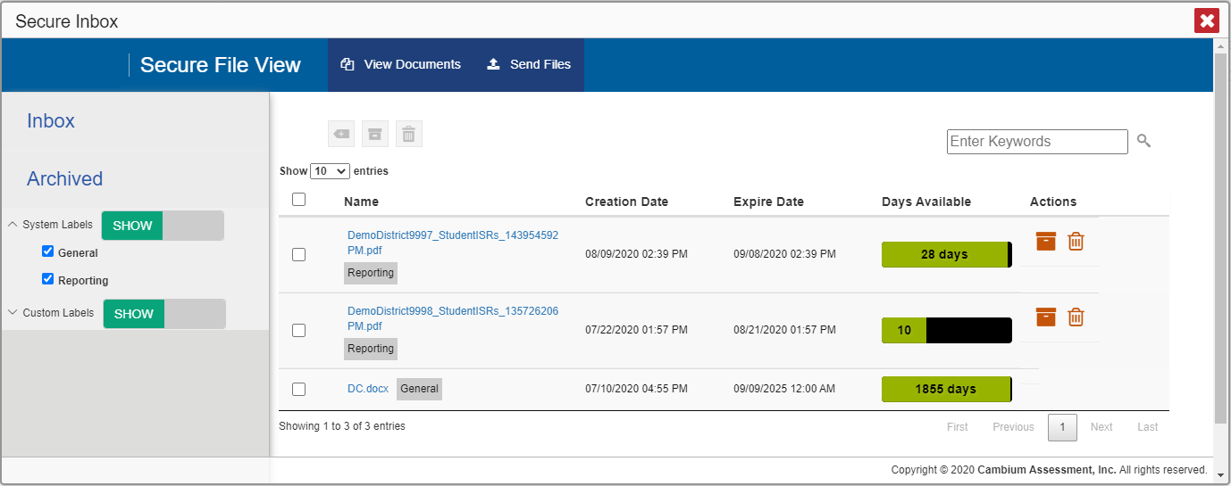
Sample Inbox
Notes:
The Inbox stores any reports you generate using the Student Results Generator tool. Click the name of a file to download it. To learn more about the features of the Inbox consult the appendix section of the Reporting Guide or view training module #8 in the series, How to Print and Export Data You Can See in Your Reports.

Slide 13
The Centralized Reporting System Series
1. How to Navigate the Dashboard and Access Your Summative Results
2. How to Understand Measures for Standards, Depth of Knowledge (DoK) Levels, and Writing Dimensions
3. How to Understand a Demographic Breakdown Report and a Student Portfolio Report
4. How to Drill Down into Your Results by Selecting Specific Tests & Classes
5. How to Drill Down into Your Results by Selecting Previous School Years & Previous Students
6. How to Track Student Performance Over Time Using the Longitudinal Report
7. How to Print Individual Student Reports (ISR) and Student Data Files
8. How to Print and Export Data You Can See in Your Reports
9. How to Use the Roster Manager to Add, Modify, and Upload Rosters
10. How to Analyze a Basic Interim Test Report
11. How to Use the Advanced Features of Reporting to View Interim Data
12. How to Hand-Score Unscored Items and Modify Machine Scores
Interim and Benchmark Assessments Only
Notes:
Thank you for viewing this module on generating Individual Student Reports and student data files. More modules are posted on the HSAP portal

Slide 14
More Help
Further Information: The Centralized Reporting Guide 2021–2022
HSAP Portal Website: https://alohahsap.org/
HSAP Help Desk Email: hsaphelpdesk@cambiumassessment.com
Help Desk Phone Number: 1-866-648-3712
Notes:
For detailed information, consult your Centralized Reporting Guide 2021–2022, located on the HSAP portal, or contact the Helpdesk.

