Slide 1
Checkpoint System Training Module
2021-2022
Notes:
Welcome to the online training module for the Checkpoint system. This training module is designed to help you create tests and items in the Checkpoint system. For additional information about the Checkpoint features, reference the 2021-2022 Checkpoint User Guide located on the Smarter Balanced, HSA-Science, and EOC pages of the AlohaHSAP.org portal.

Slide 2
After Viewing this Module You Should Understand:
How to Access Checkpoint
How to Create Items You Can Add to Tests
How to Build Tests to be Administered to Students
How to Work with the Items and Tests Available to You
How to Share Your Items and Tests with Other Educators
How to Submit Your Items to a Shared Items Library
Notes:
You will be guided through the training module in this order.
How to Access Checkpoint
How to Create Items You Can Add to Tests
How to Build Tests to be Administered to Students
How to Work with the Items and Tests Available to You
How to Share Your Items and Tests with Other Educators
How to Submit Your Items to a Shared Items Library

Slide 3
How to Access the Checkpoint System
Notes:
This section explains how to log in to the Checkpoint system and the layout of the Dashboard.

Slide 4
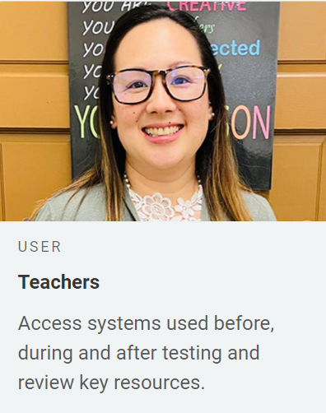
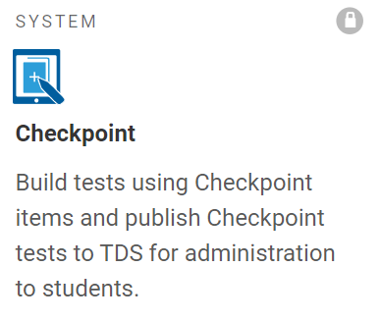
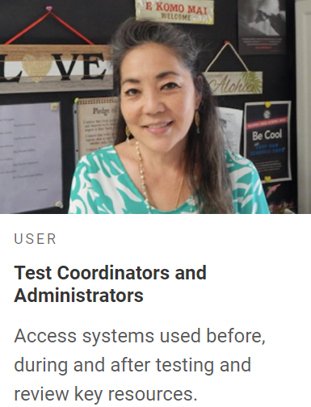
How to Access the Checkpoint System
1
2
3
Notes:
To log in to Checkpoint, you must have an authorized email address and password, which is the same as the one you use for TIDE and the TA Interface. Contact your School Administrator if you do not have a TIDE account.
Go to the Smarter Balanced, HSA Science, or EOC page of the HSAP portal. Click the button that corresponds with your role (Teacher or Test Coordinator/Administrator).
Click the Checkpoint card shown above.
Enter your username and password, and then click Secure Login.

Slide 5
Logging in to Checkpoint (continued)
The system has an authentication process that triggers when you log in from a different device or browser, or after clearing your browser’s cache.
If you see this screen, an email containing the code will be in your inbox.
Enter the code and click Submit.
If you need the code resent, click Resend Code.
Notes:
When logging in to the system using a new device or browser, or after clearing the cache on a previously used browser, you will see an Enter Code page.
If you see this screen, you will need to enter the code on this page within fifteen minutes of receiving the email. If you do not receive a code or do not enter the code within the fifteen-minute time limit, click Resend Code. Click Submit after entering the authentication code to access the system.

Slide 6
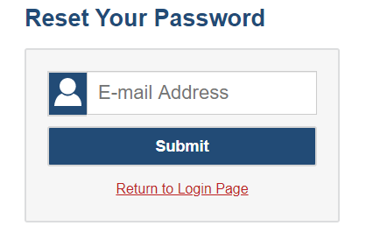
Resetting Your Password
Notes:
You will need to reset your password in the following situations:
You forget your password.
Your activation link expired.
Your account is locked because you exceeded the account login attempt limit.
It is a new school year.
To reset your password, click the Forgot Your Password link. You will be taken to the Reset Your Password page. Enter and confirm a new password and click Submit.

Slide 7
How to Navigate the Checkpoint Site
Notes:
This section explains how to use the quick links and the content tabs to find and create items and tests.

Slide 8
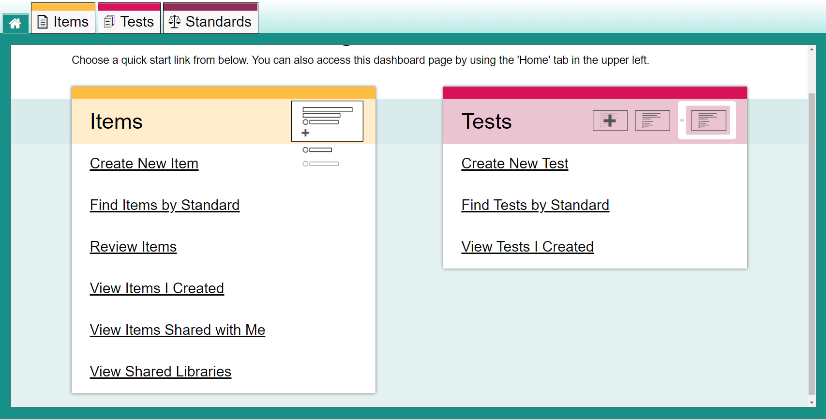
Dashboard Design
Content Tabs
Quick Links
Notes:
The Checkpoint site consists of a Dashboard with a content tab for each type of content you can work with: Items, Tests, and Standards.
It also displays quick links on the Items and Tests cards that you can click to jumpstart common tasks, such as creating items and tests and finding items and tests aligned with standards. You will need to apply filters in order to display the items.
The quick links are described on the next two slides.

Slide 9
Item Quick Links
Item Link | Description
Create New Item | Opens the item builder page where you can create a new item.
Find Items by Standard | Opens the Items tab with the filter panel focused on the Standards search bar, so you can easily locate items aligned to a specific standard. You need to enter a standard name or key and click Apply in order to display the items.
Review Items | Opens the Items tab, filtered to show you only the items submitted to a shared library that still need to be reviewed and approved.
View Items I Created | Opens the Items tab, filtered to show you only your own items that were created or edited within the last 30 days.
View Items Shared With Me | Opens the Items tab, filtered to show you only the items that other Authoring users created and shared with you within the last 30 days.
View Shared Libraries | Opens the Items tab with the Libraries, Grade, and Subject filters expanded so that you can easily locate the items in a shared library, such as SAMPLE LIBRARY. Shared libraries consist of premade items provided by Assessment Program that you can add to your tests. You will need to apply filters in order to view these items.
Notes:
On this slide you can read a quick description of what will open when you click on the various item links on the Dashboard.

Slide 10
Test Quick Links
Link | Description
Create New Test | Opens the test builder page, where you can create a new test.
Find Tests by Standards | Opens the Tests tab with the filter panel focused on the Standards search bar, so you can easily locate tests with items aligned to a specific standard. You need to enter a standard name or key and click Apply in order to display the tests.
View Tests I Created | Opens the Tests tab, filtered to show you only your own tests that were created or edited within the last 30 days.
Notes:
On this slide you can read a quick description of what will open when you click on the Tests quick links on the dashboard.

Slide 11
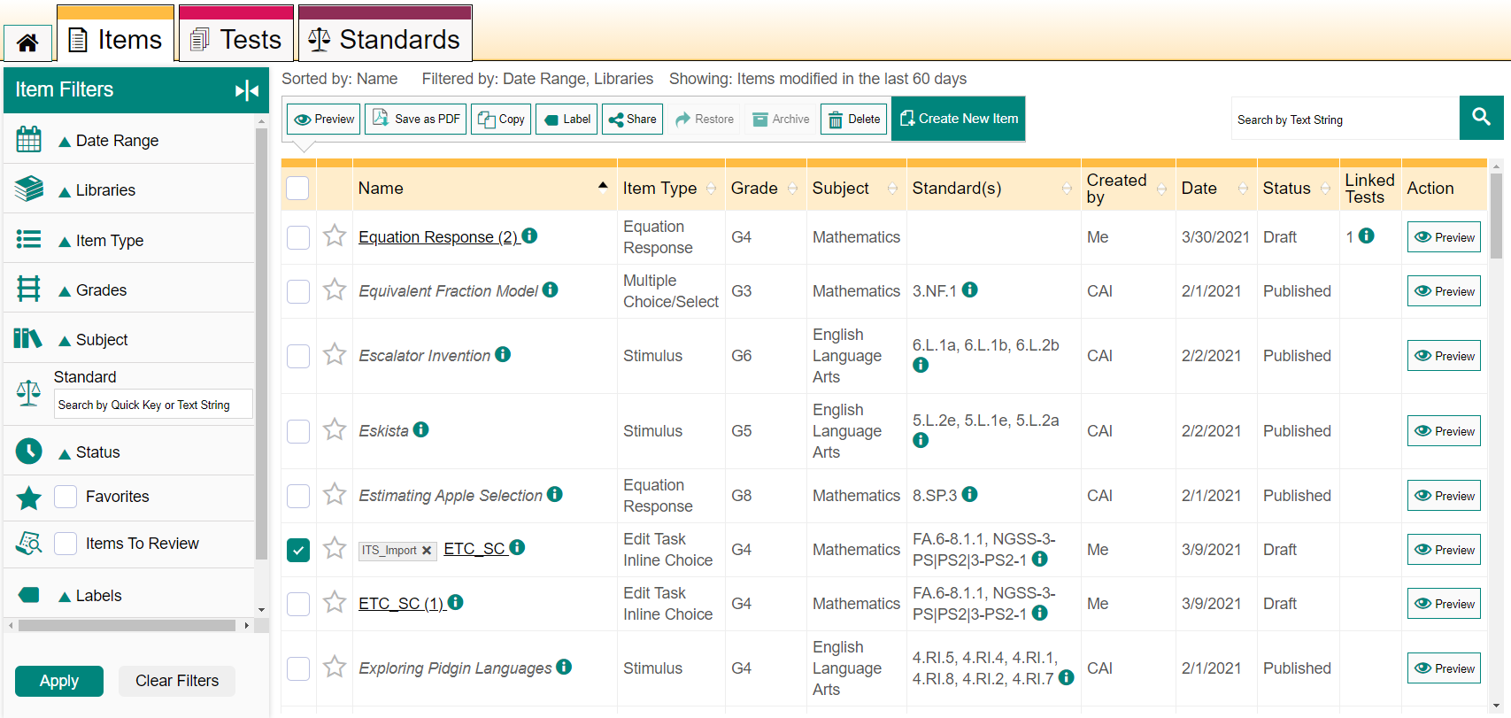
Accessing Items with the Content Tab
Item Content Tabs
F i l
t e
r
Pane l
Toolbar
Notes:
The Items content tab allows you to manage your existing items, as well as create new items. A filter panel beside the table helps you locate specific content based on its date range, item type, subject, grade level, or other properties. You can also use the toolbar above the table table to perform actions on your items, such as previewing the item, creating copies of them, printing them as PDFs, or sharing them with other users.
Note that in some cases, the tables on the Items tab will not display until you select filter options from the panel on the left and click Apply.

Slide 12
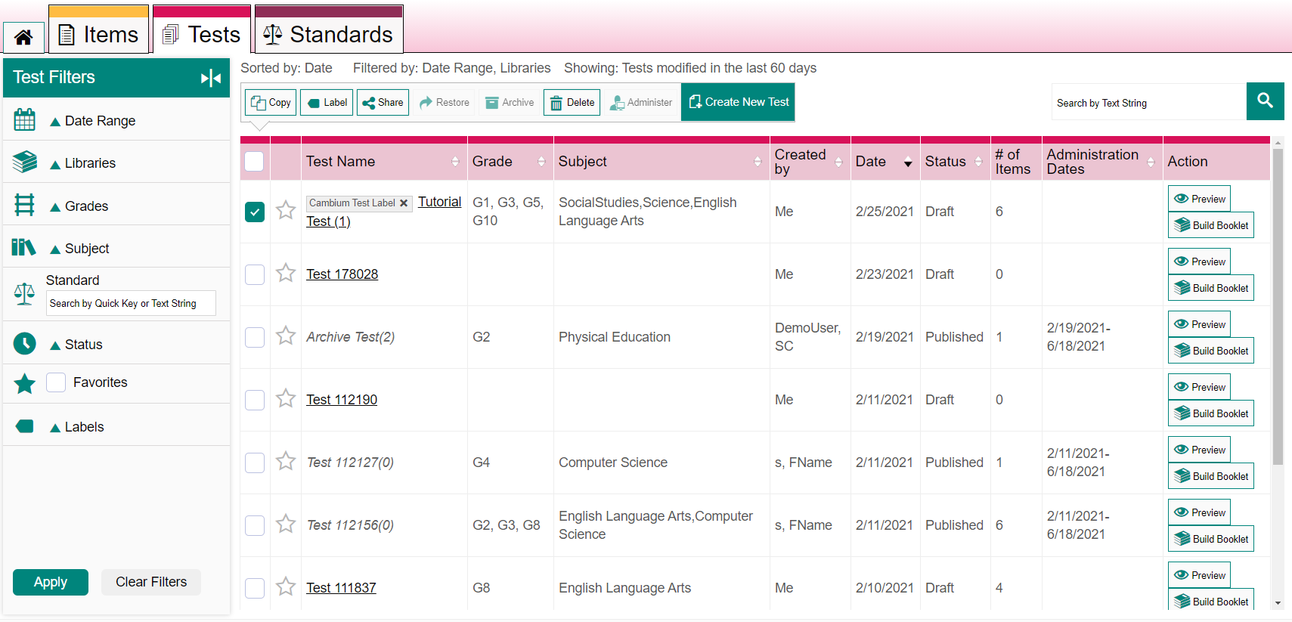
Accessing Tests with the Content Tab
Test Content Tabs
Notes:
The Tests content tab allows you to manage your existing tests, as well as create new tests. A filter panel beside the table helps you locate specific content based on its subject, grade level, or other properties. You can also use the toolbar above the table to copy, label, share, restore, archive, delete, or administer a test.
Note that in some cases, the tables on the Tests tab will not display until you select filter options from the panel on the left and click Apply.

Slide 13
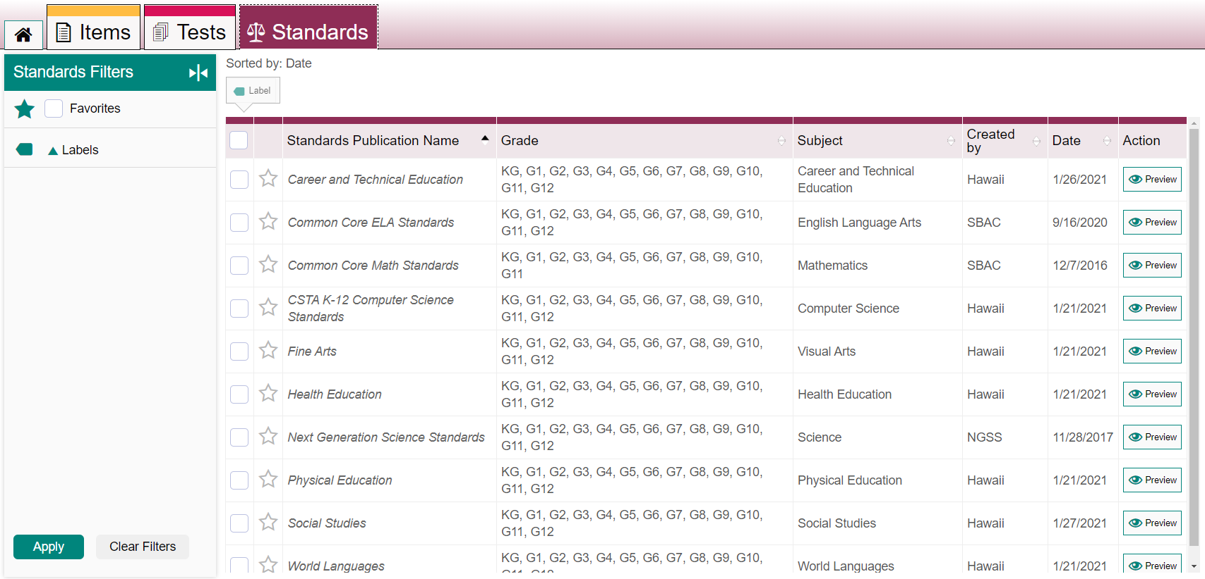
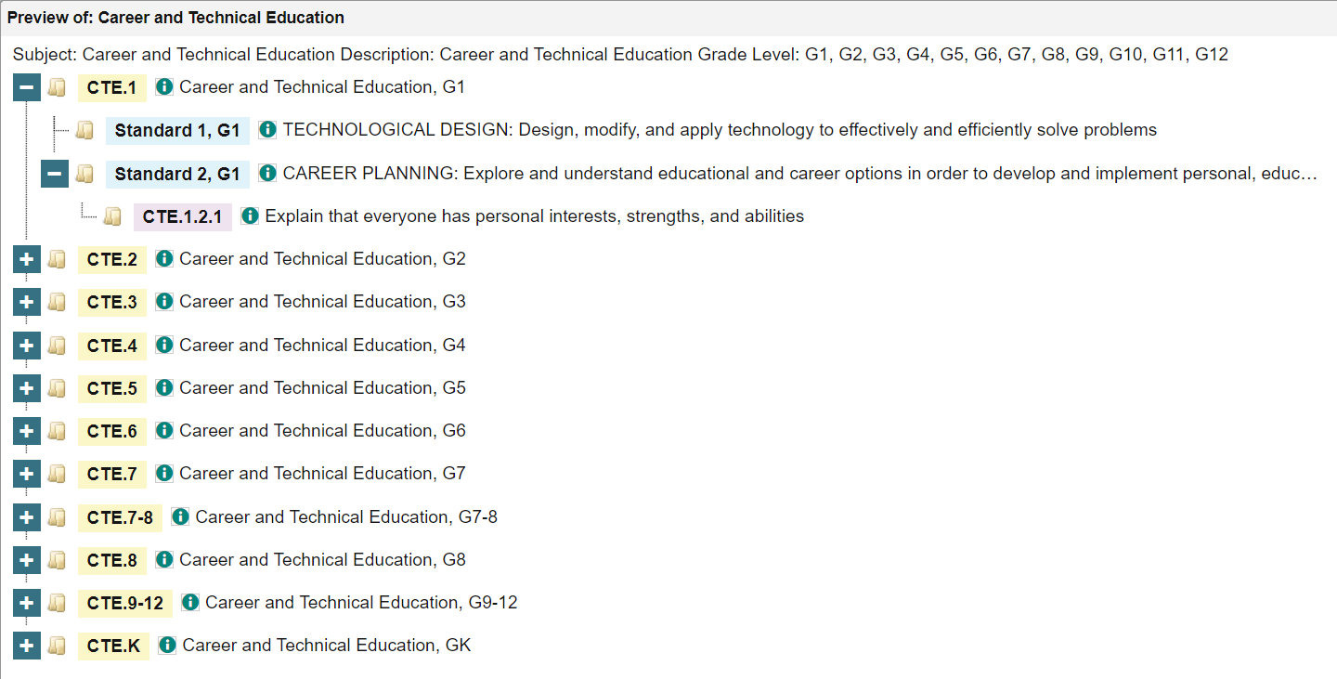
Previewing Standards with the Content Tab
Notes:
The Standards content tab displays standards publications provided by your Assessment Program. You cannot create or modify standards publications, but you can preview them to see the keys for the individual standards. Knowing the right standard key can be helpful when aligning items to standards or when filtering the content tabs by standard. When you find the key you need it’s a good idea to write it down for future reference.

Slide 14
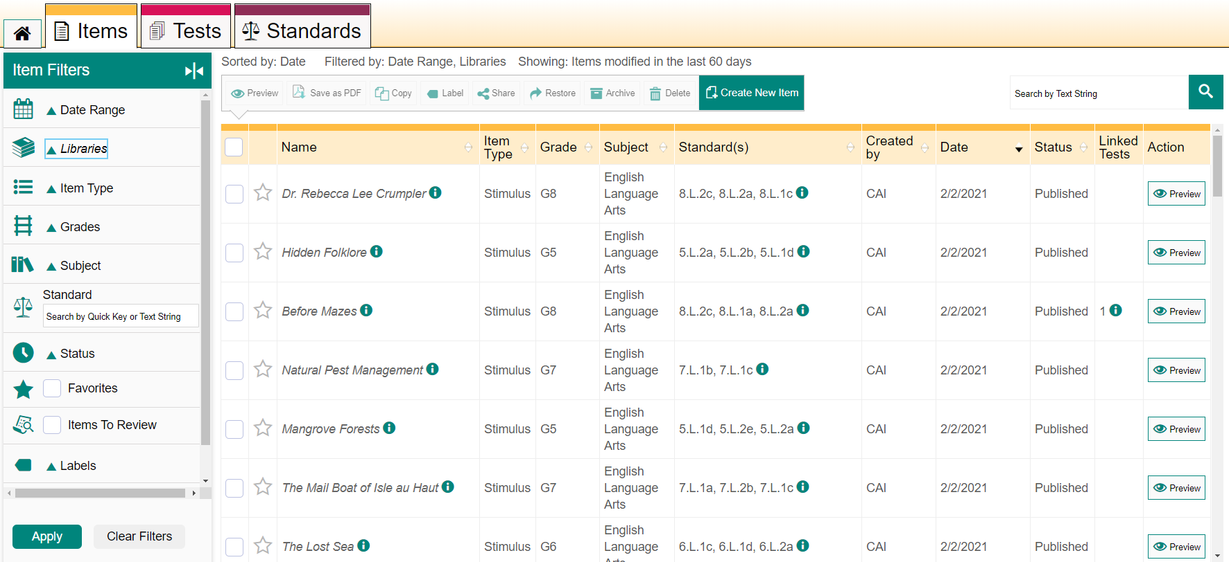
Search Bar and Filters Panel
Search Bar
Standard Search Bar
Notes:
Each content tab includes a search bar and a filter panel that help you find the items, tests, or standards you want to work with. The available filter options are different for each content type, but their use is similar.
To search for content, enter a term in the search field in the top-right corner of a content tab and click the magnifying glass button. This search bar is most appropriate when searching for words that appear in the name, text, or keyword of an item or test, such as “Shakespeare”. If you need to search for content aligned to a particular standard, you should use the Standard search field that appears in the filter panel. It’s helpful to use the Standards content tab to find the quick key identifier (such as “A-APR.1”) and type it into the Standard search field.

Slide 15
How to Use Filters and the Search Bar to Find Items, Tests, and Standards
Filter | Content Tab | Use
Date Range | Items and Tests | Expand the Date Range menu to mark a checkbox to view only the items or tests that were created, edited, or added to a shared library in the selected time period, or use a custom time period.
Libraries | Items and Tests | Expand the Libraries menu to filter your content results by items and tests you created, items and tests shared with you, or content in a shared library.
Status | Items and Tests | Expand the Status menu and mark the available checkboxes to view only the content with a particular status. Some common status terms include Draft, Published, and Archived.
Item Type | Items | Expand the Item Type menu and mark the available checkboxes to view only the items that are built in a particular item template.
Stimulus Associations | Items | Expand the Stimulus Associations menu and mark the available checkboxes to view only items that are linked to a stimulus or only items that are not linked to any stimulus.
Favorites | Items, Tests, Standards | Click the star icon next to any item, test, or standard to save it as a favorite. Mark the Favorites checkbox to show only the content you have marked.
Items to Review | Items | Mark this checkbox to show only the items that have been submitted to a shared items library and still need to be approved.
Labels | Items, Tests, Standards | Create custom labels to organize content. Expand the Labels menu and mark the available checkboxes to view only the content associated with a particular label.
Subject | Items and Tests | Expand the Subject menu and mark the available checkboxes to view only the content associated with a particular subject.
Grades | Items and Tests | Expand the Grades menu and mark the available checkboxes to view only the content associated with that grade.
Standard | Items and Tests | To show only content aligned to a particular standard, enter the ID or label for a standard in the Standard field. Items are aligned to standards directly, while a test’s standards are determined by the items on that test.
Items with Comments | Items | Mark the checkbox to show only the items that have one or more comments.
Notes:
This table is a summary of all the filter options and the uses for each.

Slide 16
How to Create Original Items for Your Tests
Notes:
This section explains how to create original items by filling out templates in the Item Builder page.

Slide 17
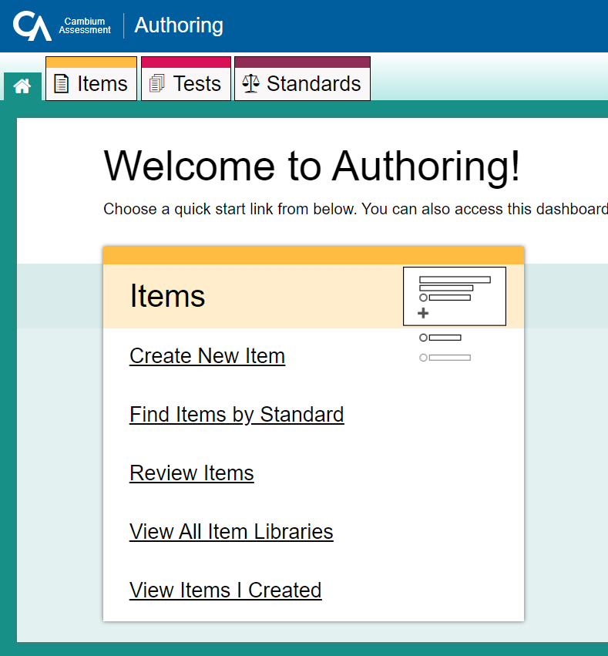
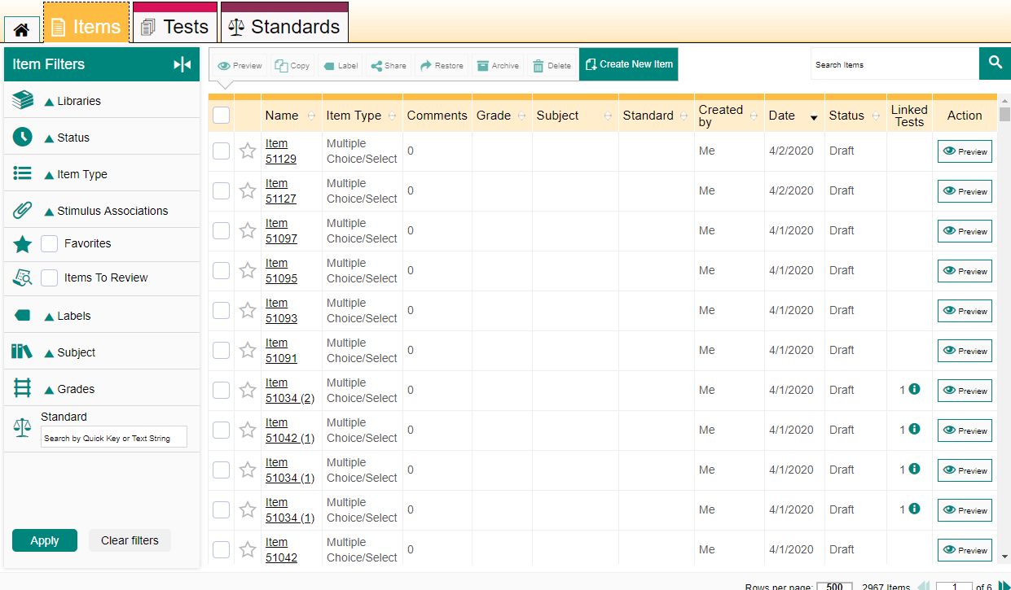
Create Original Items for Your Tests
Click the Create New Item link in the Items menu box,
Or, open the Items tab and click on the green Create New Item button.
Notes:
Items are the stimuli and questions students answer when taking a test. A stimulus can be a reading passage or other type of media students view in order to respond to its linked questions. You use the Item Builder in Authoring to create stimuli and a variety of other item types. After creating items you add them to your tests and share them with educators.
Click on the Create New Item link in the Items menu box of the Dashboard, or
Open the Items content tab and click the green Create New Item button.

Slide 18
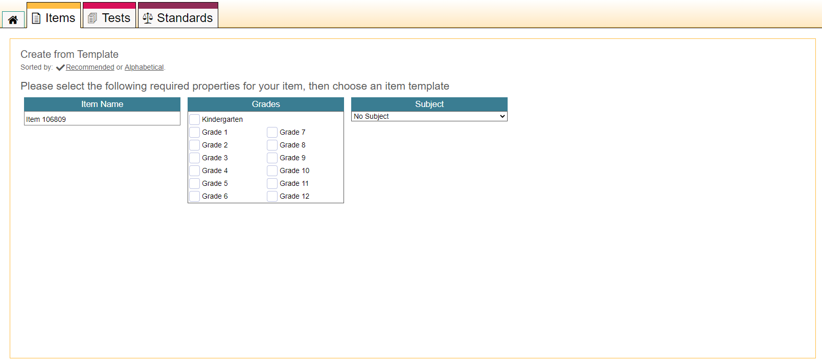
Required Item Properties
Notes:
The item builder appears. Select the grade level and subject from the fields that appear. Replace the default item name with a more descriptive name in this section. These properties make it easier to organize and locate your items in Checkpoint, in the Test Administration system, and in the Centralized Reporting System.

Slide 19
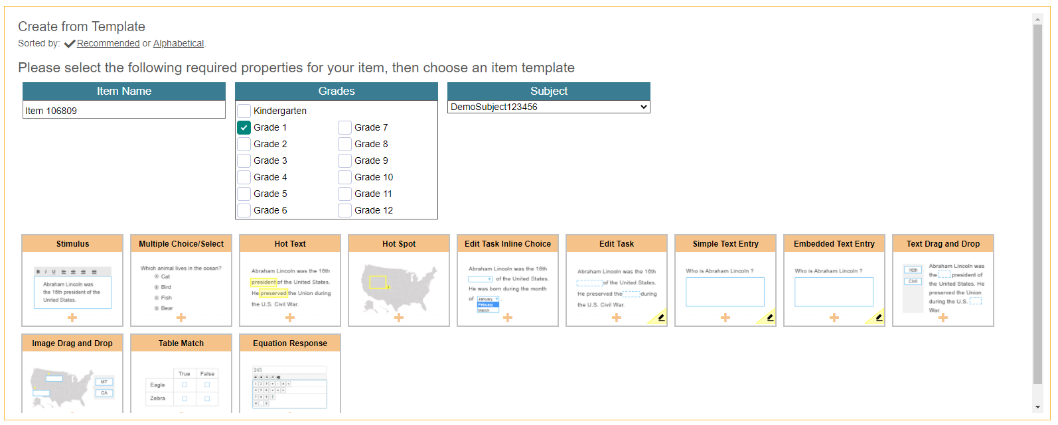
Item Builder—Template Options
The Item Builder templates can be arranged alphabetically or by those recommended.
Item Types
Notes:
A collection of item types will display. Those displaying an edit icon, which looks like a pencil, need to be scored by hand in the Centralized Reporting System. You can hover over a template to read a description of the item type. Click the item type template for the one you want to create. You can arrange the collection alphabetically or by default recommended order of common types.
There are many different item types available. All of them involve three main steps, except for the stimulus template, which doesn’t require a response area or answer key. The item types are: Stimulus, Multiple Choice/Select, Hot Text, Hot Spot, Edit Task Inline Choice, Edit Task, Simple Text Entry, Embedded Text Entry, Text Drag and Drop, Image Drag and Drop, Table Match, and Equation Response.

Slide 20
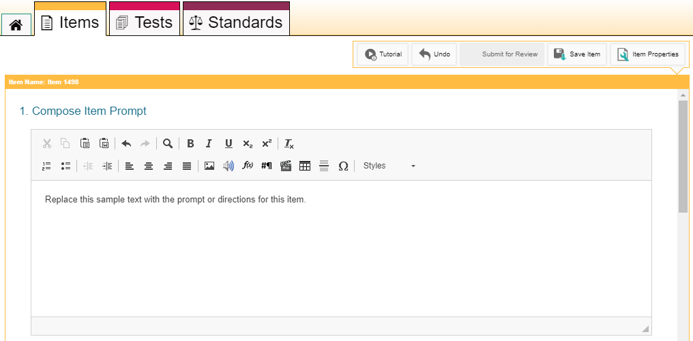
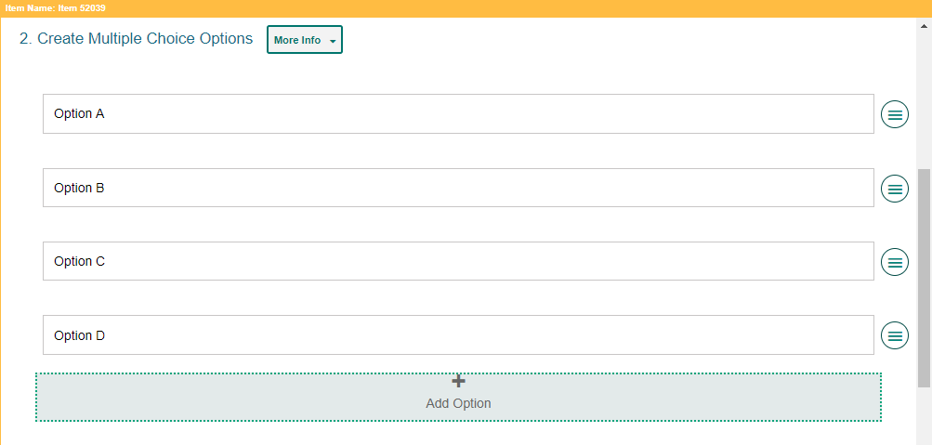
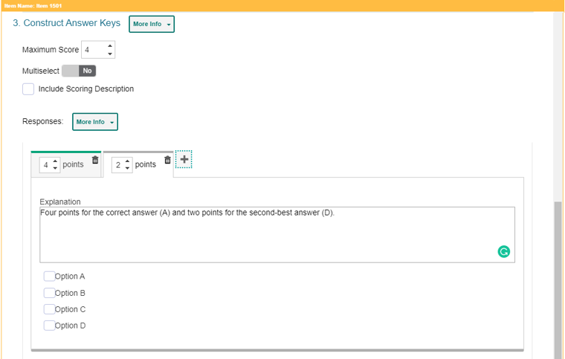
Item Builder—3 Main Steps
1
2
Multiple Choice Item Type
Compose the Item Prompt
Create the Response Area,
Construct the Answer Key.
3
Notes:
Here you see the three steps on the Item Builder page. This is showing a Multiple Choice item type.
1. Compose the Item prompt
2. Create the Response area
3. Construct the answer key.
The Compose Item Prompt step is where you build your question or write the directions students will follow to respond to an item. Enter the prompt in a text box at the top of each template. You can use the toolbar in the text box to format the text and insert media elements, such as images, videos, and tables.
Sections 2 and 3 are explained on the next several slides.
For more in depth descriptions of each item type, please reference the 2021-2022 Checkpoint User Guide or the 2021-2022 Checkpoint Mini-Module: How to Write an Item in Checkpoint located on the AlohaHSAP.org portal.

Slide 21
Step 2: Create the Response Area
The response area of the item is where the students interact with various interactive features in order to answer the question. The areas are different for each item type.
Add rationale for each multiple choice answer.
Add multiple choice options.
Notes:
The response area of the item (#2) is where students interact with various interactive features in order to answer the question or respond to the stimulus. Response areas are different for each type of item template available. Items may require students to select an answer from a list of options, type a response in a text box, enter an equation with an on-screen keypad, drag and drop answer options onto an image or chart, and more. When you click the More Info button, instructions for completing the section will drop down, along with a link that takes you to that portion of the system User Guide.
This image shows the Multiple Choice Options where you can add a rationale for each answer option and add options by clicking the plus sign at the bottom of the section.

Slide 22
Step 3: Construct the Answer Key
Determine how many points an item is worth and how to score the student’s response.
Machine-Scored Items (MC, Hot Text, Hot Spot, Text Drag and Drop, Image Drag and Drop, Table Match, Equation)
Hand-Scored Items (Edit Task Inline Choice, Edit Task, Simple Test Entry, Embedded Text Entry)
Notes:
The answer key section is used to determine how many points an item is worth and how the student’s response will be scored. For machine-scored items, the section shows a preview of the item’s response area, where you should enter a valid response and select the number of points (Maximum Score) the response is worth. To allow points for a partially correct answer, click on the plus sign and create more answer keys. You can explain each valid response in the Explanation box. The Include Scoring Description checkbox lets you add a reader-friendly description of the scoring criteria and an example of a valid response, which will be available in the Centralized Reporting System for this item.
For hand-scored items, the answer key section displays a Description field where you can enter scoring criteria and an Exemplar field where you can enter reader-friendly examples of valid responses for each score a student may earn. This information is used in the Centralized Reporting System, where student responses for the item will be scored by hand.

Slide 23
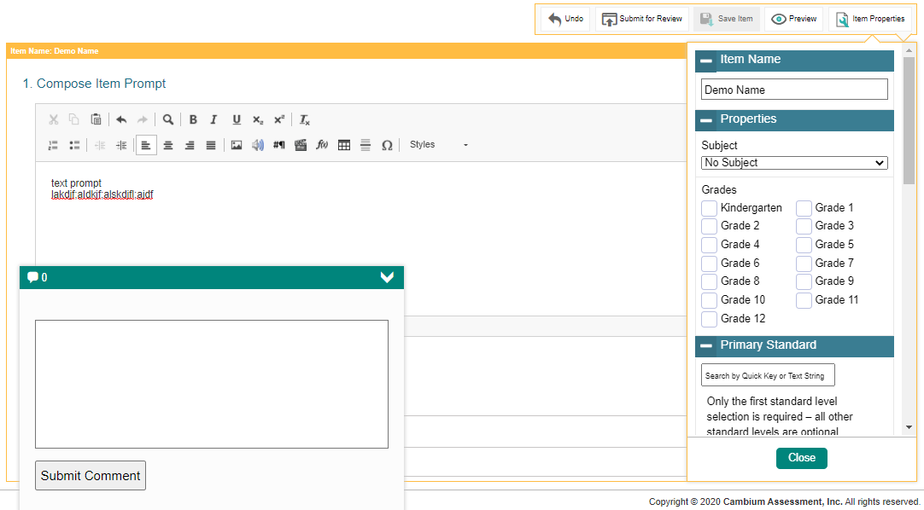
Item Toolbar
Item Toolbar
Comment
Notes:
At the top of the window, you will see an item toolbar. This toolbar allows you to perform functions such as adding item properties, previewing an item, saving an item, and submitting an item for review.
The Item Properties button allows you to enter item details such as its name, grade, subject, and standard.
The Preview Button allows you to preview how your item will appear.
The Save Item button saves your item to your items library with a Draft status. Your library items can be added to tests or shared with other users.
The Submit for Review button allows authorized users to submit items to a shared items library. The item will be removed from your personal library, and you will not be able to add it to tests until it is approved for the shared library.
To leave a comment for an item, click the arrow in the lower-left corner of the template. Enter your comment in the provided field and select Submit Comment. Comments are available to any educators you share the item with but not to students taking tests with this item.

Slide 24
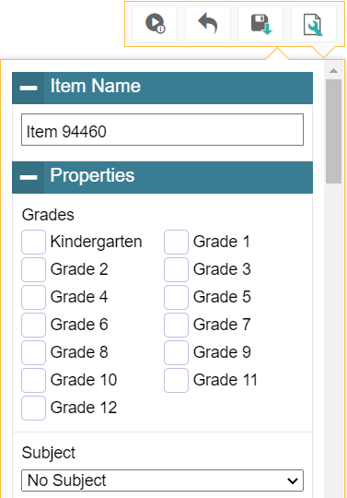
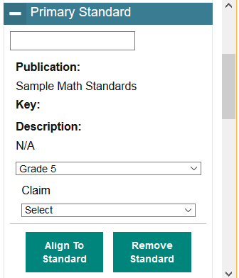
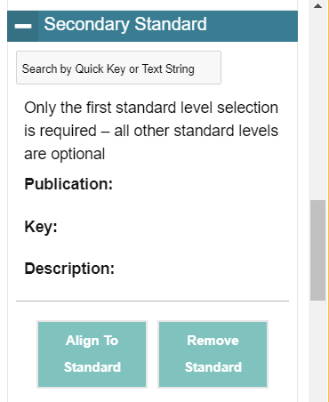
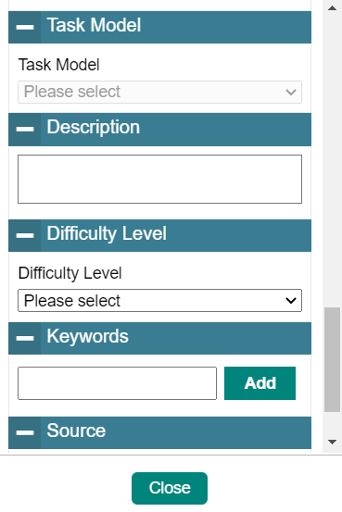
Aligning Standards & Setting Up Properties for Items
Item Properties
Notes:
You can use the Item Properties menu in the item toolbar to align your items to standards and to enter other helpful details, such as the subject and grade levels an item belongs to.
Standards identify the specific skills or areas of knowledge that an item measures. Aligned standards will appear in the reports for teacher-authored tests, helping you pinpoint the specific areas in which a student may be excelling or may need additional support. The properties you set up for items also make it easier to filter items when adding them to tests or locating them in the Items tab.
Item properties can be entered at any point while an item has a Draft status. However, once an item is added to a test and the test is published, the item status changes to Published and its properties will be locked, along with its content.

Slide 25
How to Build Tests to Administered to Students
Notes:
This section explains how to create original tests in the Test Builder page.
You can build new tests for your students in Checkpoint’s test builder. When adding items to a test, you can insert existing items from your item libraries, and you can also create new items by filling out templates directly in the test builder. After creating a test, you can publish it to the Test Administration System, where it can be administered to students.

Slide 26
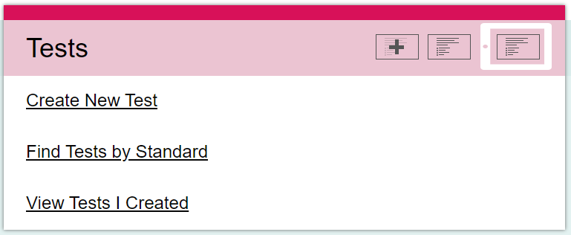
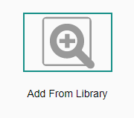
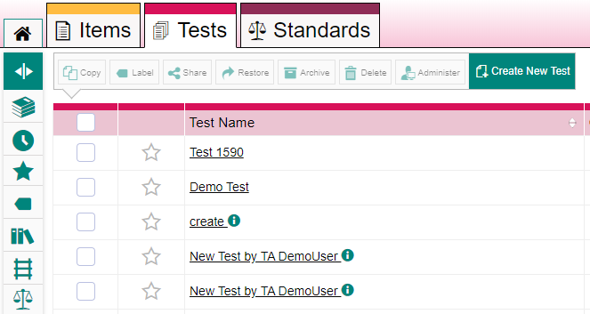
Create a New Test
Dashboard Quick Link
Tests Content Tab
1
Test Builder Page
2
Notes:
To create a new test, select the Create New Test link from the Tests card on the dashboard. Or, open the Tests content tab and click on the green Create New Test button.
The Test Builder page appears, showing two options for adding items to the test: Create from Template or Add from Library.
To create a new item using a template, click Create from Template and build the item the same way you would when using the Item Builder page. To insert an item from one of your libraries, click that button.

Slide 27
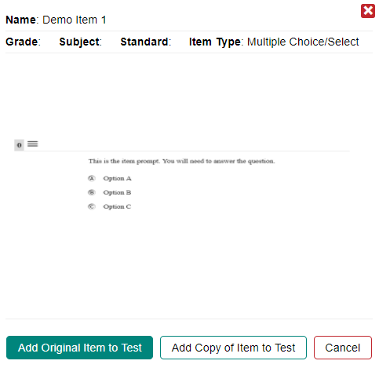
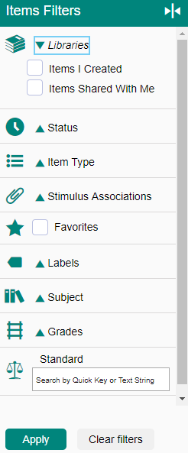
Adding an Item from a Library
Item View Window
Select item
This will add the item directly to the test and any changes you make to this item in other tests will apply to the item in this test (and vice versa).
This will add a copy of the item to the test. Any changes you make to the original item in any other tests DO NOT affect the item in THIS test.
Notes:
You can enter a keyword to search for a particular item and use the filter panel on the right to narrow your search results.
Select an item from the library. The Item View Window will display three options: Add Original Item to Test, Add Copy of Item to Test, and Cancel. Choosing Add Original Item to Test will add the item directly to the test and any changes you make to this item in other tests will apply to the item in this test (and vice versa).
If you choose Add Copy of Item to Test, you are adding a copy of the item to the test. Any changes you make to the original item in any other tests DO NOT affect the item in THIS test. Note that you must make at least one edit to a copied item so that the content is not the same as the original. If no edits are made to the original item, you will receive an error when validating the test.

Slide 28
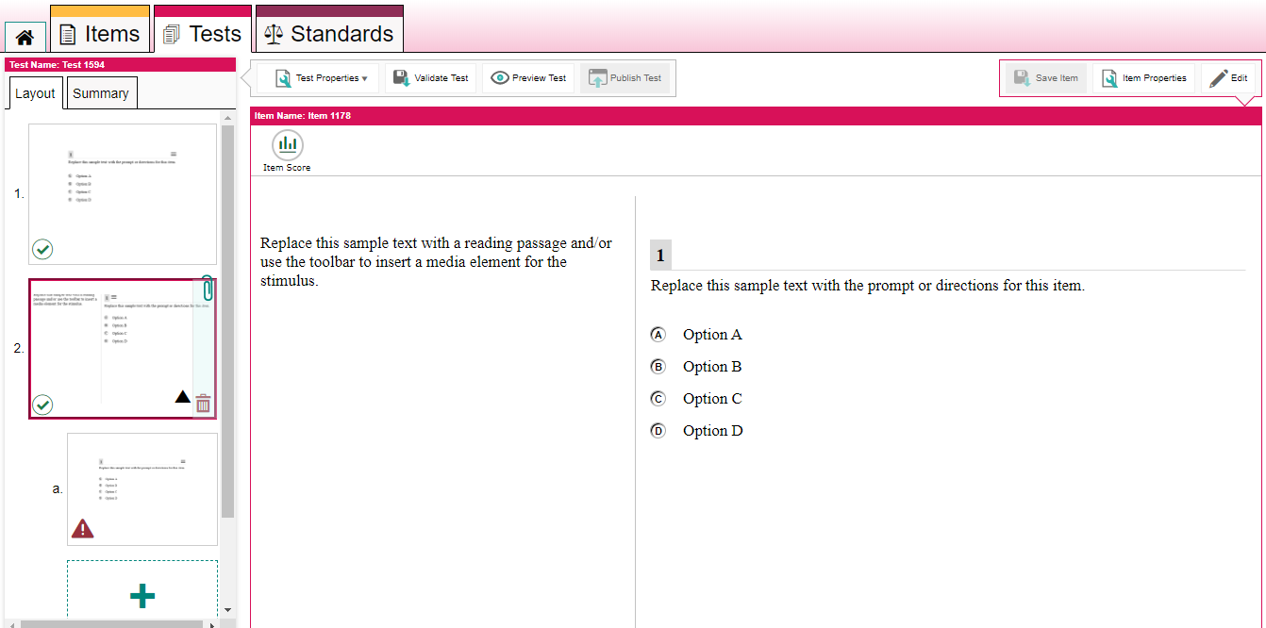
Editing Item Content when Building a Test
Edit Item
You can add an item to a test by clicking the plus icon
Save Item
This is for items that have been copied to a test.
When you add a stimulus to the test, a paper clip and a separate, smaller plus sign appears in the left panel, allowing you to create items to link to that stimulus.
Notes:
You can edit the content for your added items by following the same process used to create items in the Item Builder. You may need to click Edit in the item toolbar at the top-right corner in order to make changes to items. You cannot make changes to items that appear on a published test or items that were shared with you without editing permission.
After editing an item, click Save Item in the item toolbar. Items and tests are saved separately. Items also save automatically at a regular interval. The Save Item button is grayed out when all changes are saved.
To add more items to the test, click the plus sign in the Layout panel on the left. A new thumbnail appears in the panel for each item you add.
When you add a stimulus to the test, a paper clip and a separate, smaller plus sign appears in the left panel, allowing you to create items to link to that stimulus. You can rearrange the items in your tests by clicking their thumbnails and then clicking the arrow icons that appear.

Slide 29
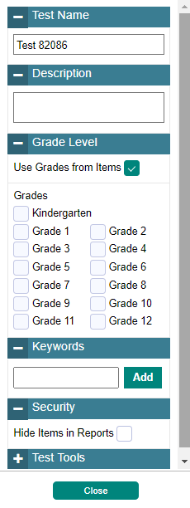
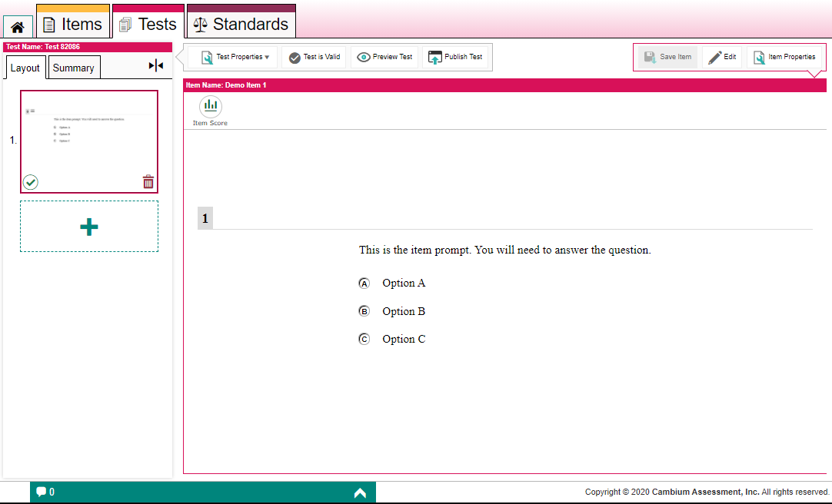
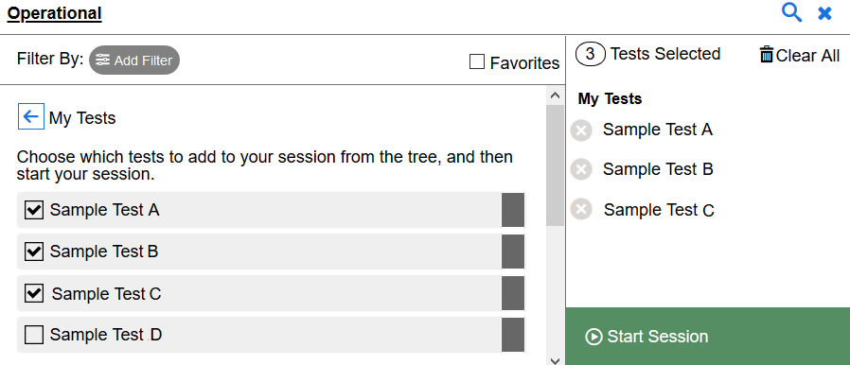
Test Properties Menu/Validate/Preview/Publish
Validate Test: ensures there are no issues with test
Preview Test: to see what your test will look like to students
Publish Test: makes tests available to administer
Test Administration System:
Test Selection Window
Notes:
At any point in building your test you can enter details such as the test’s name, description, grade, keywords, security, and test tools (calculator, periodic table, thesaurus and dictionary). Use the Test Properties button in the test toolbar, make your selections, and click Close.
To see what your test will look like to students, click Preview Test in the test toolbar. You can enter sample responses to items and click Item Score to make sure the items are being scored correctly.
To save the test, click Validate Test in the toolbar. Validating the test ensures that there are no issues with the test that prevent it from being published.
To publish the test, click Publish Test. If this button is not clickable, make sure the test does not include any blank pages and that you have saved changed to each item on the test.
After publishing a test, you can add it to your test sessions by selecting it from the Test Selection window in the Test Administration System. You can administer your own tests, shared tests, and tests from a shared test library.

Slide 30
How to Work with the Items and Tests Available to You
Notes:
This section explains how to find your items, tests, and standards using the content tabs and filters. It explains how to edit, copy, label, and archive your content on the tabs. It provides instructions for authorized users to create subjects that may be aligned with content in Checkpoint.

Slide 31
How to Use Content Tabs
Content Tabs
Notes:
The Checkpoint interface includes a content tab for each type of content you can work with: Items, Tests, and Standards. These tabs each display a table that lists and organizes the content available to you. The Items tab displays items from the library of items you created, the library of items that other educators shared with you, and any shared items libraries provided by the Hawaii Assessment Program, like the NGSS Item Library. The Tests tab displays tests from the library of tests you created, the library of tests other educators shared with you, and any shared test libraries provided by the Hawaii Assessment Program. The Standards tab displays the standards content provided by the Hawaii Assessment Program.
The next slide describes some of the toolbar actions you can perform using each content tab.

Slide 32
How to Manage Your Available Items and Tests
All Checkpoint users can perform the following actions on the Items and Tests tabs:
• Edit the content of any items and tests with a Draft status.
• Preview the item or test to view how it will render in the student interface.
Copy content that you want to modify without affecting the original version.
Label content so it is easier to organize and locate.
Archive content that you don’t need to use anymore.
Share content you want other educators to co-author or use for themselves.
School-level users can perform the following actions:
• Set administration rules for shared tests, including who can administer a test and when it will be available in the Test Administration System.
Notes:
All Checkpoint users can perform the following actions on the items and tests tabs:
• Edit the content of any items and tests with a Draft status.
Preview the item or test to view how it will render in the student interface.
• Copy content that you want to modify without affecting the original version.
• Label content so it is easier to organize and locate.
• Archive content that you don’t need to use anymore.
Share content you want other educators to co-author or use for themselves.
School-level users can perform the following actions:
Set administration rules for shared tests, including who can administer a test and when it will be available in the Test Administration System.

Slide 33
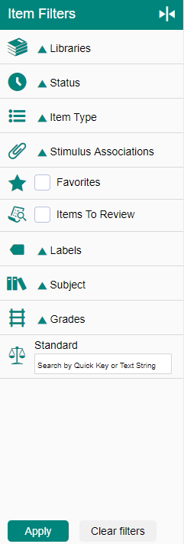
How to Use Filters and the Search Bar to Find Items, Tests, and Standards
Filter | Content Tab | Use
Libraries | Items and Tests | Expand the Libraries menu to filter your content results by items and tests you created, items and tests shared with you, or content in a shared library.
Status | Items and Tests | Expand the Status menu and mark the available checkboxes to view only the content with a particular status. Some common status terms include Draft, Published, and Archived.
Item Type | Items | Expand the Item Type menu and mark the available checkboxes to view only the items that are built in a particular item template.
Stimulus Associations | Items | Expand the Stimulus Associations menu and ark the available checkboxes to view only items that are linked to a stimulus or only items that are not linked to any stimulus.
Favorites | Items, Tests, Standards | Click the star icon next to any item, test, or standard to save it as a favorite. Mark the Favorites checkbox to show only the content you have marked.
Items to Review | Items | Mark this checkbox to show only the items that have been submitted to a shared items library and still need to be approved.
Labels | Items, Tests, Standards | Create custom labels to organize content. Expand the Labels menu and mark the available checkboxes to view only the content associated with a particular label.
Subject | Items, Tests, Standards | Expand the Subjects menu and mark the available checkboxes to view only the content associated with a particular subject.
Grades | Items, Tests, Standards | Expand the Grades menu and mark the available checkboxes to view only the content associated with that grade.
Standard | Items and Tests | To show only content aligned to a particular standard, enter the ID or label for a standard in the Standard field. Items are aligned to standards directly, while a test’s standards are determined by the items on that test.
Notes:
Each content tab includes a filter panel and search bar that helps you find the items, tests, or standards you want to work with. The available filter options are different for each content type, but they are similar in use. This table is a summary of all the filter options and the uses for each.

Slide 34
How to Edit Items and Tests You Have Created
Changes can be made to any items or tests with a Draft status
Click the item you want to edit
Any items marked Published in the status column cannot be edited.
Notes:
You can make changes to any items or tests you created that have a Draft status. You cannot edit Published items and tests. When another educator shares an item or test with you, you may only edit its content if you were given editing permissions by the original author. If you cannot edit a test or item, you may create a copy of it and make changes to the copy version.
To make changes to your content, open the content tab and click the name of the item or test you want to edit. The corresponding Builder page will appear. When editing items you may also need to click Edit in the item toolbar.

Slide 35
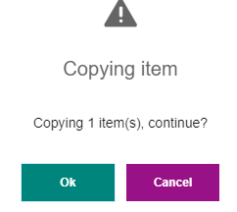
How to Make Copies of Items and Tests
NOTE: you may not have permission to copy items in certain libraries, such as the Checkpoint items or forms.
Notes:
You can create copies of any test or item that you wish to modify without affecting the original version. For example, if you want to edit a Published item, you could copy that item and make edits to the copied version. You may not have permission to copy items in certain libraries.
Open the appropriate tab and mark the checkbox for each item, test, or standards publication you wish to copy. Click the Copy button in the toolbar above the table. A confirmation window displays. Click Ok. The copied content is added to the table. You can click the name of the copied version to edit its content.

Slide 36
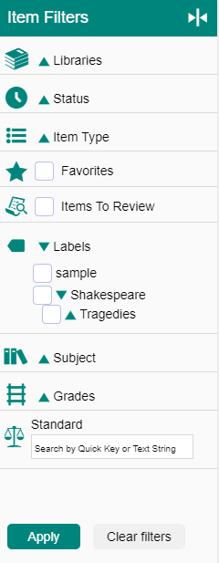
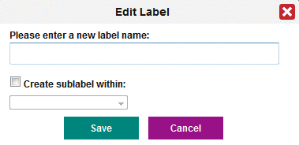
How to Add Labels to Organize Items and Tests
2
1
3
4
5
Notes:
You can create labels and add them to content that you want to organize. After adding labels to your content, you can use the Labels menu in the filter panel beside the table to easily view all the items, tests, or standards with the selected label.
On the appropriate tab, mark the checkbox for each test or item you wish to label.
Then click Label in the toolbar above the table.
The Apply Label window appears. To assign an existing label, mark the checkbox for that label and click Apply. (The Apply button will appear after you check a label from the list.) To create a new label, click Create New. The Edit Label window appears. Enter a name for the label.
Click Save and then,
Click Apply.

Slide 37
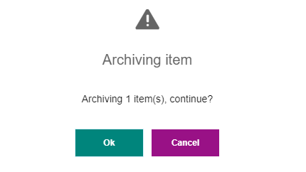
How to Archive Items and Tests You No Longer Need
2
1
3
Notes:
You can archive content that you do not wish to use anymore. This will remove it from your content tab tables. Archived content cannot be shared, administered, or associated with other content.
On the appropriate tab, mark the checkbox for each item or test you want to archive.
Then click the archive icon in the toolbar.
In the warning message that appears, click Ok.
If you need to restore the archived content, mark the Archived checkbox in the Status section of the filter panel to the left of the table. Then mark the checkbox for the content you want to restore and click the Restore icon in the toolbar.

Slide 38
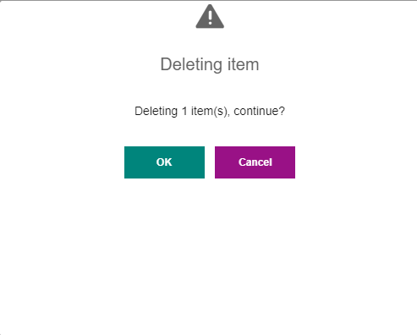
How to Archive Items and Tests You No Longer Need
3
2
1
4
Notes:
To permanently delete archived content, mark the Archived checkbox of the Status section of the filter panel.
Then mark the checkbox for the content you wish to delete and
Click Delete in the toolbar above the table.
In the warning message that appears, click OK.
The selected content is removed from your content tab tables. This cannot be reversed.

Slide 39
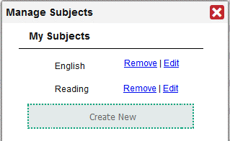
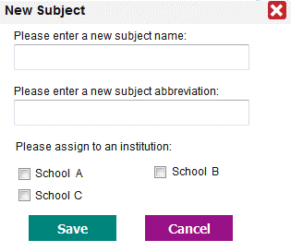
For Admin Users: How to Create Subjects to Align with Content
Notes:
In order for educators to associate their original test items with subjects, authorized users must first create those subjects and make them available to their institutions. Subjects for ELA, Math, Social Studies, and Science are already provided.
The educators in your complex will be able to associate their items with the subjects you create. The subjects for tests will be determined automatically based on the items added to tests. Associating content with subjects makes it easier to organize that content in Checkpoint and easier to locate published tests when running test sessions in the Test Administration System.
To create a new, subject Select Manage Subjects from the My Settings menu in the banner. The Manage Subject window appears. Click Create New and the New Subject window appears. Enter the name and abbreviation desired and check the institutions that should be able to associate items and standards with this subject. Click Save.
You can also edit or remove a subject using the Manage Subjects window.

Slide 40
How to Share Your Content with Other Educators
Notes:
This section explains how to share your items and tests with others. It explains how authorized users share tests with custom administration dates.

Slide 41
Sharing Roles in the Checkpoint System
Sharing Roles
Users in Checkpoint can share items, tests, and add users into workgroups based on their role. The following roles have the sharing capabilities listed below:
ROLE | SHARING CAPABILITIES
Complex Area Superintendent (CAS) | Complex Area Superintendents can share items and tests with anyone in their Complex Area, including Complex Staff, Principals, Test Coordinators, Test Administrators, and Teachers. They can also share items and tests with users in the same workgroups.
Complex Staff (CS) | Complex Staff can share items and tests with any other Complex Staff, Principals, Test Coordinators, Test Administrators, and Teachers in their complex. They can also share items and tests with users in the same workgroups.
Principals (PR) and Test Coordinators (TC) | Principals and Test Coordinators can share items and tests with any other Principals, Test Coordinators, Test Administrators, and Teachers in their school. They can also share items and tests with users in the same workgroups, even if the educators in the workgroup are from a different school. Note: PR and TC users can only be added to a workgroup with educators from different schools if a CAS or CS user adds them.
Test Administrators (TA) and Teachers (TE) | Test Administrators and Teachers can share items and tests with any other Test Administrators and Teachers in their school. They can also share items and tests with users in the same workgroups, even if the educators from the workgroups are from a different school. Note: TA and TE users can only be added to a workgroup with educators from different schools if a CAS or CS user adds them. Note: Users must have a TA role in TIDE to administer assessments to students.
Notes:
This section provides a brief overview of who can share items and tests with different user roles and workgroups in Checkpoint. Complete information about the Checkpoint System is available in the Checkpoint System User Guide.

Slide 42
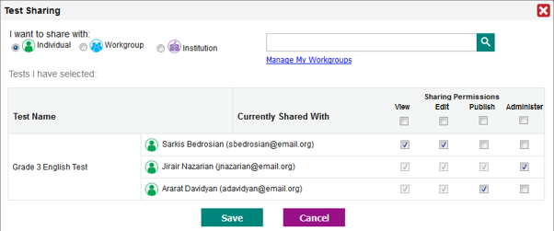
How to Share Your Items, Tests, and Standards with Other Educators
1
2
3
4
Notes:
You can share your items and tests with other educators so they can co-author the content, use the content for themselves, or administer your tests to their students. You can share with individual users, a custom groups of users (workgroups), and your school.
Open the desired content tab by clicking Items or Tests. Mark the checkboxes of the items or tests you want to share. Click the Share button above the table.
The Sharing window appears. Select the recipients you want to share your content with. You can add multiple recipients. Use the radio buttons under the words, I want to share with, and the Search box to display recipients.
Select the specific permissions you’d like to give each sharing recipient. By default, all sharing recipients will be able to create copies of your shared content, but you will have to choose the other actions you want them to be able to perform. The Sharing Permissions are View, Edit, Publish, and Administer.
Click Save.

Slide 43
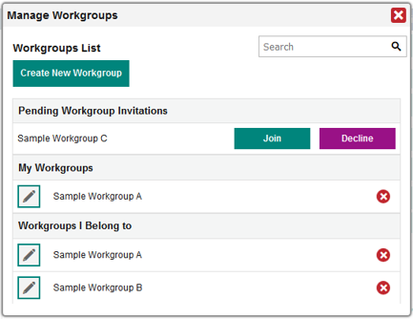
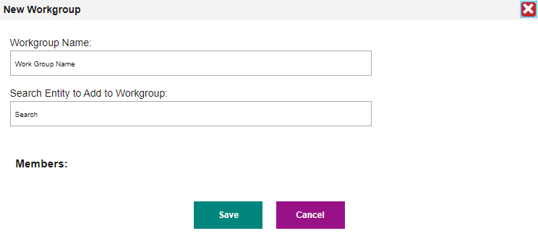
How to Create and Join Workgroups for Sharing Content
1
4
2
3
Notes:
To make it easy to share your tests and items with the same group of educators on a regular basis, you can create a workgroup for them. You can also join other workgroups you get invited to.
Select Manage Workgroups from the My Settings menu in the Checkpoint banner.
Click Create New Workgroup.
In the Workgroup Name field, enter a unique name for your group. In the Search Entity to Add to Workgroup field, enter the name or email address for the user you want to add to the group. Select the name when it appears in the dropdown.
To join a workgroup, open the Notifications menu in the banner and click Workgroup Invitations. The Manage Workgroups window appears. Click Join or Decline under the Pending Workgroup Invitations section.

Slide 44
How School-Level Users Set Administration Dates
1
2
3
Notes:
School-level users can set administration dates that specify exactly when their shared tests will be available in the recipients’ Test Administration System. Recipients will be able to access these shared tests in the Test Administration System, but they cannot view or edit them in the Checkpoint Tests tab.
On the Tests tab, mark the checkbox for each test you wish to share and click Administer above the table. The Test Administration window appears.
To specify the date range during which the test will be available in the Test Administration System, select start and end dates from the fields in the Administration Period section.
2. In the I want to administer with section, select who can administer the test in the Test Administration System:
To share the test with an individual user, mark the Individual radio button and search for that user’s name or email address. You may need to select the user’s school from the available dropdowns first.
To share the test with a workgroup, mark the Workgroup radio button and search for that workgroup’s name. A workgroup is a custom group of Authoring users.
To share the test with an entire school, mark the Institution radio button and search for that institution’s name.
Click the name of the intended administrator. You can repeat this step to add additional administrators. Click Save.

Slide 45
How to Submit Your Items to a Shared Items Library
Notes:
This section explains how to submit items to a shared items library and how authorized users review and approve submitted items.

Slide 46
Submitting Items for Review: Requirements
In order to submit an item for review, it must meet the following requirements:
The item has all the required content (such as a prompt, response area, and valid answer key)
The item has a Draft status and has not yet been added to any tests
The item is not shared with any other users
Notes:
Checkpoint includes a shared items library available to all users in your state. Members of review groups can submit their original items to the shared library. Submitted items undergo multiple stages of review before they are approved for the shared library. Once an item is added to the shared library, any user in the state can add that item to their tests. This is beneficial for all teachers as it increases the number of items available for teachers to add to their assessments.
In order to submit an item for review, it must meet the following requirements:
The item has all the required content (such as a prompt, response area, and valid answer key)
The item has a Draft status and has not yet been added to any tests
The item is not shared with any other users

Slide 47
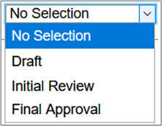
For Admin Users: Adding Authoring Users to Review Groups
Notes:
Before Checkpoint users can submit or approve items for a shared library, a user with administrator privileges must add them to a review group and assign their review level permissions within the group. Each review group consists of multiple review levels that determine which group members can submit items to the library and which members can review them at each stage of the process. For more information on review stages, please see the Checkpoint User Guide.
You can create multiple review groups, but when users submit items to the library, they can choose only one group to review it. Since a review group includes multiple review levels, a review group must include at least one member assigned at each review level in order for items to complete the review workflow. For example, if a review group does not have any members with Content Review permission, nobody can approve an item once it reaches the Content Review level.
To add Checkpoint users to a review group, select Review Groups from the My Settings menu in the banner. The Manage Review Groups window will appear. Then do the following:
1. If you wish to create a new group of authorized users, enter a name for the group in the New Group field. If you wish to update the membership of an existing group, select the desired group from the Existing Group dropdown.
2. To assign a review level permission to the group members you are adding, select an option from the Select Review Level. Note that you can assign only one review level at a time.
3. Select who should be added to the item group:
To add an individual educator, mark the Individual radio button and search for that educator's name or email address. You may first need to select the educator’s institution from the available Complex and School dropdowns.
To add the members of a workgroup, mark the Workgroup radio button and search for that workgroup's name.
To add the members of an entire institution, such as a school or complex, mark the Institution radio button and search for that institution's name.
The selected educators will be added to the list in the window. Select Save.
To remove an educator from the list, click the button in the Remove column on the right.
Please note that when setting up a new review group, you must add members to the group at each review level. If you do not assign a particular review level to any members of the group, such as Final Approval, submitted items can never be added to the library.

Slide 48
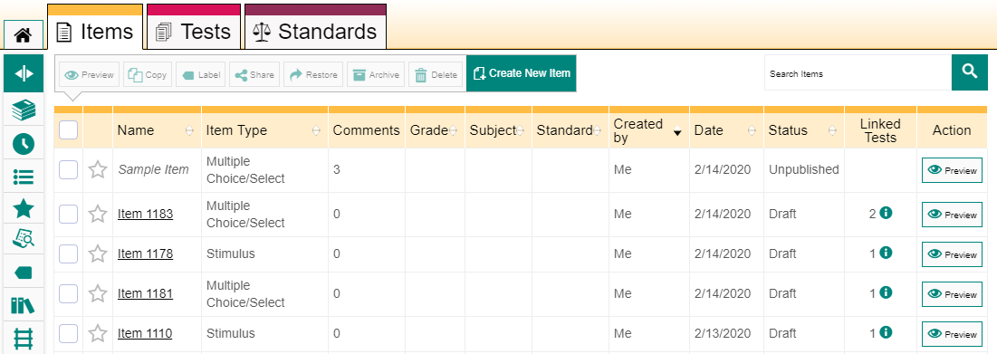
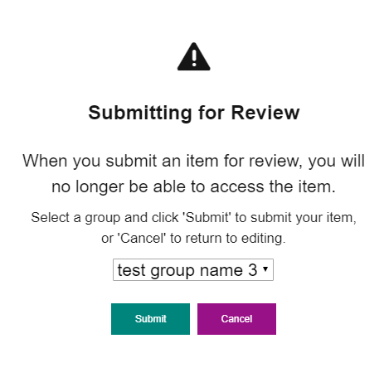
How to Submit Your Items to a Shared Items Library
1
2
3
Notes:
In order to add an item to shared library, you must first submit it for review. Only users with Draft review level permission can submit items to a review group. Once you submit an item, you cannot make any additional edits to it unless a reviewer sends it back for revision. At that point, you can modify the content and submit the item for review again.
To submit an item to a shared library do the following:
Open the Item Builder page for that item you want to submit by clicking its name in the table on the Items tab.
Click Submit for Review in the item toolbar.
In the confirmation message that appears, select the group you wish to submit the item to and click Submit.

Slide 49
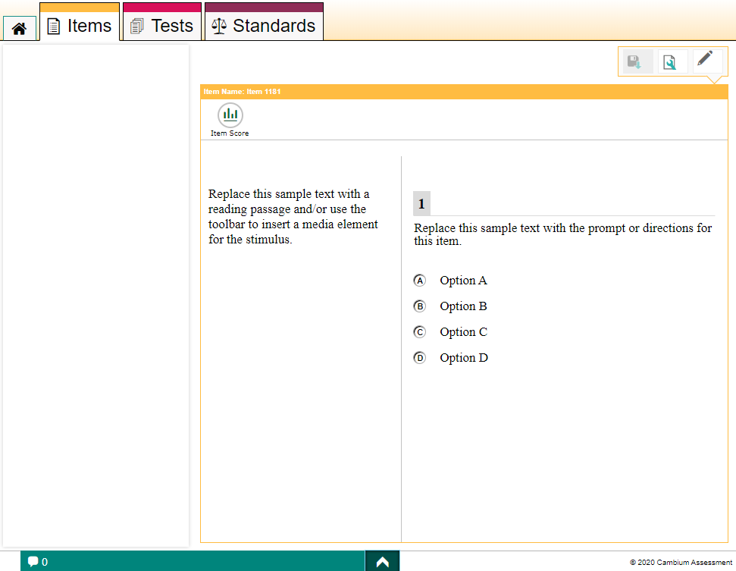
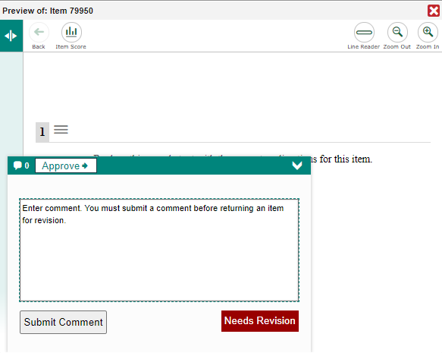
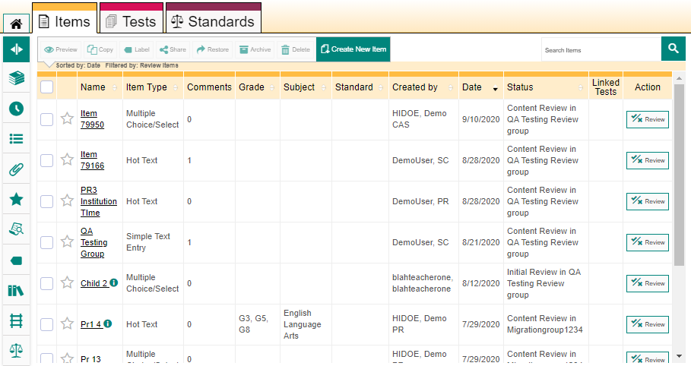
How Reviewers Approve Items Submitted to a Shared Library
1
3
2
4
Notes:
Users who have been added to review groups with the appropriate review level permissions can choose whether to approve the items in review or send them back for revision.
An item must be approved by users at each required review level before it can be finalized.
From the dashboard click on the Review Items link.
The Items tab appears, displaying the items that require approval. Click the name of the item you wish to review. You can also click the Review button in the Action column.
In the lower-left corner click the arrow to expand the item feedback panel.
Click Approve, or if the item needs revisions, enter a comment in the provided field and then click Needs Revision to return the item to its original author.

Slide 50
Checkpoint Resources
For more information about the Checkpoint System, please refer to the following resources on the Smarter Balanced, HSA Science, and EOC pages of the HSAP portal.
Checkpoint Mini Modules:
How Tests Created in Checkpoint Are Reported
How to Add Checkpoint Users to Review Groups
How to Add Images to Items
How to Align Items to Standards
How to Filter and Search for Items
How to Publish Tests in Checkpoint
How to Start a Teacher-Authored Test in TDS
How to Submit an Item for Review
How to Understand Status
How to Write an Item in Checkpoint
Checkpoint User Guides:
Checkpoint User Guide
Quick Guide to Sharing in Checkpoint
Notes:
For more information about the Checkpoint System please refer to the above resources on the Smarter Balanced, HSA Science, and EOC pages of the HSAP portal.

Slide 51
For More Help
You can contact the HSAP Help Desk for assistance with any technical issues you encounter. When contacting the HSAP Help Desk, please be ready to provide:
Any error messages that are appearing (including codes)
Your operating system and browser information
Your network configuration information
Your contact information for follow-up by phone or email
Any other relevant information, such as test names or content areas, student IDs, session IDs, and search criteria
For test administration or policy issues, please contact your school test coordinator.
Further Information
HSAP Portal: https://alohahsap.org/
HSAP Help Desk
Phone: 1-866-648-3712
Email:
hsaphelpdesk@cambiumassessment.com
Thank you!
Notes:
You can find the 2021-2022 Checkpoint User Guide and other helpful resources on the Smarter Balanced, HSA Science, and EOC page of the HSAP portal. However, if you still require assistance with troubleshooting a technical issue, you may also contact the HSAP Help Desk. When contacting the HSAP Help Desk, please be ready to provide the following information:
Any error messages that are appearing (including codes)
Your operating system and browser information
Your network configuration information
Your contact information for follow-up by phone or email
Any other relevant information, such as test names or content areas, student IDs, session IDs, and search criteria
For questions about test administration or policy issues, please contact your school test coordinator.
Thank you for taking the time to view this training module. For detailed information, consult the Checkpoint User Guide located on the Smarter Balanced, HSA Science, and EOC page of the AlohaHSAP.org portal or contact the HSAP Help Desk.

