Slide 1
Testing with Braille
Training Module for Test Administrators
Copyright © 2021 Cambium Assessment, Inc. All rights reserved.
Notes:
Welcome. In this training module, we will discuss what test administrators need to know in order to administer tests to students using Braille. For more detailed information on administering tests to students using Braille, please refer to the Assistive Technology Manual available on the portal.

Slide 2
Objectives
After viewing this presentation, you should be able to:
Check that required devices and software for testing with Braille are in place
Confirm that required hardware and software have been set up and configured
Administer tests to students using Braille
Correctly handle emboss requests during testing
Understand how students using Braille sign into the Student Testing Site and respond to test items
Notes:
By the end of this presentation, you should be able to:
Check that required devices and software for testing with Braille are in place
Confirm that required hardware and software have been set up and configured
Administer tests to students using Braille
Correctly handle emboss requests during testing
Understand how students using Braille sign in to the Student Testing Site and respond to test items

Slide 3
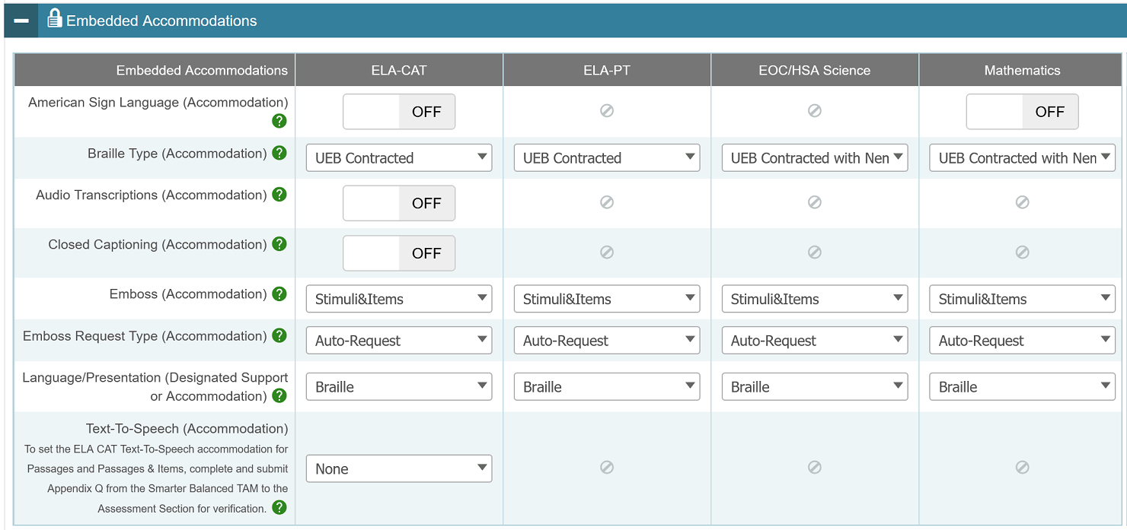
Overview of Braille Testing
Before testing, students must have the correct test settings entered in TIDE:
3
Notes:
Before any tests can be administered to students using Braille, these students must have the correct test settings entered in TIDE. The image on this slide shows some of the accommodations that need to be set:
Students’ language/presentation should be set to Braille.
The appropriate Braille type should be selected for each test type. Braille types include uncontracted, contracted, and Nemeth.
If students should have the ability to request embossing of stimuli and/or items, their emboss settings should be adjusted appropriately for each type of test.
Emboss Request Type should be set to Auto-Request or On-Request as appropriate for each test.
For the full list of Braille types and more information on TIDE settings for students using Braille, please refer to the Assistive Technology Manual.

Slide 4
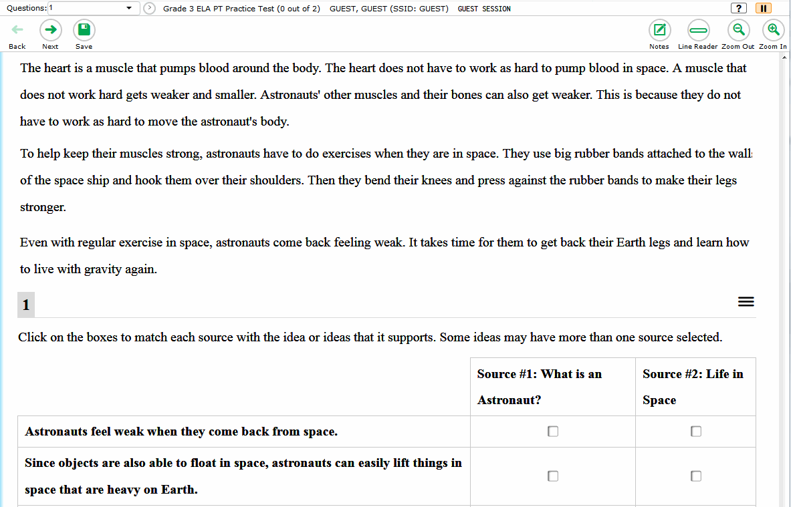
Overview of Braille Testing
Tests will automatically appear in streamlined mode for students with their test presentation set to Braille.
Content will be arranged vertically.
4
Notes:
When a student’s test presentation is set to Braille, the test automatically appears in streamlined mode. This layout arranges the test content vertically. The stimuli appear at the top of the page, and questions appear in sequence below their associated stimulus.

Slide 5
Technology for Testing with Braille

Slide 6
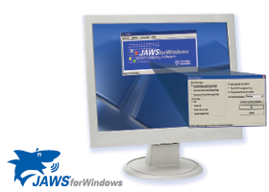
Technology for Testing with Braille
Job Access With Speech (JAWS)
A computer screen-reader program that allows blind and visually impaired students to read the screen either with a text-to-speech output or by a Refreshable Braille Display (RBD).
Students use their keyboards to navigate between lines and test elements.
6
Notes:
Specific hardware and software are required in order to administer tests to students using Braille.
Computers used by students for testing must have Job Access With Speech, or JAWS, installed. JAWS is a computer screen-reader program that allows blind and visually impaired students to read the screen either with a text-to-speech output or by a Refreshable Braille Display. Students can use JAWS keyboard commands to navigate the test sign-in process and answer test questions. We will discuss how students use JAWS later in this presentation.

Slide 7
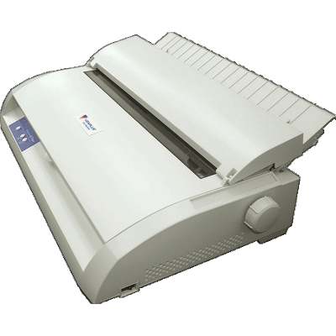
Technology for Testing with Braille
ViewPlus Max Braille Embosser
Used to create hard copies of text and images.
Embossers work with Braille translation software to print written text on the computer screen as Braille.
Files used for embossing are configured to work with the ViewPlus Max Embosser.
7
Notes:
A Braille embosser is a type of printer that creates hard copies of text and images in Braille. Braille translation software should be installed and configured on the TA’s computer so that he or she can send approved emboss requests to the embosser.
Files used for embossing are configured to work with the ViewPlus Max Braille Embosser, ViewPlus Premier, ViewPlus Columbia, and ViewPlus Columbia 2. Embossers from a manufacturer other than ViewPlus will not be able to print graphics and images in the online testing system.

Slide 8
Technology for Testing with Braille
Refreshable Braille Display (RBD)
A device for displaying Braille characters, usually by means of round-tipped pins raised through holes in a flat surface.
RBDs allow users who cannot see a computer monitor to read text output.
This device is supported but not required for online testing. RBDs cannot display images.
AIR recommends using an RBD that has at least 40 cells, such as the Brailliant 40 cell, but RBDs with fewer cells may also be used.
8
Notes:
A Refreshable Braille Display (or RBD) is a device for displaying braille characters, usually by means of round-tipped pins raised through holes in a flat surface.
In addition to Braille embossers, RBDs are another means by which students can read text without a computer monitor. RBDs are recommended but not required for online testing. If using an RBD, CAI recommends one that has at least 40 cells, such as the Brailliant 40 cell, but RBDs with fewer cells may also be used.
If a question includes text and images that the RBD cannot read, the question will be sent to a Braille embosser instead.

Slide 9
Supported Operating Systems
Student Computers
Windows 10
Windows 8.1
Test Administrator Computers
Windows 10
Windows 8.1
9
Notes:
Please note that all computers to be used by students and test administrators for testing with Braille must be running Windows. The currently supported Windows operating systems are listed on this slide.
Please consult the Assistive Technology Manual for technology requirements.

Slide 10
Test Administrator Software Configurations

Slide 11
Test Administrator Software Configuration
Install the following embossing software on machines to be used by the Test Administrator (TA)
ViewPlus Desktop Embosser Driver used to emboss PRN files (required)
Duxbury Braille Translator (version 11.1, 11.2, 11.3, 12.1, 12.2) used to emboss BRF files (required)
ViewPlus Tiger Software Suite (required if file conversion before embossment is necessary)
Configure PRN emboss settings with ViewPlus software
Configure BRF emboss settings with Duxbury Braille Translator software
11
Notes:
On all devices used by test administrators to administer tests, technology coordinators should install and configure the ViewPlus Desktop Embosser Driver and the Duxbury Braille Translator. The ViewPlus Desktop Embosser driver includes the Tiger Viewer application used to emboss PRN files. We will discuss embossing PRN and BRF files later in this presentation.
We also recommend installing the ViewPlus Tiger Software Suite, which is available for purchase online and included for free with the purchase of any ViewPlus embosser. The Tiger Software Suite is not required but can be used as an alternate method for printing PRN files. The ViewPlus Tiger Software Suite is required if you need to convert any files before embossing them.
Before any tests are administered, technology coordinators should install this software under the Windows login account of the test administrator and configure BRF and PRN emboss settings according to the detailed instructions in the Assistive Technology Manual. If these steps are not carefully followed using sample Braille files, unexpected technology issues may arise during test administration.

Slide 12
TA Software Configuration: ViewPlus Desktop Driver
The ViewPlus embosser desktop driver includes the Tiger Viewer application used to emboss PRN files.
The desktop embosser driver can be found on the installation CD that comes with the embosser, or you may download the driver from the ViewPlus website.
Only the ViewPlus Tiger Max Embosser has been tested for compatibility with the online testing system.
12
Notes:
The ViewPlus desktop driver includes the ViewPlus Tiger Viewer application used to emboss PRN files. This driver can be found on the installation CD that comes with the embosser, or you may download the latest driver from the ViewPlus website.
If you are installing the driver from the ViewPlus website, the driver will be downloaded as a .zip file. Extract the contents to your hard drive and open the application file ending in “.exe.” If you get a Windows security alert, click Install to proceed.

Slide 13
TA Software Configuration: ViewPlus Desktop Driver
Ensure that the embosser is connected to the computer with its included USB cable.
Note: You should always plug the embosser into the same USB port on your computer.
Follow the installation instructions for installing the ViewPlus desktop embosser driver. You will need to restart your computer for the installation to complete.
Download a sample PRN file. This can be found on the TA Training Site in the Help Guide.
Click the sample PRN file to open it.
13
Notes:
To install and configure the ViewPlus Desktop Embosser Driver and Tiger Viewer:
Ensure that the embosser is connected to the computer with its included USB cable.
Note: You should always plug the embosser into the same USB port on your computer. Plugging into a different USB port may cause the computer to not recognize the embosser even though it was previously installed.
Follow the installation instructions for installing the ViewPlus desktop driver. You will need to restart your computer for the installation to complete.
Download a sample PRN file. This can be found on the TA Training Site in the Help Guide’s Sample Braille Files appendix.
Click the sample PRN file to open it.

Slide 14
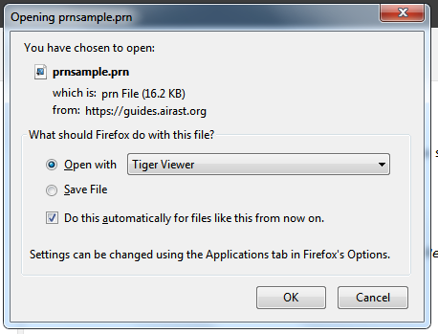
TA Software Configuration: ViewPlus Desktop Driver
5. In the Open with drop-down list, select Tiger Designer.
If that option is not shown, click Browse and navigate to the location where it is installed.
Check the box labeled “Do this automatically for files like this from now on.”
6. Click OK.
Tiger Designer
14
Notes:
In the “Open with” drop-down list, select Tiger Designer.
If that option is not shown, click Browse and navigate to the location where it is installed.
Check the box labeled “Do this automatically for files like this from now on.”
Click OK.

Slide 15
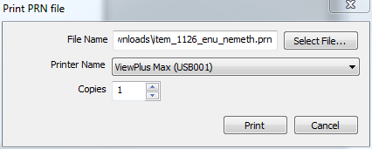
TA Software Configuration: ViewPlus Desktop Driver
The Tiger Designer program opens and previews the file.
Go to File > Print. The Print window opens.
Ensure that the printer is set to ViewPlus Max (or other ViewPlus embosser) and that only one copy is being printed.
Click Print to emboss.
Check the embossed braille output. If it is correct, then your machine is now properly configured to print PRN files.
15
Notes:
Follow the below steps when printing a file in PRN format:
The Tiger Designer program opens and previews the file.
Go to File > Print. The Print window opens.
Ensure that the printer is set to ViewPlus Max (or other ViewPlus embosser) and that only one copy is being printed.
Click Print to emboss.
Check the embossed braille output. If it is correct, then your machine is now properly configured to print PRN files.
Please note that if you are having difficulties embossing PRN files using the Tiger Viewer, you may be able to emboss successfully by restarting the embosser and then using the ViewPlus Designer program instead. ViewPlus Designer is part of the Tiger Software Suite included on the installation CD that comes with all ViewPlus embossers.
If the Print button is disabled, you may need to convert the files in Tiger Designer. To do this, open the file in Tiger Designer and click Yes when a popup message asks if you want to convert the file. Then save the file as a Tiger Designer Document file (.TDSX) and try printing it again.

Slide 16
TA Software Configuration: Duxbury Braille Translator
Install the Duxbury Braille Translator used to emboss BRF files:
Ensure that the braille embosser is turned on and connected, with the correct device driver installed.
Install DBT from the web or from an installation CD.
Download a sample BRF file. This can be found on the TA Training Site in the Help Guide.
Click the Sample BRF file to open it. A dialog window will pop up.
16
Notes:
The following directions can be used to install Duxbury Braille Translator versions 11.1 to 12.2, which can be used to emboss BRF files. For directions about installing and configuring previous versions of Duxbury, please refer to the Assistive Technology Manual.
Ensure that the braille embosser is turned on and connected, with the correct device driver installed.
Install DBT from the web or from the installation CD.
Download a sample BRF file. This can be found on the TA Training Site in the Help Guide’s Sample Braille Files appendix.
Click the Sample BRF file to open it. A dialog window will pop up.

Slide 17
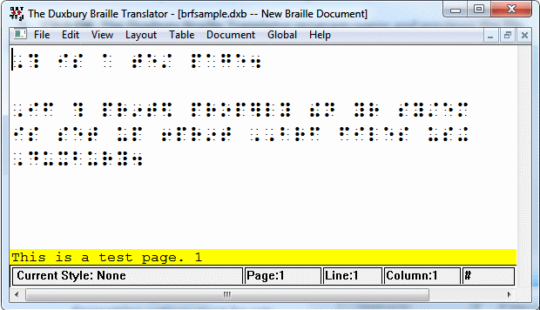
TA Software Configuration: Duxbury Braille Translator
5. In the Open with drop-down list, select Duxbury Braille Translator.
If that option is not shown, click Browse and navigate to the location where Duxbury is installed.
Open the DBT folder and select dbtw.exe.
Check the box labeled “Do this automatically for files like this from now on.”
6. Click OK. The Duxbury Braille Translator opens and previews the file.
17
Notes:
In the Open with drop-down list, select Duxbury Braille Translator.
If that option is not shown, click Browse and navigate to the location where Duxbury is installed.
Default location: C:\Program Files (x86)\Duxbury\DBT 11.3\dbtw.exe If you are using a different version of the Duxbury software, then you will need to change 11.3 to the appropriate version number.
Check the box labeled “Do this automatically for files like this from now on.”
Click OK. The Duxbury Braille Translator opens and previews the file.

Slide 18
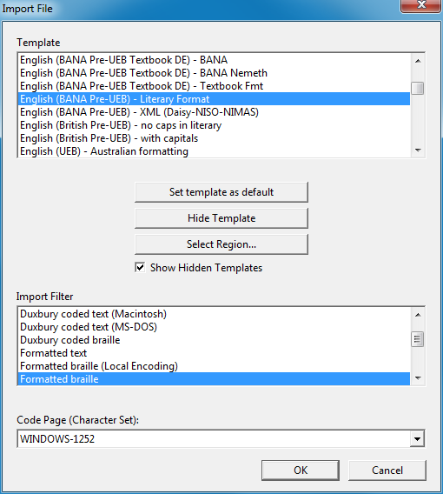
TA Software Configuration: Duxbury Braille Translator
If the Import File window appears,
Set the Template to either English (American) – Standard Literary Format (for Duxbury 11.2 or earlier) or English (BANA Pre-UEB) – Literary Format (for Duxbury 11.3 or later).
Set the Import Filter to Formatted Braille.
Click OK to continue.
18
Notes:
If the Import File window appears,
set the Template to either English (American) – Standard Literary Format (for Duxbury 11.2 or earlier) or English (BANA Pre-UEB) – Literary Format (for Duxbury 11.3 or later).
Set the Import Filter to Formatted Braille.
Click OK to continue.

Slide 19
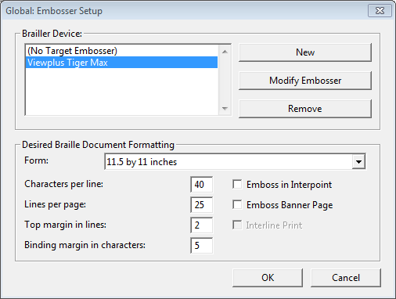
TA Software Configuration: Duxbury Braille Translator
In the Duxbury Braille Translator window, go to Global > Embosser Setup. The Global: Embosser Setup window appears.
19
Notes:
In the Duxbury Braille Translator window, go to Global > Embosser Setup. The Global: Embosser Setup window appears. To add a new embosser click New.

Slide 20
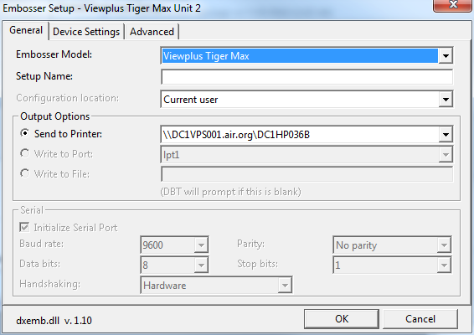
TA Software Configuration: Duxbury Braille Translator
To add a new embosser,
Click New. The Embosser Setup – Untitled Configuration window appears.
From the Embosser Model drop-down list, select the embosser type.
From the Send to Printer drop-down list, select the embosser’s name and click OK.
In the Global: Embosser Setup window, click OK.
20
Notes:
After clicking New to add a new embosser, the Embosser Setup window will appear.
To add a new embosser,
Click New. The Embosser Setup – Untitled Configuration window appears.
From the Embosser Model drop-down list, select the required embosser type.
From the Send to Printer drop-down list, select the required embosser’s name and click OK.
In the Global: Embosser Setup window, click OK to return to the Global Embosser Setup window.
These steps only need to be performed if your embosser does not appear in the list of braille devices.

Slide 21
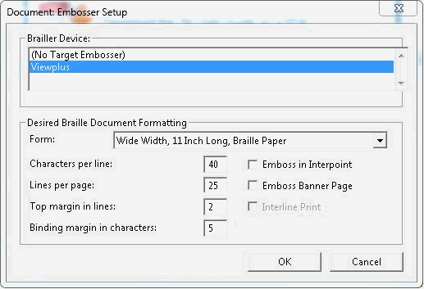
TA Software Configuration: Duxbury Braille Translator
Once you have selected your Braille embosser in the Brailler Device list, adjust the Desired Braille Document Formatting settings to those shown here.
Click OK when done.
21
Notes:
Once you have selected your Braille embosser in the Brailler Device list, adjust the Desired Braille Document Formatting settings to those shown here:
Set Characters per line to 40.
Set Lines per page to 25.
Set Top margin in lines to 2.
Set Binding margin in characters to 5.
Make sure that the checkbox for Emboss in Interpoint is not selected.
Click OK when done.

Slide 22
TA Software Configuration: Duxbury Braille Translator
You will return to the Duxbury Braille Translator window.
Go to Global > Formatted Braille Importer.
In the Global: Formatted Braille Importer window that appears, mark the Read formatted Braille without interpretation checkbox and click OK.
Select File > Emboss. The File: Emboss window appears.
Ensure that only one copy is being embossed, the page range is set to All, and the Brailler Device is set to the ViewPlus embosser you wish to use.
Click OK to emboss.
Confirm that the embossed braille output is correct and that no braille text is cut off or printed beyond the edge of the page. If it is correct, then you are ready to print BRF files.
22
Notes:
You will return to the Duxbury Braille Translator window.
Go to Global > Formatted Braille Importer.
In the Global: Formatted Braille Importer window that appears, mark the Read formatted Braille without interpretation checkbox and click OK.
Select File > Emboss. The File: Emboss window appears.
Ensure that only one copy is being embossed, the page range is set to All, and the Brailler Device is set to the ViewPlus embosser you wish to use.
Click OK to emboss.
Confirm that the embossed braille output is correct and that no braille text is cut off or printed beyond the edge of the page. If it is correct, then you are ready to print BRF files.

Slide 23
Video Walkthrough: Configuring Duxbury Braille Translator
23
Notes:
This slide contains a video walkthrough showing how to install and configure Duxbury Braille Translator for embossing BRF files.

Slide 24
Student Software Configuration

Slide 25
Student Software Configuration
Install the following software on machines to be used by students testing with Braille:
Secure Browser 12.5
JAWS (version 2019, 2020, or 2021)
Configuration instructions for JAWS:
Configure JAWS to recognize the Secure Browser
Apply JAWS settings for Contracted or Uncontracted Braille
Configure JAWS to speak “dollars”
For details, see the Assistive Technology Manual.
25
Notes:
Before administering tests to students with Braille, TAs should confirm that their technology coordinator has installed and configured the Secure Browser and JAWS on all devices to be used by students testing with Braille.
JAWS must be configured according to the detailed instructions in the Assistive Technology Manual. If JAWS is not configured, it will not work properly during test administration. Prior to launching the Secure Browser, you can also adjust JAWS voice settings for students based on their individual needs. Students should take practice tests using JAWS so they can determine whether these settings need to be adjusted.
In the next few slides, we will walk through required configuration of software on student testing devices. The following examples are applicable for installing JAWS 2019, 2020, and 2021. Users upgrading from JAWS 2019 also have the option to migrate all of their customized settings directly into their new version of JAWS. See the Freedom Scientific website for details.
For information on previous versions of JAWS software, please consult the Assistive Technology Manual.

Slide 26
Student Software Configuration
The Secure Browser is available for download on your state’s portal.
JAWS is available online at: http://www.freedomscientific.com/products/fs/jaws-product-page.asp
26
Notes:
Students use the Secure Browser to log in to the Student Interface of the Test Delivery System (TDS). Visit your state portal for more information on downloading and installing the Secure Browser. JAWS is available on the Freedom Scientific website.

Slide 27
Configure JAWS to Recognize the Secure Browser
Open the JAWS ConfigNames.ini file.
Default Location: Start > All Programs > JAWS 2019 > Explore JAWS > Explore Shared Settings
In the ConfigNames.ini file, locate the line of text containing firefox:3=firefox
At the end of this line, press Enter, and on the new line type HISecureBrowser=firefox, where HISecureBrowser is the exact name of the Secure Browser found on the desktop.
When you are finished, save the file.
27
Notes:
The first step in configuring student software is to ensure that JAWS recognizes the Secure Browser. To perform this task:
First, open the JAWS ConfigNames.ini file. You can get to this file from the Start Menu by clicking: Start > All Programs > JAWS 2019 > Explore JAWS > Explore Shared Settings. If you are using a different version of JAWS, then simply change “JAWS 2019” to the correct version number.
In the ConfigNames.ini file, locate the line of text containing firefox:3=firefox.
At the end of this line, press Enter and type HISecureBrowser=Firefox, where HISecureBrowser is the exact name of the Secure Browser found on the desktop.
When you are finished, save the file.

Slide 28
Video Walkthrough: Configuring JAWS to Recognize the Secure Browser
28
Notes:
This slide contains a video walkthrough showing how to configure JAWS to recognize the Secure Browser. Please note that the JAWS version in this video may differ from your software.

Slide 29
JAWS Settings

Slide 30
Apply JAWS Settings for Contracted or Uncontracted Braille
Open JAWS and go to Utilities > Settings Center. The Settings Center window opens.
From the Application list at the top of the window, select Firefox.
30
Notes:
In order for students to use contracted or uncontracted Literary Braille with their RBD, the correct JAWS settings must be applied prior to launching the Secure Browser. The following instructions can be used to perform this task using JAWS 2018 or later.
First, open JAWS and go to Utilities > Settings Center. The Settings Center window opens.
From the Application drop-down list at the top of the window, select Firefox.

Slide 31
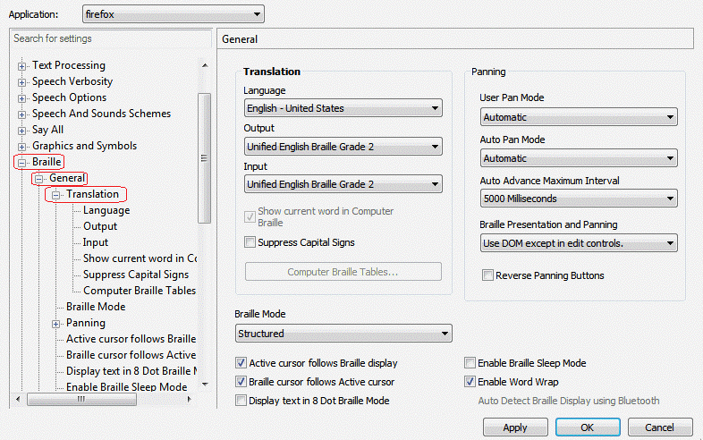
Apply JAWS Settings for Contracted or Uncontracted Braille
3. Expand the Braille settings, General sub-settings, and Translation sub-settings in the Search for settings panel on the left. The Settings Center window displays the options for Braille Translation.
In the Translation section, verify the Language drop-down list is set to English – United States.
For students who prefer contracted Braille, select Unified English Braille Grade 2 from both the Input and Output drop-down lists.
For students who prefer uncontracted Braille, select Unified English Braille Grade 1 from the Output drop-down list.
31
Notes:
3. Expand the Braille settings, General sub-settings, and Translation sub-settings in the Search for settings panel on the left. The Settings Center window displays the options for Braille Translation.
In the Translation section, verify the Language drop-down list is set to English – United States.
For students who prefer contracted Braille, select Unified English Braille Grade 2 from both the Input and Output drop-down lists.
For students who prefer uncontracted Braille, select Unified English Braille Grade 1 from the Output drop-down list.

Slide 32
Apply JAWS Settings for Contracted or Uncontracted Braille
In the Braille Mode section, ensure that only the following settings are checked:
Active cursor follows Braille display
Braille display/cursor follows Active cursor
Enable Word Wrap
Auto Detect Braille Display using Bluetooth (if available)
Click Apply, and then click OK.
32
Notes:
4. In the Braille Mode section, ensure that only the following settings are checked:
Active cursor follows Braille display
Braille display/cursor follows Active cursor
Enable Word Wrap
Auto Detect Braille Display using Bluetooth (if available)
Click Apply, and then click OK.
The necessary settings for contracted Braille appear on this slide.

Slide 33
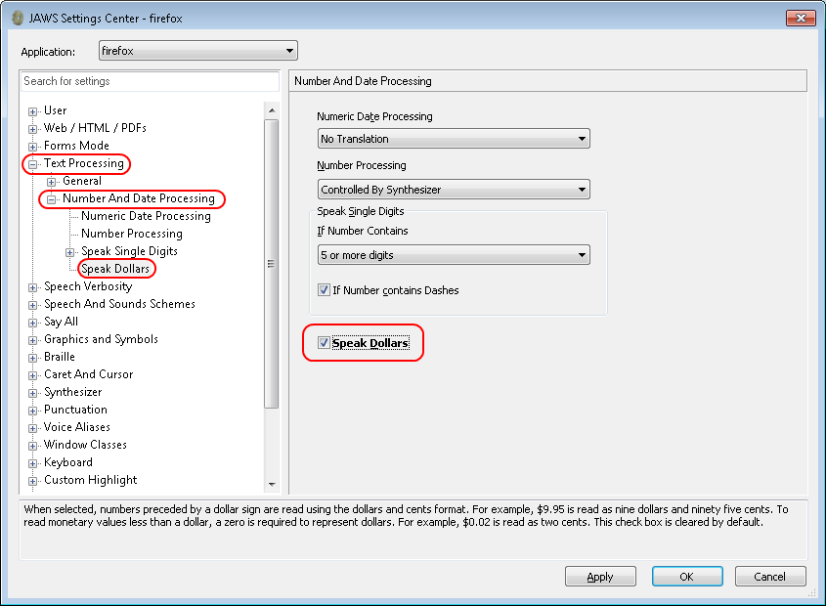
Configure JAWS to Speak “Dollars” ($)
Open JAWS and go to Utilities > Settings Center. The Settings Center window opens.
In the Search for settings panel on the left, expand the Text Processing settings and Number And Date Processing sub-settings. Click Speak Dollars. The Settings Center window displays the Number And Date Processing options.
Mark the Speak Dollars checkbox.
Click Apply, and then click OK.
33
Notes:
To ensure that JAWS correctly speaks the dollar symbol, the following steps must be performed:
First, open JAWS and go to Utilities > Settings Center. The Settings Center window opens.
In the Search for settings panel on the left, expand the Text Processing settings and Number And Date Processing sub-settings. Click Speak Dollars. The Settings Center window will display the Number And Date Processing options.
Mark the Speak Dollars checkbox.
Click Apply, and then click OK.

Slide 34
Video Walkthrough: Applying JAWS Settings
34
Notes:
This slide contains a video walkthrough showing how to apply JAWS settings for contracted or uncontracted braille and how to configure JAWS to speak “dollars.”

Slide 35
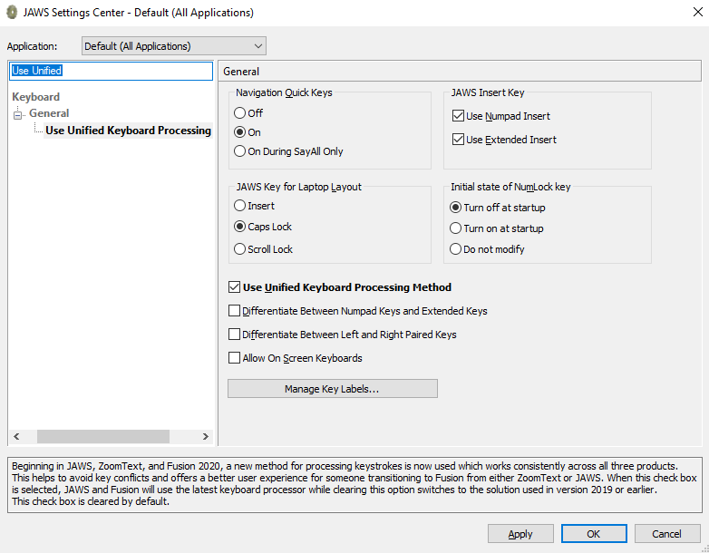
Verify the JAWS Unified Keyboard Settings
Open JAWS 2020 and navigate to Utilities>Setting Center.
Search in the Settings Center for “Unified Keyboard” and mark the Use Unified Keyboard Processing Method checkbox.
Notes:
JAWS 2020 includes a unified keyboard setting that allows students to use Alt+Tab to return to the Secure Browser when Permissive Mode is turned on. If students are using JAWS 2019 or earlier, TAs may need to help students return focus to the Secure Browser by manually clicking it. Students using a full-sized keyboard may also be able to press the backslash key on the numpad to return focus to the test.
The unified keyboard setting is turned on by default in JAWS 2020, but you should still verify it is enabled for students using JAWS 2020 before they begin testing.
Open JAWS 2020 and navigate to Utilities > Setting Center.
Search in the Settings Center for “Unified Keyboard” and mark the Use Unified Keyboard Processing Method checkbox.

Slide 36
Administer Tests to Students Using Braille

Slide 37
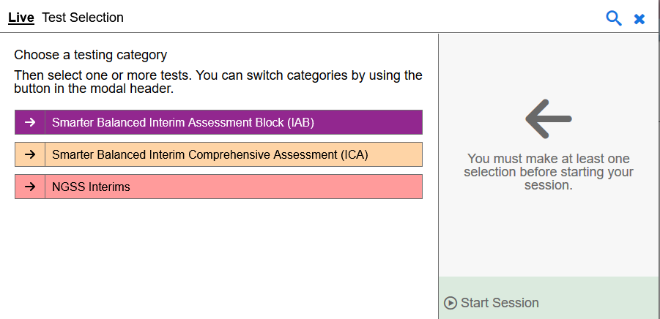
Create a Test Session
37
Notes:
The first step in administering a test is to create a test session. This procedure is the same as it would be for students not using Braille. The test session should be started less than 20 minutes prior to starting the test in order to prevent the system from timing out.
To create a test session, first navigate to the HSAP portal and log in to the TA Live Site with your username and password. If you do not have a valid username and password, contact your test coordinator for assistance.
You create test sessions in the Test Selection window that appears when you log in. The Test Selection window color-codes the available tests and organizes them into categories. You can click the plus sign next to a category name to view the tests in that category. To create a test session, click the test(s) you want to administer or click the checkbox for a category to include all tests in that category.
Once you select your tests, select the Start Session button. The system will automatically generate a session ID. This ID must be provided to students in order for them to log in.

Slide 38
Prepare Student Testing Devices
Before testing begins, the TA must:
Open JAWS on student testing devices.
Open the Secure Browser on student testing devices.
If administering an ELA test using a screen reader other than JAWS 18+, mute the device manually.
38
Notes:
Before testing can begin, the TA must prepare all devices that students will use for testing. First, the TA should open JAWS. Please note that if students are taking an ELA test and are using a screen reader other than JAWS 18 or later, the TA must also mute the students’ devices. This step can be performed by manually muting the system volume. To navigate the test without sound, students may use RBDs, have a TA read text aloud, and/or request that stimuli and items be embossed.
Next, the TA should open the Secure Browser that students will use to access the online testing interface. For more detailed information and additional technical tips, please refer to the Test Administration Manual and the Quick Guide for Setting up Your Online Testing Technology.

Slide 39
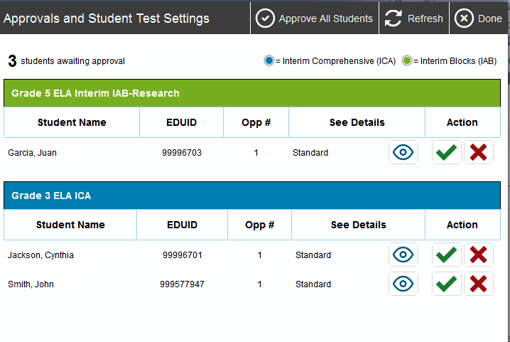
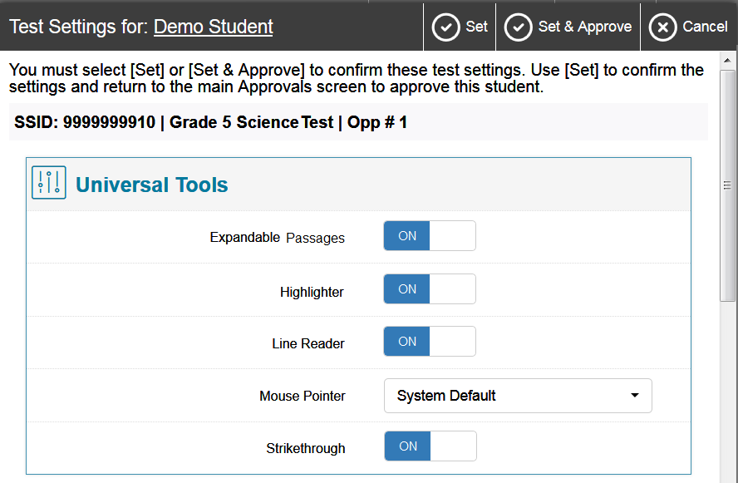
Approving Student Entry
39
Notes:
The TA Live Site will automatically show students in the session as they log in.
Once the Test Administrator starts the test session and students log in, he or she must approve their test settings before they can access their tests. You can do this by clicking the Approvals button. A list of students will display, organized by test name. The Test Administrator should review the list to make sure that all students chose the correct content area and test.
The Test Administrator should also ensure that all of the test settings are correct for each student (as described earlier in this presentation). You can check a student’s test settings using the Eye button in the See Details column.
If no changes are needed, select Approve All Students to admit all students to the session. If a student selected an incorrect test, you must deny that student entry to the test session by clicking the red X button in the Action column.

Slide 40
Denying Student Entry
40
Notes:
Although you can approve all students at the same time, students must be individually denied entry into the test session.
Denying the student entry into the test session will not prevent other approved students from beginning their tests.
If the student’s test settings are incorrect, the settings must be updated before the student takes the test. Test Administrators should contact their School or District Test Coordinator to have the settings updated. This will prevent needing to reset the test for the student later.
Note that no settings can be changed while the student is actively testing. Once a student begins testing, the language option cannot be changed without resetting the test opportunity.

Slide 41
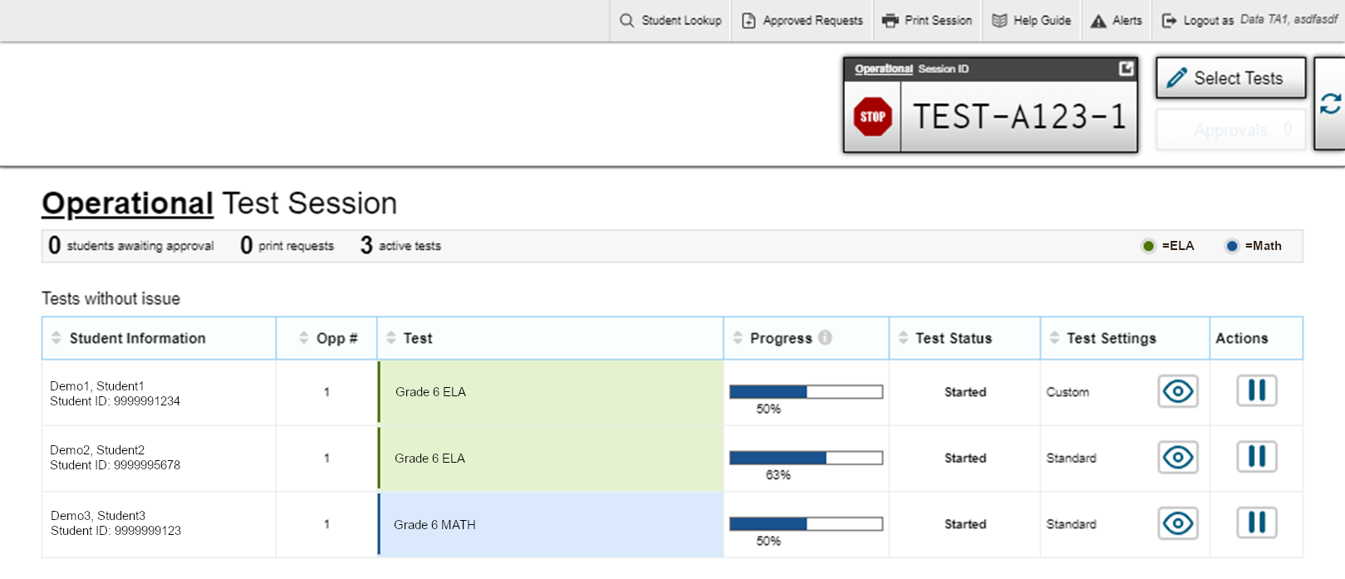
Monitoring Student Status
41
Notes:
While students are taking tests, the test administrator can monitor their status from this screen. A table shows Student Information, Opportunity Number, Test name, Progress, Test Status, Test Settings, and Actions column.
The Progress column displays the student’s progress through the items in the test. It may display a progress bar to indicate the student’s progress through the test or display the total number of items completed thus far and the total number of items in the test.
The Test Status column indicates a student’s testing status. For a list of test statuses, please see the Guide to Navigating the Online HSAP Administration.
The Test Settings column will display either Standard or Custom. This column displays Custom when a student’s test settings are different from the default settings for that test. Click the Eye button to view a student’s test settings. In some states, the number of accommodations and designated supports will also appear.
The Actions column allows you to pause a student’s test. If a student request a printout, a printer icon will appear in this column.

Slide 42
Emboss on Request
Students with Emboss on Request enabled in their test settings may emboss test items and/or stimuli in Braille, depending on the rules for the selected test:
On-Request: Students may manually submit emboss requests to the TA for approval.
Auto-Request: Emboss requests automatically appear on the TA Interface as students navigate the test.
42
Notes:
The online testing system allows students to emboss test material with TA approval. As mentioned previously, the software that sends emboss requests to the Braille embosser must be installed on computers that TAs use for test sessions.
If a test requires manual emboss requests, students send emboss requests to the TA. If a test has auto-emboss request enabled, emboss requests automatically appear on the TA Live Site as students navigate the test.
A note about the Auto-Request setting: Auto-emboss request automatically “pre-fetches” (or queues up) print requests for upcoming test items before students access them. For example, when a student accesses the fifth test item, auto-emboss request may send print requests for items six and seven in advance. If a student pauses the test and you do not print out the pre-fetched print requests, the student will need to send print requests manually when he or she resumes the test and proceeds to those pre-fetched items.
Test Administrators can see which emboss setting is selected for a given student’s test in the test settings window during the approval process.
For more information about handling emboss requests, please refer to the Assistive Technology Manual.

Slide 43
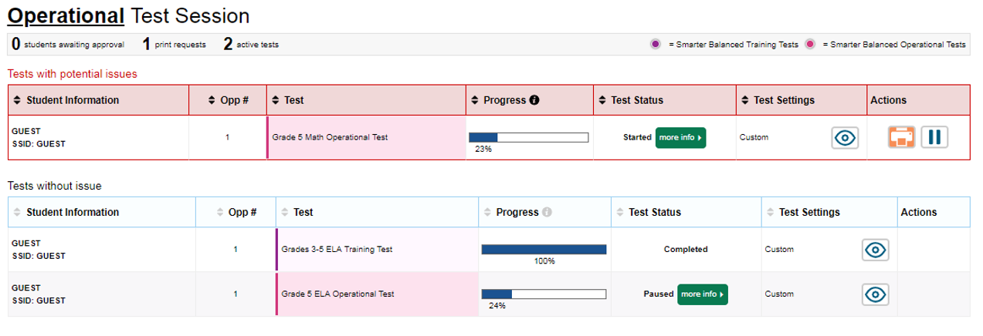
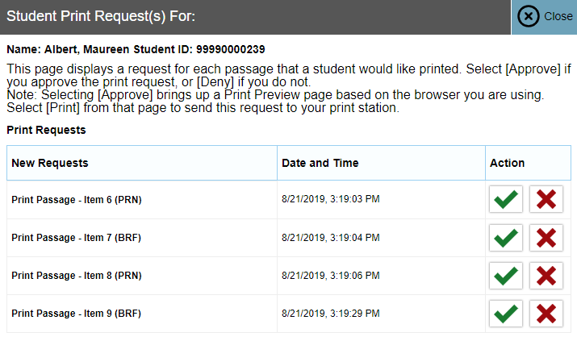
Emboss on Request
43
Notes:
When a student sends an emboss request, the Printer button will appear in the Actions column of the monitoring screen. Click the button to view the request. If you click the red X button to deny the emboss request, nothing will be embossed.
If you click the green Check button to approve the emboss request, a print dialog will appear depending on the type of item you are embossing.
Before approving the student’s emboss request, ensure that it will be sent to an embosser that is monitored by staff who have been trained in test security. All printed or embossed test items, stimuli, and reading passages must be securely stored and destroyed immediately following a testing session.

Slide 44
Emboss on Request
There are two types of files that TAs may need to emboss:
Braille Ready File (BRF) types are used for emboss requests containing only text (including formatted tables). The Duxbury Braille Translator software handles BRF files.
Printer Output File (PRN) types are used for emboss requests containing tactile or spatial components (such as images). The ViewPlus Tiger Viewer software handles PRN files.
44
Notes:
The embossed output for student emboss requests depends on the file type associated with a test question. There are two types of files:
Braille Ready File (BRF) types are used for emboss requests containing only text (including formatted tables). The Duxbury Braille Translator software handles BRF files.
Printer Output File (PRN) types are used for emboss requests containing tactile or spatial components (such as images). The ViewPlus Tiger Viewer software handles PRN files.

Slide 45
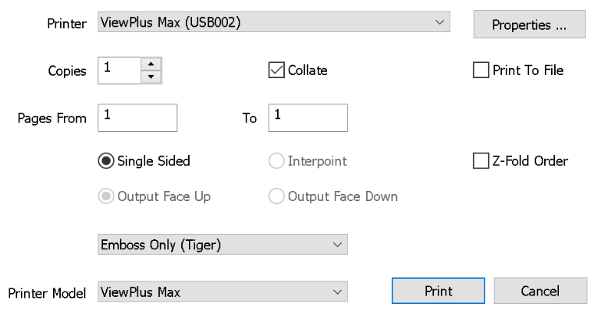
Emboss on Request—PRN
To emboss a Printer Output File (PRN):
1. When you approve a print request that prints in PRN format, a print dialog window opens.
a. Select to Save the file to your computer.
2. Locate the saved PRN file and open it.
a. If Tiger Designer is set as the default program for PRN files, a Print Window appears.
3. Click Print.
45
Notes:
Follow the below steps when printing a file in PRN format:
When you approve a print request that prints in PRN format, a print dialog window opens.
Select to Save the file to your computer.
Locate the saved PRN file and open it.
If Tiger Designer is set as the default program for PRN files, a Print window appears. Ensure that only one copy is being printed and the Printer Name is set to ViewPlus Max (or for the supported ViewPlus embosser you are using).
3. Click Print.

Slide 46
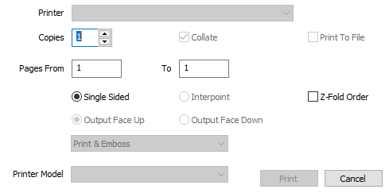
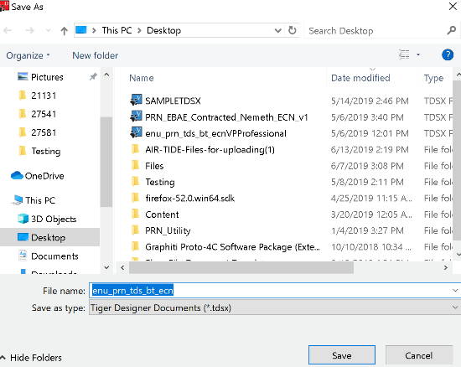
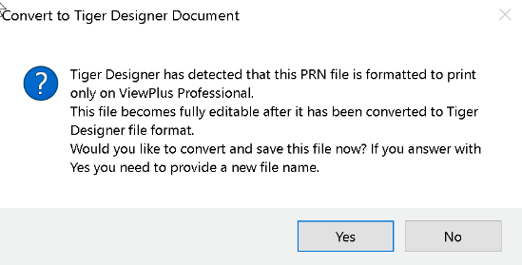
Emboss on Request—PRN (cont.)
If the Print button is disabled, you may need to convert the files in Tiger Designer.
Open the file in Tiger Designer and click Yes when a popup message asks if you want to convert the file.
Save the file as a Tiger Designer Document file (.TDSX) and try printing it again.
If this popup message does not appear, navigate to File>Save As. Choose the destination where you wish to save the file, then select ViewPlus Cub/Max PRN files from the Save as Type dropdown.
Disabled Print button
46
Notes:
If the Print button is disabled, you may need to convert the files in Tiger Designer. To do this, open the file in Tiger Designer and click Yes when a popup message asks if you want to convert the file. Then save the file as a Tiger Designer Document file (.TDSX) and try printing it again.
If this popup message does not appear, navigate to File > Save As. Choose the destination where you wish to save the file, then select Viewplus Cub/Max PRN files (*.prn) from the Save as Type dropdown.

Slide 47
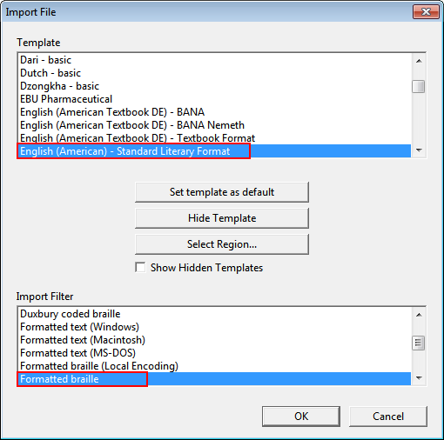
Emboss on Request – BRF
To emboss a Braille Ready File (BRF):
When you approve a print request that prints in BRF format, a print dialog window opens.
Select Open with.
In the drop-down list, select Duxbury Braille Translator.
Click OK. The Import File window opens
Ensure that the following are selected:
Template:
For Duxbury 11.2 or earlier: English (American) – Standard Literary Format
For Duxbury 11.3 or later: English (BANA Pre-UEB) – Literary Format
Import Filter: Formatted braille
47
Notes:
Follow these steps when printing a file in BRF format:
When you approve a print request that prints in BRF format, a print dialog window opens.
Select Open with.
In the drop-down list, select Duxbury Braille Translator.
Click OK. The Import File window opens.
In the Import File window, ensure that the following are selected:
Template:
For Duxbury 11.2 or earlier: English (American) – Standard Literary Format
For Duxbury 11.3 or later: English (BANA Pre-UEB) – Literary Format
Import Filter: Formatted braille

Slide 48
Emboss on Request – BRF
To emboss a Braille Ready File (BRF):
Click OK. The Duxbury Braille Translator preview window opens.
Go to File > Emboss. The File: Emboss window opens.
Ensure that only one copy is being printed, the page range is set to All, and the Brailler Device is set to ViewPlus Max (or other ViewPlus embosser).
Click OK.
48
Notes:
Click OK. The Duxbury Braille Translator preview window opens.
Go to File > Emboss. The File: Emboss window opens.
Ensure that only one copy is being printed, the page range is set to All, and the Brailler Device is set to ViewPlus Max (or other ViewPlus embosser).
Click OK.

Slide 49
Deleting Test-Related Files
Most supported web browsers automatically save downloaded files.
If your computer saves the BRF and PRN files from emboss requests, you must delete all test-related files from your browser’s download archive for security purposes.
For more information on how to delete test-related files from your internet browser’s download archive, please consult the Assistive Technology Manual.
49
Notes:
Most supported web browsers automatically save downloaded files. If your computer saves the BRF and PRN files from emboss requests, you must delete all test-related files from your browser’s download archive for security purposes. This task is accomplished in different ways depending on which browser you are using.
For more information on how to delete test-related files from your internet browser’s download archive, please consult the Assistive Technology Manual.

Slide 50
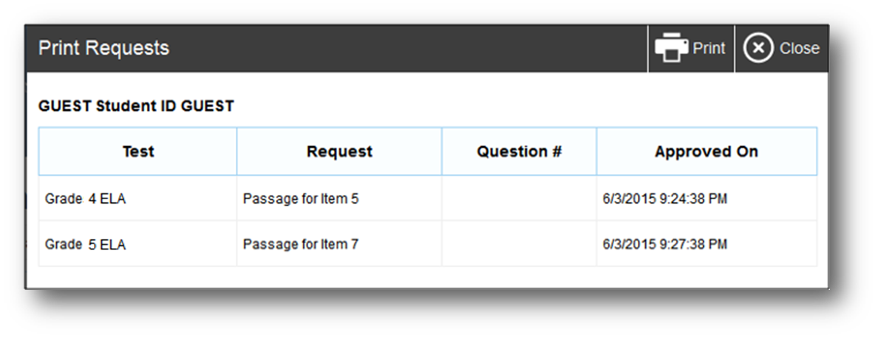
TA Interface: Approved Requests
50
Notes:
The Approved Requests button allows the Test Administrator to view a list of every emboss request that he or she approved during the current session. To print this list for your own records, click Print at the top of the Approved Requests window.

Slide 51
Printing Test Session Information
51
Notes:
If you wish to print a snapshot of the TA Interface in its current view, click the Print Session button. This can be useful for tracking which students did not complete their tests and may need to be scheduled for another session. It may be necessary to set the page layout to landscape or adjust the margins in the Print Preview screen in order for the list to fit on the page. Remember that any printouts containing personally identifiable student information must be securely stored and should be destroyed after use.

Slide 52
Navigate a Test Using Braille

Slide 53
JAWS Keyboard Commands
Action | Keyboard Command
Navigate to the next landmark element on the page. | R
Move to the next line on the page. | Down Arrow
Move to the previous line on the page. | Up Arrow
Move to the next component on the page. | Tab
Move to the previous component on the page. | Shift + Tab
Jump to the next heading on the page. | H
Jump to the previous header on the page. | Shift + H
Select an option or button. | Enter
Read everything on the page (from your current place on the page). | Insert + Down arrow
Stop JAWS from reading. | Ctrl
53
Notes:
Next, we are going to walk through the steps that students using Braille will follow in order to sign in to the online testing system and take tests.
JAWS allows students to navigate through their test by using keyboard commands. You can see some commonly used keyboard commands for JAWS in this table. We will refer back to these commands in the following slides.
Note that students testing with an RBD may have other means of navigating the online testing interface. For more information and a complete description of keyboard commands, please consult the Assistive Technology Manual.

Slide 54
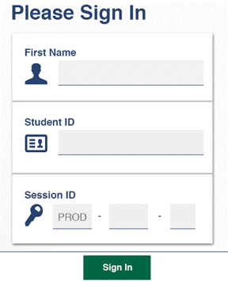
Navigating Student Sign-in
Students use the Tab key to navigate between fields and enter their information.
54
Notes:
To log in to the online testing system using the Secure Browser, students must enter three pieces of identifying information: their first name, their student ID, and the current session ID. The session ID is generated when the test administrator creates the test session. It needs to be given to students by the test administrator when it is time for them to log in to the test. Session IDs should not be generated more than 20 minutes before students are ready to log in.
Students will use the Tab key to navigate between fields and enter their information. Note that the Session ID is treated as three separate fields, though the first field is filled in automatically. When finished entering information in the final Session ID field, students can press Tab to navigate to the Sign in button and press Enter to sign in.
The test administrator may assist students with logging in, if necessary.

Slide 55
Login Errors
Issue | Error Message | What to Do
Student first name and student ID do not match what is in the system. | Please check that your information is entered correctly. If you need help, ask your Test Administrator. | Verify that the student has entered the correct first name and student ID , paying special attention to spelling. You may need to use the Student Lookup Tool, which is located in the TA Interface, to verify that the student is in the system.
Student enters the session ID incorrectly. | The session is not available for testing. | Verify that the student has entered the correct Session ID with no extra spaces or characters.
Student enters a session ID for an incorrect or expired session. | Session has expired. | Ensure that the student enters the correct session ID for the current session. If this does not work, verify that your session is open using the TA Interface.
55
Notes:
If a student is having difficulty logging in, an error message and code will display on the login screen. The most common errors occur when the student’s first name and student ID do not match what is in the system and when student IDs are entered incorrectly. If the student receives an error message indicating that he or she has entered incorrect information in the first name or student ID fields, the test administrator should use the student lookup tool in the TA Interface to verify the student’s information.
Another common error occurs when the student enters an incorrect session ID. If a student receives the message “The session is not available for testing,” verify that the session ID was entered correctly, with no extra spaces or characters. The session ID can be found in the TA Interface.
If a student receives the error message “Session has expired,” ensure that the student has entered the correct session ID for the current session. If the student has entered the session ID correctly, use the TA Interface to verify that your session is still open.
For a list of common login errors, please consult the Guide to Navigating the Online HSAP Administration.

Slide 56
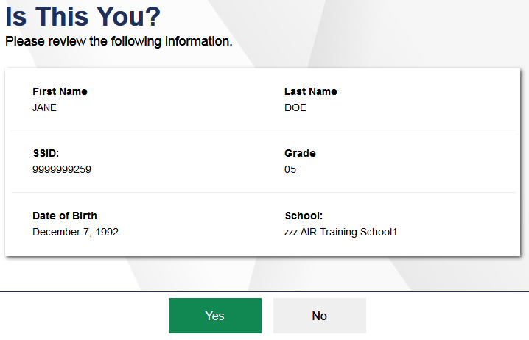
Navigating Student Sign-in
Students listen to each line of text by pressing the Down arrow key.
To move to the No and Yes buttons, press Tab.
56
Notes:
After logging in, students need to complete a few more steps before they begin testing. Students will be asked to view and verify their personal information. On the “Is This You?” page, students can listen to each line of text by pressing the Down arrow key. To move to the Yes and No buttons, press Tab.
If their information is correct, they should navigate to the Yes button and press Enter to proceed to the “Your Tests” screen.
If their information is incorrect, they should navigate to the No button and press Enter to return to the login page. Test administrators must then contact their school test coordinator to have the student information updated in the Test Information Distribution Engine (TIDE) before the student attempts to log in again.

Slide 57
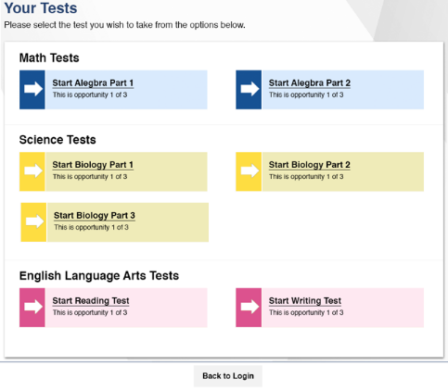
Test Selection
Press Tab to navigate to each test listed on this page. The navigation order is from left to right and top to bottom, in a zigzag pattern. Press Enter to start or resume the test.
57
Notes:
On the “Your Tests” screen, a list of assigned tests for this test session will appear on students’ screens. Students should select the correct test and wait for their Test Administrator’s approval to proceed.
Press Tab to navigate to each test listed on this page. The order of navigation is from left to right and top to bottom, in a zigzag pattern. When the appropriate test is selected, press Enter to start or resume the test.
If the tests displayed are incorrect, or the expected test is not listed, students should press Tab until the Back to Login button is selected.
Press Enter to return to the login page and consult the Test Administrator to resolve the issue.

Slide 58
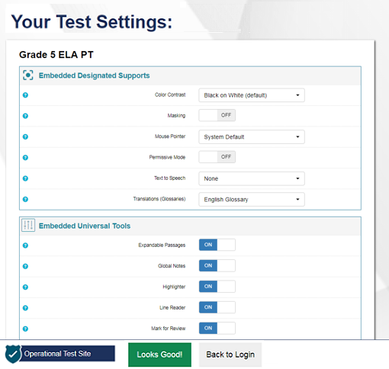
Login Confirmation
To listen to each line of text, press the Down arrow.
To move to the Looks Good! and Back to Login buttons, press Tab.
To select Looks Good! or Back to Login, press Enter.
58
Notes:
After the test administrator has approved students for a test session, a screen titled “Your Test Settings” will appear for students. This screen displays the name of the test and whether or not any accessibility resources have been selected.
To listen to each line of text, press the Down arrow.
To move to the Looks Good! and Back to Login buttons, press Tab.
To select Looks Good! or Back to Login, press Enter.
If any of the information is incorrect, students should navigate to the Back to Login button, press Enter, and then wait to be advised by the Test Administrator.
Note that the actual settings displayed for students may vary from what is shown on this slide. Be sure to refer to the scripts located in the Test Administration Manual to guide students through the login and confirmation process.

Slide 59
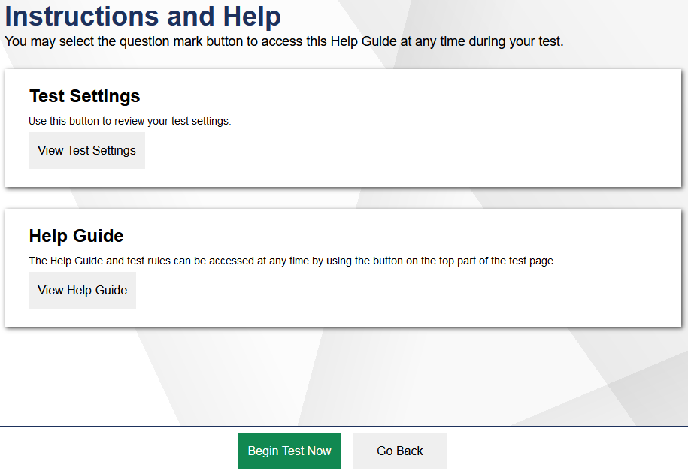
Instructions and Help
To open the Help Guide, press Tab to navigate to the View Help Guide button and press Enter. To close the Help Guide, use the Tab key to navigate to the Back button and press Enter.
To open the Test Settings window, press Tab to navigate to the View Test Settings button and press Enter. To close the Test Settings window, use the Tab key to navigate to the OK button and press Enter.
To move to the Begin Test Now and Return to Login buttons, press Tab.
To select to the Begin Test Now or Return to Login button, press Enter.
59
Notes:
On the Instructions and Help page, students have the opportunity to review detailed information about the tools and navigation features they will use during testing. Follow these steps to navigate the Instructions and Help page:
To open the Help Guide, press Tab to navigate to the View Help Guide button and press Enter.
To close the Help Guide, use the Tab key to navigate to the Back button and press Enter.
To open the Test Settings window, press Tab to navigate to the View Test Settings button and press Enter.
To close the Test Settings window, use the Tab key to navigate to the OK button and press Enter.
To move to the Begin Test Now and Return to Login buttons, press Tab.
To select to the Begin Test Now or Return to Login button, press Enter.

Slide 60
Test Elements

Slide 61
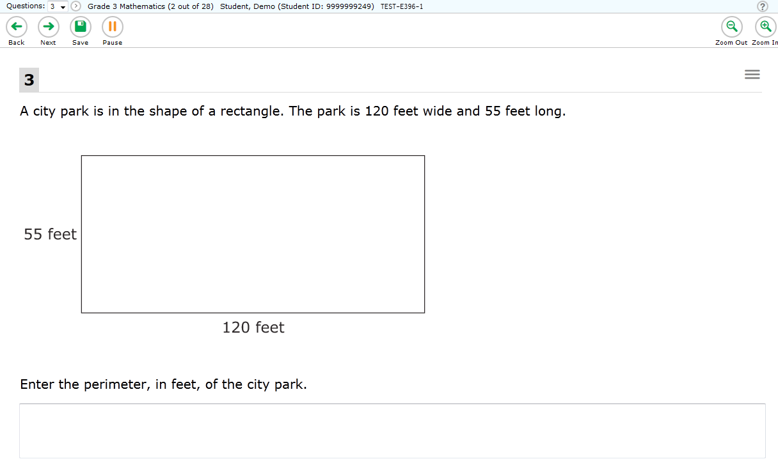
Test Elements
Banner
Navigation Buttons & Test Tools
Stimulus Section
Test Content
Question Section
61
Notes:
Students will also use JAWS to navigate within their test. The first time a test loads, JAWS may start reading everything on the page until the student stops it. However, on the next test page, the focus will be initially on the first question on the page.
A test page has three different sections: the Banner, the Navigation and Test Tools, and the Test Content. Please note that this page may appear differently on your screen.
The Banner contains the test information. This row displays the current question number(s), test name, student name, test settings button, pause button and Help button. Selecting the Help button will bring up the on-screen Help Guide window.
The Navigation Buttons and Test Tools allows students to:
Navigate test pages using the Back and Next arrow buttons
Save their answers before moving to the next question, if desired
And Zoom In and Zoom Out of test pages
Please note that whether or not students click Save, their answers will save automatically when they navigate to the next part of the test.
The Test Content is divided into two sections: the Stimulus Section and the Question Section:
The Stimulus Section contains the stimulus title, stimulus context menu, and stimulus content.
The Question Section contains the question number, question context menu, question stem, and response area.
To navigate between the three areas, press the R key. Use the Up and Down arrow keys to move up or down the lines of text. JAWS will read each line as a student navigates to it.

Slide 62
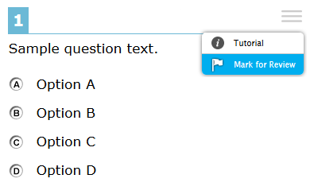
Opening Context Menus
Context menus allow students to:
Mark items for review
View item tutorials
Send emboss requests to the TA
Access additional features depending on test settings
and item types
Using context menus:
When the context menu is in focus, press Enter to open it.
Use Up and Down arrows to move between options.
Press Space to select an option.
Press Esc to exit the menu without making a selection.
62
Notes:
Students may use the context menu mentioned on the previous slide to mark items for review, send emboss requests to the TA, and access additional test features.
To open the context menu for a stimulus or question:
First, if opening a stimulus context menu, ensure that the focus is on the stimulus. If opening a question context menu, ensure that the focus is on the question.
To navigate directly to the context menu button, press Tab twice. JAWS reads aloud “Menu button.”
Press Enter. The context menu opens and displays the list of available menu options. JAWS reads aloud the first option in the menu.
To move up and down the list, press the Up and Down arrow keys. JAWS automatically reads aloud each option.
To select a menu option, press Space.
To exit the menu without making a selection, press Esc. JAWS returns focus to the context menu button.

Slide 63
Responding to Questions with JAWS Keyboard Commands

Slide 64
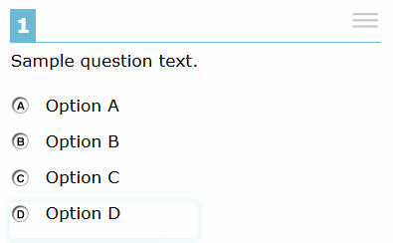
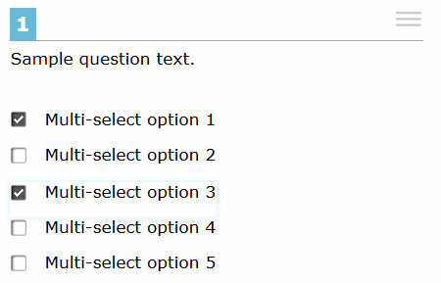
Responding to Questions: Multiple Choice and Multi-Select
Multiple choice and multi-select questions require you to choose from a group of options by selecting a radio button or checking one or more checkboxes.
Multiple Choice
How to Respond:
After listening to the question, press Tab to hear the option letter and corresponding text.
Use Tab and Shift + Tab or the Up and Down arrow keys to move between answer options and hear each one read aloud.
Press Space to select the current response option in focus.
Multi-Select
64
Notes:
Multiple choice questions require you to choose a response option by selecting a radio button. Multi-select questions require you to choose one or more response options by selecting checkboxes. Students follow the same procedure for responding to both types of items.
To respond to a multiple choice or multi-select question, students can follow these steps:
First, after listening to the question text, students can press the Tab key to hear JAWS read aloud the option’s corresponding text. If the option is an image, JAWS reads the text description associated with the image.
To navigate to each answer option, use the Tab and Shift + Tab commands, or use the Up and Down arrow keys. JAWS reads aloud the text for the option in focus.
To select a response option in focus as your response, press the Space bar. The response is selected and JAWS reads “Space.”

Slide 65
Responding to Questions: Hot-Text
Hot-text questions require you to select at least one word, phrase, or sentence. Each selectable text area is pre-defined. Selecting a phrase or sentence automatically marks all the words in that text area as selected.
How to Respond:
After listening to the question text, press Tab to hear JAWS read aloud the text that is in focus.
Use the Tab and Shift + Tab commands to move between selectable text areas and hear each one read aloud.
Press Enter to choose a selectable text area in focus as your response.
65
Notes:
Hot-text questions require you to select at least one word, phrase, or sentence. For these question types, it is critical to follow the instructions provided in the question. Each selectable text area is pre-defined. Selecting a phrase or sentence automatically marks all the words in that text area as selected.
To respond to a multi-select question, students can follow these steps:
First, after listening to the question text, students can press the Tab key to hear JAWS read aloud the text that is in focus.
Navigate to each selectable text area using the Tab and Shift + Tab commands. JAWS will read aloud the selectable text.
To choose a selectable text area in focus as your response, press the Enter key. JAWS announces the text is checked.

Slide 66
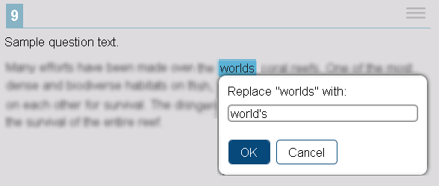
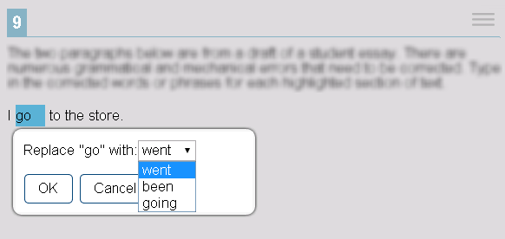
Responding to Questions: Edit Task
Edit task questions require you to replace an incorrect selectable word or phrase in a reading excerpt. Some edit task questions require you to enter the response into a text box, and others require you to select a response from a drop-down.
How to Respond:
Use the Down arrow to read through each line of text. If text is selectable, JAWS reads “clickable” after that word or phrase.
Use Tab and Shift + Tab to move between selectable text fields.
66
Notes:
Edit task questions require you to replace an incorrect selectable word or phrase in a reading excerpt. For these question types, it is critical to follow the instructions provided in the question. Some edit task questions require you to enter the response into a text box. Some edit task questions require you to select a response from a drop-down list. Each selectable text area is pre-defined.
Some edit task questions, such as the first image shown on this slide, require students to make changes that are punctuation-based. For these edit task questions, JAWS needs to read in character mode. CAI strongly recommends that students read through an entire Edit Task question before responding. Students can listen to the question as well as read it via an RBD or printout from an embosser.
To respond to an edit task question, students can follow these steps:
First, use the Down arrow to read through each line of text. If a line of text has a selectable word or phrase, JAWS reads “clickable” after the word or phrase.
Navigate to each selectable text field in the question by doing one of the following:
Return to the beginning of the question.
Press Shift + H.
Press the Tab key to go to the first selectable text field.
Move backwards through the selectable text fields in the question.
Press Shift + Tab.

Slide 67
Responding to Questions: Edit Task
How to Respond (continued):
Press Space to select the current text in focus. JAWS reads “Edit tools dialog” and provides additional instructions.
The student’s actions in the edit menu will depend on the type of edit task question:
Text box: Type in the replacement word or phrase.
Drop-down list: Use the Up and Down arrows to move between options. To select an option, press Enter.
Press Tab to move to the OK button. Press Enter to close the edit menu.
67
Notes:
When the selectable text is in focus, press the Space bar. This opens the edit menu. JAWS reads “Edit tools dialog” and provides additional instructions.
From here, the student’s actions will depend on the type of edit task question.
If the edit menu contains a text box, type in the replacement word or phrase.
If the edit menu contains a drop-down list, use the Up and Down arrow keys to move between options in the list. JAWS will read aloud each option. To select an option, press the Enter key.
Finally, press the Tab key to move to the OK button. Press Enter to close the edit menu.

Slide 68
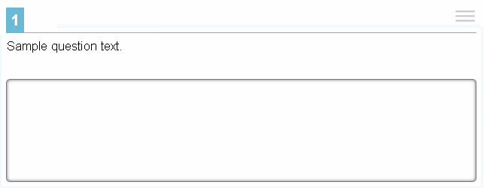
Responding to Questions: Text Response
Text Response questions require you to enter text in a text box. Students may need to write a sentence, paragraph, essay, or equation.
How to Respond:
Listen to the question and then use Tab to move to the text box. JAWS beeps and reads “Edit, type in text.”
Enter your response. When you are done, press Tab to navigate from the text box to the next question on the page. JAWS beeps again in a different tone.
68
Notes:
Text response questions require you to enter text in a text box. Students may be asked to write a sentence, paragraph, or essay. Some text response questions include a row of text formatting buttons. However, these formatting options are not available to students testing with Braille.
To respond to a text response question, students can follow these steps:
First, listen to the question and then use the Tab command to move to the text box. JAWS beeps and reads “Edit, type in text.”
Then, enter your response. When you are done, press the Tab key to navigate from the text box to the next question on the page. JAWS beeps again in a different tone upon leaving the text box.

Slide 69
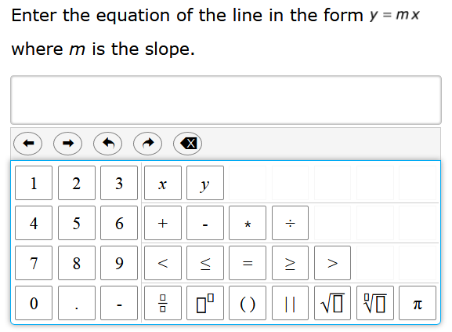
Responding to Questions: Equation
Equation questions require you to enter a math equation or expression in a text box using an on-screen keypad.
How to Respond:
Listen to the question and then use Tab and Shift + Tab to move between keypad buttons. JAWS reads aloud the character or action for each button.
To enter a character or perform an action, press Enter or press the corresponding key on your keyboard.
69
Notes:
Equation questions require you to enter a math equation or expression in a text box using an on-screen keypad.
To respond to an equation question, students can follow these steps:
Listen to the question and then use Tab and Shift + Tab to move between keypad buttons. JAWS reads aloud the character or action for each button.
To enter a character or perform an action, press Enter or press the corresponding key on your keyboard.
Optionally, you can add special characters to the text field by pressing Alt + 7 with the focus on the text field. A pop-up window opens, with a drop-down list of the available characters. To move between the options in this list, use the arrow keys. JAWS reads the name of each special character. To insert the selected character, press Enter.

Slide 70
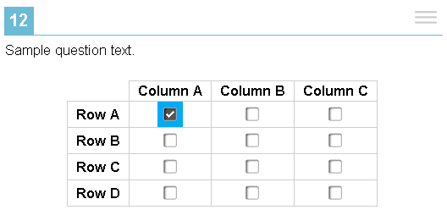
Responding to Questions: Table-Match
Table-match questions require students to mark at least one checkbox in the cells of a table consisting of multiple rows and columns. The table row heading and column heading are not selectable.
How to Respond:
Listen to the question, and then press Tab twice. This takes you to the first cell containing a checkbox.
To navigate to each cell that has a checkbox, press Tab. JAWS reads aloud the column and row names for that cell.
To mark a checkbox, press the Space bar.
70
Notes:
Table-match questions require students to mark at least one checkbox in the cells of a table consisting of multiple rows and columns. The table row heading and column heading are not selectable.
To respond to a table match question, students can follow these steps:
First, after listening to the question text, press the Tab key twice. This takes you to the first cell containing a checkbox. JAWS reads aloud the column and row names for that cell.
To navigate to each cell that has a checkbox, press the Tab key. Again, JAWS reads aloud the column name and row name for each cell.
To mark a checkbox, press the Space bar.

Slide 71
Pausing and Ending a Test

Slide 72
Test Pause
72
Notes:
If your school plans to test over multiple days, you may wish to instruct students to pause their tests at a certain point so that they can resume testing at another time. You may also allow a pause if students are taking a break from testing or if they need to leave the room for any reason.
Whether they have been instructed to do so or not, students have the ability to pause their test at any time by selecting the Pause button in the banner region of their screen.
When they do so, a pop-up message will appear, asking them to confirm that they want to pause the test. Students should choose Yes to confirm the pause or No to resume testing.

Slide 73
Test Pause Rules
For performance tasks and for computer-adaptive tests (CATs) that have been paused for less than 20 minutes, students returning from a break in testing can revisit any items in the current test segment and change their answers if desired.
Students taking a CAT who have paused their tests for longer than 20 minutes may only return to the most recently visited page containing unanswered test items in the current test segment. They may change any answers present on this page but may not access any items on previous pages or in previous segments of the test.
If all items on the most recently visited page were answered prior to pausing, the student will resume the test on the next page with unanswered items and will not be allowed to access previous pages or segments of the test.
73
Notes:
Some rules apply when students pause their tests, depending upon the type of test and how long the pause lasts. For performance tasks and computer-adaptive tests (CATs) that have been paused for less than 20 minutes, students returning from a break in testing can revisit any items in the current test segment and change their answers if desired.
Students taking a CAT who have paused their tests for longer than 20 minutes may only return to the most recently visited page containing unanswered test items in the current test segment. They may change any answers present on this page but may not access any items on previous pages. If all items on the most recently visited page were answered prior to pausing, the student will resume the test on the next page with unanswered items and will not be allowed to access previous pages or segments of the test.

Slide 74
Test Timeout
Test Timeout Due to Inactivity
As a security measure, after 30 minutes of test inactivity, students are logged out and their tests are paused automatically.
Inactivity is determined by whether the student is interacting with the test by selecting answers or using navigation tools.
Students will receive a warning message prior to being logged out and must select OK on the pop-up within 30 seconds in order to avoid automatic logout and pausing of their test.
If a student’s test is paused due to inactivity, the same rules apply as when the student intentionally pauses the test.
74
Notes:
As a security measure, after 30 minutes of test inactivity, students are logged out, and their tests are paused automatically. Students will receive a warning message prior to being logged out and must select OK on the pop-up within 30 seconds in order to avoid automatic logout and pausing of their test. If a student’s test is paused due to inactivity, the same rules apply as when the student intentionally pauses the test. The student can log back in to the test and resume from the point that testing was interrupted, subject to the pause rule, if applicable.
Additionally, if a screen saver, anti-virus scan, or software update is activated during testing, the security breach feature will log the student out of the test. To avoid any such interruption, schools should schedule virus scans and automatic updates to occur outside of planned testing hours and ensure that screen savers are either disabled or set to more than the allocated testing time.

Slide 75
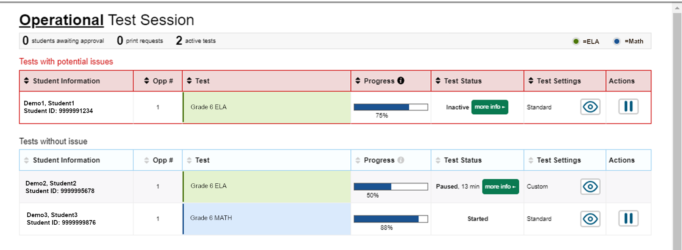
Pausing Sessions
75
Notes:
The TA can also pause a student’s test by clicking the Pause button on the monitoring screen for that student. When prompted, click OK to confirm that you want to pause the test. This option would be appropriate if a student becomes ill, for example.

Slide 76
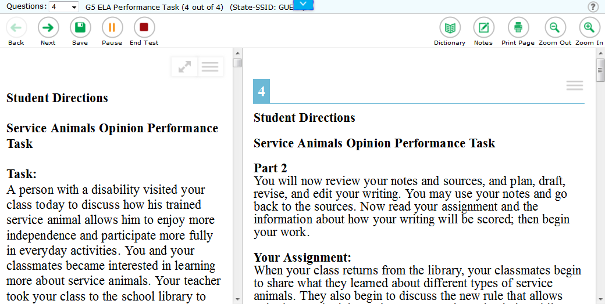
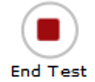
Test End
76
Notes:
When students answer the final question on their test, the End Test button will appear in the upper-left section of the screen, along with a message advising them that the test has been completed and is ready to be submitted. If students select the Next button at this point, a pop-up will appear that advises them to click the End Test button when they have completed reviewing their answers. They may also select the Back button to go back and revisit previous items.

Slide 77
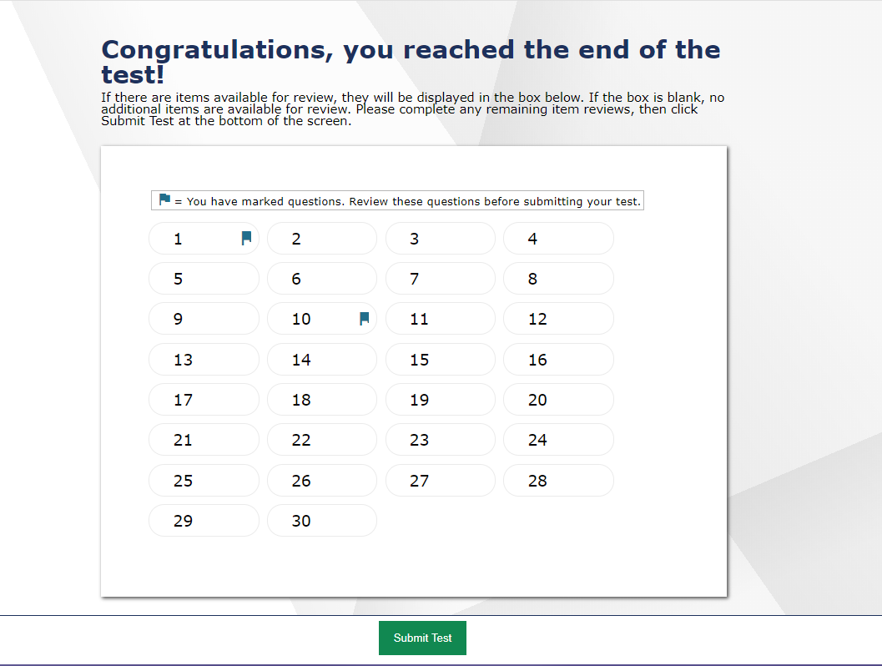
Test End
77
Notes:
When students end a test, the End Test page appears. This page allows students to review answers and submit the test for scoring. A flag icon appears for any questions marked for review.
Students who are ready to submit their tests should select Submit Test to finish. They will receive a confirmation pop-up asking if they are sure they want to submit. Selecting No will return them to the review screen. Selecting Yes will take them to the end screen, which shows a message indicating that the test was successfully submitted and advises the student to log out.

Slide 78
Stopping Sessions
78
Notes:
To stop a test session, click the Stop button in the upper right corner of the screen. A pop-up titled “Important!” will appear requesting verification to end the session and log students out. Click OK to continue.
If you stop the session, all in-progress tests will be paused. If a session stops, it cannot be resumed. The Test Administrator will have to create a new session and give the new session ID to students so that they can resume testing.
If you forget to log out before leaving the testing area, the session will close automatically after 30 minutes of inactivity in both the Test Administrator and student computers. The Test Administrator would then need to create a new session and provide the new session ID to students in order to resume testing.
When all students have completed testing, refer to the Test Administration Manual for instructions on destroying any printed or embossed testing materials and reporting testing improprieties or irregularities.

Slide 79
Thank You!
Further Information
HSAP Portal: https://alohahsap.org
Assistive Technology Manual
Quick Guide to Setting Up Your Online Testing Technology
Guide to Navigating the Online HSAP Administration
Test Administration Manual
HSAP Help Desk
1-866-648-3712
hsahelpdesk@cambiumassessment.com
79
Notes:
Thank you for viewing this training module. If you have general questions or need further information, please visit the HSAP portal or consult the HSAP Help Desk for assistance.
For information about administering online tests, please consult the documents listed on this slide, available on the HSAP portal.

