Slide 1
HOW TO BUILD A TEST TO ADMINISTER TO STUDENTS Using the NGSS Item Library
Checkpoint System Training Module
2021-2022
Notes:
This section explains how to create original tests in the Test Builder page.

Slide 2
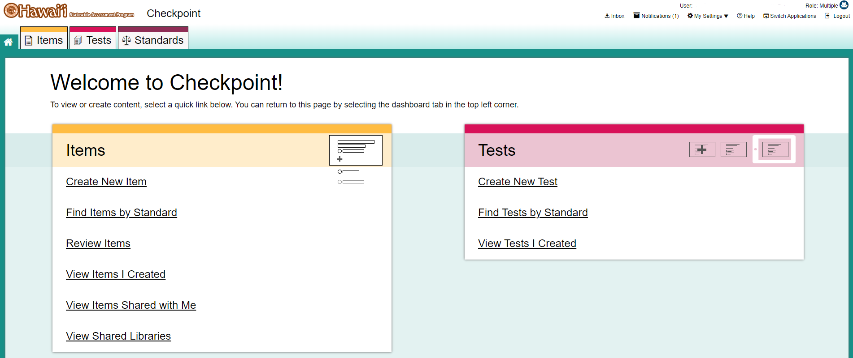
Create a New Test
1
Notes:
To create a new test, select the Create New Test (1) link from the Tests card on the dashboard.

Slide 3
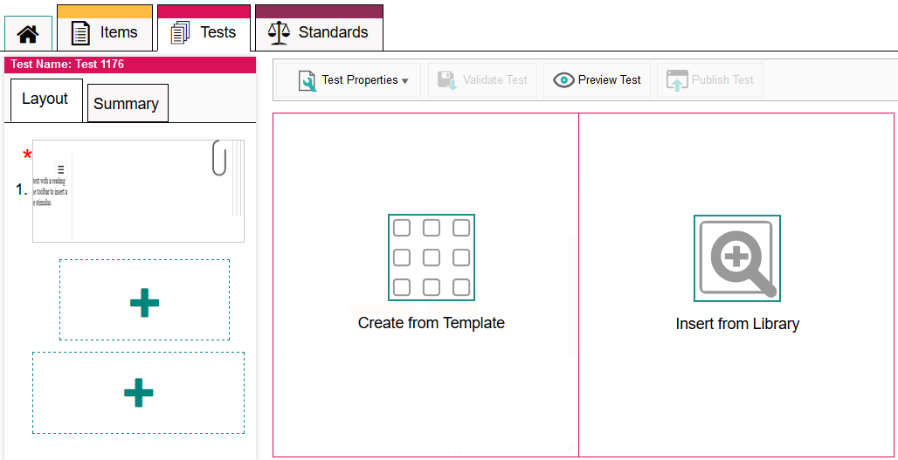
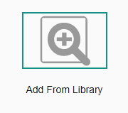
Create a New Test
Test Builder Page
Notes:
To use the existing NGSS Item Pool, select Add from Library.
To create a new item using a template, click Create from Template and build the item the same way you would when using the Item Builder page. To insert an item from one of your libraries, click that button.

Slide 4
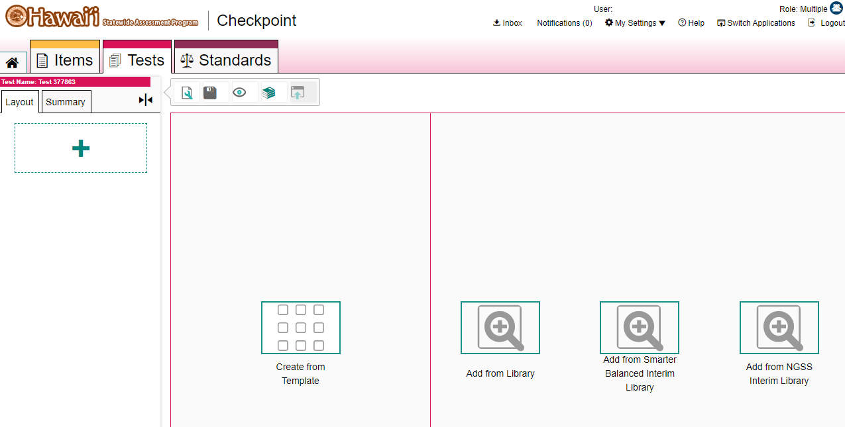
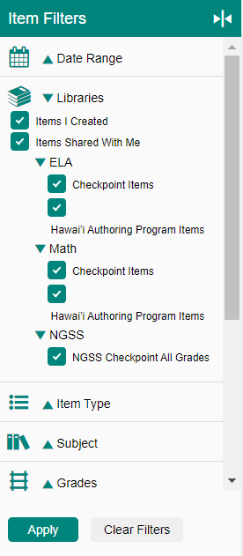
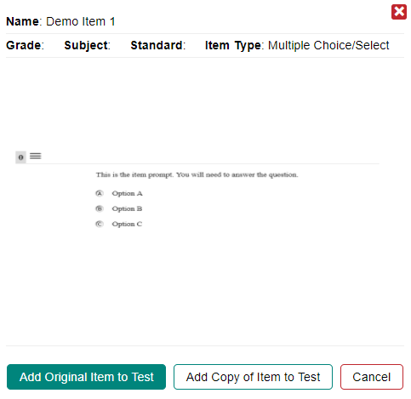
Insert an Item from a Library
Select filters and item
Notes:
Select an item from the library. The Item View Window will prompt you to choose a filter and select Apply to view items. When you select an item, there will be two options: Add Original Item to Test and Add Copy of Item to Test. Choosing Add Original Item to Test will add the item directly to your test.

Slide 5
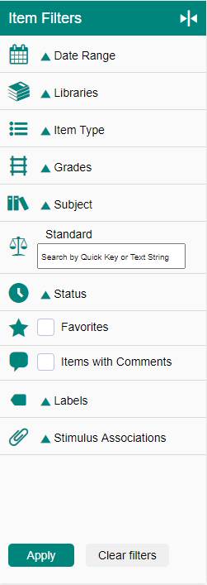
Filtering Items
Notes:
You can limit the items presented by using the filter panel on the upper right corner of the window to narrow your search results. Items can be sorted by the categories shown.
When filtering by Standard, always begin the text string with NGSS-Grade-Domain, for example NGSS-7-ESS.

Slide 6
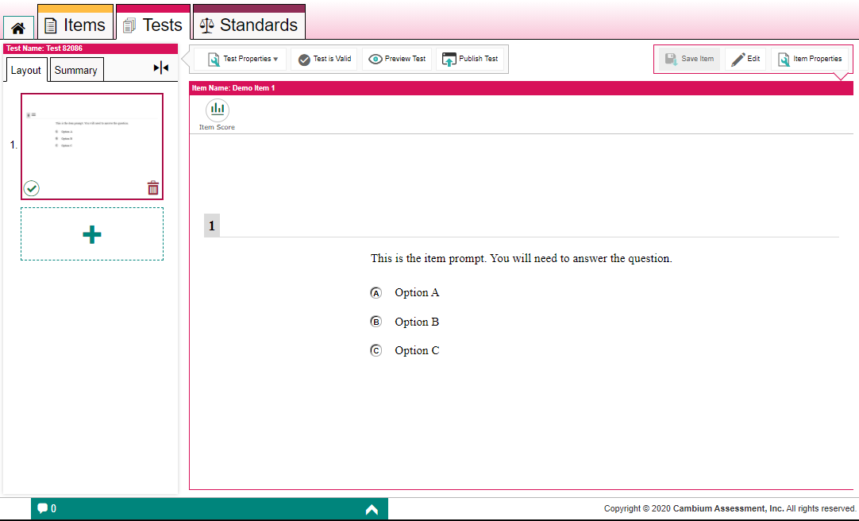
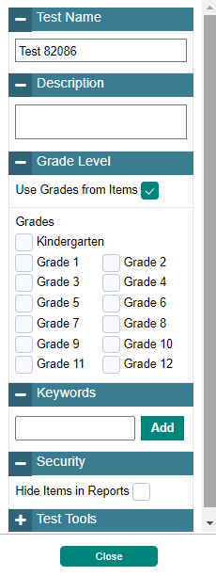
Test Properties Menu/Validate/Preview/Publish
2
3
1
Notes:
At any point in building your test you can enter details such as the test’s name, description, grade, keywords, security, and test tools (calculator, periodic table, thesaurus and dictionary). Use the Test Properties button (1) in the test toolbar, make your selections, and click Close.
To see what your test will look like to students, click Preview Test (2) in the test toolbar. You can enter sample responses to items and click Item Score to make sure the items are being scored correctly.
To publish the test, click Publish Test (3). If this button is not clickable, make sure the test does not include any blank pages and that you have saved changed to each item on the test.
After publishing a test, you can add it to your test sessions by selecting it from the Test Selection window in the Test Administration System. You can administer your own tests, shared tests, and tests from a shared test library.

Slide 7
For More Help
You can contact the HSAP Help Desk for assistance with any technical issues you encounter. When contacting the HSAP Help Desk, please be ready to provide:
Any error messages that are appearing (including codes)
Your operating system and browser information
Your network configuration information
Your contact information for follow-up by phone or email
Any other relevant information, such as test names or content areas, student IDs, session IDs, and search criteria
For test administration or policy issues, please contact your school test coordinator.
Further Information
HSAP Portal: https://alohahsap.org/
HSAP Help Desk
Phone: 1-866-648-3712
Email:
hsaphelpdesk@cambiumassessment.com
Thank you!
Notes:
You can find the 2021-2022 Checkpoint User Guide and other helpful resources on the HSAP state assessment portal under HSA Science Resources. However, if you still require assistance with troubleshooting a technical issue, you may also contact the HSAP Help Desk. When contacting the HSAP Help Desk, please be ready to provide the following information:
Any error messages that are appearing (including codes)
Your operating system and browser information
Your network configuration information
Your contact information for follow-up by phone or email
Any other relevant information, such as test names or content areas, student IDs, session IDs, and search criteria
For questions about test administration or policy issues, please contact your school test coordinator.
Thank you for taking the time to view this training module. For detailed information, consult the Checkpoint User Guide located on the AlohaHSAP.org portal or contact the HSAP Help Desk.

