Slide 1
Test Administrator (TA) Interface for Online Testing
Training Module
2021 – 2022
Copyright © 2021 Cambium Assessment, Inc. All rights reserved.
Notes:
Welcome to the Test Administrator Interface for Online Testing training module. This presentation describes the Test Administrator (TA) Interface that you will use to administer online tests. Please note that your state’s TA Interface may be different from the images shown in this presentation. Please consult your state’s portal for additional information about specific features of your state's TA Interface.

Slide 2
Objectives
After viewing this presentation, you should be able to:
Use the TA Interface to start and run a test session
View student test settings and accessibility resources
Monitor the testing process
Pause and stop a test session
Transfer sessions between computers and mobile devices
Print test session information
Exit and log out of the TA Interface
Notes:
After viewing this presentation, you should be able to:
Use the TA Interface to start and run a test session
View student test settings and accessibility resources
Monitor the testing process
Pause and stop a test session
Transfer sessions between computers and mobile devices
Print test session information
Exit and log out of the TA Interface

Slide 3
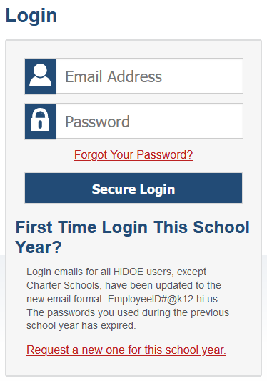
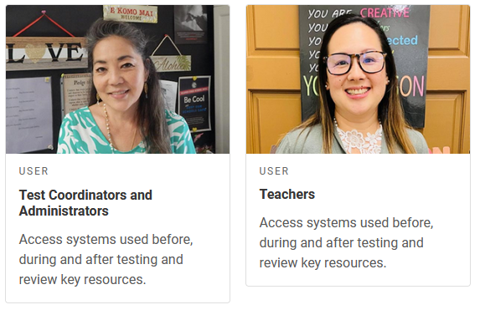
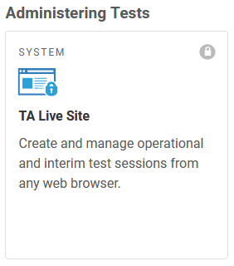
Logging in to the TA Interface
Notes:
The TA Interface is used to create and manage test sessions that students join to complete online tests. We will begin with detailed instructions on how to log in to the interface followed by a detailed review of each feature.
To log in to the TA Interface, go to the AlohaHSAP.org portal. Click the appropriate assessment card, then the appropriate user role. On the next page, click the system card used for operational test administration. Enter your username and password, and then click Secure Login to continue.

Slide 4
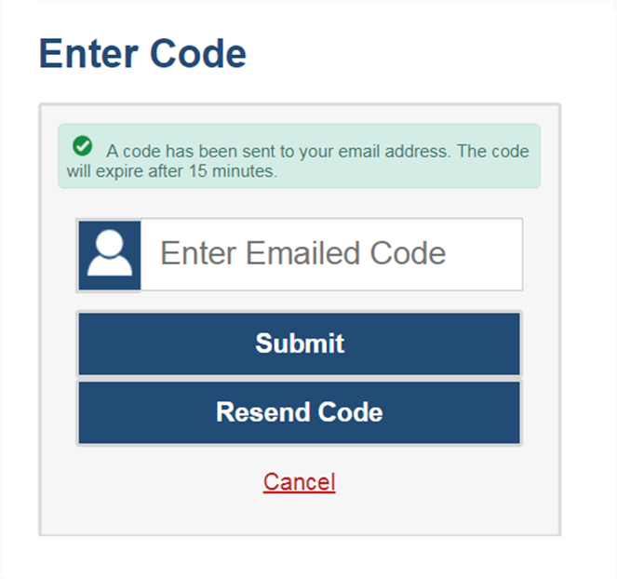
Logging in to the TA Interface (continued)
The system has an authentication process that will be triggered when you log in from a different device or browser, or after clearing your browser’s cache.
If you see this screen, an email containing the code will have automatically been sent to your email address.
Enter the code and click Submit.
If you need the code resent, click Resend Code.
Notes:
When logging in to the system using a new device or browser, or after clearing the cache on a previously used browser, you will see an Enter Code page.
If you see this screen, you will need to enter the code on this page within 15 minutes of receiving the email. If you do not receive a code or do not enter the code within the 15-minute time limit, click Resend Code. Click Submit after entering the authentication code to access the system.

Slide 5
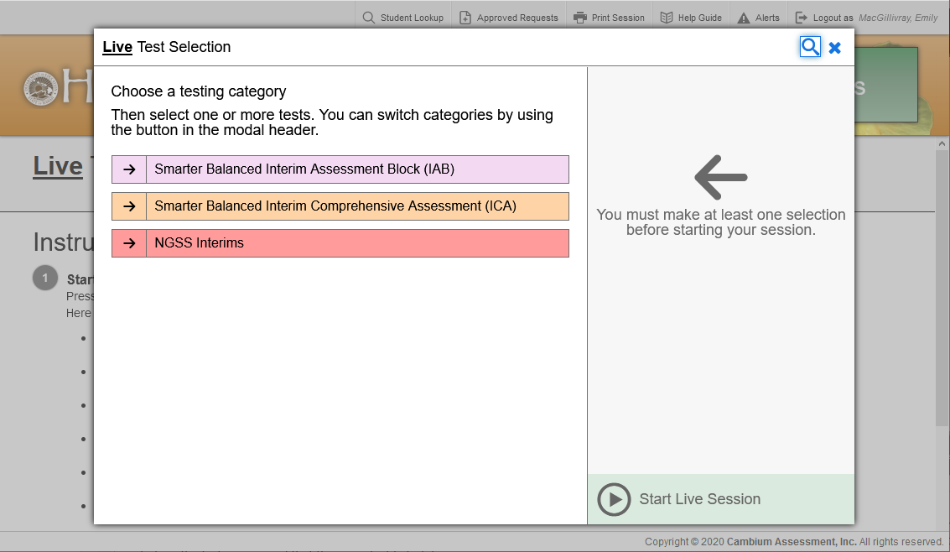
Create a Test Session: Test Categories
Notes:
The first step in administering any test is to create a test session. This should be done fewer than 20 minutes prior to starting the test in order to prevent the system from timing out.
After logging in, the Test Selection pop-up window appears, displaying color-coded test. It will also list a category for teacher-authored tests if any tests have been created in Checkpoint.
To expand a category and see all the possible tests for that category, click the arrow next to the category name.

Slide 6
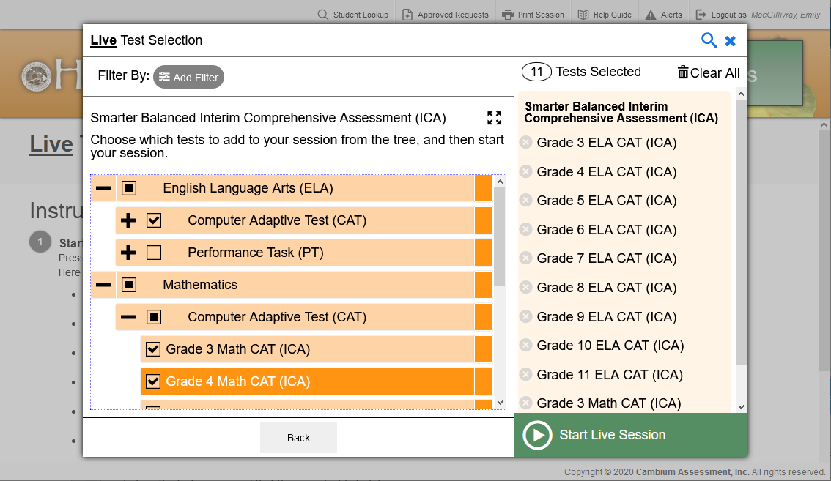
Create a Test Session: Test Selection
Notes:
Once you have selected a test category, you can click the plus sign (+) button next to a test group name to view the tests in that group. To create a test session, click one or more tests to administer, or click the checkbox for a test group to include all tests in that that group. Once you select tests to add to the session, they will appear in the “Tests Selected” column on the right side of the window. If you need to remove a test that you have previously selected, click the “x” button to the left of the test name.
To add tests from a different test category, click the back button to return to the list of test categories.

Slide 7
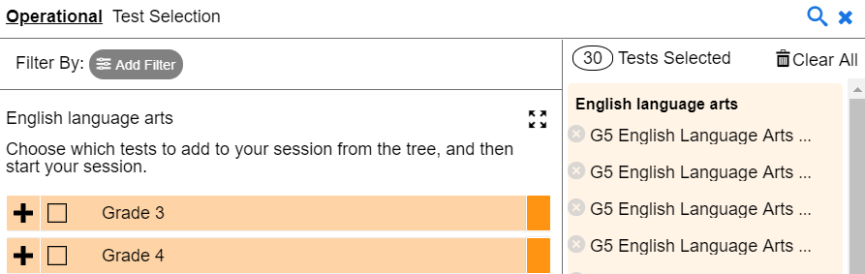
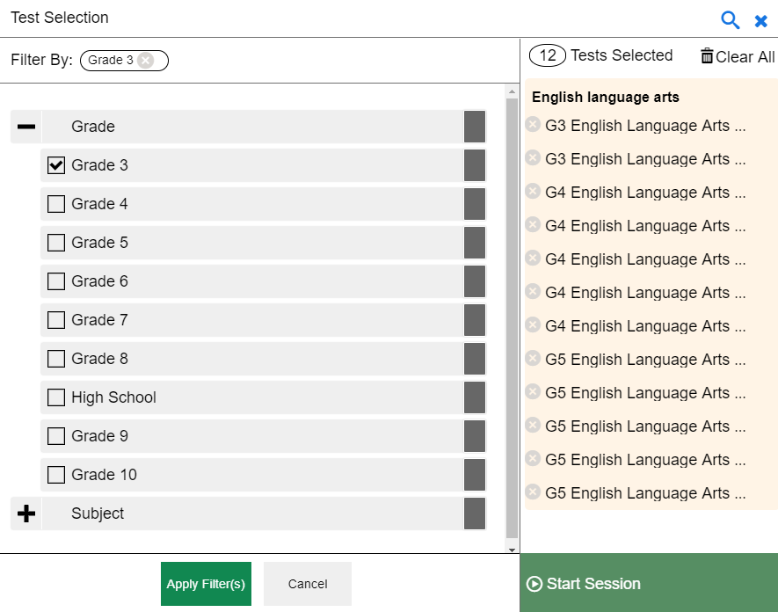
Create a Test Session: Filters
Notes:
You can also filter a list of tests by grade and subject, in order to focus on specific types of assessments. If teacher-authored tests are available, you can filter by custom label and standards, as well. The filters function is especially useful if a large number of tests exist.
To filter a list of tests, first click on the Add Filter button and the filters panel will appear. Then click the plus sign (+) button next to the grade and/or subject to expand the category and see a list of available grades and subjects. Mark the checkboxes next to the grades and/or subjects you want to filter by. Your selected filters will appear at the top of the window. If you want to remove a filter, select the “x” button next to the filter you want to remove.
Once you are finished selecting filters, click Apply Filter(s).

Slide 8
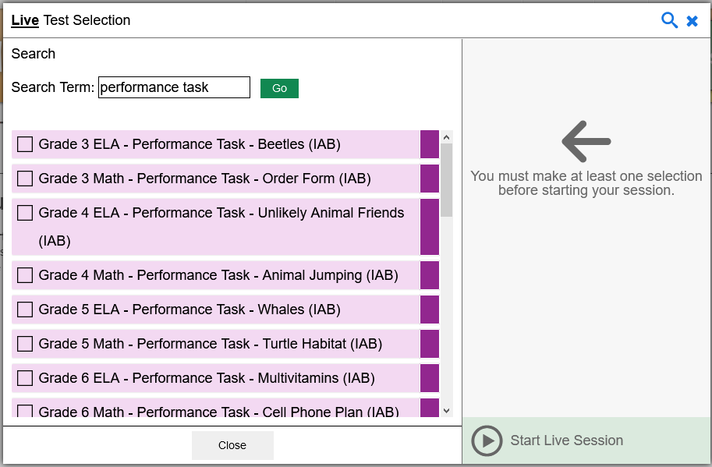
Create a Test Session: Global Search Feature
Notes:
You can also search for specific tests to add to your session by using the global search feature.
To search for tests, click the magnifying glass in the upper right corner of window. On the search panel that appears, enter the full or partial test label in the Search Term field and select Go. A list of tests containing your search terms will appear below. Select the test(s) you want to add to your session by marking the checkbox next to the test name. If you want to close the search window, select the Close button at the bottom of the panel.

Slide 9
Create a Test Session: Start Session
Notes:
Once you have selected the test or tests you want to add to the session, click the Start Live Session button.

Slide 10
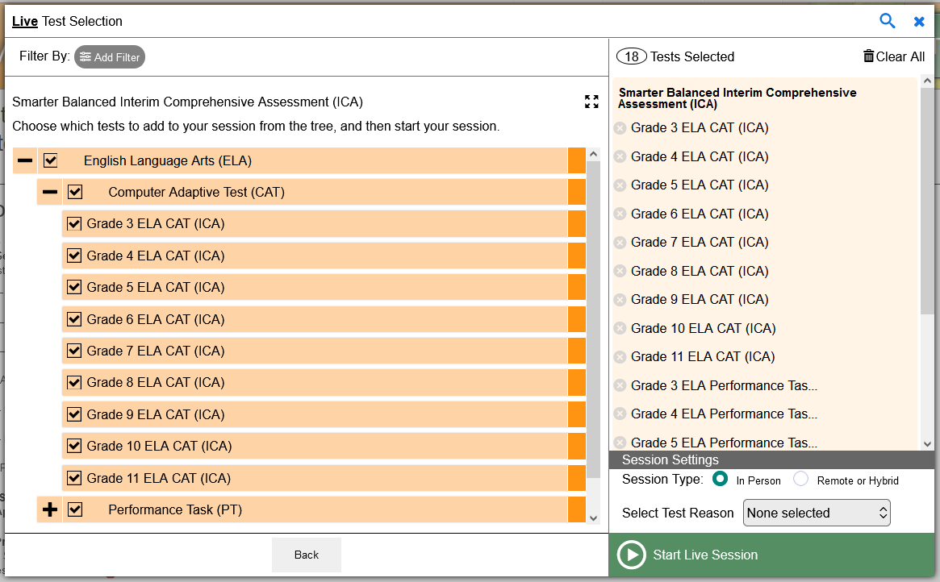
Create a Test Session: Test Reasons
For Interim Assessments Only
Notes:
If any of the selected tests require an attribute, such as test reason for Interim Assessments, a drop-down list appears in the System Settings section. From the drop-down list, select the required attribute for the session. This is required for Interim Assessments.
Once the required session attributes have been selected, select Start Live Session.

Slide 11
Create a Test Session: Session Type
For Remote Summative Administration Only
Notes:
If you are setting up a remote summative administration test session, you will need to change the Session Type to Remote or Hybrid, then select Start Live Session.

Slide 12
Session ID
Notes:
Once you start a session, the system will automatically generate a session ID. The session ID will appear at the top of the TA Interface along with a Stop button. This ID must be provided to students in order for them to log in. You may write it on the board or provide it to students using a printed card or similar method. If you do provide students with the information on paper, be sure to collect and destroy it when the session is complete.
You should also note the session ID for your own records. If you accidentally close your browser, entering the session ID will allow you to resume the session. If you do not have this information when you try to resume, you will be unable to do so.
When students start signing into the test session, an Approvals button will also appear next to the session ID. Once you approve students for testing, the Test Session table will appear in the center of the TA Interface, displaying students’ testing progress. We will discuss more about this in later slides.

Slide 13
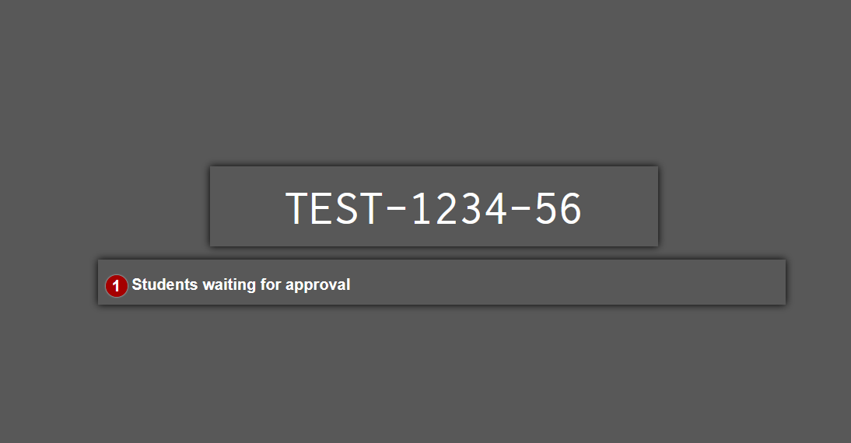
Screensaver Mode
Notes:
Since the student test progress tables in the TA Interface often contain sensitive student information, such as student IDs, the TA Interface contains a screensaver function to hide the data from view. If the screensaver mode is auto-enabled, the screensaver will automatically turn on if you are not active in the TA Site for 5 minutes. If the screensaver mode is not auto-enabled, it is strongly recommended that you manually turn on the screensaver mode when stepping away from your device.
To turn on screensaver mode, select the box icon in the top right corner of the session ID. The screensaver displays the Session ID and the timer, if applicable. It also displays notifications if students are awaiting approval, there are pending print requests, or if students require other interventions.
The screensaver will automatically turn off if any mouse or keyboard activity is detected. It will also turn off automatically if the test session times out due to TA or student inactivity or once the allotted time expires for a timed test.

Slide 14
Banner
Notes:
In the banner at the top of the window, you will see a set of buttons and your username.
Click Session Attributes to review or set specific testing attributes.
Click Student Lookup to search for student login information and verify that the student’s login credentials are correct.
Click Approved Requests to view a list of student print requests that you approved during the test session.
Click Print Session to print a screenshot of the TA Interface.
Click Help Guide to access additional information about the TA Interface.
Click Alerts to view messages sent by your state department of education.
Click the Logout button to exit the TA Interface.

Slide 15
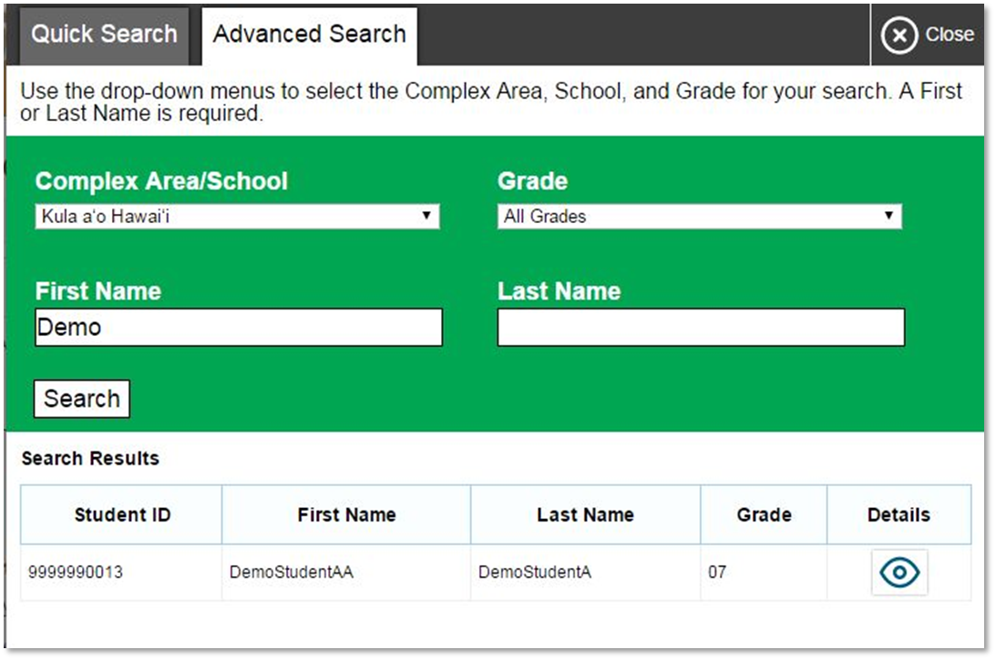
Student Lookup
Notes:
If a student is having trouble logging in, use the Student Lookup feature to verify that the student’s login credentials are correct. You can use either the Quick Search or Advanced Search option to view the information entered for the student in the Test Information Distribution Engine (TIDE). With Quick Search, you simply enter the student’s state-assigned student ID and click the Submit SSID button. Advanced Search allows you to narrow your search using several filters, including Complex Area/School, Grade, First Name, and Last Name.
When using Quick Search or Advanced Search, if the search results in matches, the information will appear in the bottom of the window. If there is no match, you will see an error message.

Slide 16
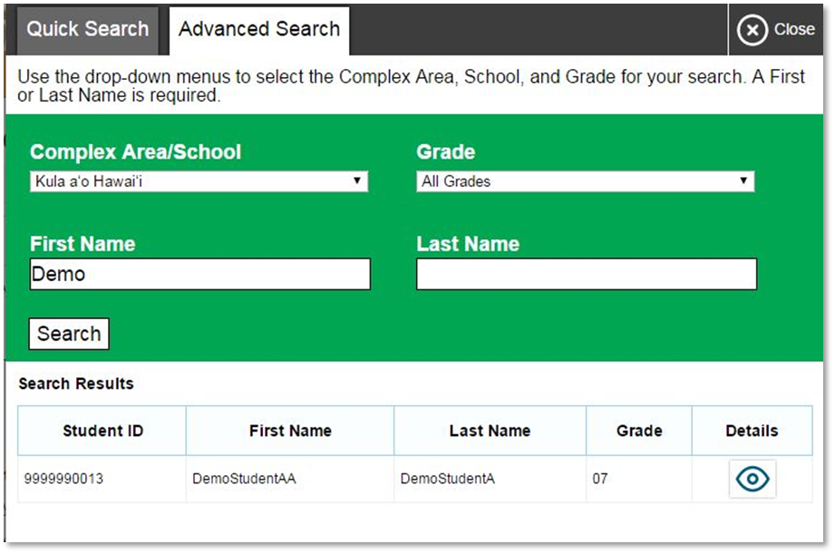
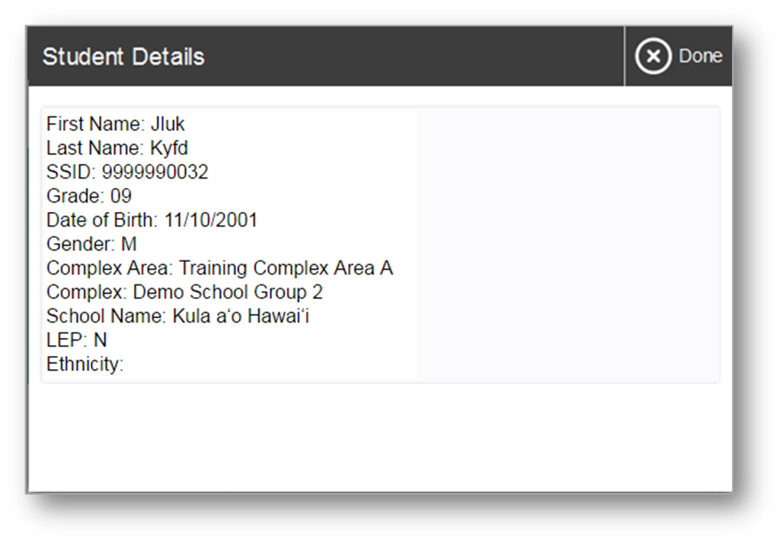
Student Lookup (continued)
Notes:
If you see the student you are looking for, click the Eye button next to the student’s name. A new window displaying the student’s information will appear. Note that the information displayed may vary slightly from what is shown here.

Slide 17
Approving Student Entry
2
Notes:
Once you start the test session and students log in, you must approve their test settings before they can access their tests. It is very important that you pay close attention to the test name prior to approval to be sure that students have selected the appropriate test. To approve students for testing, click the Approvals button next to the session ID. A list of students will display, organized by test name. You should review the list to make sure that all students chose the correct content area and test. You should also ensure that all the settings for each student are correct. This is done using the Eye button in the See Details column. We will talk more about that in a few moments.
If no changes are needed, select Approve All Students to admit all students to the session. You will see a confirmation message appear after clicking Approve All Students. If a student selected an incorrect test, you must deny that student entry to the test session by clicking the X button in the Action column.

Slide 18
Denying Student Entry
Deny entry to a test session in these circumstances:
The student is not supposed to enter this session.
The student’s demographic information is incorrect.
The student’s required accommodations are incorrect.
Notes:
Although you can approve all students at the same time, students must be individually denied entry into the test session.
You should deny students entry into the session in these circumstances:
• The student is not supposed to enter this session.
• The student’s demographic information is incorrect.
• The student’s required accommodations are incorrect.
Denying the student entry into the test session will not prevent other approved students from beginning their tests.
If the student’s test settings are incorrect, the settings must be updated in TIDE or the TA Interface before the student takes the test. Contact your School Test Coordinator to have the settings updated. This will prevent resetting the test for the student later. Please note that the changes may not be immediate.
Note that no settings can be changed while the student is actively testing. Once a student begins testing, the language option cannot be changed without resetting the test opportunity. Updates to background color or font size will take effect only after the student logs out and then resumes testing.

Slide 19
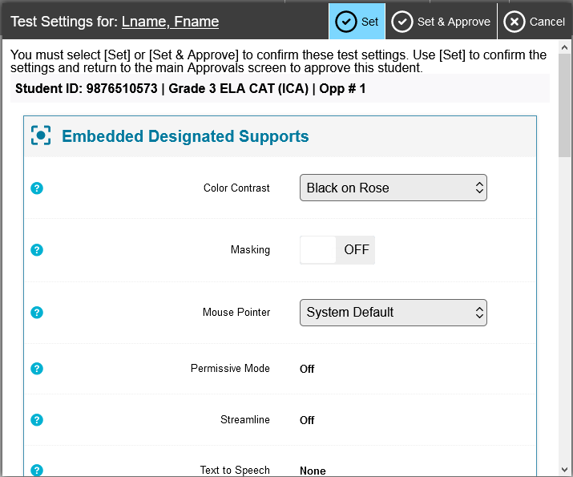
Editing Student Details: See/Edit Details
Notes:
If you need to change test settings for a student, click the Eye button in the See Details column. The Test Settings window will appear, which displays the student’s information at the top and various test settings organized by the level of support (universal tools, designated supports, and accommodations).
Some test settings can be changed in this window. After adjusting settings, click the Set button to change the settings without approving the student. To both change settings and approve the student for testing, click the Set & Approve button.
Some test settings can be viewed but not changed in this window. These test settings must be set by an authorized user in TIDE prior to testing. See the TIDE User Guide for more information.
Note that the Test Settings window may not appear exactly as it is shown here, depending on your user role and permissions.

Slide 20
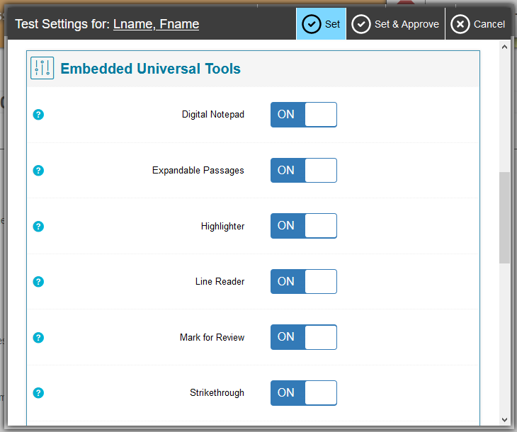
Editing Student Details: Turn Settings On and Off
Notes:
Some of the universal tools available by default may not be appropriate for some students. If you need to turn a universal tool off or on for a student, you must do so before testing begins. Use the drop-down lists in the Test Settings window to enable or disable the appropriate settings.
Some settings are managed using the TA Interface while other accessibility resources must be set up in TIDE prior to testing. For more information, consult the Guide to Navigating the Online HSAP Administration and the Usability, Accessibility and Accommodations Guidelines, available on the AlohaHSAP.org portal website. As noted previously, the Test Settings window may not appear exactly as shown here, depending upon your user role and permissions.

Slide 21
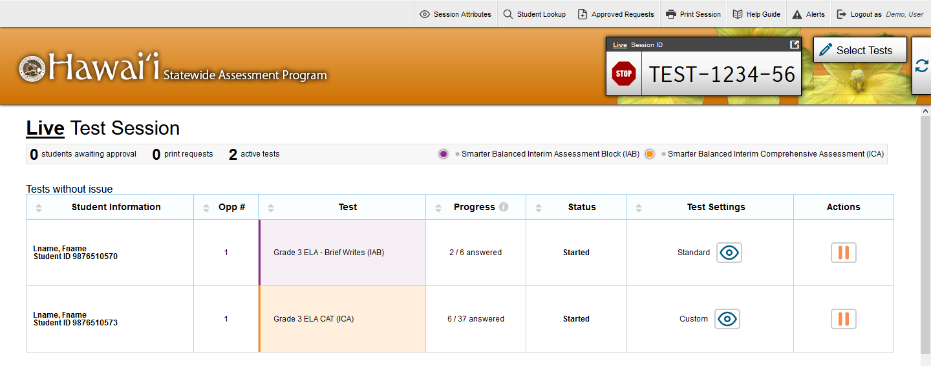
Monitoring Student Progress
Notes:
Once students log in and are approved for testing, you can monitor their status from the table(s) displayed on the TA Interface. The table shows Student Information, Opportunity Number, Test Name, Progress, Test Status, Test Settings, and an Actions option.
The Progress column displays the student’s progress through the items in the test. It may display a progress bar to indicate the student’s progress through the test or display the total number of items completed thus far and the total number of items in the test.
The Test Status column indicates a student’s testing status. For a list of test statuses, please see the Guide to Navigating the Online HSAP Administration.
The Test Settings column will display either Standard or Custom. This column displays Custom when a student’s test settings are different from the default settings for that test. Click the Eye button to view a student’s test settings. In some states, the number of accommodations and designated supports will also appear.
The Actions column allows you to pause a student’s test. If a student request a printout, a printer icon will appear in this column.

Slide 22
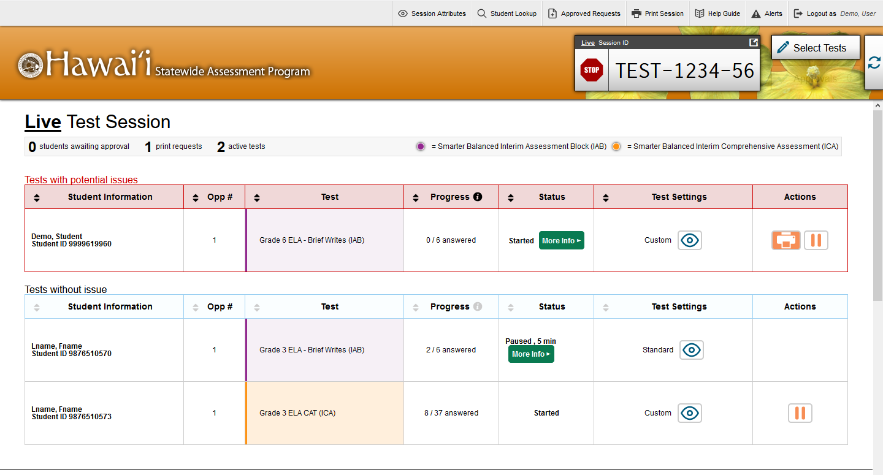
Test with Potential Issues Table
Notes:
If the TDS detects that a student may be having technical issues or requires assistance, a “Tests with potential issues” table will appear above the “Tests without issue” table. A “more info” icon will appear in the Test Status column. Hovering over this icon will display more information about the issue.

Slide 23
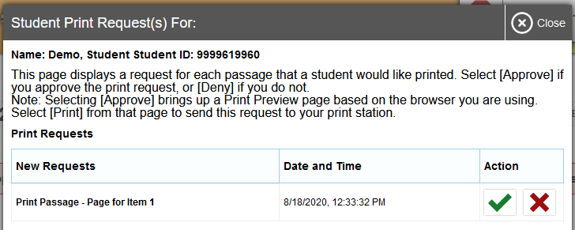
Print on Request
Notes:
The Print on Request feature is available only for students who require it. Please contact your School Test Coordinator if your student needs this accommodation. It is a testing impropriety to apply this restricted resource for a student who does not have an IEP or Section 504 Plan documenting his or her need for the accommodation.
Students with this accommodation can request printouts of stimuli and/or items, depending on their settings.
• When a student sends a print request, the Printer button will appear in the Actions column of the Tests with potential issues table on the TA Interface. Click the button to view the request.
• If you click the Check button to approve the print request, a cover sheet containing the student’s name and SSID will display in a new browser window. No test content will ever display on your screen.
• Click Print in the new window to complete the print request. The printer dialog box will display.
• Click OK to send the request to the printer.
• If you click the X button to deny the print request, nothing will be printed.
Before approving the student’s print request, ensure that it will be sent to a printer that is monitored by staff who have been trained in test security. All printed test items, stimuli, and reading passages must be securely stored and destroyed immediately following a test session.

Slide 24
Approved Requests
Notes:
The Approved Requests button allows you to view a list of every print request you approved during the current session. If you wish to print this list for your own records, click Print at the top of the Print Requests window.

Slide 25
Printing Test Session Information
Notes:
If you wish to print a snapshot of the TA Interface in its current view, click the Print Session button. This can be useful for tracking which students did not complete their tests and may need to be scheduled for another session. It may be necessary to set the page layout to landscape or adjust the margins in the Print Preview screen in order for the list to fit on the page. Remember that any printouts containing personally identifiable student information must be securely stored and should be destroyed after use.

Slide 26
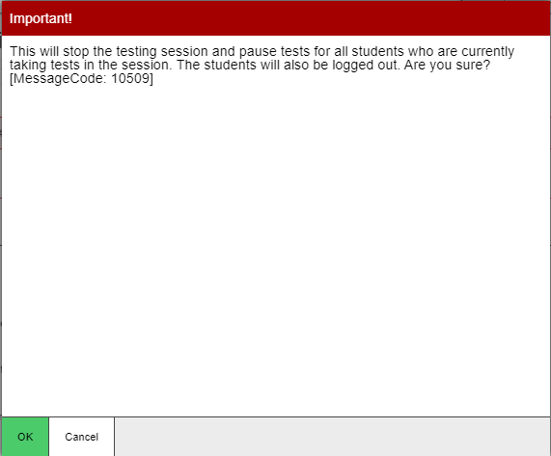
Pausing and Stopping Sessions
Stop
Pause
Notes:
You have two options within the TA Interface to pause or stop testing once it has begun. You can pause an individual student’s test or stop the entire session. To pause an individual student’s test, click the Pause button in the Actions column on the “Tests with potential issues” or “Tests without issue” table for that student. When prompted, click OK to confirm that you want to pause the test. This option would be appropriate if a student becomes ill, for example. In the event of an emergency that requires all students to stop testing, you can pause all students’ tests by stopping the session.
If you stop the session, all in-progress tests will be paused. If a session stops, it cannot be resumed. You will have to create a new test session and give the new session ID to students so that they can resume testing. To stop the entire test session for all students, do the following:
Click the Stop button next to the session ID. A pop-up message will appear requesting verification to end the session and log students out.
When prompted, click OK to continue.
If you forget to log out before leaving the testing area, the session will close automatically after 30 minutes of inactivity on both the TA and student computers. You would then need to create a new session and provide the new session ID to students in order to resume testing.

Slide 27
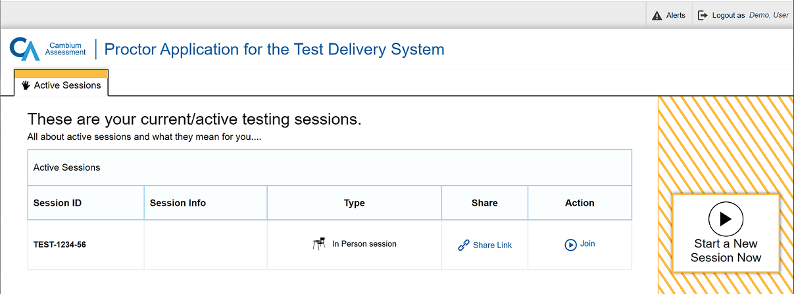
Transferring Sessions
Notes:
In the event that you have problems with your computer or web browser or need to change computers during an active test session, you can transfer the session from one computer, mobile device, or browser to another without stopping the session or interrupting in-progress tests. To transfer a test session to a new device or browser, remember the following:
Do not log out of the session you are currently in or stop the test session. If you do, you will end the test session and pause all students’ tests.
Log in to the TA Interface on the new machine or in the new browser. A screen listing your current/active test sessions will appear.
Click Join. The TA Interface will open with the list of students in your active test session.
The test session on the previous computer or browser will close automatically. This will not stop the session or pause student tests.

Slide 28
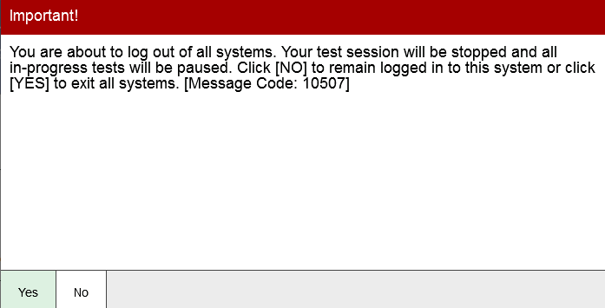
Logging Out of the TA Interface
Notes:
To log out of the TA Interface, click the Logout button in the upper-right corner of the page. It is preferable for you to log out only after stopping your active test session, as logging out will cause all in-progress tests to be paused. A confirmation message will appear, asking you to confirm that you want to exit the website and pause all students’ in-progress tests. This scenario also occurs when you navigate to another website from the TA Interface. However, regardless of when or how you log out or navigate away from the TA Interface, student data will NOT be lost. If you need to access another application, we encourage you to open it in a separate browser window.
Click Yes to proceed. When all students have completed testing, refer to the Test Administration Manual for instructions on destroying any printed testing materials and reporting testing improprieties or irregularities.

Slide 29
Troubleshooting
Description | What to Do
What should I do if a test session ends? | Log in and start a new session. Provide the students with a new session ID.
What should I do if a student gets logged out of a test while a session is still active? | If a student’s test session is interrupted, the student should log back in and rejoin the session.
What should I do if forbidden applications are running? | The Secure Browser will not allow the student to begin testing if forbidden applications are running. You will see messages advising you which applications must be closed before testing can begin.
What should I do if a student’s test freezes? | Force-quit the Secure Browser and log back in. For instructions, refer to the Test Administration Manual.
Notes:
This table presents some of the common issues that you or your students may encounter during a test session. Please take a moment to review this information. For more detailed information please refer to the Test Administration Manual and the Quick Guide for Setting Up Your Online Testing Technology.

Slide 30
Thank You!
Further Information
Visit
alohahsap.org
smarterbalanced.org
Call, fax, or email the HSAP Help Desk
Hours: 7:30 am to 4:00 p.m. HST, Monday-Friday (except holidays)
Phone: 1-866-648-3712
Fax: 1-877-231-7813
Email: HSAPHelpDesk@cambiumassessment.com
Notes:
Thank you for taking the time to view this training module. If you have general questions or need further information, please visit your state’s portal or consult your help desk for assistance.

