Slide 1
Administering a Test Using Speech-to-Text (STT) Software
Training Module
2022 – 2023
Copyright © 2022 Cambium Assessment, Inc. All rights reserved.
Notes:
Welcome to our training module on the speech-to-text (STT) state test accommodation and how it is used during testing. This technology is a non-embedded, state test accommodation that requires the installation of a third-party voice recognition software and the enabling of permissive mode in TIDE. Please note that your state’s speech-to-text features may be different from the images shown here.

Slide 2
Objectives
After viewing this presentation, testing personnel should know how to:
Set up the hardware and software needed for STT testing.
Turn on permissive mode (in TIDE) to allow third-party voice recognition software (i.e., “DragonNaturallySpeaking”).
Navigate both the Test Administrator Interface and the Student Interface.
Show the student how to use the correct mode in Dragon software (Get the spoken word into the correct place in the test).
Assist the student with standard Dragon commands to interact with the test.
Notes:
After viewing this presentation, testing personnel should know how to set up the hardware and software necessary for STT testing. Testing coordinators (TCs) learn how to turn on permissive mode in the Test Information Distribution Engine (TIDE), which allows the software to operate within the secure browser. Test administrators (TAs) will learn how to navigate both the TA Interface and the Student Interface. Also, TAs will help students choose the correct mode of Dragon speech recognition software and assist the student with the standard commands required by Dragon to interact with the test. Tasks performed will depend on your role. Please consult your TC if you are unsure about the information applicable to your role.
It is very important to provide the student with significant practice time with the STT software before live testing. The student should be familiar and comfortable with the hardware and the software.

Slide 3
What is Speech-to-Text Testing, and Who Uses It?
Speech-to-Text (STT) software is a type of assistive technology. This technology
converts spoken words into electronic written text, and
requires “permissive mode” to be enabled in TIDE.
STT is an accommodation for students with
a significant motor impairment or processing disability;
a medical emergency causing the inability to type; and/or
an IEP or Section 504 Plan listing STT as an appropriate state test accommodation.
Important Note: The student should be familiar with using STT software and should be using it regularly as part of classroom instruction. Significant practice time should be provided prior to test day.
Notes:
Speech-to-Text (STT) software is a type of assistive technology that converts words that are spoken aloud to electronic written text. The STT state test accommodation is for students with significant motor impairment or processing disabilities. It can also be for those who have suffered a medical emergency that impacts the ability to type a response, such as a broken hand or arm.
The need for STT must be documented via an IEP or Section 504 Plan. There should also be evidence that the student uses STT consistently in daily instruction and assessment of writing. The student will need to practice with the voice recognition software before using it during live testing.

Slide 4
Technology Requirements for STT
The table below outlines the technology requirements for students testing with STT.
 | Requirements for Student Computers
Operating Systems | Windows 8.1, 10, 11
Hardware | High-quality USB microphone/headset
Software | The Secure Browser DragonNaturallySpeaking software (recommended) https://www.nuance.com/dragon.html (to purchase software) https://www.nuance.com/dragon/support/dragon-naturallyspeaking.html (installation support)
Location | Private location required Background noise minimized
Notes:
Using Dragon speech recognition software on a Windows 8.1, 10, or 11 desktop computer equipped with a high-quality USB microphone/headset is recommended. Dragon is the only software that has been thoroughly tested with the Hawai`i State Assessment Program (HSAP) online testing system. Support for other STT software within the secure browser is not guaranteed. To purchase and install Dragon speak software, use the two websites listed in the table.
To administer the test appropriately, the TA and student should be working in a private space where background noise has been significantly minimized. The next three slides explain what needs to happen before testing a student with an STT state test accommodation.

Slide 5
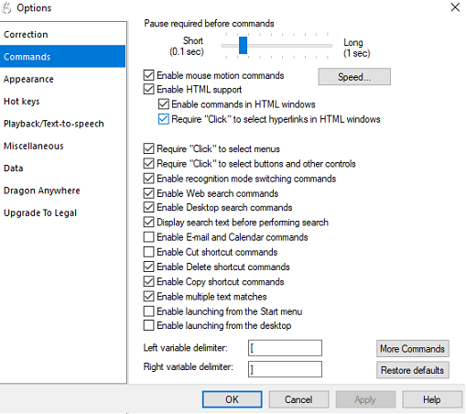
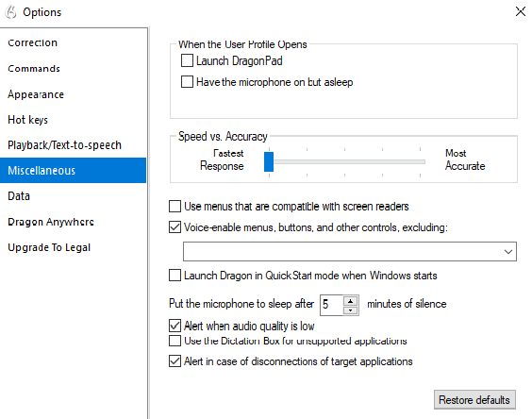
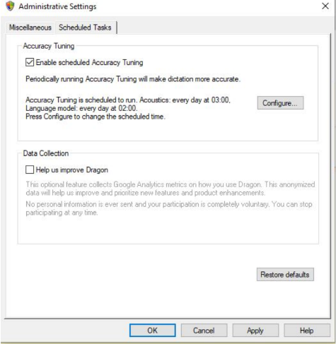
Configuring Dragon Naturally Speaking 15 for Windows
Commands Tab
Miscellaneous Tab
Administrative Settings
Notes:
Necessary configurations for Dragon Naturally Speaking can be made from the Options dialog box, which is accessed from the Tools drop-down menu on the DragonBar.
From the Commands tab, uncheck the following settings: Enable launching from the Start menu, Enable launching from the desktop, Enable E-Mail and Calendar commands, Enable Cut shortcut commands.
From the Miscellaneous tab, uncheck Use Dictation Box for unsupported application.
In the Scheduled Tasks tab of the Administrative Settings window, do one of the following: In Dragon 15.5 or earlier, uncheck Enable scheduled Data Collection; In Dragon 15.6, uncheck Help us Improve Dragon.
After you configure Dragon Naturally Speaking, the HIDOE Assessment Section strongly recommends testing the application on a practice test administration through the Secure Browser prior to using it for live testing.

Slide 6
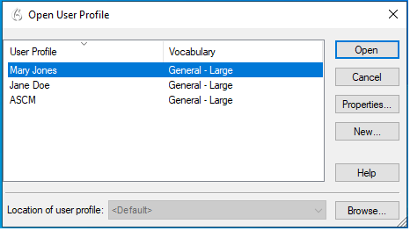
Setting up User Profiles for Students in Dragon
Notes:
Dragon Naturally Speaking requires each student to use a specific User Profile. You will need to create User Profiles and ensure that Dragon Naturally Speaking is set to the proper profile for each student prior to testing. When creating a profile, you can select the student’s age range, language, and accent, as well as set the audio input devices. Students will then read aloud prompts that Dragon Naturally Speaking uses to learn their voice. After creating profiles, you can select Profiles in the Dragon toolbar, then click Open User Profile… to switch between User Profiles.

Slide 7
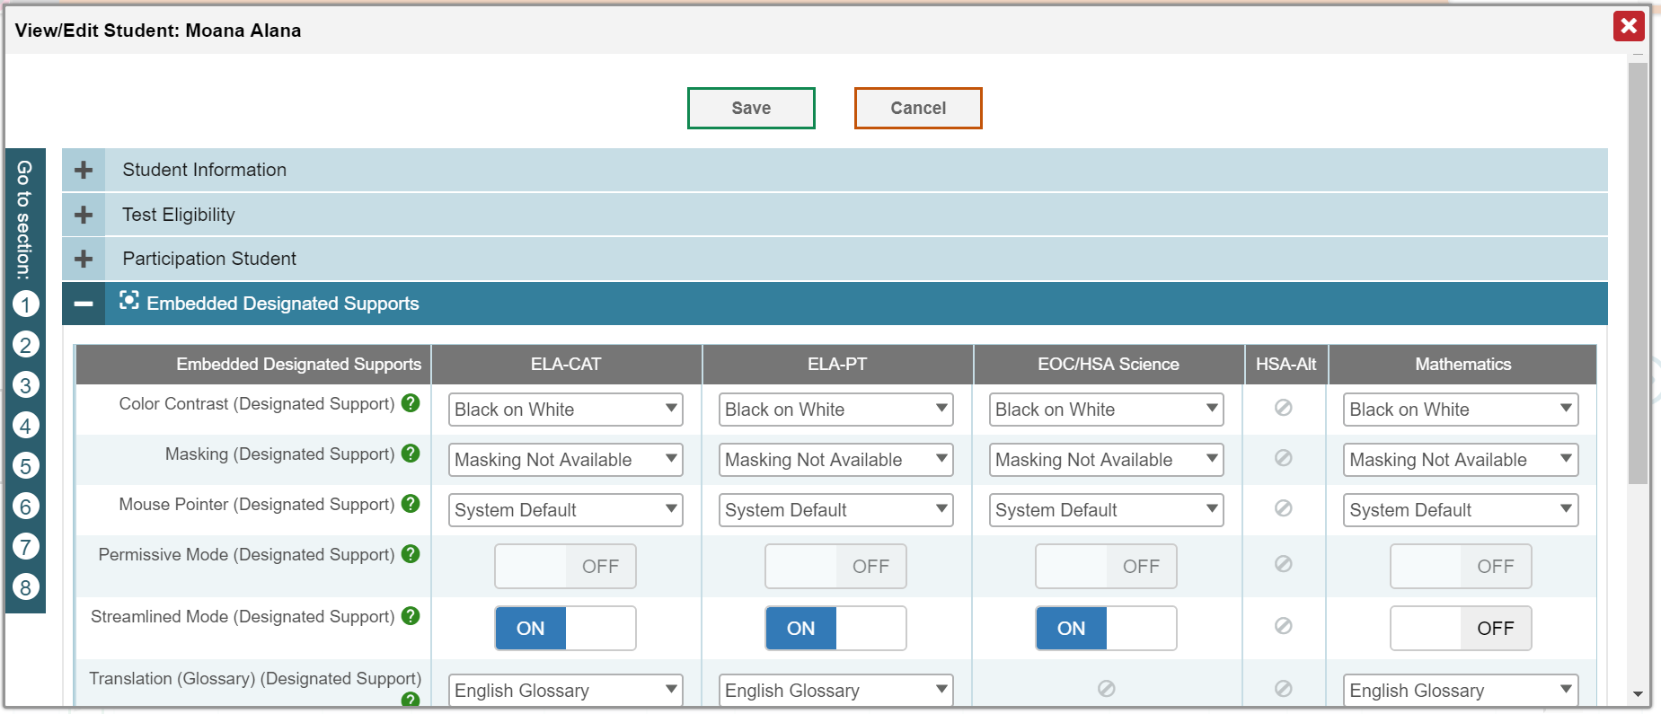
Test Coordinator: Preparing to Test with STT Technology
Notes:
Before the test can be administered using speech recognition software, the Test Coordinator must enable permissive mode for the student. To do so, log in to the AlohaHSAP.org portal and access the TIDE. From the View/Edit Student page, search for the student who requires the STT and edit the Embedded Designated Supports portion. Find the Permissive Mode (Designated Support) row and switch the button from OFF to ON for the appropriate tests. (This is Section #3 of the Student Information page.)
More information on embedded designated supports can be found in the TIDE User Guide located on the AlohaHSAP.org portal.
The speech recognition software will now be accessible to the student in the secure browser. The student should use the available Practice Tests with the speech recognition software well before live testing.

Slide 8
Student: Practicing with Speech Recognition Software
Record a profile with the microphone headset that will be used with the actual test.
Review the modes and commands prior to the test.
Provide significant practice with the software before live testing.
Notes:
The student should practice using STT before live testing. The image shown here is the DragonBar from DragonNaturallySpeaking 15. Initially, a student will record a profile of his or her voice with the microphone headset used during the actual test. Practicing with this profile will allow the software to learn the student’s voice and make fewer errors from dictation, over time. The student will also need to practice with the various commands that are used in the default mode. In Dragon, the default mode is Dictation & Commands.
The next slide shows the modes available in DragonNaturallySpeaking 15.

Slide 9
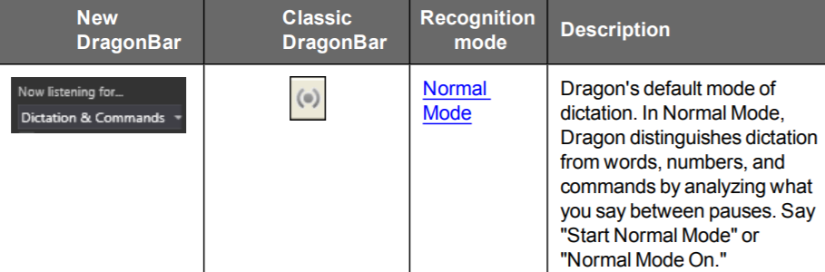
Recognition Modes in DragonNaturallySpeaking 15
Normal Mode: Allows students to dictate and speak commands
Dictation Mode: Allows students to dictate the text they wish to write in text fields
Command Mode: Allows students to speak commands to navigate the secure browser
Numbers Mode: Allows students to speak the numbers they wish to write in text fields
Spell Mode: Allows students to spell out the words they wish to write in text fields
Notes:
To select a recognition mode, students choose the required mode from the Now listening for… menu of the DragonBar. Students can also switch modes by speaking the mode they want to activate. For example, if a student wants to use Normal Mode, they would say "Switch to Normal Mode." The following recognition modes can be used in the secure browser:
Normal Mode: Allows students to dictate and speak commands
Dictation Mode: Allows students to dictate the text they wish to write in text fields
Command Mode: Allows students to speak commands to navigate the secure browser
Numbers Mode: Allows students to speak the numbers they wish to write in text fields
Spell Mode: Allows students to spell out the words they wish to write in text fields

Slide 10
For Additional Information on Dragon Software
DragonNaturallySpeaking 15 Command Cheat Sheet
DragonNaturallySpeaking
User Guide15
Go to sleep.
Wake up.
Microphone off.
Undo that.
Spell that.
Go to end of line.
Underline.
Move mouse up.
Notes:
The Dragon website provides a cheat sheet with all of the standard commands that the software allows. Some of these commands might not be available in the secure browser. A DragonNaturallySpeaking User Guide is also available if you need additional information on the complete system.

Slide 11
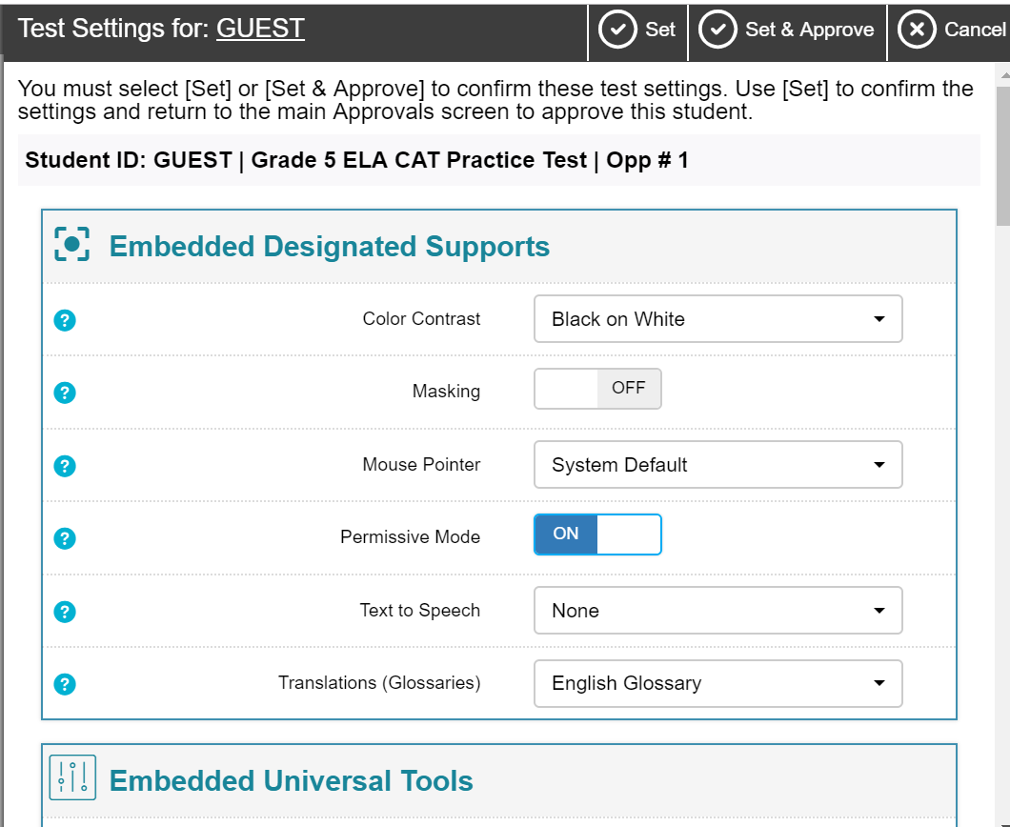
TA: Generate an Operational Test Session
Information on how to generate a test session is found in the Guide to Navigating Online HSAP Administration.
Notes:
On test day, the TA should generate an operational test session as usual. To check that permissive mode is enabled from the TA Interface, the TA clicks on Test Settings for the student. Under Embedded Designated Supports, the toggle switch should be ON. If Permissive Mode is NOT enabled, the TA will need to contact the Test Coordinator.
Information on how to generate a test session is found in the Guide to Navigating Online HSAP Administration located on the AlohaHSAP.org portal.

Slide 12
Student: Navigating a Test with Dragon Software
Student opens voice recognition software.
Student opens the secure browser and signs into the test.
TA approves student’s entry to test.
The speech recognition tool appears at the top of the computer screen.
Student immediately makes any necessary setting changes to the voice recognition software.
Student continues with the sign-in process to begin the test.
Once installed, the “DragonBar” will appear at the top of the computer screen.
Notes:
The student will then open the voice recognition software on the testing computer. The secure browser should also be opened as the student logs in to the test. At this point, from the TA Interface, the TA approves the student to test. Once approved, the speech recognition task bar will appear at the top of the student’s computer screen.
At this time, the student should make any setting changes that are necessary using the speech recognition bar tools button. Then, the student should continue with the sign-in process to begin the test. The speech recognition task bar will remain in place during the test.

Slide 13
Move through a Test Using Dragon Software
Students will navigate the test page using voice commands, including:
Action on Test Page | Command (the student says)
Bring focus to the Student Testing Site | Select
Shift focus to next element on a page | Tab
Shift focus to previous element on a page | Shift Tab
Click a button, mark a checkbox, open a drop-down menu | Press Enter
Close a pop-up window or menu | Press Escape
Notes:
When Dragon is set to Normal Mode or Command Mode, students can use various voice commands to move through the test site. The first time students use a command in a given test session, they may need to say, "Select," in order to bring focus to the Student Testing Site.
To navigate a test page with voice commands:
To shift the focus to the next element on a page, students say, "Tab."
To shift the focus to the previous element on a page, students say, "Shift Tab."
To click a button, mark a checkbox, or open a drop-down list, students say, "Press Enter."
To close a pop-up window or menu, students say, "Press Escape."

Slide 14
Text Response Items
To respond to text response items:
Action on Test Page | Command (what the student says)
Shift the focus to a text response item’s test box | Tab (until cursor appears in the test box)
Dictate text into the box | Their response
Correct text | Correct [incorrect text], then speak the correct text
Spell a word correctly | Switch to Spell Mode
Delete last entered text | Backspace
Select the entered text | Select All
Notes:
When Dragon is set to Normal Mode, students can also dictate the text that they wish to write for text response items on the test.
To respond to text response items:
To shift the focus to a text response item's text box, students say, "Tab," until the cursor appears in the text box.
To dictate text into a text response box, students speak their response.
If Dragon enters the wrong text, students can say, "Correct [incorrect text]" and then speak the correct text. They can also spell it out by saying, "Switch to Spell Mode."
To delete the last entered text, students say, "Backspace."
To select all the entered text, students say, "Select All."

Slide 15
Thank You
Further Information
2022-2023 Assistive Technology Manual: https://smarterbalanced.alohahsap.org/resources/resources-2022-2023/assistive-technology-manual-and-braille-resources-2022-2023
Visit
alohahsap.org
smarterbalanced.org
Call, fax, or email the Cambium Assessment HSAP Help Desk
Hours: 7:30 am to 4:00 p.m. HST, Monday-Friday (except holidays)
Phone: 1-866-648-3712
Fax: 1-877-231-7813
Email: HSAPHelpDesk@cambiumassessment.com
Notes:
Thank you for taking the time to view this training module. For additional information, refer to the Assistive Technology Manual located on your portal or contact the Help Desk.

